Slide 1
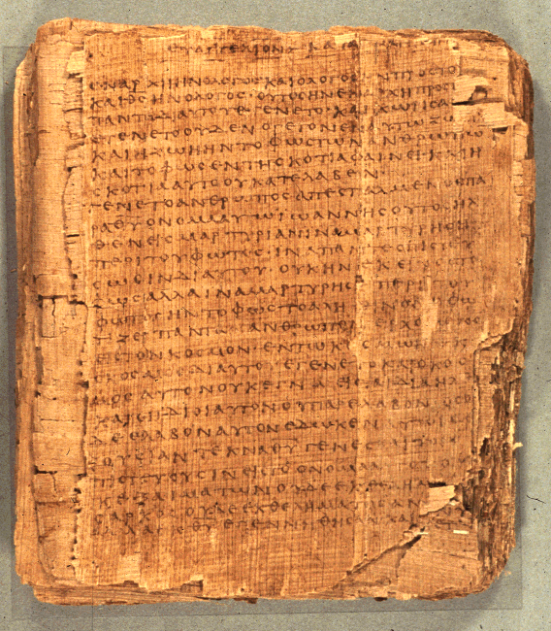
COS 221 Bible II
Dr. Rodney K. Duke

Slide 2
DAY 2
Assign: (see handout)
1) (Daily) Write in a journal entry
2) #4 Narrative as portrait [skip; if covered in class]
3) #5 Gen 18-19 (see list of literary features, CP p.26)
4) #6 on Gen 12, 20, 26 (nature of oral transmission)
Day Objectives:
Explain the nature of oral transmission.
Control an outline of Israelite history, 12 C's (major periods,
events and characters).
3) Explain the process of successful communication and identify how one should approach interpreting the Bible.
Notes:
Might wait on 6 Will probably not get to these until Day 4

Slide 3
Over 5700 Greek manuscripts
Codex Vaticanus and Codex Siniaticus SKIP?
Two excellent parchment copies of the entire New Testament which date from the 4th century (325-450 A.D.).
Old Papyrii (118 texts)
Papyrus copies of portions of the New Testament date from 100 to 200 years (180-225 A.D.) before Vaticanus and Sinaticus. The outstanding ones are the Chester Beatty Papyrus (P45, P46, P47) and the Bodmer Papyrus II, XIV, XV (P46, P75).
From these five papyrii manuscripts alone, we can construct all of Luke, John, Romans, 1 and 2 Corinthians, Galatians, Ephesians, Philippians, Colossians, 1 and 2 Thessalonians, Hebrews, and portions of Matthew, Mark, Acts, and Revelation. Only the Pastoral Epistles (Titus, 1 and 2 Timothy) and the General Epistles (James, 1 and 2 Peter, and 1, 2, and 3 John) and Philemon are excluded.
[“Are the Biblical Documents Reliable?, Jimmy Williams. www.leaderu.com/orgs/probe/docs/bib-docu.html]
[Duke: Some people claim that Diocletian's persecution (303-311) resulted in most NT manuscripts (mss) being destroyed, which is why Constantine ordered the production of fifty Bibles; and, they claim that these Bibles were rewritten to present new Christian teaching/doctrine. Not only is the case of Diocletian overstated, but the evidence is that the manuscripts PRIOR to Diocletian agree with the manuscripts that are AFTER Diocletian.]
Notes:
Added this and next two slides in 2014 after students expressed concern over establishing the text.
Over 5700 Greek mss, 10,000 Latin mss and a million quotations from church fathers and others. (Reinventing Jesus, p. 71)

Slide 4
SKIP? About Mid-Second Century Copies in a Region Begin to Get “Standardized” (take on similar characteristics).
Copyists in different regions have different copying “techniques” that can be identified.
“Families” / text types

Slide 5
Author and Work | Author's Lifespan | Date of Events | Date of Writing* | Earliest Extant MS** | Lapse: Event to Writing | Lapse: Event to MS
Matthew, Gospel | ca. 0-70? | 4 BC - AD 30 | 50 - 65/75 | ca. 200 | <50 years | <200 years
Mark, Gospel | ca. 15-90? | 27 - 30 | 65/70 | ca. 225 | <50 years | <200 years
Luke, Gospel | ca. 10-80? | 5 BC - AD 30 | 60/75 | ca. 200 | <50 years | <200 years
John, Gospel | ca. 10-100 | 27-30 | 90-110 | ca. 130 | <80 years | <100 years
Paul, Letters | ca. 0-65 | 30 | 50-65 | ca. 200 | 20-30 years | <200 years
Josephus, War | ca. 37-100 | 200 BC - AD 70 | ca. 80 | ca. 950 | 10-300 years | 900-1200 years
Josephus, Antiquities | ca. 37-100 | 200 BC - AD 65 | ca. 95 | ca. 1050 | 30-300 years | 1000-1300 years
Tacitus, Annals | ca. 56-120 | AD 14-68 | 100-120 | ca. 850 | 30-100 years | 800-850 years
Seutonius, Lives | ca. 69-130 | 50 BC - AD 95 | ca. 120 | ca. 850 | 25-170 years | 750-900 years
Pliny, Letters | ca. 60-115 | 97-112 | 110-112 | ca. 850 | 0-3 years | 725-750 years
Plutarch, Lives | ca. 50-120 | 500 BC - AD 70 | ca. 100 | ca. 950 | 30-600 years | 850-1500 years
Herodotus, History | ca. 485-425 BC | 546-478 BC | 430-425 BC | ca. 900 | 50-125 years | 1400-1450 years
Thucydides, History | ca. 460-400 BC | 431-411 BC | 410-400 BC | ca. 900 | 0-30 years | 1300-1350 years
Xenophon, Anabasis | ca. 430-355 BC | 401-399 BC | 385-375 BC | ca. 1350 | 15-25 years | 1750 years
Polybius, History | ca. 200-120 BC | 220-168 BC | ca. 150 BC | ca. 950 | 20-70 years | 1100-1150 years
“Are the Biblical Documents Reliable?”, Jimmy Williams http://www.leaderu.com/orgs/probe/docs/bib-docu.html

Slide 6
Differences between Oral and Writing Cultures
Oral Culture Writing Culture
Authority based on spoken (memorized words) of teacher/tradent
Based on communal knowledge
Words are dynamic, visual and dramatic
Performance oriented
Fluidity to respond to audience and situation
Communal interpretations
Text as authority/orthodox
Knowledge comes from the text
Text as unchanging artifact
Teaching is static
Rule oriented
Individual interpretations

Slide 7
Transmission of Tradition
Setting Expectations for Reading Biblical Accounts
When we work with some biblical texts, we are working with layers of tradition.
Woman’s story
Children’s accounts of the story
Written record for the sake posterity
Original words
Oral reports of words for continued application
Written records for preservation & application
Tradition with 3 settings, perspectives, and purposes.
*
* Note: For NT, the period of oral transmission overlaps with written.
Notes:
Can we start with the final account and work back to the “original”? Do we need to?

Slide 8
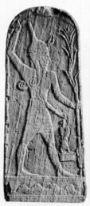
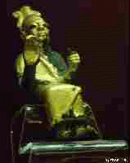
THE CANAANITES
Government: Feudal city-states with own king
Economy: agriculture and trade
Culture had major impact on Israelites
Ba’al from Ugarit
El from Ugarit

Slide 9
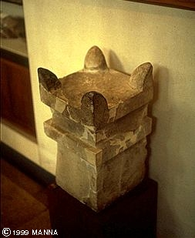
Canaanites (1 of 2)
Texts forbidding Canaanite practices: Hosea 4:10-14; Deut 23:17f.
Gods connected with nature, and therefore fertility (Ba’al). Myths about fertility (agricultural) cycle.
*What made Canaanite religion attractive? Mimetic practices to manipulate the gods: something people could do. [See Lev. 26:1-5]
“horned” altar from Megiddo a Canaanite city taken by Joshua

Slide 10
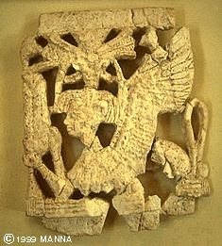
Canaanite (2 of 2)
Texts using literary allusions: Isa 27:1; Ps 74:13f; Ps 29; Ps 48:2.
*Main Point: Israel borrowed poetic, mythical imagery, but adapted it to Yahwistic theology. [Pattern of adopting and re-adapting!]
Ivory figure from Megiddo, a Canaanite city taken by Joshua

Slide 11
Israelite Functionaries and Institutions
NT assumes knowledge of these roles and institutions
King:
monarchy, national identity, term "messiah," Davidic dynasty
NT: David lineage, Messiah, messianic & political expectation of Jesus’ day
Priest:
cult, sacrificial system, Temple, the Law
NT: sacrificial imagery, Jesus as High Priest and atoning sacrifice, Sadducees, Christians as a royal priesthood
Prophet:
(unlike ANE: court/temple/shrine) independent "preacher"/ activist / demonstrator /conscience of the people
NT: John the B, Jesus, apostles, prophets, “pastors,” etc.
Sage:
court advisor, scribe (school?)
NT: wisdom forms of Jesus' teaching, Pharisees, scribes and rabbis.

Slide 12
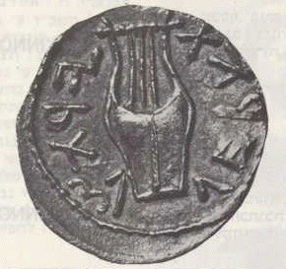
History of Israel
Difficulties for Reconstructing Israelite History (1 of 4)
1. The OT documents are difficult to date ("literary" problem) and often seem to be much later than the event they record.
Why a problem?
"Distance" in time between the date of events and the date of the records, leads to skepticism about the accuracy of the records.
2. External sources (other ANE artifacts) for corroborative evidence are often lacking and sometimes appears contradictory. Problem?
Historians are skeptical about relying on one source.
Scholars divide Israelite history into 2 periods (Prehistorical and Historical). Why?
Biased in favor of political history

Slide 13
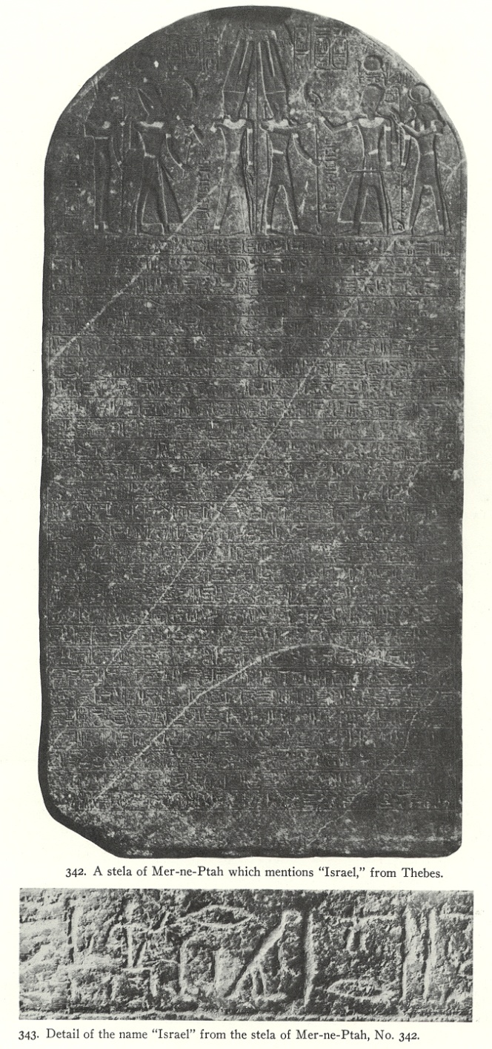
History of Israel
Difficulties for Reconstructing Israelite History (2 of 4)
Prehistorical Period (before Kingdom): (a) very little external evidence, and (b) OT sources seem quite late.
Merneptah Stele, first external mention of Israel, c. 1220 BCE

Slide 14
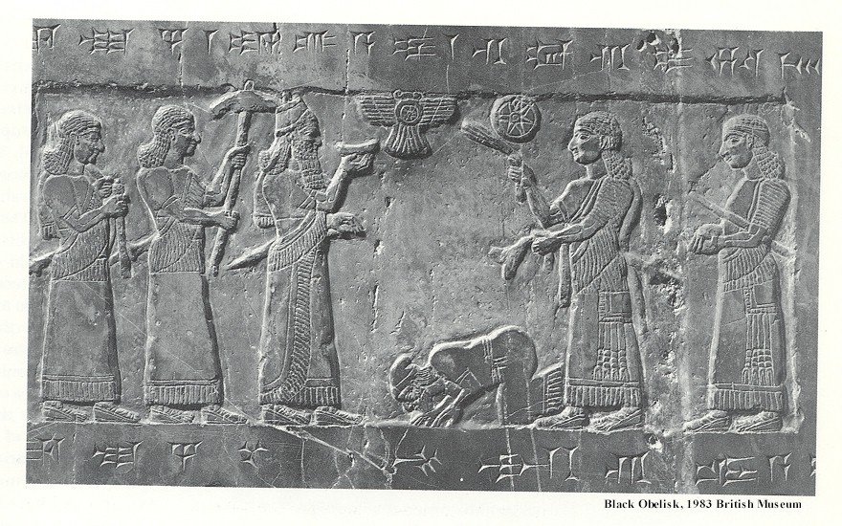
History of Israel
Difficulties for Reconstructing Israelite History 2 of 3
Historical Period (political Israel): (a) more external evidence, and (b) OT sources more contemporary.
(E.g. Jehu, King of Israel paying tribute to Shalmaneser III of Assyria, 825 BCE.)

Slide 15
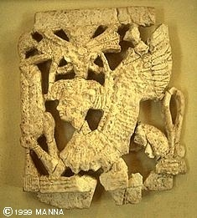
History of Israel
Difficulties for Reconstructing Israelite History (4 of 4)
3. OT history is presented from a theological perspective.
Why a problem?
(a) Seems less objective to modern historians who search for atheistic / “natural” causes to events.
[The Israelite bias should be recognized; however, all history writing is interpreted/biased!]
(b) Causes the OT history to focus on different topics than on what the modern historian would focus, leaving "gaps" in the record.

