Slide 1
Human Wonder Research:
Attending to Attention and Understanding Understanding
Jeff Goodman
goodmanjm@appstate.edu

Slide 2
What is attention?
What is understanding?
How do these relate to teaching and learning?

Slide 3
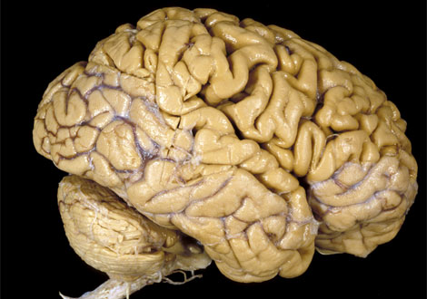
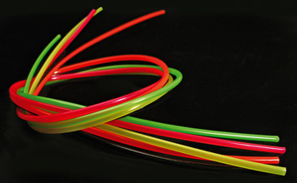
Learning about Neuroplasticity
The Brain
Neurons: 100 billion (It would take you 5000 years to count them, 1 per second, 16 hours a day.)
Synapses: Average of 10,000 per cell = 1,000,000,000,000,000 (It would take you 50 million years to count them all.)
http://thebsreport.files.wordpress.com/2009/04/human-brain-vis304784-ga.jpg

Slide 4
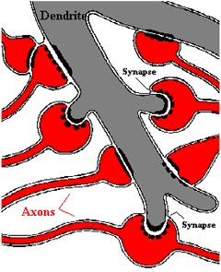
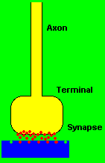
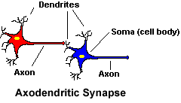
Notes:
http://faculty.washington.edu/chudler/synapse.html
http://faculty.washington.edu/chudler/java/em.html

Slide 5
Attention
Notes:
The idea that we can put anything in people's heads without addressing motivation is crazy
Everyone is always paying attention to something -- just not always to what we "want" them to be paying attention to.

Slide 6
We Live in a World of Information
Notes:
Monkey Business Illusion by Daneil Simons: http://www.youtube.com/watch?v=IGQmdoK_ZfY&feature=player_embedded
Huge amounts of sensory information -- millions of bits per second -- come into us at all times; but what do we attend to and why?

Slide 7
Notes:
Pay attention to your senses right now. Now, pay attention to the feeling of the seat against the back of your legs. There is just too much to pay attention to!

Slide 8
Notes:
Pay attention to your senses right now. Now, pay attention to the feeling of the seat against the back of your legs. There is just too much to pay attention to!

Slide 9
How can we help students attend?

Slide 10
1. We attend to novelty.

Slide 11
The mystery here: why did my drinking upside down make such an impression?
Notes:
http://library.thinkquest.org/11226/main/c14.htm

Slide 12
How can we integrate novelty in instruction?

Slide 13
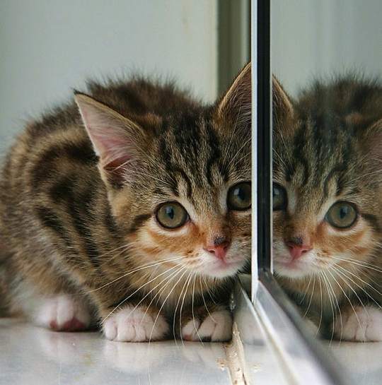
2. We attend when we predict.

Slide 14
How can we integrate prediction in instruction?

Slide 15
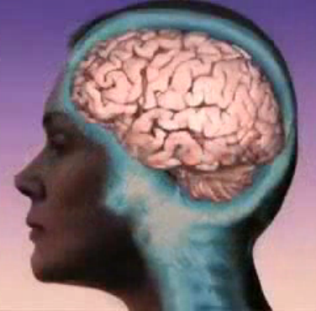
3. We attend to our senses, especially touch and vision.
Let’s say I want to teach you about the brain.

Slide 16
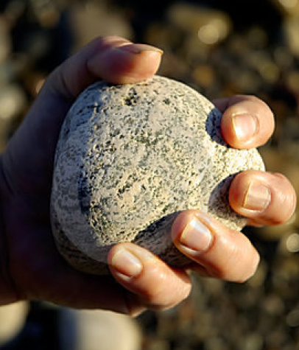
Notes:
The rock is going to represent the limbic system, the ball will represent the prefrontal cortex.

Slide 17
Notes:
http://bungelab.berkeley.edu/kidscorner/kidscorner/glossary.html

Slide 18
The Limbic System
Notes:
http://bungelab.berkeley.edu/kidscorner/kidscorner/glossary.html
In my example, the Limbic System is represented by the rock. Notice that I’ve colored it grey.

Slide 19
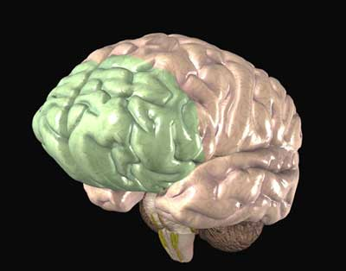
The Prefrontal Cortex
Notes:
http://bungelab.berkeley.edu/kidscorner/kidscorner/glossary.html
In my example, the prefrontal cortex is represented by the ball; notice it’s green.

Slide 20
How can we integrate multiple senses in instruction?

Slide 21
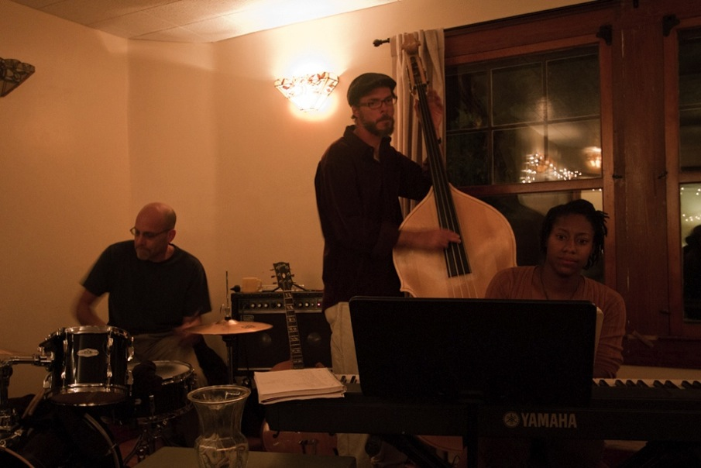
4. We attend to sound (music and poetry)

Slide 23
How can we integrate music in instruction?

Slide 24
5. Attention cues work together: Multiple types of sensory data, combined with mystery, yield pleasure and attention.
Notes:
The Fun Theory: http://www.youtube.com/watch?v=2lXh2n0aPyw
We experience pleasure and deep attention when a variety of sense are invoked in solving a mystery

Slide 25
How can we integrate multiple attention cues at once in instruction?

Slide 26
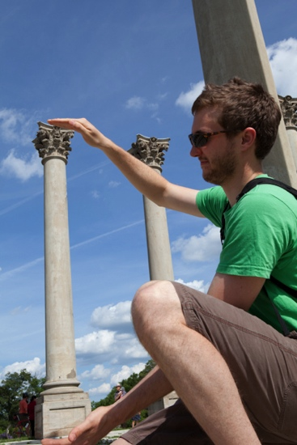
6. We attend to information that has personal relevance
Notes:
“Chester Middle School Principal Ernie Jackson, for instance, challenged reading and social studies teacher Mel Wesenberg to find ways to use text messaging to teach poetry.
The results were surprising: Kids who used their cell phones to boil down the main points of the stanzas got 80 percent of the questions about a poem correct on a state test.
Kids taught the same poem in the traditional way – reading, reciting and discussing – got only 40 percent of the questions right.” “Texting Poetry Inspires Kids to Learn” http://www.recordonline.com/apps/pbcs.dll/article?AID=/20100426/NEWS/100429736

Slide 28
Stroop Test

Slide 29
Stroop Test
Read the word of the ones without boxes, ink color of the one’s with.
Notes:
You’re using your prefrontal cortex.

Slide 30
How can we make core content personally relevant?

Slide 31
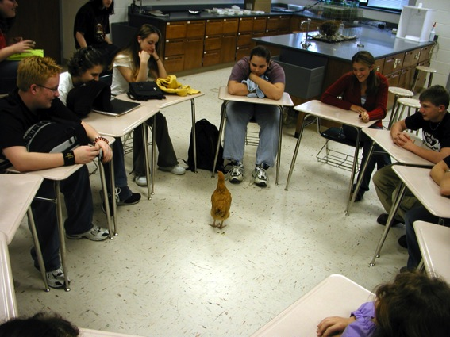
7. We attend to community

Slide 32
How can we strengthen the community in out classes ?

Slide 33
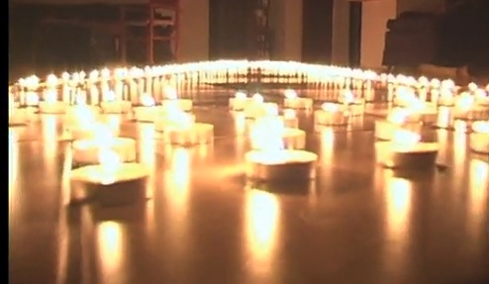
8. We can be taught to attend to our own thinking (metacognition).
Notes:
Experience of metacognition -- thinking about thinking (If attention doesn't reach the prefrontal cortex -- the problem solving, abstract thinking brain -- it is not stored meaningfully and flexibly in memory.)
http://www.youtube.com/watch?v=U9PZizBDBZw

Slide 34
Quote from a 7th grader:
“I imagine neurons making connections in my brain when I study. I feel like I'm changing my brain when I learn something, understand it, and review it.”

Slide 35
How can we help students become metacognitive?

Slide 36
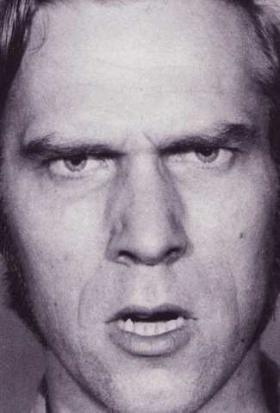
9. Emotion mediates what we attend to and how we attend.
Notes:
For example, stressful situations turn off meaningful learning even though they make us attend.
Two groups of kids were shown pictures that were either positive or negative emotions and then given a test. The ones who saw positive faces did much better on a memory test.

Slide 37
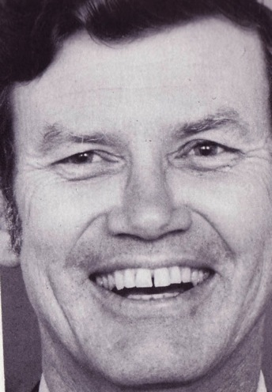
Notes:
Positive feelings allow our brain to route information to the prefrontal cortex.
Two groups of kids were shown pictures that were either positive or negative emotions and then given a test. The ones who saw positive faces did much better on a memory test.

Slide 38
Notes:
Two groups of kids were shown pictures that were either positive or negative emotions and then given a test. The ones who saw positive faces did much better on a memory test.

Slide 39
Power of optimism: positive emotions help the brain learn more deeply
Notes:
http://www.youtube.com/watch?v=FCoGkz0bm9g

Slide 40
How can we create a positive
emotional environment in our classes?

Slide 41
Understanding

Slide 42
“Learning takes place through the active behavior of the student: it is what he does, not what the teacher does.”
Ralph W. Tyler, 1949

Slide 44
Quote from a 7th grader:
“If I use my prefrontal cortex to mentally manipulate what I learn, my dendrites and synapses grow, and I will own that learning for a long, long time. I won't have to learn fractions all over again each year.”

Slide 45
Teaching is the art of changing the brain.
Students’ brains.
(Not teachers’)

Slide 46
1
2
3
4
5
6
7
8
9
Notes:
Memorize this code.

Slide 47
Translate
262-2176

Slide 48
1
2
3
4
5
6
7
8
9
Notes:
It’s much easier when you have a construct onto which you can hang your understanding.

Slide 49
Translate
262-2176

Slide 51
Is all learning understanding?

Slide 52
Notes:
From http://www.johnbiggs.com.au/academic/solo-taxonomy/

