Slide 1
From the Concrete to the Abstract and Back
Jeff Goodman
goodmanjm@appstate.edu

Slide 2
Why does math matter?

Slide 3
Solve for X:
X²+81=126
Notes:
http://www.wolframalpha.com

Slide 4
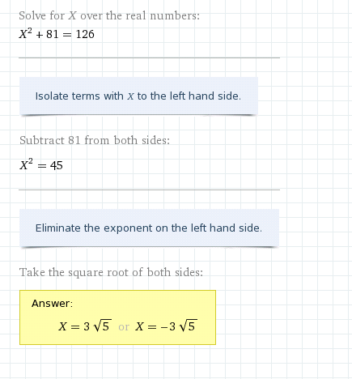
Notes:
Why teach math when computer algorithms can do much of what we ask students to do?

Slide 5
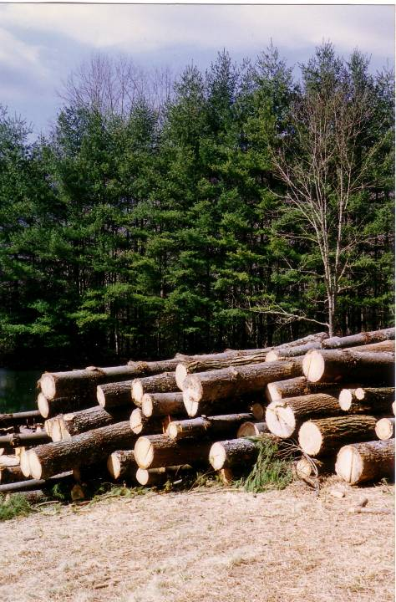
Notes:
M<y experience of building my house.

Slide 6
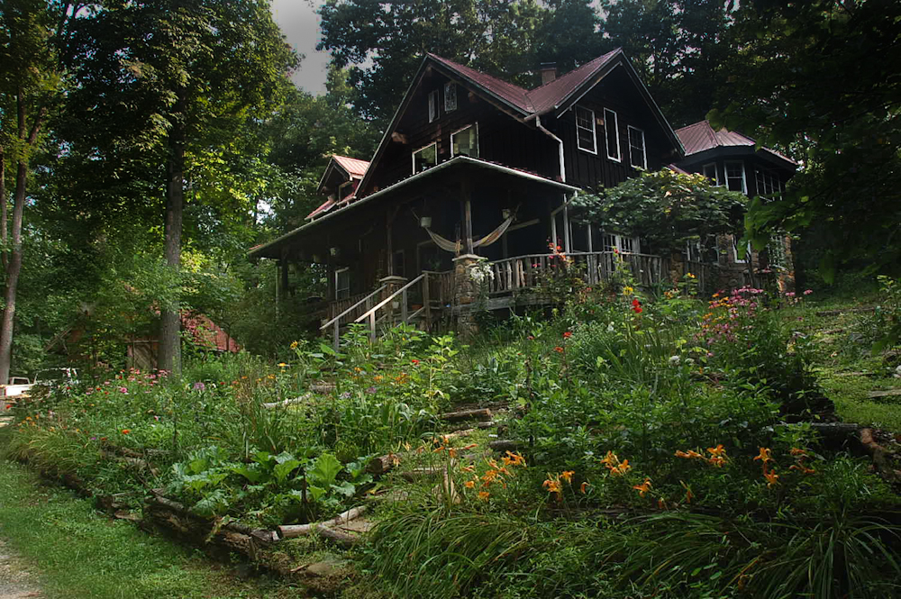

Slide 7
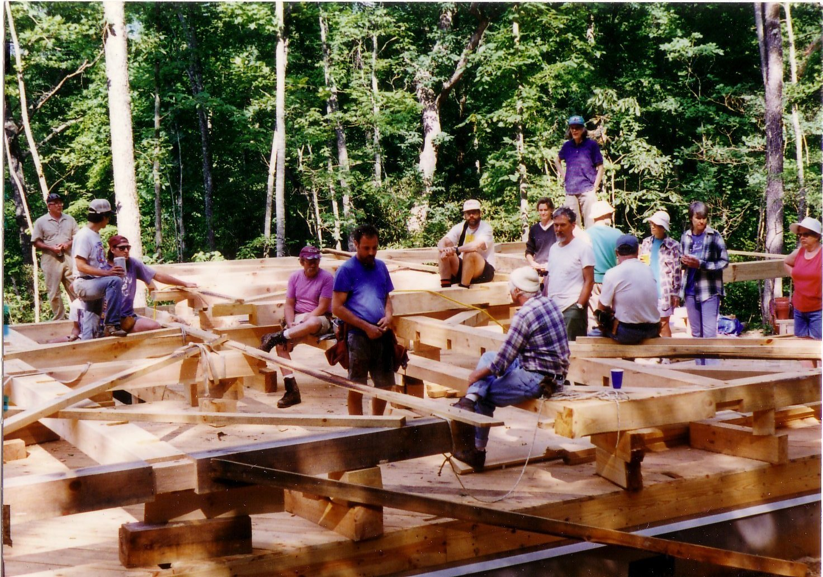
Notes:
My friends getting ready for lifting the “bents” – cross-sections of timbers – that I had assembled.

Slide 8
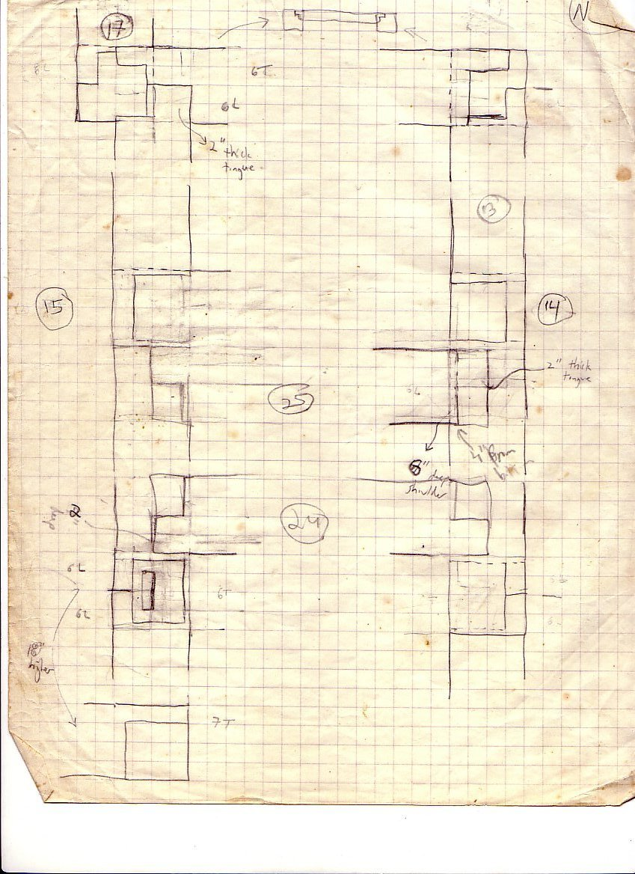
Notes:
Some of my sketches for how I joined the timbers.

Slide 9
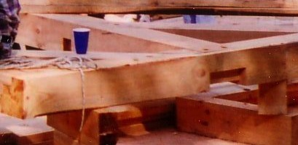

Slide 10
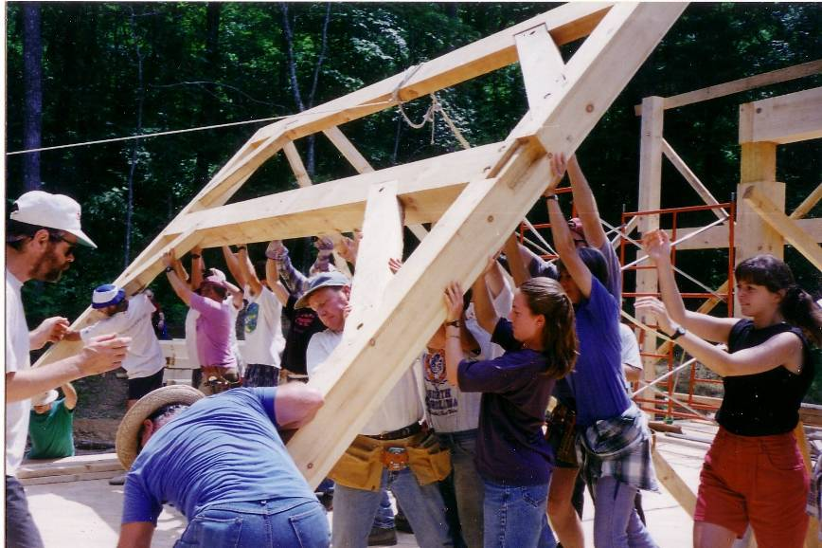

Slide 11
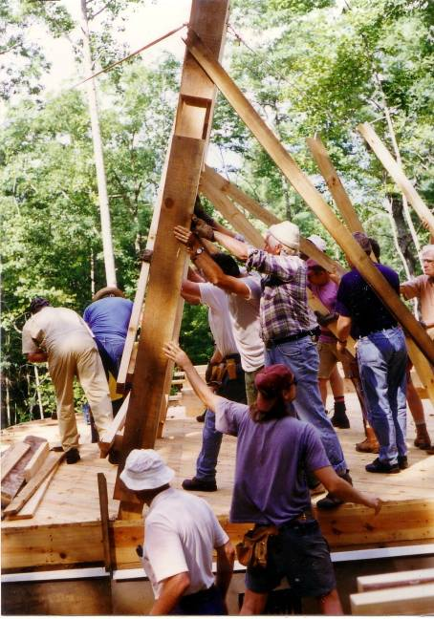

Slide 12
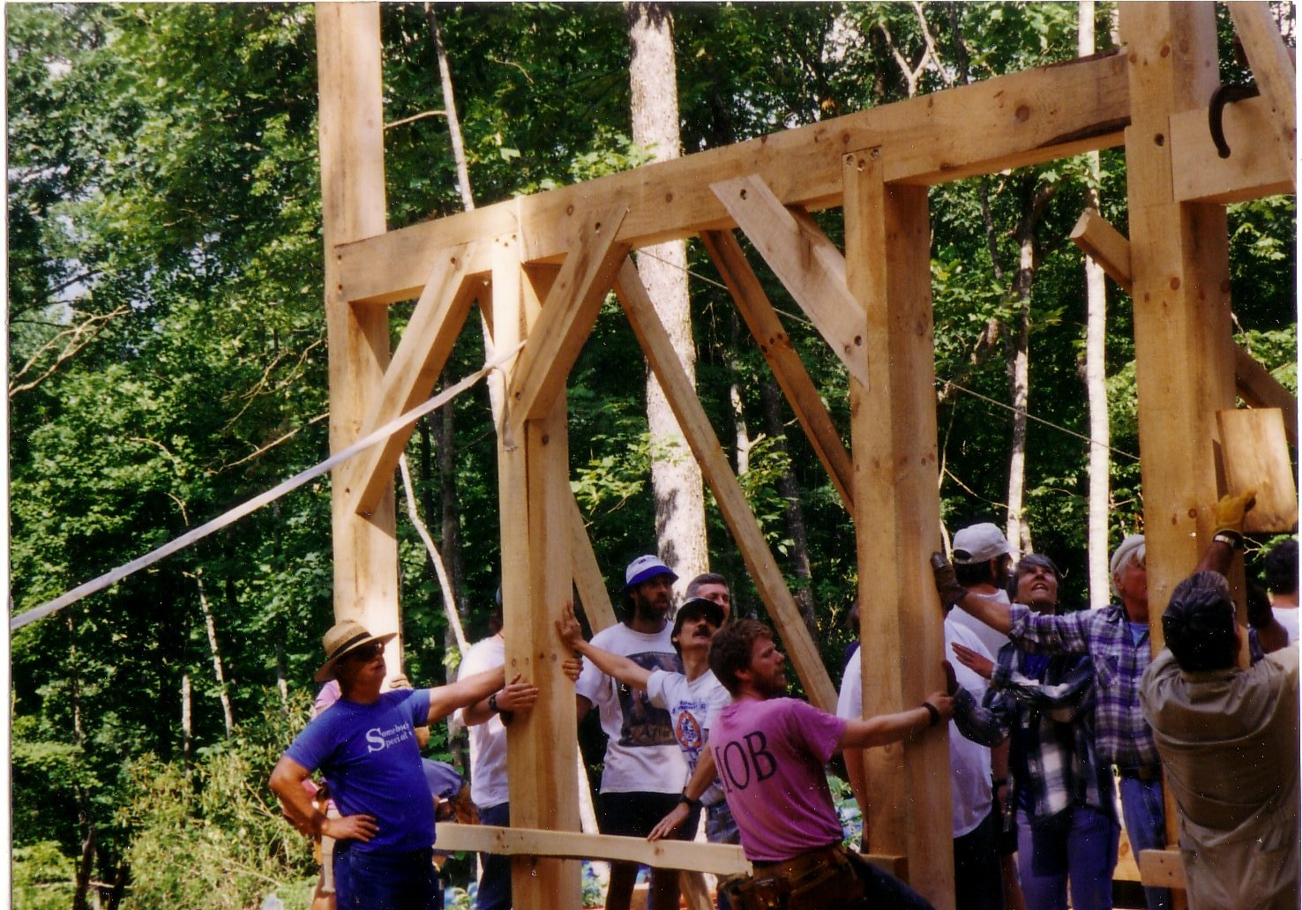

Slide 13
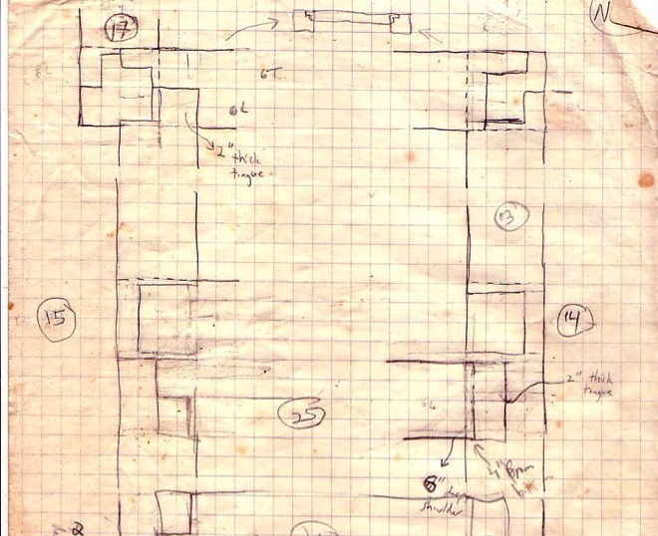
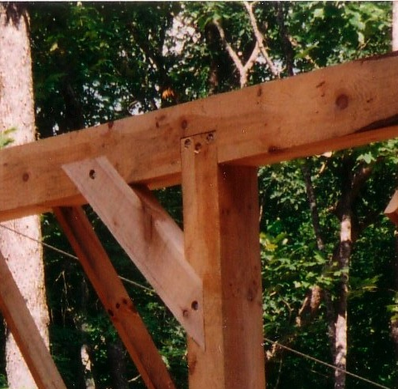
Notes:
I had to be careful and make the joinery correct! These things weighed several tons, and lots of people would have been waiting around while I scratched my head if I had messed up.

Slide 14
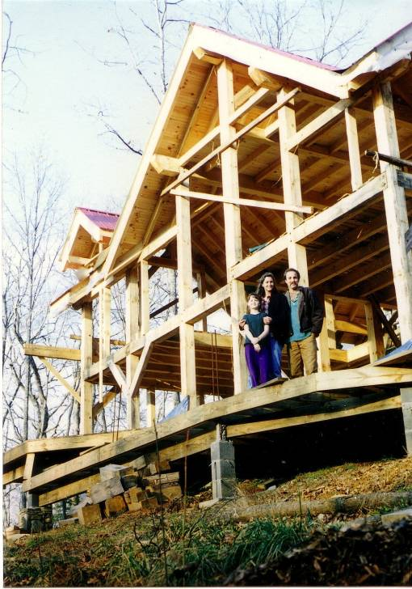
Notes:
Margot, Julia and I in front of the frame of the house.

Slide 15
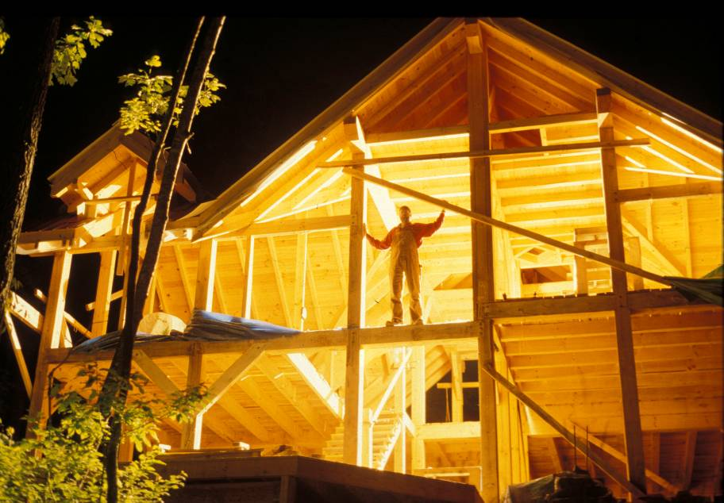
Notes:
The frame at night.

Slide 16
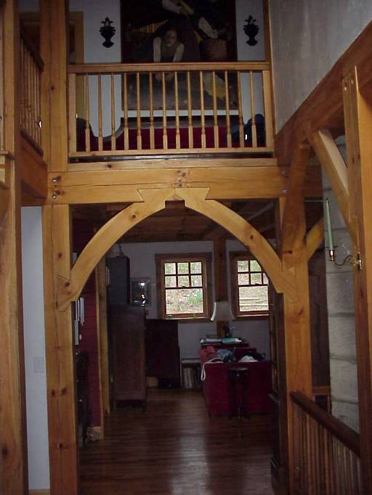
Notes:
The arch as you come in. Lots of math here.

Slide 17
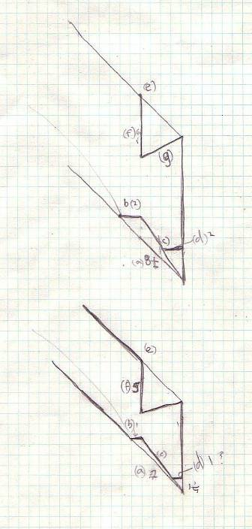
What information is necessary to define these shapes?

Slide 18
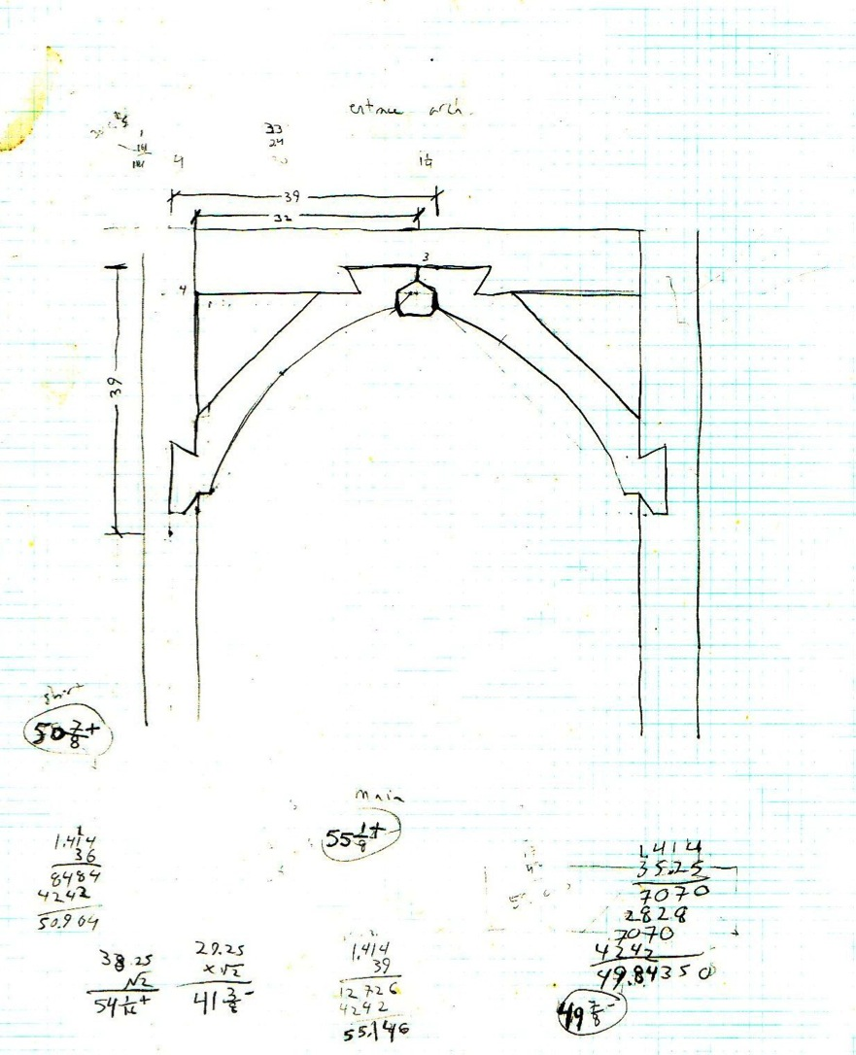
What’s the best way to define these curves?

Slide 20
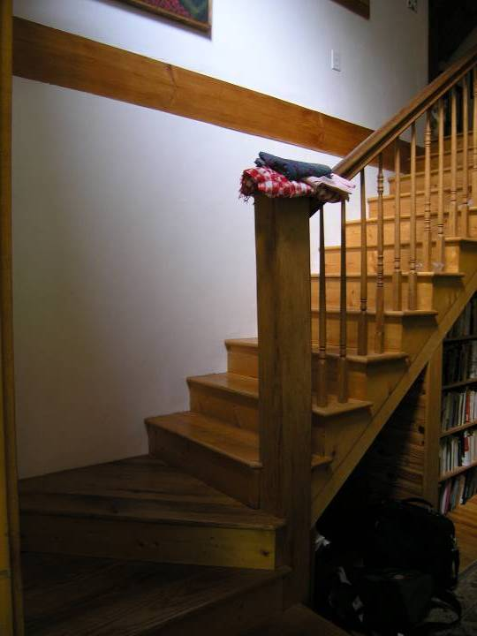
What math is behind a set of stairs?
Notes:
Stairs require lots of calculation. If they aren’t even and the right rise and run, you trip your whole life long.

Slide 21
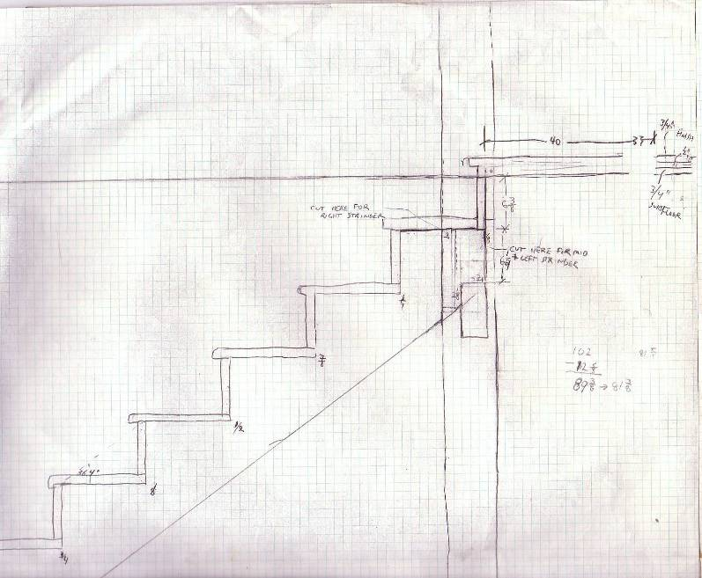
For stairs to be comfortable, they should be proportioned by the formula:
2 x (riser height) + (tread length) = between 24 and 26 inches

Slide 22
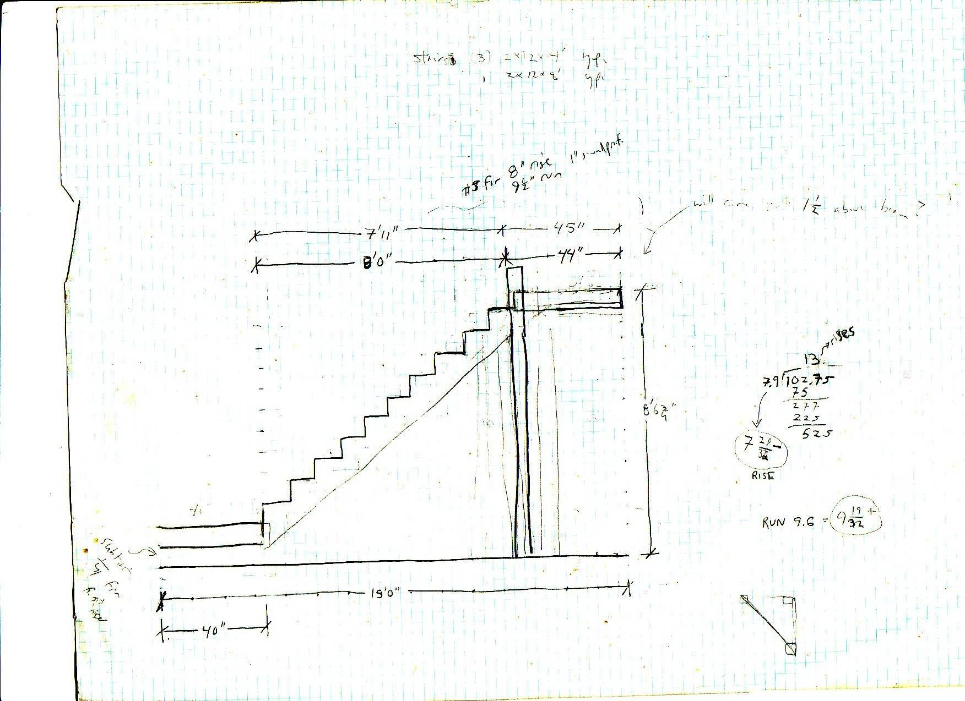
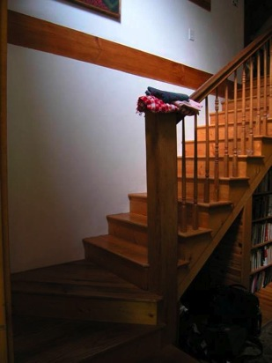
RISERS

Slide 23
RISERS
With 10 more rises on the straightaway, I would have 13 rises total.

Slide 24
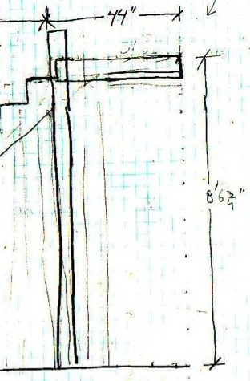
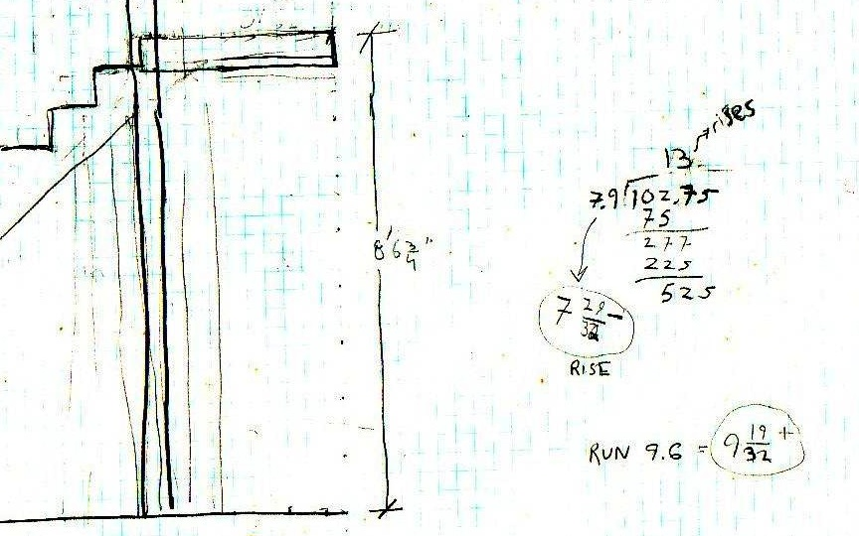
RISERS
102.75/ 13 = 7.9

Slide 25
TREADS
I had 8 feet of floor space to put in 10 stairs on the straight run

Slide 26
TREADS
So the tread for each stair would be:
96 inches
8 feet
/ 10 = 9.6 inches per stair

Slide 27
How did I do with the formula for comfort?
2 x (riser height) + (tread length) = between 24 and 26 inches
Risers = 7.9 inches
Treads = 9.6 inches
(2 x 7.9) + 9.6 = 25.4
Notes:
Stairs require lots of calculation. If they aren’t even and the right rise and run, you trip your whole life long.

Slide 28
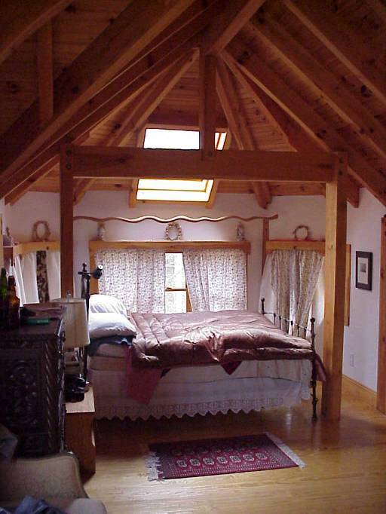
Notes:
Here it is inside.

Slide 29
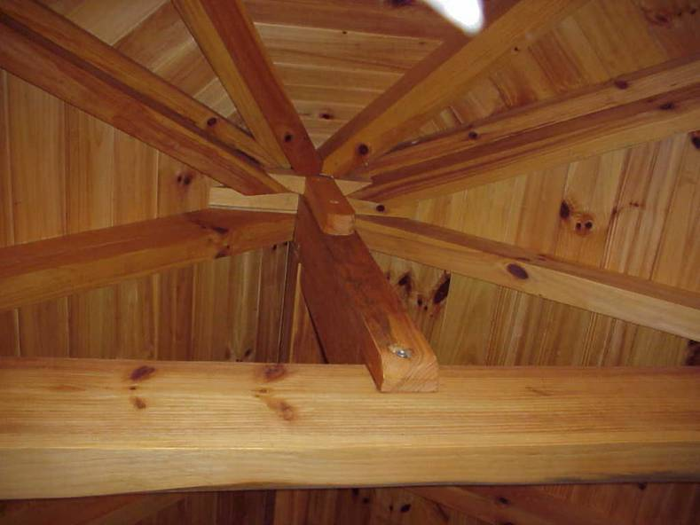
Notes:
The ONLY TIME I EVER REALLY USED arctan in my life was in this roof.

Slide 30
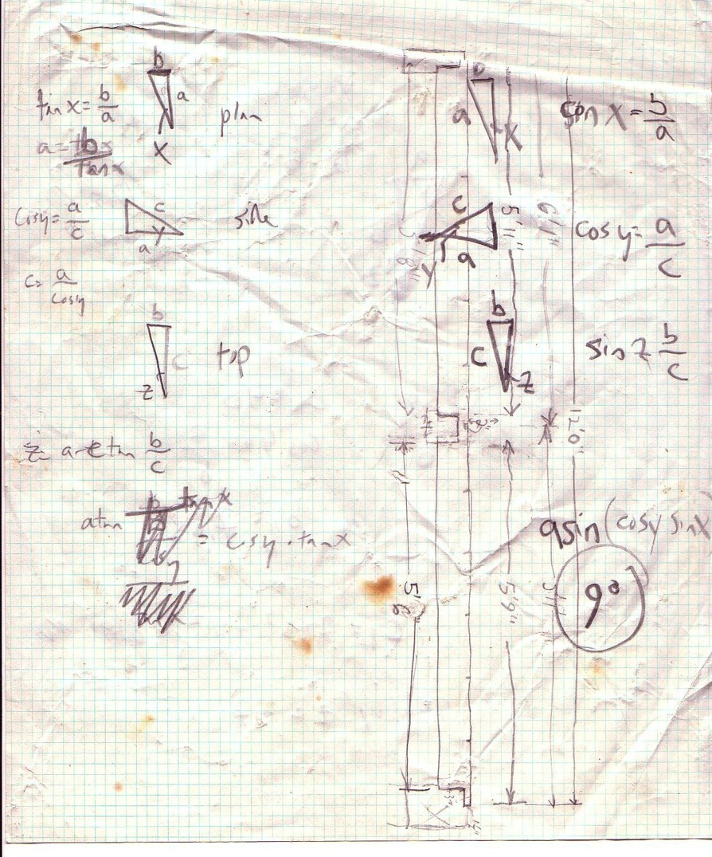
Notes:
Here’s my actual calculation.

Slide 31
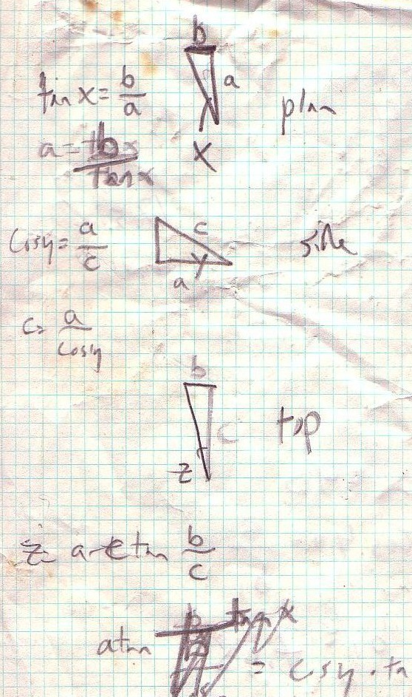
Notes:
Arctan. Can you believe it!?

Slide 32
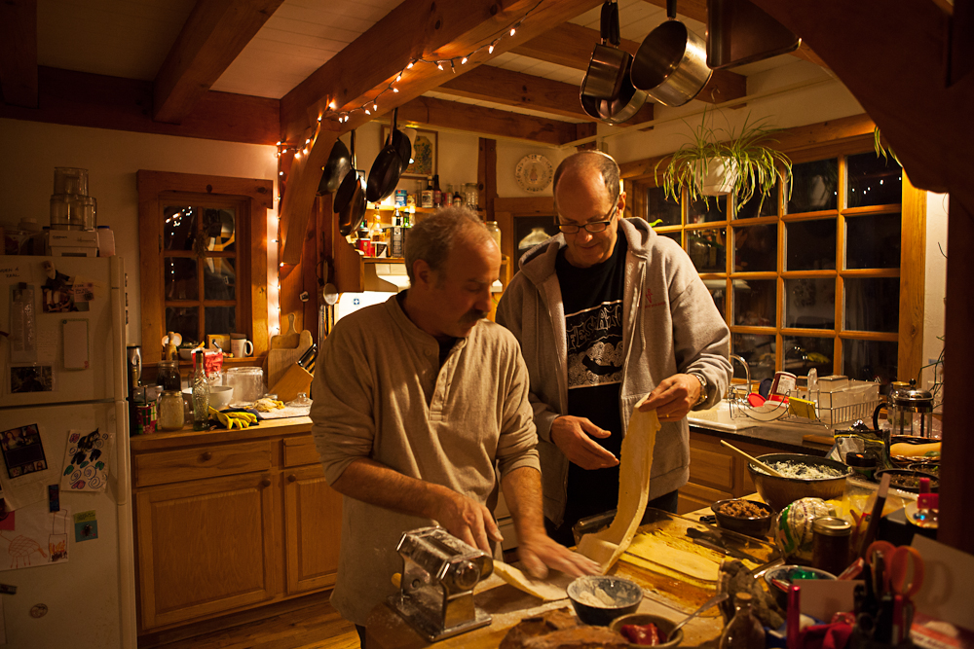
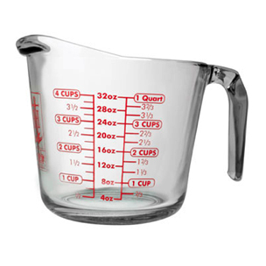
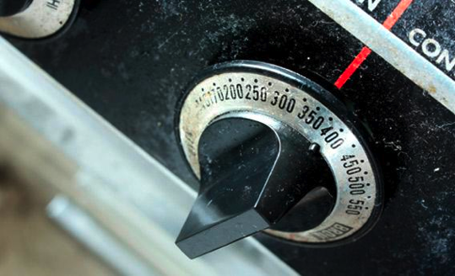
Notes:
http://www.anchorhocking.com/images/product_images/product%20item%20main&thumbs/prep/MeasuringCup32oz55178OL_Main.jpg
http://www.slate.com/content/dam/slate/articles/life/food/2012/08/120802_FOOD_OvenDial.jpg.CROP.rectangle3-large.jpg

Slide 33
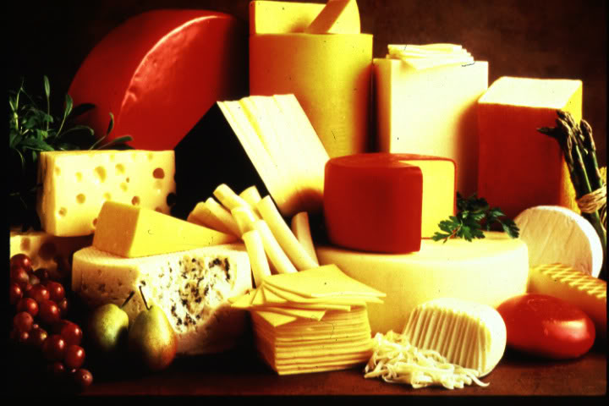

Slide 34
120/70
Notes:
http://graphics8.nytimes.com/images/2008/03/03/health/hypertension_245.jpg

Slide 36
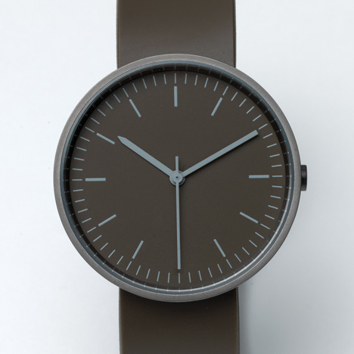
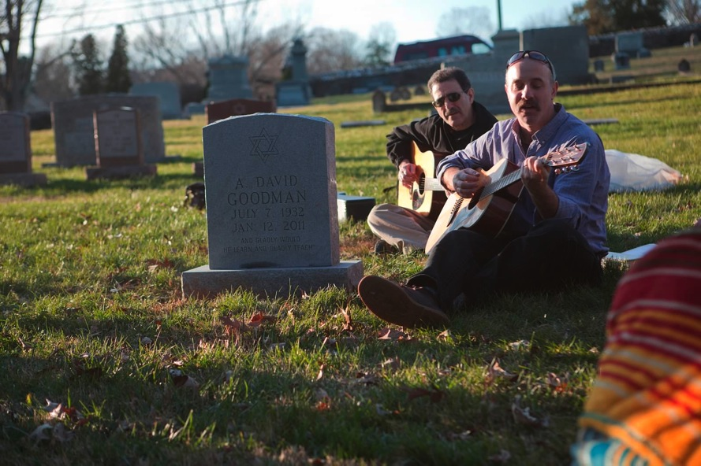

Slide 37
Where does math come from?

Slide 38
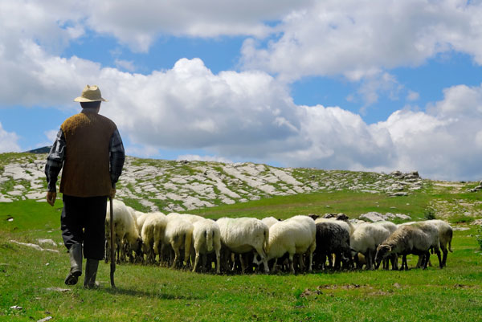
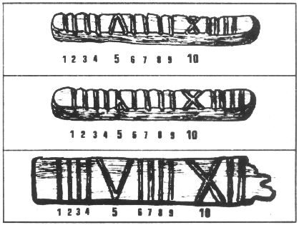
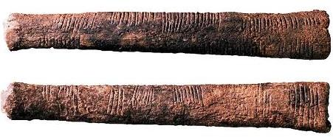
Notes:
http://www.blogcdn.com/www.engadget.com/media/2012/08/shut226-sheep-shepherd.jpg
http://www.freedomsphoenix.com/Uploads/093/Graph/tally_sticks1.jpg
http://homepages.sover.net/~donnl/iiiivsiv.html

Slide 39
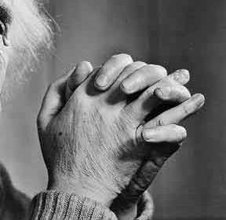
2
5
7
4
1
3
6
8
9
10

Slide 40
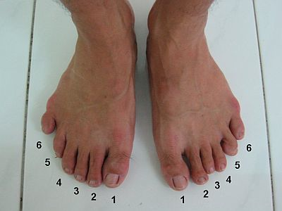
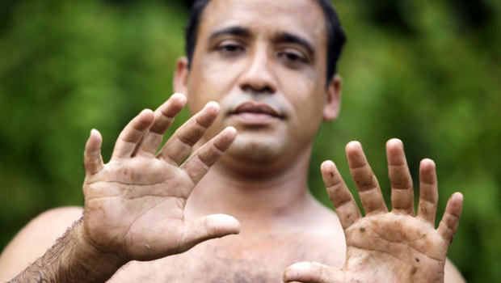
Notes:
http://midwestrootstomumbaishoots.files.wordpress.com/2012/11/toomanytoes.jpg
http://i.i.com.com/cnwk.1d/i/tim/2011/08/29/polydactyly-AP110826017714_620x350.jpghttp://i.i.com.com/cnwk.1d/i/tim/2011/08/29/polydactyly-AP110826017714_620x350.jpg

Slide 41
Base 12
ten
eleven
1 2 3 4 5 6 7 8 9 Λ Ω
Twenty two: 1 Λ
One twelve
Plus ten

Slide 42
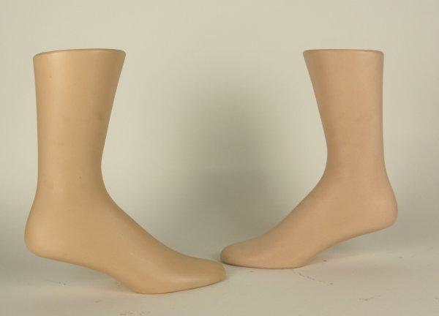
Notes:
http://www.icollect247.com/itempics/177_1343588956A.jpg

Slide 43
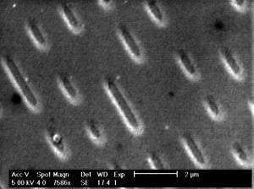
Base 2
Jeff is: 110001 years old
Notes:
http://taxdollars.blog.ocregister.com/files/2009/05/computer-code.jpghttp://www.thenakedscientists.com/HTML/uploads/RTEmagicC_REM_CD_GEPRESST.jpg.jpg
http://www.thenakedscientists.com/HTML/content/kitchenscience/exp/colours-in-cds/

Slide 44
What’s special about 60?
Notes:
The ancient Babylonian’s number system was based on the number 60.

Slide 45
30
30

Slide 47
20
20
20

Slide 49
15
15
15
15

Slide 51
12
12
12
12
12

Slide 53
10
10
10
10
10
10

Slide 54
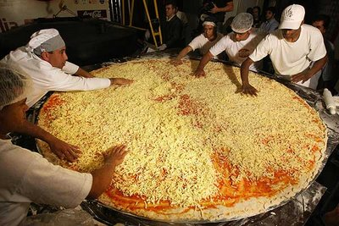
Notes:
If you use 60 as your base, you can divide things easily by 2, 3, 4, 5, 6, 10, 12, 15, 20 and 30!
http://25.media.tumblr.com/tumblr_mdgndtV2Te1rin469o1_400.jpg

Slide 55
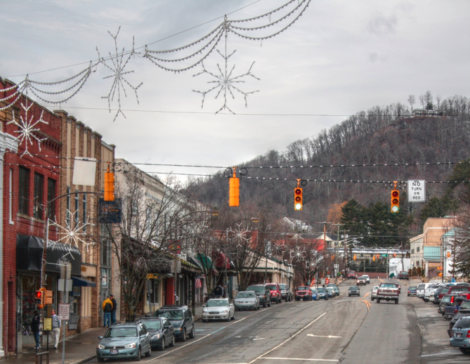
minutes
seconds
degrees
36°12′41″N 81°40′7″W
Notes:
Where else do we use base 60?

Slide 56
What are the benefits of returning to concrete relationships as we solve problems?

Slide 57
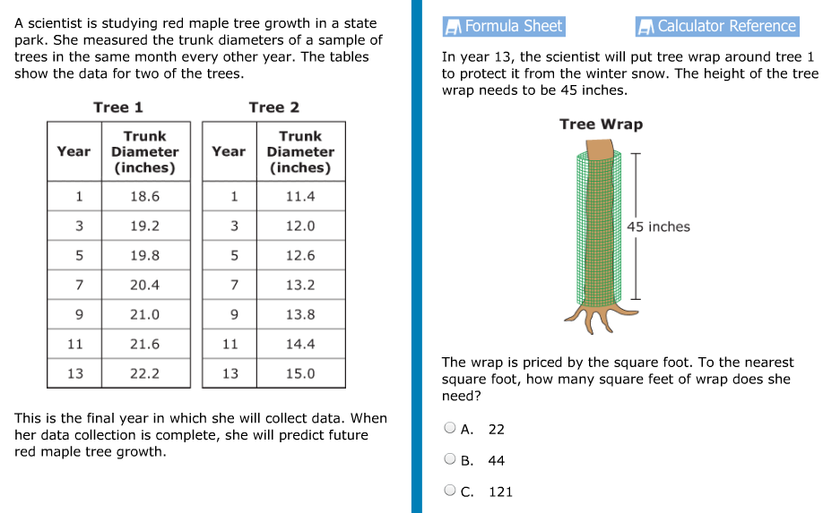
GED 2014

Slide 58
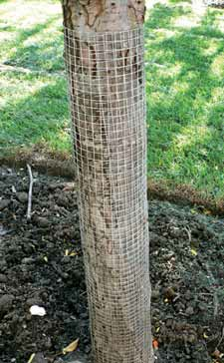
Notes:
http://urbanext.illinois.edu/gardenerscorner/images/03_winter_03.jpg

Slide 59
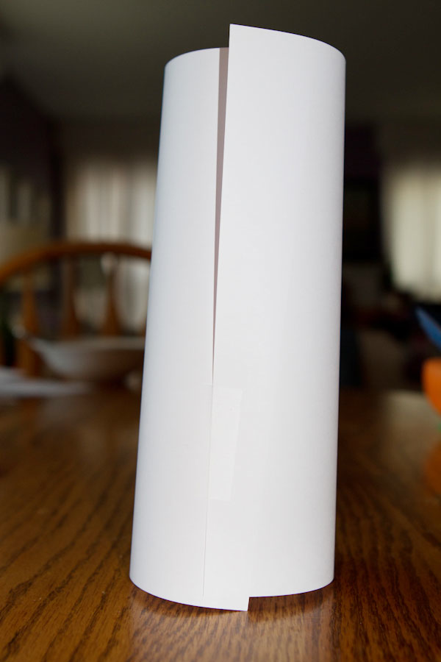
Notes:
http://www.chelles-creations.com/wp-content/uploads/2012/02/paper-WEB.jpg

Slide 60
What are the benefits of making math abstract?

Slide 62
What are the pitfalls of making math abstract?

Slide 63
Just remember, if you ever need to wrap a tree with wire and it is sold by the square yard, the amount you’ll need to pay is:
πdh/144*p/9

Slide 64
Why return to the real world to check our answers?

Slide 65
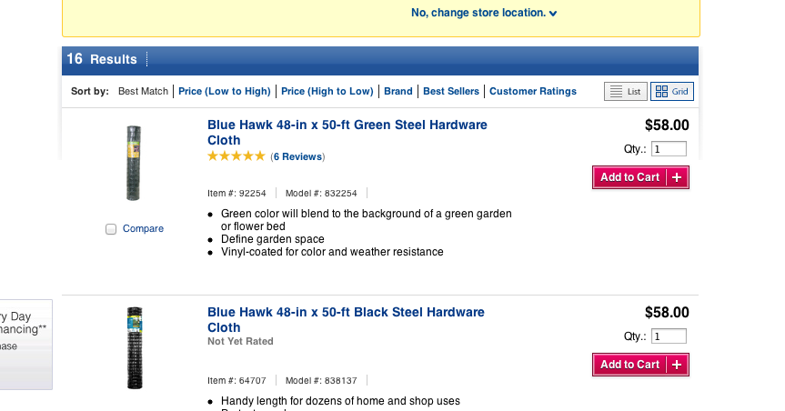
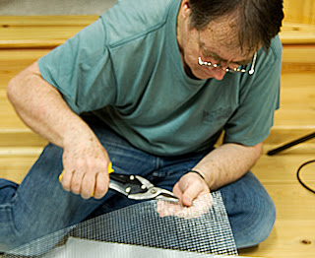
Notes:
http://4.bp.blogspot.com/_XxQVqUVtq2M/SB1HBnYmz3I/AAAAAAAAAV0/__YXXNL6thk/s320/cutting_chickenwire.jpg

Slide 66
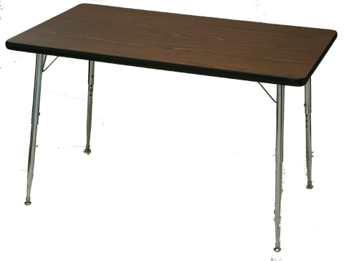
Notes:
The area of a table? Compare to our answer.

Slide 67
The Bowling Ball Pendulum Wave: a real life example

Slide 68
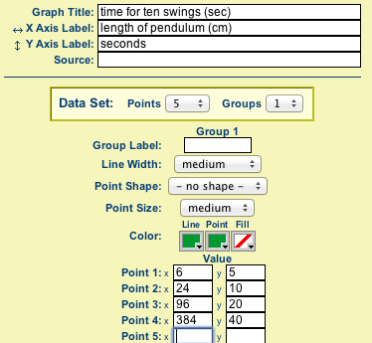

Slide 69
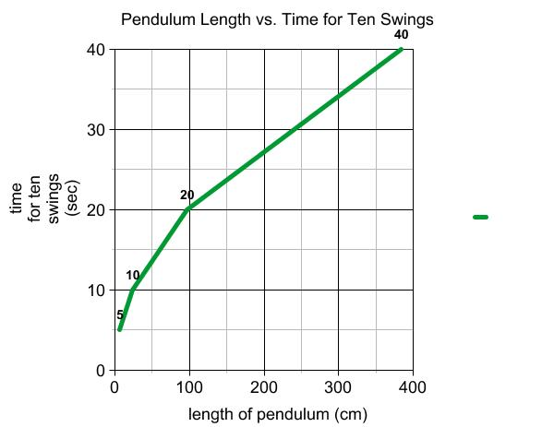

Slide 71
Notes:
Bowling ball pendulum wave at: http://youtu.be/RNxqEudZ-hE

Slide 72
Increasingly abstract
Real World
Physical Representation
Abstraction
Test out on real world

