Slide 1
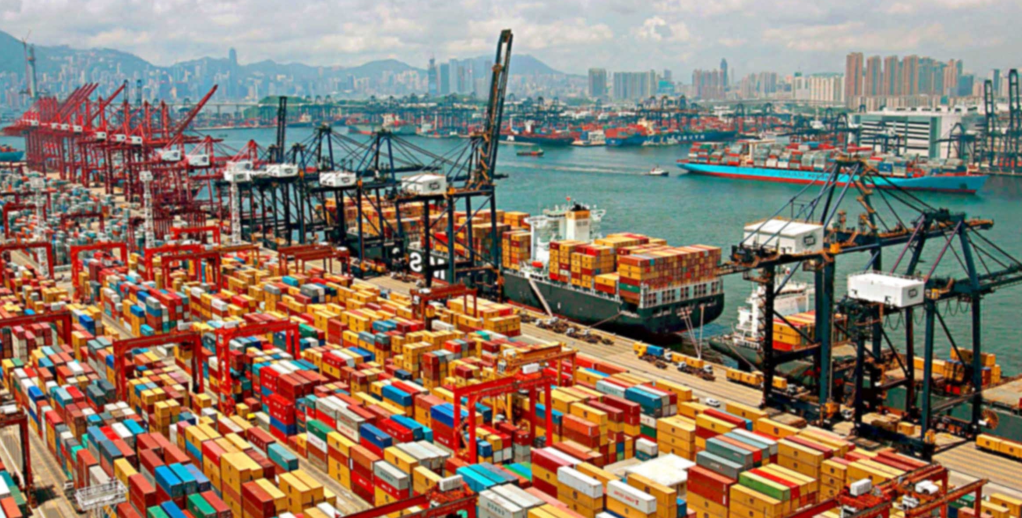
International Monetary Systems
Topic: Interdependence and Gains from Trade

Slide 2
Contact Information
Dr. Dave McEvoy
Associate Professor of Economics
Appalachian State University, NC 28608
Email: mcevoydm@appstate.edu
Course Website: davemcevoy.weebly.com/imsangers2018.html

Slide 3
Agenda:
Discuss syllabus
Introduce groups and presentation assignment
Interdependence and gains from trade

Slide 4

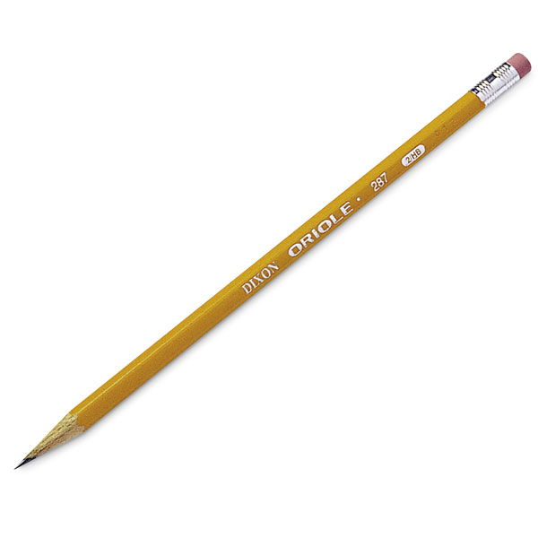

Slide 5
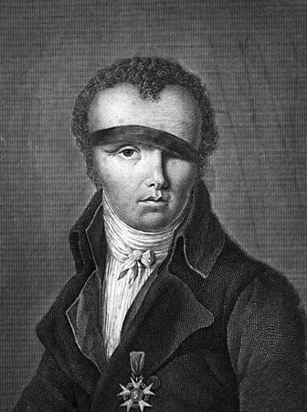
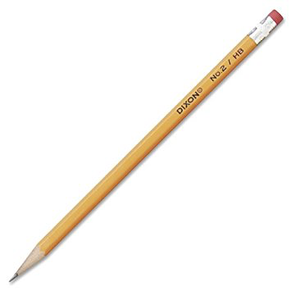
Nicolas-Jacques Conte
Rubber (e.g., D.R. of the Congo)
Cedar – (e.g., western United States)
Zinc and Copper – e.g., Chile
Yellow pigment from castor plant - India
Graphite – Sri Lanka; Canada

Slide 6
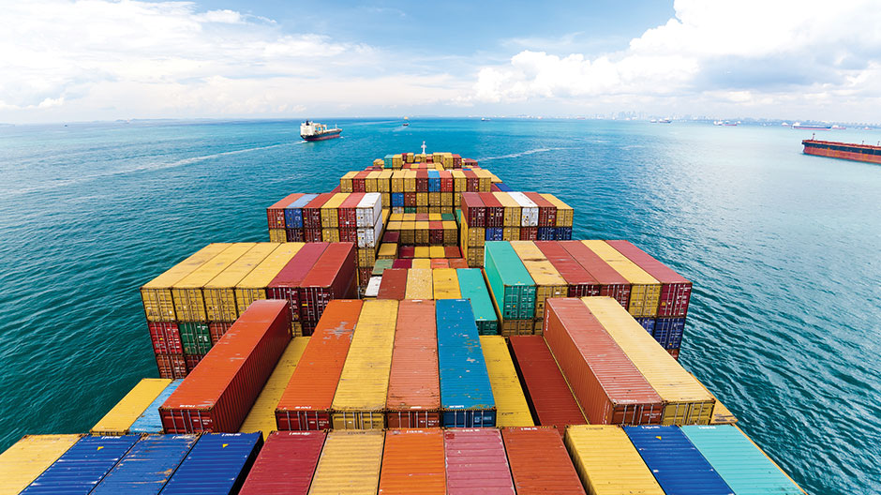
Why do we trade?

Slide 7
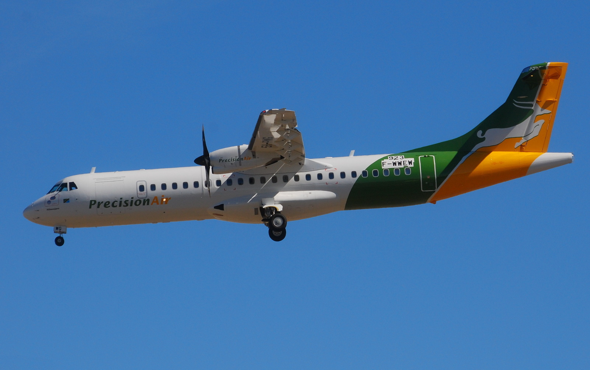

What to export and what to import?
France – exports (613 B): aircraft, cars, engines, pharmaceuticals, beverages
France – imports (695 B): fuel, parts
US – exports (1.4 T): computers and machinery, aircraft, vehicles, fuels
US – imports (2.16 T): cars, fuels, computers, parts
Source: https://atlas.media.mit.edu/en/profile/country/usa/

Slide 8
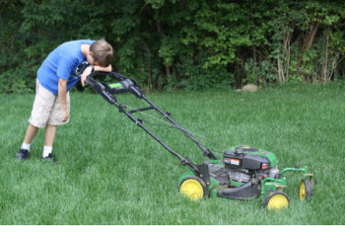
Question: should Antoine Griezmann cut his own lawn?

Slide 9

What is the cost of attending university?

Slide 10
Opportunity Cost:
The value of what you give up when you make a choice.

Slide 11
Two Country Example
0
Two countries: the United States and France
Two goods: computers and wine
One resource: labor, measured in hours
We will look at how much of both goods
each country produces and consumes
  if the country chooses to be self-sufficient
  if it trades with the other country
Notes:
11

Slide 12
Two Country Example: Production Possibilities in France
0
France has 50,000 hours of labor
available for production, per month.
Producing one computer
requires 100 hours of labor.
Producing one barrel of wine
requires 10 hours of labor.
Notes:
12

Slide 13
Productions Possibilities in France
Two goods can be produced in the economy (computers and wheat)
It takes 100 hours to make a computer
It takes 10 hours to make a unit (barrel) of wine
There are 50,000 labor hours available.
What is the opportunity cost when increasing production from 100 computers to 200 computers?

Slide 14
Production Possibilities Frontier (PPF)
0
Wine (brls)
5,000
4,000
3,000
2,000
1,000
Computers
0
100
200
300
400
500
Notes:
14

Slide 15
The Shape of the PPF
The PPF could be a straight line or curved
Shape depends on what happens to opportunity cost
as economy shifts resources from one industry
to the other.
  If opportunity cost remains constant,
  PPF is a straight line.
  If opportunity cost of a good rises as the economy produces more of the good, PPF is curved
Notes:
15

Slide 16
Why the PPF Might Be Curved

Slide 17
The PPF: A Summary
The PPF shows all combinations of two goods that an economy can possibly produce, given its resources and technology.
The PPF illustrates the concepts of scarcity, tradeoffs, opportunity cost and efficiency.
Notes:
17

Slide 18
France Without Trade: Half time on each
0
Wine (brls)
5,000
4,000
3,000
2,000
1,000
Computers
0
100
200
300
400
500
18
Notes:
18

Slide 19
United States production possibilities
  US has 30,000 hours of labor available for production, per month.
  Producing one computer requires 125 hours of labor.
  Producing one barrel of wine requires 25 hours of labor.
Question: which country produces computers using fewer labor hours?
for wine?

Slide 20
United States has 30,000 hours of labor available for production, per month.
Producing one computer requires 125 hours of labor.
Producing one barrel of wine requires 25 hours of labor.
If the US spends all of its time making computers, how many computers can it make?
Answer: 240

Slide 21
The PPF for the United States
0
Wine (brls)
2,000
1,000
0
Computers
100
200
300
21
Notes:
21

Slide 22
U.S. Without Trade: Half time on each
0
Wine (brls)
2,000
1,000
0
Computers
100
200
300
Notes:
22

Slide 23
Consumption With and Without Trade
0
Baseline situation without trade:
  France consumers get 250 computers
  and 2500 barrels of wine.
  United States consumers get 120 computers
  and 600 barrels of wine.
Key point: for trade to be beneficial for both countries, consumption levels for both goods must be weakly higher than the baseline after trading.
Notes:
23

Slide 24
Specialization
Suppose France produces 3400 barrels of wine. How many computers would France be able to produce with its remaining labor?
Answer: 160

Slide 25
France Specialized Production
0
Wine (brls)
5,000
4,000
3,000
2,000
1,000
Computers
0
100
200
300
400
500
25
Notes:
25

Slide 26
Specialization
Suppose the US produces 240 computers.
How many barrels of wine would the US be able to produce with its remaining labor?

Slide 27
United States Specialized Production
0
Wine (brls)
2,000
1,000
0
Computers
100
200
300
Notes:
27

Slide 28
After Specialized Production
France
 | Baseline | Specialized Production | Balance
Computers | 250 | 160 | -90
Wine | 2,500 | 3400 | +900
United States
 | Baseline | Specialized Production | Balance
Computers | 120 | 240 | +120
Wine | 600 | 0 | -600

Slide 29
Exports & Imports
0
Exports:
goods produced domestically and sold abroad
To export means to sell domestically produced goods abroad.
Imports:
goods produced abroad and sold domestically
To import means to purchase goods produced in other countries.
Notes:
29

Slide 30
Trade Example (specialization)
Suppose France exports 700 barrels of wine to the US, and imports 110 computers from the US.
  How much of each good is consumed in France?
  How much of each good is consumed in the U.S.?

Slide 31
France Consumption With Trade
0
Wine (brls)
5,000
4,000
3,000
2,000
1,000
Computers
0
100
200
300
400
500
Notes:
31

Slide 32
United States Consumption With Trade
0
Wine (brls)
2,000
1,000
0
Computers
100
200
300
Notes:
32

Slide 33
Trade Makes Both Countries Better Off
0
France
consumption without trade
consumption with trade
gains from trade
computers
250
270
20
wine
2500
2700
200
United States
consumption without trade
consumption with trade
gains from trade
computers
120
130
10
wine
600
700
100
Notes:
33

Slide 34
Where Do These Gains Come From?
0
Absolute advantage: the ability to produce a good using fewer inputs than another producer
France has an absolute advantage in wine
  producing a barrel of wine uses 10 labor hours
  in France vs. 25 in the U.S.
If each country has an absolute advantage
in only one good and specializes in that good,
then both countries can gain from trade.
Notes:
34

Slide 35
Where Do These Gains Come From?
0
Which country has an absolute advantage in computers?
Producing one computer requires
125 labor hours in the U.S but only 100 in France
France has an absolute advantage in both goods!
Why do both countries gain from trade?
Notes:
35

Slide 36
Two Measures of the Cost of a Good
0
Two countries can gain from trade when each specializes in the good it produces at lowest cost.
Absolute advantage measures the cost of a good in terms of the inputs required to produce it.
Recall:
An important measure of cost is opportunity cost.
In our example, the opportunity cost of a computer is the amount of wine that could be produced using the labor needed to produce one computer.
Notes:
36

Slide 37
Opportunity Cost and
Comparative Advantage
0
Comparative advantage: the ability to produce
a good at a lower opportunity cost than another producer
Which country has the comparative advantage in computers?
To answer this, must determine the opportunity cost of a computer in each country.
Notes:
37

Slide 38
Opportunity Cost and
Comparative Advantage
0
The opportunity cost of a computer is
  10 barrels of wine in France, because producing one computer requires 100 labor hours,
  which instead could produce 10 barrels of wine
  5 barrels of wine in the U.S., because producing one computer requires 125 labor hours,
  which instead could produce 5 barrels of wine.
So, the United States has a comparative advantage in computers. Lesson: Absolute advantage is not necessary for comparative advantage!
Notes:
38

Slide 39
Table of Opportunity Costs

Slide 40
Comparative Advantage and Gains from Trade
0
Gains from trade arise from comparative advantage (differences in opportunity costs).
When each country specializes in the good(s) in which it has a comparative advantage, total production in all countries is higher, the world’s “economic pie” is bigger, and all countries can gain from trade.
Notes:
40

Slide 41
Group Work: An Example on Absolute Advantage, Comparative Advantage and Gains from Trade
The next few slides have questions related to the information below.
Work out these problems in your groups and write down the answers
Argentina and Brazil each have 10 hours of labor per month.
In Argentina,
  producing one kilo of coffee requires 2 hours
  producing one case of wine requires 4 hours
In Brazil,
  producing one kilo of coffee requires 1 hour
  producing one case of wine requires 5 hours

Slide 42
Argentina and Brazil each have 10 hours of labor per month.
In Argentina,
  producing one kilo of coffee requires 2 hours
  producing one case of wine requires 4 hours
In Brazil,
  producing one kilo of coffee requires 1 hour
  producing one case of wine requires 5 hours
Graph each country’s Production Possibilities Frontier
Which country has an absolute advantage in coffee?
Which country has an absolute advantage in wine?
What is Brazil’s opportunity cost of producing one case of wine?
What is Argentina’s opportunity cost of producing one case of wine?
Which country should specialize in and export wine?

