Slide 1
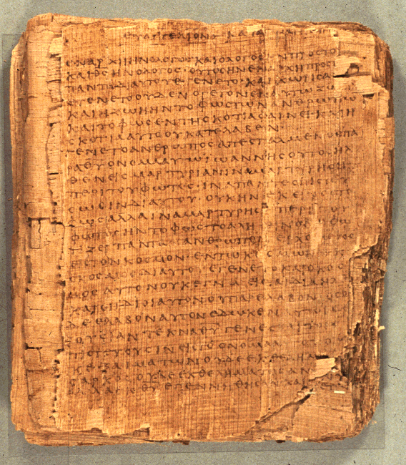
COS 221
Bible II
Dr. Rodney K. Duke

Slide 2



Rodney Duke
Professor at
Appalachian State
University
Boone, NC
Web: http://www.appstate.edu/~dukerk/
‘Conservative’ or ‘Liberal’?
(evaluate each issue separately)
Need to know:
1) Extremely fallible
2) Love Jesus!

Slide 3

INTRODUCTIONS
a) Name
b) Issues related to the OT/Bible that interest/concern you.
c) What anxieties you have about this course, if any.
What is a nickname that you have been given at some time?

Slide 4

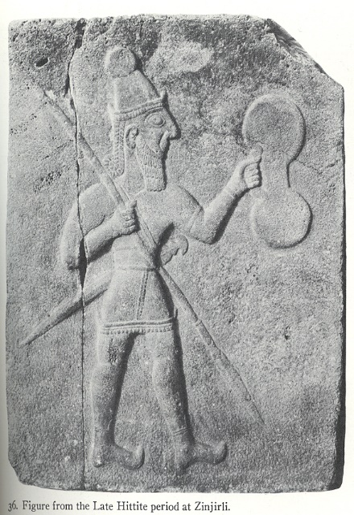
OT INTERESTS/ISSUES CONCERNS
Figure from Late Hittite Period

Slide 5
INSPIRATION, PRESUPPOSITIONS AND THE NATURE OF THE BIBLE
CONTEMPORARY CHURCH
Doctrine + (modern assumptions) → decide what we must find
Original is Divine Truth & Later is Corrupt
NOTE: “Authority” based on “author”
ANCIENT COMMUMITY OF FAITH
Experience → Doctrine (see what we find)
Adopting and Passed on under Inspiration
NOTE: θεόπνευστος (2 Tim. 3:16) often translated ‘God breathed’ (passive), can mean ‘God breathing’ (active).

Slide 6
QUICK NITTY GRITTY OVERVIEW
Class pace: fairly fast and intense
[Slides: Posted. More than necessary. Will skip some. Focus on main points. Can come back to details Please ask.]
Work load: moderately heavy; budget 2 hours for reading and writing preparation required for next class
Literary approach: communication model. This is not “anything goes,” opinion vs. opinion. We will seek to uncover what the texts meant to their original audiences.
#1 Rule: be willing to be wrong and make mistakes, then we can all loosen up, learn from each other, and have fun learning

Slide 7
COS 221 Bible II
Overview
Objectives: COS Catalog Statement
This course interprets the critical events, developing institutions, and traditions of Israel. Attention is given to the earliest Covenants, to the Exodus, to the rise of the monarchy, and to other events up to the eighth century prophets.
Students will be able to:
Articulate a historical overview of the experience and faith of ancient Israel.
Exegete selected passages that illustrate crucial turning points in the history of Israel.
Apply exegesis to preaching, other pastoral responsibilities, and issues of the present day.

Slide 8
DAY 1
Assign: (see CoursePack handout; prefer typed work!)
1) (Daily) Write a journal entry (couple of paragraphs)
[When taking notes, you might rule off a section for
jotting down journal comments to develop later.]
2) #1 on “Functions of Communication” (pp. 16-17)
3) #2 on 12 C’s *Look over but do not need to do (N)
4) #3 on Genesis 1 and 2.
Day Objectives:
1) Explain the course goals and objectives.
2) Identify structure & content of Hebrew Bible/Old Testament
3) Identify the nature of different Bible translations
4) Draw a map of the Ancient Near East (ANE) by memory.
5) Explain the differences among the cultures of the ANE

Slide 9
Poles of Communication (Explain Homework #1)
Emotive
Addresser
|
Means------------------------|---------------------Referent
|
Addressee
Poetic
Referential
Conative (persuasive)

Slide 10
Matters of Old Testament Scholarship/Study
Reflect on the significance of the Old Testament (OT).
The OT was the Bible of early Christians prior to circulation of New Testament (over 300 years until officially canonized).
Discuss:
The importance your knowledge of the OT currently holds for you in your Christian faith, and
The role you think it should play in Christian life.

Slide 11
Describe and evaluate different approaches to the OT.
Discuss:
Is there a correct way to approach reading the Bible? Are some ways better than others?
What do you think of a “scholarly” approach to the Bible? Think about:
  How might some students of the OT see the scholarly approach as inadequate?
  Is a scholarly approach destructive to faith? Could it be complementary?
  What did you like/not like about Fretheim?
  What did you like/not like about Collins?
Notes:
This slide will probably bring up issues re: the textbook. The text tends to emphasize reconstruction of the history of the OT and of Israel. This information may be helpful, but the community of faith will focus on the final form and how it communicates the divine Word as Freitheim argues.

Slide 12
Approaches: Scholarly vs. Community of Faith
a) Scholarly focus is on what text meant (historical), but
community of faith focuses on what text means (contemporary).
b) Scholarly approach ("objectively") is not how texts were meant
to be read. To be read by those with a vested interest who
"submit" to the Word of God.
c) Scholarly approach might be unsatisfying for faith community,
but might provide foundation.
VS.

Slide 13
Duke: Need for Scholarly Study of the OT
God may speak to a person through a text out of context,
  BUT we should use caution before applying such readings to the lives of others as “biblical teaching.”
  Privatized readings are product of Enlightenment (18th cent.) NOT standard practice of the Church.
Allegorical/symbolic readings of OT dominated in life of Church until Enlightenment.
  Arose from need to apply the OT (particularly narratives) to the community of faith.
      [Modernity “forgot” that narratives communicate meaning mimetically.]
  Controls: 1) supported by clear teaching elsewhere in Bible, and 2) promoted love of God and neighbor. (cont.)
Notes:
Even Luther and Calvin, who wanted the Bible in the vernacular and to be available to all people, thought that interpretation should be in community.

Slide 14
Need for Scholarly Study of the OT (cont.)
Reliance on “clear teaching” for application brings in need for tools of biblical scholarship (“criticism”).
Linguistic and historical-critical tools are neutral
  BUT they are sometimes employed with presuppositions that are not neutral (e.g. Rationalism, Empiricism, Naturalism).
  Fundamentalism was a reaction against classical late 19th century Christian liberalism.
    Contemporary “fundamentalism” is virtually unaware of the original Fundamental essays.
Therefore: The goal of sound biblical scholarship is first to try to understand what the biblical texts would have communicated and taught the original, ancient audiences.
Notes:
Note problem that we, too, easily bring in modern assumptions (e.g. nature of literary composition) and pop-cultural Christianity that is not very biblical. Fundamentalism: Might mention BB Warfield as one of the fathers of inerrancy, and James Orr et al on evolution.

Slide 15
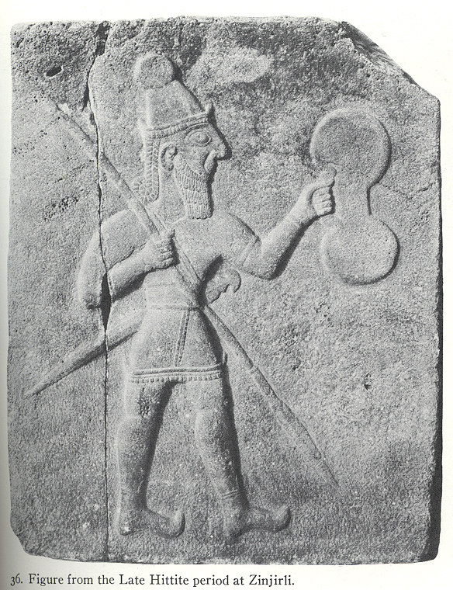
Description of OT (1 of 2)
A. Collection of writings from 1st millennium BC/BCE by Jews.
1. 24 "books" (Hebrew), 39 (Protestant)
2. 2nd millennium? - 200 BCE?
3. Hebrew, some Aramaic
4. authoritative, defining view of world and way of life
B. Genres (types of literature), variety:
laws, prophetic oracles, historical, narrative,
hymnic, wisdom, apocalyptic, etc.
C. Scope (historical):
[creation] Abraham (1800? BCE)
to Ezra (400? BCE)
Figure from Late Hittite Period

Slide 16
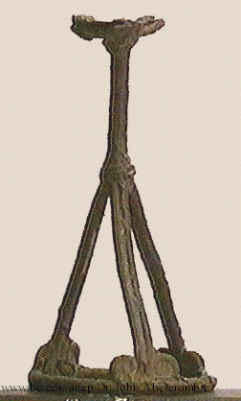
Description of OT (2 of 2)
D. Product w/several dimensions:
1. human:
product of human experience,
reflections, styles of writing
2. historical:
a) product of specific time, culture
b) product of historical memory
3. literary:
product of literary genres and conventions
4. religious:
product of religious experience and
understanding of reality
5. Divine: inspired for God’s intention
These dimensions are inextricably intertwined!
incense altar from Beth Shan

Slide 17
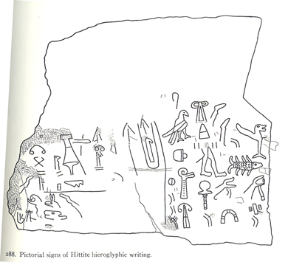
“Approaching OT on its own terms”
1. Recognize these intertwined dimensions and not read as just inspired for the 21st-cent. reader. (Inspired FOR us, but NOT written TO us.)
2. Put aside own questions, issues, perspectives and try to see questions, issues, and perspective of OT writings and original audience.
Hittite hieroglyphics

Slide 18
COMPONENTS OF THE BIBLICAL TEXTS (CP, p.7)
Oral Stage: Documents: Author/
Community Authors Editor Text Audience
……..……...……………..
Source Criticism
Text Criticism
Literary Criticism (narrow)
Historical Reconstruction
Reader-response Criticism
Form Criticism
Redaction Criticism
History of the Text
Literary Criticism (broad)

Slide 19
Sample questions that can be asked about the Bible
1) How can this text be used to reconstruct the history of the …?
(historical criticism)
2) What does the audience bring to the reading of a text that
influences their conclusions about what it means?
(reader-response criticism)
3) What was the psychological makeup of the author?
(psychological criticism)
4) What impact did the original author wish to have on the original
audience? (literary criticism)
5) Did the author/editor use documentary source to help compose
the final text? (source criticism)
6) How did the author/editor use the sources to shape the final text?
[redaction (=to edit) criticism]
7) Was the text, or sections of it, given form by use in an oral
setting? (form criticism)

Slide 20
II. Formation of Biblical Literature: Introductory Matters
Guiding Questions:
Why do YOU believe the Bible is authoritative and inspired?
For what purposes does the Bible state it is authoritative?
Key Concepts:
The community of faith recognizes the divine authority of Scripture.
Divine inspiration has guided the canonical PROCESS, the formation of the biblical books, from beginning stage to final form. [We do not need to identify each author.]
Key Caution: We need to avoid projecting modern expectations and concepts of composition onto the Bible.

Slide 21
Shifts in Locus of Authority, and Issue of Unity
Duke thesis: The 19th century “battle” between “liberal higher critics” and “conservatives” was based on same misplaced presupposition about the locus of authority. Both assumed that authority rested in authorship [Note linguistic connection of “author” as “originator/authority”!]
Shifts in the Locus of Authority
Start: divine locus: experience of community w/mediator or text convinces them of divine origin.
Shift to mediator as locus: Jewish tradition of Mosaic source of Torah:
  a) Since God spoke to Moses, if Moses said it, it is authoritative. By the time of NT:
  b) If it is authoritative, Moses must have said it. (Even oral tradition of elders. Note: much like ‘modernists’!)

Slide 22
Shift to text as locus. Seen in b above, but develops with gradual movement from oral to written culture.
Shift to interpreter of text as locus. As the authority of the Church grows, the locus shifts to the official interpreters. (Later rejected with Protestantism and growing rejection of religious authority.
Shift to author as locus: In modern, Western “objective” culture, biblical historical criticism focused on literary sources and historical setting of author. Authority now found in knowing sources and their authors.
Resulting false presupposition (accepted by “liberals” & “conservatives”:
One must prove that author X wrote everything or it is not authoritative [conservative] or not genuine [liberal]!
Notes:
See my dated reflections on Seitz and my thoughts under folder Isaiah stuff: Isaiah thoughts on unity and authority.doc

Slide 23
But, historically, the original focus was on the Divine Word!
Biblical authority (as define by communities of faith):
The locus/source of revelation is God, and only
Mediated through:
a) recognized spokespeople & prophets, and/or
b) later recorded as a text, and given the
Assent of the community to the validity of the revelation.
Therefore, the locus of authority, the “author” was God and not the human mediators.
[Note: Even the Gospels, do NOT name the authors.]
[Duke: Historical critical reconstructions of HOW the OT came to be (e.g. Collins) provide valuable insights, BUT do not impact the authority of Scripture.]
Notes:
Result: Scholars try to reconstruct the history of the text and may or may not be correct. Whatever the history of composition might be, I trust the final product.

Slide 24
Skip Formation of an OT Book

Slide 25
Skip Formation of an OT Book
Key Concept: Divine inspiration guides the canonical PROCESS, the formation of the biblical books from beginning stage to final form. (Avoid projecting modern concepts of composition!)
A. Materials gradually gathered and edited over a long time,
sometime several centuries, by the community of faith.
Two examples - books of Judges and Jeremiah
B. Book of Judges. Five identifiable steps:
Formation of stories, poetry, anecdotes, etc. in response to real life experiences of some portion of ancient Israelite peoples.
Examples of important events and stories remembered orally* in early Israel:
Stories of hero Samson
Song of Deborah (Jd. 5). Celebration of Israelite victory
* Stories preserved orally. Less than 1% of the population could read or write.
Notes:
Cover “Key Concept.” Discuss confusion between doctrine of inspired and authoritative Scripture and modern assumptions about the process of composition. Perhaps skip the rest, since Anderson goes into such detail.

Slide 26
Skip
2. Passing on these materials, often for many generations, in oral form. Often shaped and adapted to address the circumstances of each succeeding generation.
3. Grouping stories around common themes, the same person, etc.
Stories about Samson or Gideon, or lists of “minor judges” in Jd. 10:1-5 and 12:7-15
NOTE: In these first three steps, everything is oral, and therefore more fluid and adaptable.
4. An editor puts together the first written copy collections of collections and forms the book of Judges.
5. Later editors revise the first editor’s written work. Book of Judges gradually comes close to its present form, perhaps after 700-800 years.

Slide 27
Skip
C. The Book of Jeremiah. Jeremiah, prophet (627-582 BCE). Ch. 36, (about 605) tells of an early form of the book. At least three steps:
1. Jeremiah the prophet speaks, many times (usually in short snatches) prior to 605 BCE.
2. The Lord tells Jeremiah to write down all these words (36:2-3). (scribe Baruch) The king and reads it, cuts off pieces, and burns them! Writes it again (36:28-31). v. 32 implies he may have added more.
Jeremiah’s career, another 23 years, more speeches preserved orally or in writing by him or his followers, probably added to the second version.
(Early copies of Jeremiah as a complete book have some differences, perhaps due to different forms and collections by different people. Example: chs 46-51 in some manuscripts in the middle of 25:13.)

Slide 28
What are some popular opinions you have heard about translations of the Bible?
“The Bible has been translated so many times, it cannot be accurate!”

Slide 29
GOSPEL TRANSMISSION
The Mistaken Notion of Literary (Written) Textual Transmission:
The idea that a Gospel gets rewritten as it get copied.
A (“first”) -> B -> C -> D -> E -> F (last = corrupt)
FALSE!
This is not the process.

Slide 30
Textual Transmission: The Exponential Growth of a Text
Gospel written by end of first century
Copies quickly made as the Church spreads.
Etc.
By mid second century: 4 Gospels and 13 Letters of Paul were standard fare for Christian communities throughout the Mediterranean, and copyists are comparing copies, creating “families” of text types.
Question:
How possible would it be after just a few “generations” of a Gospel being copied for someone (like Marcion) to “revise” the words of Jesus in a Gospel and effectively change Christian teaching?
Notes:
Note that early copies were sloppy. “Theological” modifications do take place, particularly after late 2nd century controversies arise, but these are a very small percentage of variants, and they are detectable. See Metzger AND Ehrman, The Text of the NT, Ch 7.II.6, Ch 8.IV.

Slide 31

About Mid-Second Century Copies in a Region Begin to Get “Standardized” (take on similar characteristics).
Copyists in different regions have different copying “techniques” that can be identified.
“Families” / text types

Slide 32
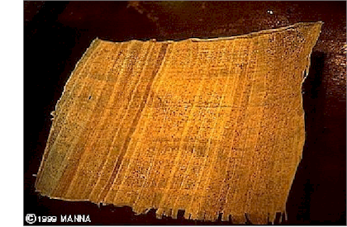
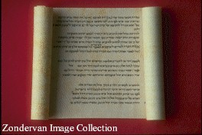
Textual Criticism
“Textual Criticism” is the scholarly approach to:
Establish history of transmission of text, and
Reconstruct earliest possible wordings of biblical texts
General principle, when 2 or more texts have different readings:
The more difficult reading (the one that best explains the other readings as attempts to clarify it) is more likely the older, “original” reading.

Slide 33
Which Reading is Most Likely the Original?
(Which is the most difficult reading that explains the others?
The Israelites brought foreigners to serve in the Temple, and the Lord’s anger turned against the people.
The Israelites brought foreigners to serve in the Temple, and the Lord’s anger turned against them.
The Israelites brought foreigners to serve in the Temple, and the Lord’s anger turned against the Israelites.

Slide 34
[In class, will probably skip following slides on textual criticism]
Ancient publication techniques.
In ancient world, all copies had to be hand written. Two methods:
One person handwrites one new copy from one old copy.
What kind of accidental mistakes would a scribe be likely to make?
More likely to be accurate than:
Many scribes write while one scribe reads.
What kind of accidental mistakes would a scribe be likely to make?
Easier to make mistakes (“mistakes of the eye” for the reader, plus “mistakes of the ear” and fatigue for the listener).

Slide 35
G. Second setting of the Standard Text, and the Masoretes [Late first millennium (6th-10th cent.)]
    Jewish scribes, Masoretes, due to differing texts, set the Standard Text for 2nd time.
    They add the vowels (“pointing”)
`^yh,(l{a/-~[i tk,l,Þ [;nEïc.h;w> ds,x,ê tb;h]a;äw> ‘jP'v.mi tAfÜ[]-~ai yKiä
((Micah 6:8)
    Manuscripts have to agree on: # of words, # of letters, middle word, middle letter.
    Oldest complete OT manuscript in Hebrew from about the year 1000 CE

Slide 36
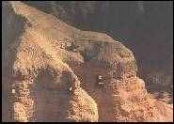
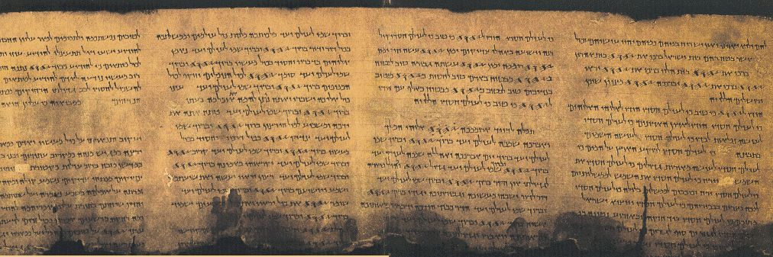
H. The Dead Sea Scrolls (DSS)
Found beginning in 1947.
Date: 1st cent. BCE & first cent. CE.
Why not just use them as our OT?
(Parts of all books except for Esther.)
  An older text is not necessarily more accurate.
  Only complete book: Isaiah.
BUT, the DSS valuable witness to early form of the Hebrew OT text.
Qumran Cave #4
Photo by Nancy A. Carter
http://gbgm-umc.org/umw/bible/outside2.stm#scrolls
Psalms (Tehillim) 11QPs Israel Antiquties Authority http://www.ibiblio.org/expo/deadsea.scrolls.exhibit/Library/psalms.html

Slide 37
[In class, probably skip these slides on Ancient Translations]
Ancient Translations of the OT
A. The Septuagint (LXX).
First known translation of the OT into another language.
Place: Alexandria, Egypt.
First, the five Books of Moses/ the Law (c. 250 BCE).
Rest of OT and much of “Apocrypha” over next couple of centuries.
Seems to have been used by the writers of the NT (disputed).
Became the “Bible” of the ancient Christian Church.
Two theories about how the Septuagint came to be:
  Letter of Aristeas: Hellenistic pharaoh sponsors translation by 70 scholars translated exactly the same in 70 days, hence the title. Possible a pharaoh sponsored such a translation.
  Different persons, on their own, translate different parts of the HB. Later pulled together into one collection.

Slide 38
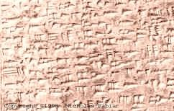
8. Fairly literal translation, therefore, can be important witness back to the early Hebrew text.
9. Some major difference between LXX and Hebrew (Masoretic Text).
For example:
LXX book of Job is quite a bit shorter
LXX story of David slaying Goliath is shorter (?)
LXX of Jeremiah shorter and different order
10. Because of use of LXX by Christians, Jews in the second century CE turned away to a more literal Greek translation by Aquila.
CUNEIFORM on clay tablet

Slide 39
Other Ancient Translations
Syriac
Aramaic
Latin: Jerome’s Vulgate (vulgar=”common”).
  Various Old Latin Versions of books of the OT and NT
  Pope Damasus asked Jerome to clean these up. Jerome first translated the Gospels, then rest of the NT, often doing new translations rather than revising the old ones.
  He then studied Hebrew and translated OT from Hebrew into Latin.
  At first Church preferred the LXX, but later Vulgate caught on.
  Vulgate dominant Bible of the Roman Catholic Church until the early 20th century.

Slide 40
In reality, textual critics work with all of the manuscript evidence available to understand the history of how the text was transmitted over time (text criticism) and to create the best reconstructed (“earliest”) text for translators to use. As a result each modern translation (A-F) has its own merit – and most are very reliable.
B
A
F
Reconstructed text
C
E
D

Slide 41
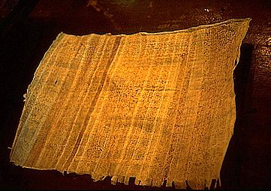
English Translations
King James Version (KJV).
  “Authorized Version” for use in Church of England.
  Done in 1611. (There is no “The KJV”: There have been many minor revisions over the centuries. Original had Apocrypha. Most people today have the 1873 revision.) Became the dominant translation until the 20th century.
  Beautiful Shakespearian Era English.
  Two major problems:
    Textual basis: we have more and better Hebrew (and Greek NT) texts today;
    English is now outdated and often difficult to understand.
Note: The KJV was initially rejected by people, who preferred their “sacred” traditional translation, and was defended by its translators with the same arguments people later rejected (and defended) our newer translations!
Papyrus

Slide 42
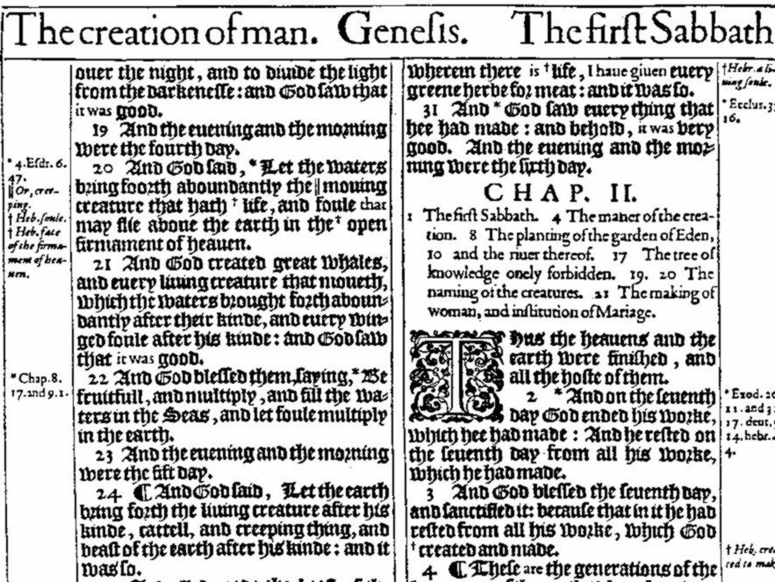
ORIGINAL KINGS JAMES VERSION
Notes:
Can you read it?

Slide 43
Skip: Do you understand these Scriptures from the KJV?
Thou shalt destroy them that speak leasing. Ps.5:6
Nevertheless even him [Solomon] did outlandish women cause to sin. Neh. 13:26
Solomon loved many strange women. 1Kings 11:1
The noise thereof sheweth concerning it, the cattle also concerning the vapour. Job 36:33
I trow not. Luke 17:9
We do you to wit of the grace of God. 2Cor. 8:1
Ye are not straitened in us, but ye are straitened in your own bowels. 2Cor.6:12
The words of the wise are as goads, and as nails fastened by the masters of assemblies, which are given from one shepherd. Eccl.12:11

Slide 44
Skip: Do You Know These Words in the KJV?
almug, algum, chode, charashim, chapt, earing, gat, habergeon, hosen, kab, ligure, leasing, maranatha, nard, neesed, pate, rabboni, raca, ring-staked, stacte, strake, sycamyne, thyme wood, trode, wimples, ouches, tatches, brigandine, ambassage, occurent, purtenance, bruit, fray, cracknels, nusings, mufflers, anathema, corban, talitha cumi, ephrata, aceldama, centurion, quarternion, sanctum sanctorum, let, wot, trow, sod and swaddling clothes.

Slide 45
B. Revised Standard Version (RSV) . Skip
1. An update and revision of the KJV
    2. Changes in two major areas:
    a. more contemporary English;
    b. better knowledge of the ancient Hebrew text.
C. New English Bible (NEB).
1. Totally new translation, w. no reference to earlier ones.
2. Regarding Hebrew text: often goes “out on a limb.”
D. Jerusalem Bible.
Modern Roman Catholic translation into English.
E. New International Version (NIV)
Interdenominational, Protestant, “conservative,” idiomatic translation.
F. New Revised Standard Version (NRSV): gender inclusive

Slide 46
Translation Approaches
Highly literal (word for word)
Idiomatic (phrase for phrase)
Loosely paraphrased
Interlinear Bibles
NASV NRSV
New International Version
“Cotton Patch Gospel”
Living Bible

Slide 47
WHAT TO LOOK FOR IN A TRANSLATION
Date:
  Does it use latest manuscript resources?
  Does it employ latest understanding of home language?
  Does it address changes in target language?
Approach: Is the goal to be highly literal OR
idiomatic OR to paraphrase?
Translators: Individual? Committee? Committees?
Bias: Denominational? Multi-denominational?

Slide 48
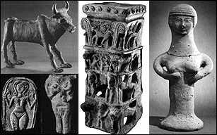
Translation Conventions for the OT
“Lord” - adonai, good generic translation
“God” - elohim, good generic translation
“LORD” - Yahweh, Israelite personal name of their God
Origin of “Jehovah”:
1) Consonants of divine name: JHVH (German transliteration of YHWH)
2) Plus Hebrew vowels of “Lord” (adonai) = JeHoVaH
Bull 12 th - 5 th cent Palestine,
Fertility Goddess plaques,
One Hathor/Qadesh incense holder from Taanach, with symbols of Inanna and Hathor surmounted by a radiant calf.
Terracotta Asherah 11th - 6th cent BC. (Gadon, Pritchard 1954)

Slide 49
SKIP IV. Canon/Canonization of the Hebrew Bible

Slide 50
SKIP IV. Canon/Canonization of the Hebrew Bible
“Canon” (literal: reed; figurative: something straight or used to keep straight, hence something ruled or measured)
“Closed collection of books that contain the authoritative rule of faith and practice.”
“Canonization” the process by which certain writings became included or excluded in the canons of the Jewish Tanak, and the Christian OT and NT.
*Nowhere in either the OT or NT does it specify which books belong in the OT or NT. The communities of faith decided.
*Compare the charts of the OT (handouts) for the differences among the Jewish canon, Protestant canon, and Roman Catholic canon.

Slide 51
Handouts p. 8

Slide 52
Skip: A. Jewish TaNaK became “canonized” in 4 stages?
1. Torah (5 books of Moses, or Law, or Pentateuch).
a. by about 400 BCE, by unspoken community consensus
b. most important/authoritative part of the HB for Jews
2. Prophets (Former/Latter, Major/Minor)
a. apparently accepted by community consensus by approximately 200 BCE.
b. some question about Ezekiel (to be discussed below)
3. Writings.
    Last section to become canonized
    Most disagreements/debates about books in this section.
    Contains many types of writings (genres): wisdom, hymnic, historical narrative, story, etc.
    Some books rejected by Jewish community, but accepted within the Christian Apocrypha (to be discussed below).

Slide 53
Skip:
4. Last stage?: Possibly a council in 90 CE to discuss a number of issues, including the canon (Council of Jamnia). Council or not, there was substantial discussion within the Jewish community.
  Need for canonization: Because Temple destroyed in 70 CE, the Tanak would play a more important role within Judaism, and the community needed to decide what was scripture and what was not.

Slide 54
Skip in class:
Examples of books debated (some rabbis wanted to omit):
a. Esther - the book never mentions God, many rabbis therefore questioned its inclusion; however, Esther was a popular folk heroine and the book of Esther describes the origin of Purim, a popular Jewish minor festival.
b. Ecclesiastes - seems to present some very “unorthodox” teachings. E.g., Eccl. 3:12-13, 16-22; 8:14-15; 9:1-5. Included because it claimed Solomonic authorship (1:1) and had “orthodox” ending (12:11-13).
c. Song of Solomon - Like erotic love poetry (5:2-6) seemed inappropriate. Included by arguing that it was by Solomon (1:1), and by interpreting it allegorically as a love song between God and Israel. (Christians: allegorically as a love song between Christ and His church.)

Slide 55
Skip in class:
d. Ezekiel (Prophets category) - some priestly details seem to be in conflict with the Torah. (Story about rabbi who locked himself away with a copy of the five books of Moses and a copy of Ezekiel, and figured out a way to explain the apparent conflicts between the two.)
e. Ecclesiasticus (Ben Sira) - Not included in Jewish canon, because it was written quite late (Prologue), and Jews felt all books had to be written by prophets. (Rabbis felt that prophecy “faded away” around 400 BCE: later books not by prophets, not canonical.)
f. Daniel and other Apocalyptic literature - led Jews to rebel against oppressors, that God would fight on their side. At times they rebelled, and got stomped, as in 70 CE and 135 CE. Rabbis excluded most all apocalyptic literature, with exception of Daniel.

Slide 56
Skip: Jewish Canon (conclusion)
Not all Jews accepted this canon:
The Sadducees, who faded away after the temple was destroyed in 70 CE, accepted only the Torah.
The Samaritans, a few hundred of whom still exist in Israel today, also recognize only the Torah.

Slide 57
#1 skip rest B. Christian Old Testament Canon
Early Church: Bible (OT) was Septuagint which included Jewish canon AND other “extra books” [see chart Unit 1, p.3].
Jerome’s Vulgate: He preferred the shorter HB list but under pressure included longer Septuagintal list. So, until the time of the Protestant Reformation, virtually every Western Christian used an expanded canon. (So, too, the Eastern Orthodox Church, which kept the LXX list.)
Protestant Reformation: In 1500s, Luther and other Reformers rejected some Roman Catholic teachings (e.g. purgatory - suggested only by a passage in II Maccabees). Since several doctrines rejected by Protestants could be supported only by passages in the “extra books”(which Protestants today call the Apocrypha), they chose the shorter Jewish canon as their OT.
Council of Trent (late 1500’s): Roman Catholic Church responded by officially approving longer Septuagintal list. Catholics today call the extra books “Deuterocanon” (secondary canon).

Slide 58
Handouts p. 8
Christian divisions:
Pent./Law
History *
Poetry/Writings
Prophets

Slide 59
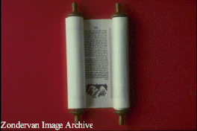
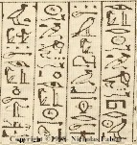
STRUCTURE OF HEBREW CANON (1 of 3) (CP p. 9)
Law/Torah/Pentateuch
1. Traditional Domain: priests (preserved ritual laws, in late
period taught Torah)
2. Literary Forms: historical narratives and laws
3. Functions: to provides Israelite foundations for:
a. world-view (nature of God, world, humanity)
b. origin and purpose of Israel (covenant with God)
c. conduct (ritual, moral, social, criminal laws, etc.)

Slide 60
STRUCTURE OF HEBREW CANON (2 of 3)
Prophets
1. Traditional Domain: prophets
"Former Prophets": key characters in course of Israelite
history, believed to have kept records
"Latter Prophets": main characters and their messages
2. Literary Forms:
"Former Prophets": broad-sweeping historical narratives
"Latter Prophets": narratives focused on individuals;
oral, poetic messages
3. Functions:
"Former Prophets":
a. preserve the traditions of Israel,
b. answer questions about the course their history
took, evaluating their kings and nation
c. teach about the nature of reality
"Latter Prophets": hold people accountable to faith priorities
(different emphases with each prophet)

Slide 61
STRUCTURE OF HEBREW CANON (3 of 3)
Writings
1. Traditional Domain: varied, but wisdom literature associated
with the sage (collected knowledge, wisdom)
2. Literary Forms: (varied) wisdom literature, hymnic lit.,
historical narrative, story
3. Functions: (varied)
a. wisdom: teach about the nature of life and how to live
skillfully
b. hymnic: guidance and encouragement in
expressions of prayer, worship and celebration
c. narrative: (same as under "Former Prophets")

Slide 62
THE ANCIENT NEAR EAST
and
ISRAEL
Thesis:
The people of Israel, being ‘birthed’ in the midst of the much older cultures of the Ancient Near East, appropriated much from those cultures (symbol systems, institutions, architecture, literature, etc.) and readapted it to their Yahwistic faith.
Notes:
Might talk about divine accommodation and incarnation. Christians and Christmas.

Slide 63
V. MAP DRAWING EXERCISE
(Predicting the history of Israel)

Slide 64
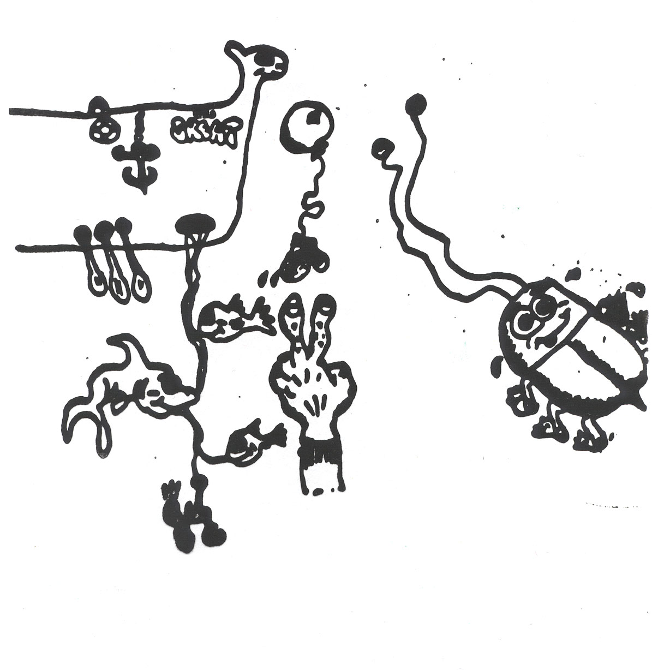

Slide 65
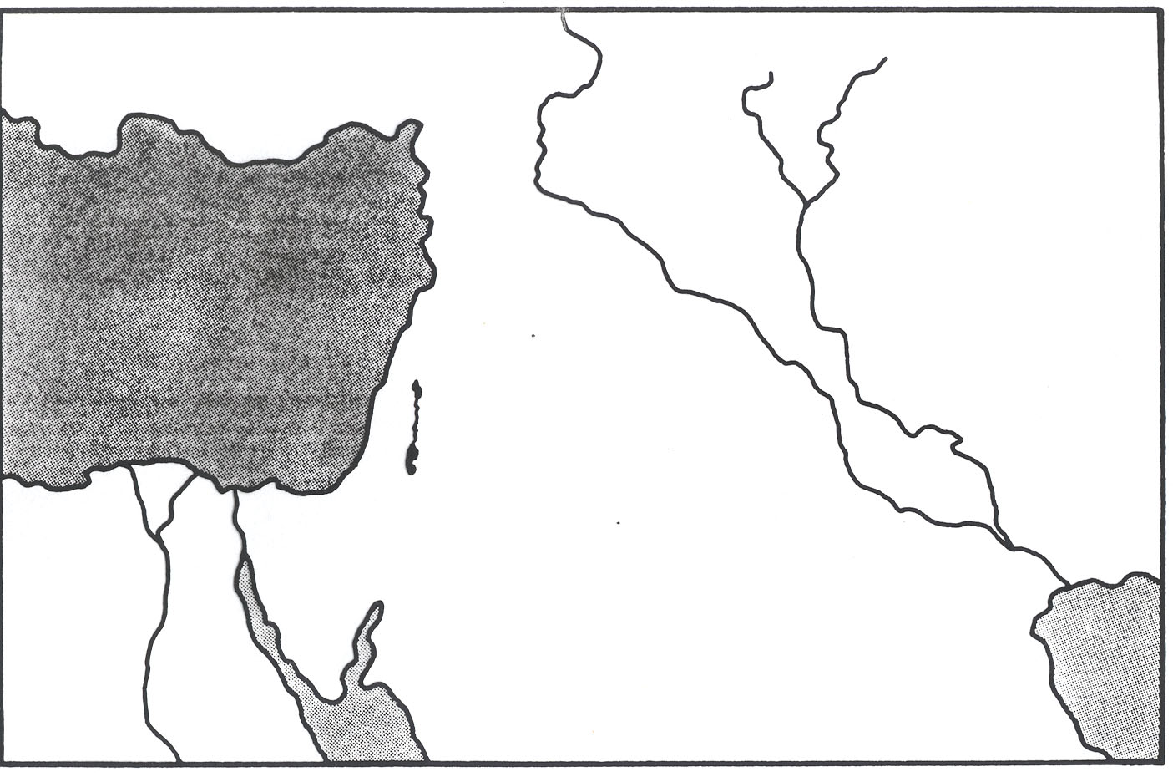
(CP. P. 10)

Slide 66
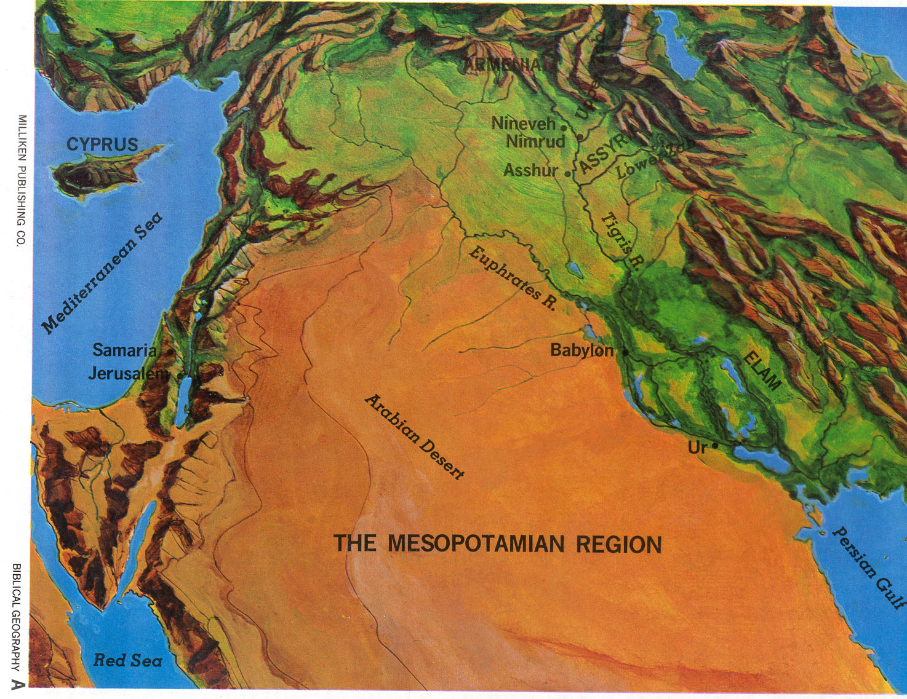

Slide 67
Middle East: Topography

Slide 68
CROSSROADS OF THE ANCIENT NEAR EASTERN WORLD

Slide 69
Middle East: Present

Slide 70
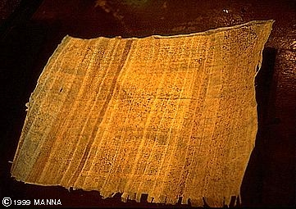
VI. Discovery of the Ancient Near East
Objectives
Explain how the Ancient Near East was
discovered.
Explain what a “tell” is.
Identify different kinds of writing material.

Slide 71
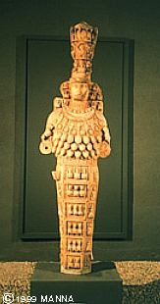
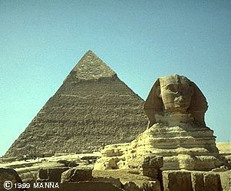
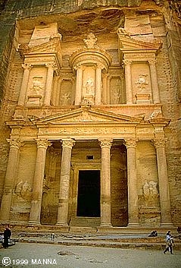
What impact did the discovery of the ANE have on the study of the OT?
Sphinx & Pyramid
Egypt
Goddess Diana statue
Petra Treasure House
Edom
Notes:
Add this material on ANE here?

Slide 72
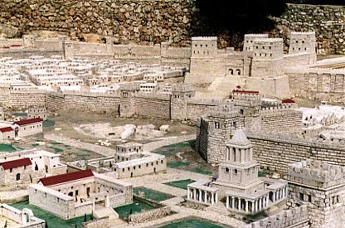
What constitutes “civilization”?

Slide 73
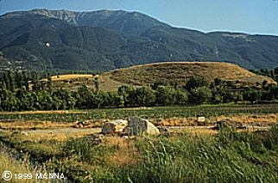
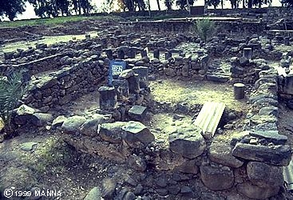
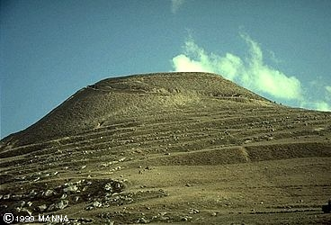
What is a Tell?
Tell of Colossae
Ruins of Capernaum
Tell of Herodium

Slide 74
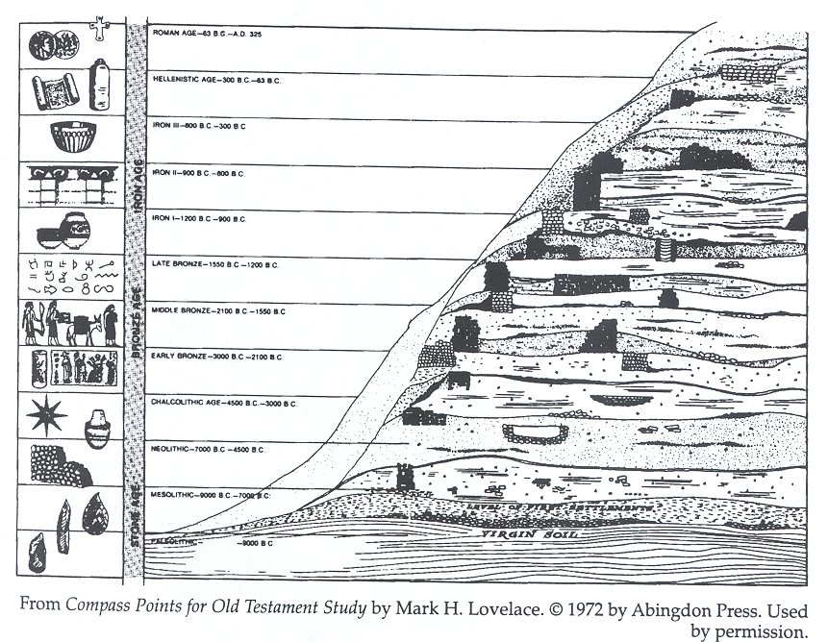
ARCHAEOLOGICAL TELL

Slide 75
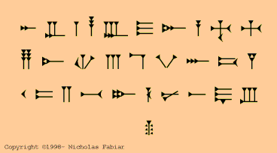
When did writing begin? How long before Abraham?
CUNEIFORM on clay tablet
Ugartic Alphabet
PAPYRUS
EGYPTIAN HIEROGLYPICS

Slide 76
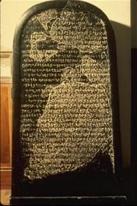
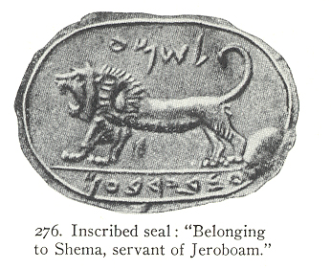
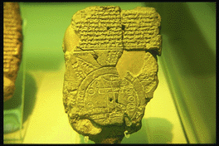
What kinds of literature are found in the ANE?
Moabite Stone
royal inscription,
c. 840 BCE
Assyrian Map
Zondervan Image Archive

Slide 77
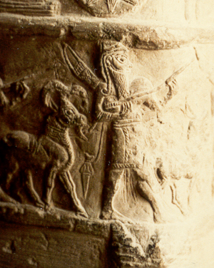
THE MYSTERY OF SHELET
(2 Sam 8:7 // 1 Chronicler 18:7; Song of Sol 4:4; Ezek 27:11 )
Jlv
shield or quiver?
Answer: Bow & arrow case

Slide 78
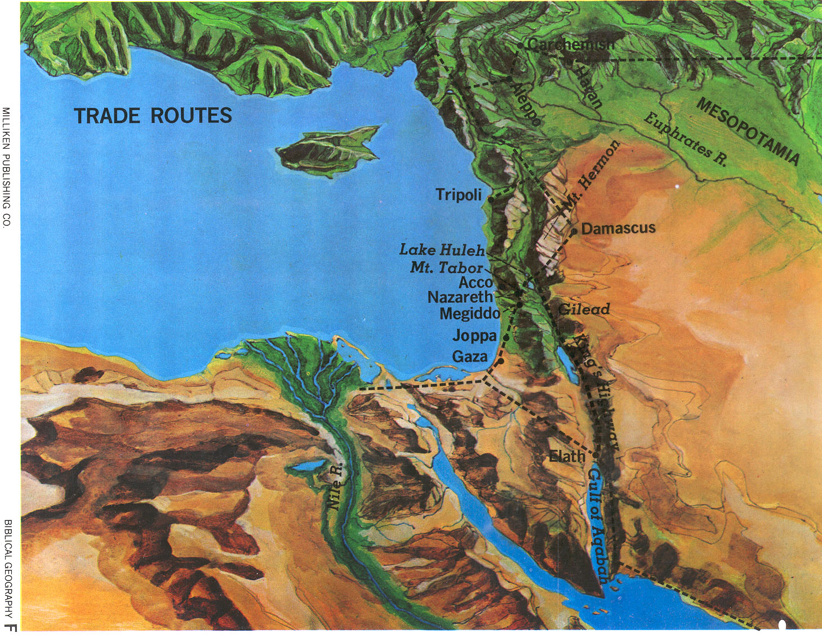
How would you characterize Israel’s impact on the world of the ANE?

