Slide 1
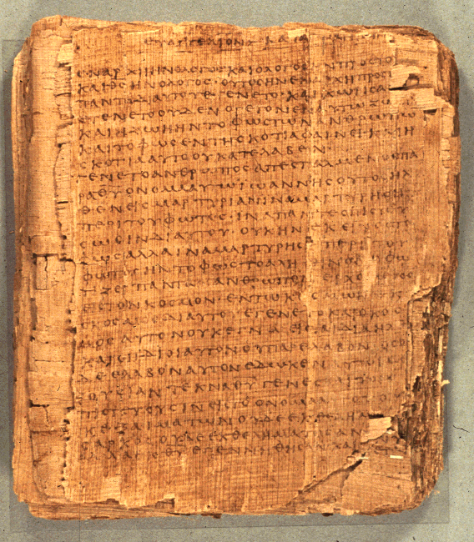
COS 221
Bible II
Dr. Rodney K. Duke

Slide 2
DAY 1
Assign: (see CoursePack handout; prefer typed work!)
1) (Daily) Write a journal entry (couple of paragraphs)
[When taking notes, you might rule off a section for
jotting down journal comments to develop later.]
2) #1 on “Functions of Communication” (pp. 16-17)
3) #2 on 12 C’s *Look over but do not need to do (N)
4) #3 on Genesis 1 and 2.
Day Objectives:
1) Explain the course goals and objectives.
2) Identify structure & content of Hebrew Bible/Old Testament
3) Identify the nature of different Bible translations
4) Draw a map of the Ancient Near East (ANE) by memory.
5) Explain the differences among the cultures of the ANE

Slide 3
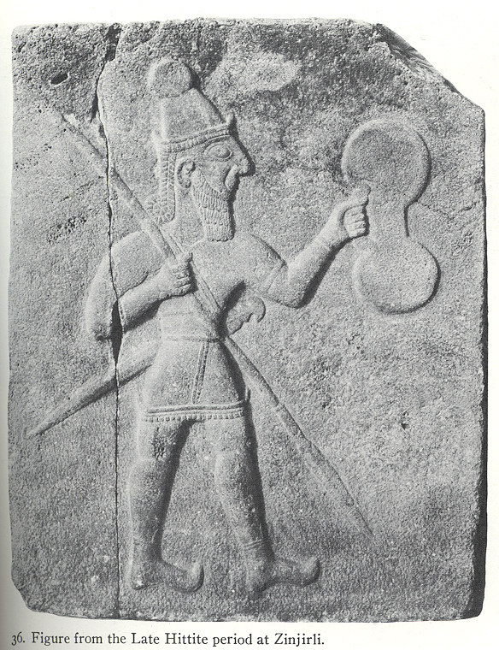
Description of OT (1 of 2)
A. Collection of writings from 1st millennium BC/BCE by Jews.
1. 24 "books" (Hebrew), 39 (Protestant)
2. 2nd millennium? - 200 BCE?
3. Hebrew, some Aramaic
4. authoritative, defining view of world and way of life
B. Genres (types of literature), variety:
laws, prophetic oracles, historical, narrative,
hymnic, wisdom, apocalyptic, etc.
C. Scope (historical):
[creation] Abraham (1800? BCE)
to Ezra (400? BCE)
Figure from Late Hittite Period

Slide 4
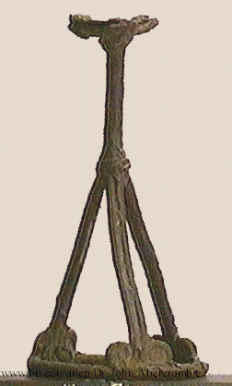
Description of OT (2 of 2)
D. Product w/several dimensions:
1. human:
product of human experience,
reflections, styles of writing
2. historical:
a) product of specific time, culture
b) product of historical memory
3. literary:
product of literary genres and conventions
4. religious:
product of religious experience and
understanding of reality
5. Divine: inspired for God’s intention
These dimensions are inextricably intertwined!
incense altar from Beth Shan

Slide 5
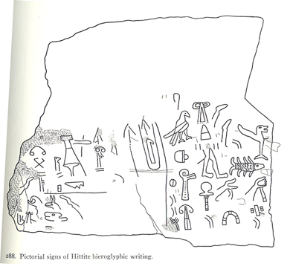
“Approaching OT on its own terms”
1. Recognize these intertwined dimensions and not read as just inspired for the 21st-cent. reader. (Written FOR us, but not TO us.)
2. Put aside own questions, issues, perspectives and try to see questions, issues, and perspective of OT writings and original audience.
Hittite hieroglyphics

Slide 6
Skip Formation of an OT Book
Key Concept: Divine inspiration guides the canonical PROCESS, the formation of the biblical books from beginning stage to final form. (Avoid projecting modern concepts of composition!)
A. Materials gradually gathered and edited over a long time,
sometime several centuries, by the community of faith.
Two examples - books of Judges and Jeremiah
B. Book of Judges. Five identifiable steps:
Formation of stories, poetry, anecdotes, etc. in response to real life experiences of some portion of ancient Israelite peoples.
Examples of important events and stories remembered orally* in early Israel:
Stories of hero Samson
Song of Deborah (Jd. 5). Celebration of Israelite victory
* Stories preserved orally. Less than 1% of the population could read or write.
Notes:
Cover “Key Concept.” Discuss confusion between doctrine of inspired and authoritative Scripture and modern assumptions about the process of composition. Perhaps skip the rest, since Anderson goes into such detail.

Slide 7
Skip
2. Passing on these materials, often for many generations, in oral form. Often shaped and adapted to address the circumstances of each succeeding generation.
3. Grouping stories around common themes, the same person, etc.
Stories about Samson or Gideon, or lists of “minor judges” in Jd. 10:1-5 and 12:7-15
NOTE: In these first three steps, everything is oral, and therefore more fluid and adaptable.
4. An editor puts together the first written copy collections of collections and forms the book of Judges.
5. Later editors revise the first editor’s written work. Book of Judges gradually comes close to its present form, perhaps after 700-800 years.

Slide 8
Skip
C. The Book of Jeremiah. Jeremiah, prophet (627-582 BCE). Ch. 36, (about 605) tells of an early form of the book. At least three steps:
1. Jeremiah the prophet speaks, many times (usually in short snatches) prior to 605 BCE.
2. The Lord tells Jeremiah to write down all these words (36:2-3). (scribe Baruch) The king and reads it, cuts off pieces, and burns them! Writes it again (36:28-31). v. 32 implies he may have added more.
Jeremiah’s career, another 23 years, more speeches preserved orally or in writing by him or his followers, probably added to the second version.
(Early copies of Jeremiah as a complete book have some differences, perhaps due to different forms and collections by different people. Example: chs 46-51 in some manuscripts in the middle of 25:13.)

Slide 9
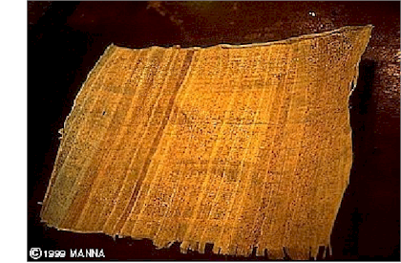
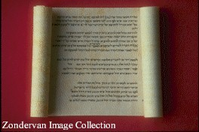
Textual Criticism
“Textual Criticism” is the scholarly approach to:
Establish history of transmission of text, and
Reconstruct earliest possible wordings of biblical texts
General principle, when 2 or more texts have different readings:
The more difficult reading (the one that best explains the other readings as attempts to clarify it) is more likely the older, “original” reading.

Slide 10
[In class, will probably skip following slides on textual criticism]
Ancient publication techniques.
In ancient world, all copies had to be hand written. Two methods:
One person handwrites one new copy from one old copy.
What kind of accidental mistakes would a scribe be likely to make?
More likely to be accurate than:
Many scribes write while one scribe reads.
What kind of accidental mistakes would a scribe be likely to make?
Easier to make mistakes (“mistakes of the eye” for the reader, plus “mistakes of the ear” and fatigue for the listener).

Slide 11
G. Second setting of the Standard Text, and the Masoretes [Late first millennium (6th-10th cent.)]
    Jewish scribes, Masoretes, due to differing texts, set the Standard Text for 2nd time.
    They add the vowels (“pointing”)
`^yh,(l{a/-~[i tk,l,Þ [;nEïc.h;w> ds,x,ê tb;h]a;äw> ‘jP'v.mi tAfÜ[]-~ai yKiä
((Micah 6:8)
    Manuscripts have to agree on: # of words, # of letters, middle word, middle letter.
    Oldest complete OT manuscript in Hebrew from about the year 1000 CE

Slide 12
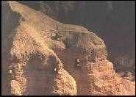
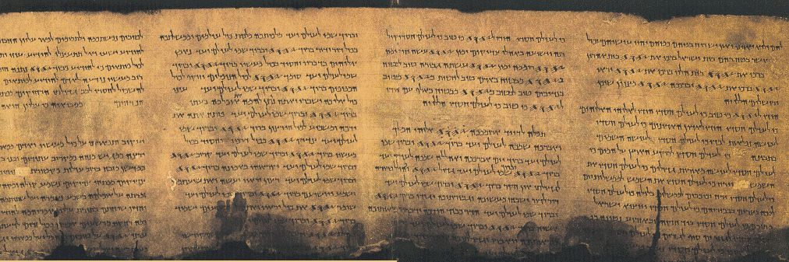
H. The Dead Sea Scrolls (DSS)
Found beginning in 1947.
Date: 1st cent. BCE & first cent. CE.
Why not just use them as our OT?
(Parts of all books except for Esther.)
  An older text is not necessarily more accurate.
  Only complete book: Isaiah.
BUT, the DSS valuable witness to early form of the Hebrew OT text.
Qumran Cave #4
Photo by Nancy A. Carter
http://gbgm-umc.org/umw/bible/outside2.stm#scrolls
Psalms (Tehillim) 11QPs Israel Antiquties Authority http://www.ibiblio.org/expo/deadsea.scrolls.exhibit/Library/psalms.html

Slide 13
[In class, probably skip these slides on Ancient Translations]
Ancient Translations of the OT
A. The Septuagint (LXX).
First known translation of the OT into another language.
Place: Alexandria, Egypt.
First, the five Books of Moses/ the Law (c. 250 BCE).
Rest of OT and much of “Apocrypha” over next couple of centuries.
Seems to have been used by the writers of the NT (disputed).
Became the “Bible” of the ancient Christian Church.
Two theories about how the Septuagint came to be:
  Letter of Aristeas: Hellenistic pharaoh sponsors translation by 70 scholars translated exactly the same in 70 days, hence the title. Possible a pharaoh sponsored such a translation.
  Different persons, on their own, translate different parts of the HB. Later pulled together into one collection.

Slide 14
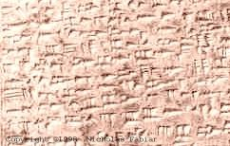
8. Fairly literal translation, therefore, can be important witness back to the early Hebrew text.
9. Some major difference between LXX and Hebrew (Masoretic Text).
For example:
LXX book of Job is quite a bit shorter
LXX story of David slaying Goliath is shorter (?)
LXX of Jeremiah shorter and different order
10. Because of use of LXX by Christians, Jews in the second century CE turned away to a more literal Greek translation by Aquila.
CUNEIFORM on clay tablet

Slide 15
Other Ancient Translations
Syriac
Aramaic
Latin: Jerome’s Vulgate (vulgar=”common”).
  Various Old Latin Versions of books of the OT and NT
  Pope Damasus asked Jerome to clean these up. Jerome first translated the Gospels, then rest of the NT, often doing new translations rather than revising the old ones.
  He then studied Hebrew and translated OT from Hebrew into Latin.
  At first Church preferred the LXX, but later Vulgate caught on.
  Vulgate dominant Bible of the Roman Catholic Church until the early 20th century.

Slide 16
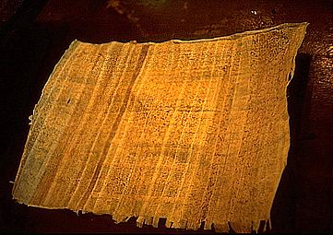
English Translations
King James Version (KJV).
  “Authorized Version” for use in Church of England.
  Done in 1611. (There is no “The KJV”: There have been many minor revisions over the centuries. Original had Apocrypha. Most people today have the 1873 revision.) Became the dominant translation until the 20th century.
  Beautiful Shakespearian Era English.
  Two major problems:
    Textual basis: we have more and better Hebrew (and Greek NT) texts today;
    English is now outdated and often difficult to understand.
Note: The KJV was initially rejected by people, who preferred their “sacred” traditional translation, and was defended by its translators with the same arguments people later rejected (and defended) our newer translations!
Papyrus

Slide 17
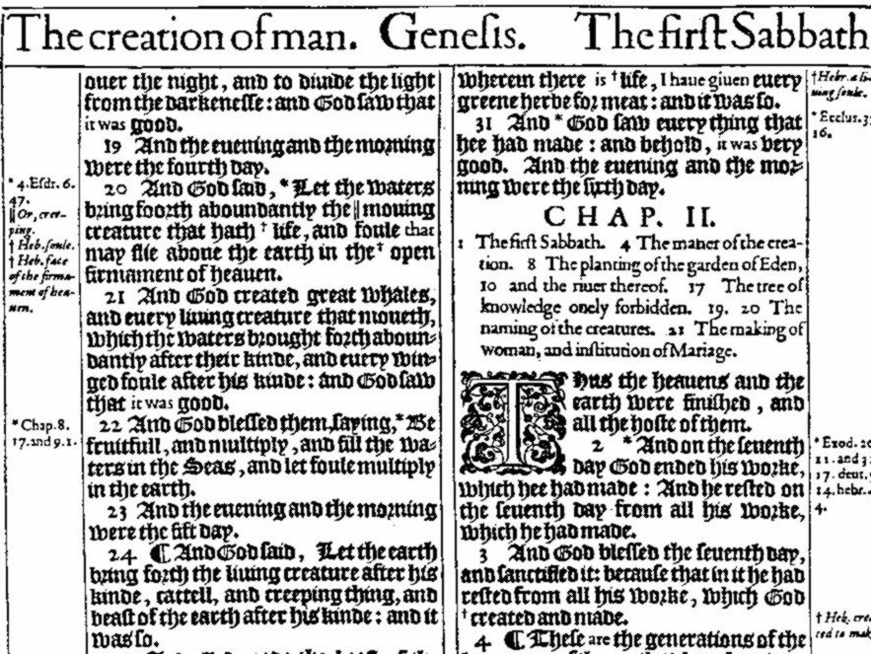
ORIGINAL KINGS JAMES VERSION
Notes:
Can you read it?

Slide 18
Skip: Do you understand these Scriptures from the KJV?
Thou shalt destroy them that speak leasing. Ps.5:6
Nevertheless even him [Solomon] did outlandish women cause to sin. Neh. 13:26
Solomon loved many strange women. 1Kings 11:1
The noise thereof sheweth concerning it, the cattle also concerning the vapour. Job 36:33
I trow not. Luke 17:9
We do you to wit of the grace of God. 2Cor. 8:1
Ye are not straitened in us, but ye are straitened in your own bowels. 2Cor.6:12
The words of the wise are as goads, and as nails fastened by the masters of assemblies, which are given from one shepherd. Eccl.12:11

Slide 19
Skip: Do You Know These Words in the KJV?
almug, algum, chode, charashim, chapt, earing, gat, habergeon, hosen, kab, ligure, leasing, maranatha, nard, neesed, pate, rabboni, raca, ring-staked, stacte, strake, sycamyne, thyme wood, trode, wimples, ouches, tatches, brigandine, ambassage, occurent, purtenance, bruit, fray, cracknels, nusings, mufflers, anathema, corban, talitha cumi, ephrata, aceldama, centurion, quarternion, sanctum sanctorum, let, wot, trow, sod and swaddling clothes.

Slide 20
B. Revised Standard Version (RSV) . Skip
1. An update and revision of the KJV
    2. Changes in two major areas:
    a. more contemporary English;
    b. better knowledge of the ancient Hebrew text.
C. New English Bible (NEB).
1. Totally new translation, w. no reference to earlier ones.
2. Regarding Hebrew text: often goes “out on a limb.”
D. Jerusalem Bible.
Modern Roman Catholic translation into English.
E. New International Version (NIV)
Interdenominational, Protestant, “conservative,” idiomatic translation.
F. New Revised Standard Version (NRSV): gender inclusive

Slide 21
Translation Approaches
Highly literal (word for word)
Idiomatic (phrase for phrase)
Loosely paraphrased
Interlinear Bibles
NASV NRSV
New International Version
“Cotton Patch Gospel”
Living Bible

Slide 22
WHAT TO LOOK FOR IN A TRANSLATION
Date:
  Does it use latest manuscript resources?
  Does it employ latest understanding of home language?
  Does it address changes in target language?
Approach: Is the goal to be highly literal OR
idiomatic OR to paraphrase?
Translators: Individual? Committee? Committees?
Bias: Denominational? Multi-denominational?

Slide 23
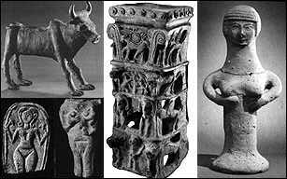
Translation Conventions for the OT
“Lord” - adonai, good generic translation
“God” - elohim, good generic translation
“LORD” - Yahweh, Israelite personal name of their God
Origin of “Jehovah”:
1) Consonants of divine name: JHVH (German transliteration of YHWH)
2) Plus Hebrew vowels of “Lord” (adonai) = JeHoVaH
Bull 12 th - 5 th cent Palestine,
Fertility Goddess plaques,
One Hathor/Qadesh incense holder from Taanach, with symbols of Inanna and Hathor surmounted by a radiant calf.
Terracotta Asherah 11th - 6th cent BC. (Gadon, Pritchard 1954)

Slide 24
SKIP IV. Canon/Canonization of the Hebrew Bible

Slide 25
SKIP IV. Canon/Canonization of the Hebrew Bible
“Canon” (literal: reed; figurative: something straight or used to keep straight, hence something ruled or measured)
“Closed collection of books that contain the authoritative rule of faith and practice.”
“Canonization” the process by which certain writings became included or excluded in the canons of the Jewish Tanak, and the Christian OT and NT.
*Nowhere in either the OT or NT does it specify which books belong in the OT or NT. The communities of faith decided.
*Compare the charts of the OT (handouts) for the differences among the Jewish canon, Protestant canon, and Roman Catholic canon.

Slide 26
Skip: A. Jewish TaNaK became “canonized” in 4 stages?
1. Torah (5 books of Moses, or Law, or Pentateuch).
a. by about 400 BCE, by unspoken community consensus
b. most important/authoritative part of the HB for Jews
2. Prophets (Former/Latter, Major/Minor)
a. apparently accepted by community consensus by approximately 200 BCE.
b. some question about Ezekiel (to be discussed below)
3. Writings.
    Last section to become canonized
    Most disagreements/debates about books in this section.
    Contains many types of writings (genres): wisdom, hymnic, historical narrative, story, etc.
    Some books rejected by Jewish community, but accepted within the Christian Apocrypha (to be discussed below).

Slide 27
Skip:
4. Last stage?: Possibly a council in 90 CE to discuss a number of issues, including the canon (Council of Jamnia). Council or not, there was substantial discussion within the Jewish community.
  Need for canonization: Because Temple destroyed in 70 CE, the Tanak would play a more important role within Judaism, and the community needed to decide what was scripture and what was not.

Slide 28
Skip in class:
Examples of books debated (some rabbis wanted to omit):
a. Esther - the book never mentions God, many rabbis therefore questioned its inclusion; however, Esther was a popular folk heroine and the book of Esther describes the origin of Purim, a popular Jewish minor festival.
b. Ecclesiastes - seems to present some very “unorthodox” teachings. E.g., Eccl. 3:12-13, 16-22; 8:14-15; 9:1-5. Included because it claimed Solomonic authorship (1:1) and had “orthodox” ending (12:11-13).
c. Song of Solomon - Like erotic love poetry (5:2-6) seemed inappropriate. Included by arguing that it was by Solomon (1:1), and by interpreting it allegorically as a love song between God and Israel. (Christians: allegorically as a love song between Christ and His church.)

Slide 29
Skip in class:
d. Ezekiel (Prophets category) - some priestly details seem to be in conflict with the Torah. (Story about rabbi who locked himself away with a copy of the five books of Moses and a copy of Ezekiel, and figured out a way to explain the apparent conflicts between the two.)
e. Ecclesiasticus (Ben Sira) - Not included in Jewish canon, because it was written quite late (Prologue), and Jews felt all books had to be written by prophets. (Rabbis felt that prophecy “faded away” around 400 BCE: later books not by prophets, not canonical.)
f. Daniel and other Apocalyptic literature - led Jews to rebel against oppressors, that God would fight on their side. At times they rebelled, and got stomped, as in 70 CE and 135 CE. Rabbis excluded most all apocalyptic literature, with exception of Daniel.

Slide 30
Skip: Jewish Canon (conclusion)
Not all Jews accepted this canon:
The Sadducees, who faded away after the temple was destroyed in 70 CE, accepted only the Torah.
The Samaritans, a few hundred of whom still exist in Israel today, also recognize only the Torah.

Slide 31
#1 skip rest B. Christian Old Testament Canon
Early Church: Bible (OT) was Septuagint which included Jewish canon AND other “extra books” [see chart Unit 1, p.3].
Jerome’s Vulgate: He preferred the shorter HB list but under pressure included longer Septuagintal list. So, until the time of the Protestant Reformation, virtually every Western Christian used an expanded canon. (So, too, the Eastern Orthodox Church, which kept the LXX list.)
Protestant Reformation: In 1500s, Luther and other Reformers rejected some Roman Catholic teachings (e.g. purgatory - suggested only by a passage in II Maccabees). Since several doctrines rejected by Protestants could be supported only by passages in the “extra books”(which Protestants today call the Apocrypha), they chose the shorter Jewish canon as their OT.
Council of Trent (late 1500’s): Roman Catholic Church responded by officially approving longer Septuagintal list. Catholics today call the extra books “Deuterocanon” (secondary canon).

