Slide 1
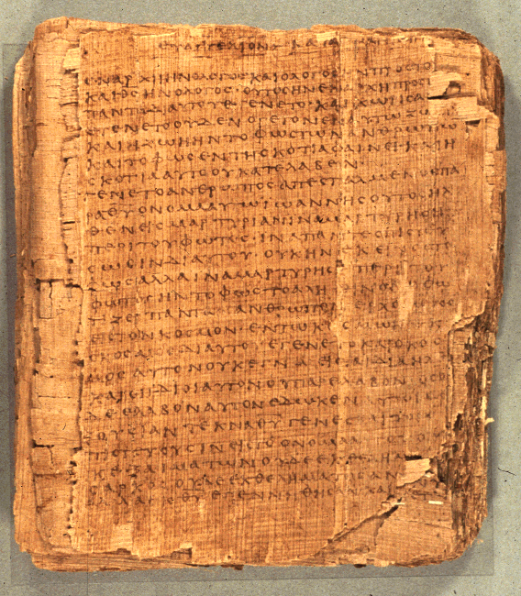
COS 221
Bible II
Dr. Rodney K. Duke

Slide 2
DAY 2
Assign: (see handout)
1) (Daily) Write in a journal entry
2) #4 Narrative as portrait [skip; will cover in class Day 3]
3) #5 Gen 18-19 (see list of literary features, CP p.26)
4) #6 on Gen 12, 20, 26 (nature of oral transmission)
Day Objectives:
Explain the nature of oral transmission.
Control an outline of Israelite history, 12 C's (major periods,
events and characters).
3) Explain the process of successful communication and
identify how one should approach interpreting the Bible.
Notes:
Might wait on 6 Will probably not get to these until Day 4

Slide 3
JOURNAL THOUGHTS & OBSERVATIONS

Slide 4
Thought Tease
What did the scientist/theologian mean when he said,
“I have faith in God, but I do not believe God exists”?
He meant (like the early Church Fathers, and going back before John Duns Scotus -13th cent.):
God had revealed Himself sufficiently for him to entrust himself to God (“faith”). Therefore, God is real; but,
God’s ‘existence’ is NOT the same as our understanding of being/existence in our natural world. If we equate God’s being with natural being, we make God a nature god and practice idolatry. We can only talk about God’s ‘being’ by using the language of our experience through analogy.
Notes:
Theologian could have said, “I have experienced the reality of God, but I cannot adequately speak about God’s being.
Points: limitations of human language and our “natural” understanding of God. Issue of why science, which deals with the ‘material’ world cannot prove or disprove God.

Slide 5
Nature of Oral Transmission of Tradition

Slide 6
NATURE OF ORAL TRANSISSION OF HISTORICAL NARRATIVES (Assign. #6)
1. main point retained
2. incidental details dropped
3. tends to shorten
4. follows*stereotypical form
+5. in Mid-east, closing evaluative statements, kept exact
+Wisdom/instructional material, often
memorized word-for-word. Depends on setting.
(Article by Bailey on oral tradition posted Duke: ALPS site)
* ARCHETYPAL PATTERNS
1. Once something has happened in our lives, we tend to find similar happenings to the first. (We interpret the present by the past.)
2. We have cultural patterns: gunfight at high-noon
3. Later OT and NT events compared events to "archetypes" in OT.
(See Literary Description, Literary Features, CoursePack, p. 26.)

Slide 7
Differences between Oral and Writing Cultures
Oral Culture Writing Culture
Authority based on spoken (memorized words) of teacher/tradent
Based on communal knowledge
Words are dynamic, visual and dramatic
Performance oriented
Fluidity to respond to audience and situation
Communal interpretations
Text as authority/orthodox
Knowledge comes from the text
Text as unchanging artifact
Teaching is static
Rule oriented
Individual interpretations

Slide 8
Trust in Oral Transmission over Written
Papias (writing in early 2nd century CE)
“If, then, any one came, who had been a follower of the elders, I questioned him in regard to the words of the elders -- what Andrew or what Peter said, or what was said by Philip, or by Thomas, or by James, or by John, or by Matthew, or by any other of the disciples of the Lord, and what things Aristion and the presbyter John, the disciples of the Lord, say. For I did not think that what was to be gotten from the books would profit me as much as what came from the living and abiding voice.”
(Eusebius, Church History, III.39.4, quoting Papias)

Slide 9
  Setting Expectations for Reading Biblical Accounts
When we work with some biblical texts, we are working with layers of tradition.
Story:
A woman sees what turns out to be a political assassination that over a few months leads to a war that over a few years leads to new country boundaries. Thirty years later a researcher who is writing an historical account of this war interviews a child of this woman. The child tells the researcher her mother’s story about the day of the assassination.
Do you expect the child only heard the story told once?
Do you expect that the mother told it the same way each time?
Do you expect that the child (now adult) repeats the story exactly as his mother stated it?
Do you expect that the researcher sees the event from the same different perspective of the woman?

Slide 10
Transmission of Tradition
  Setting Expectations for Reading Biblical Accounts
When we work with some biblical texts, we are working with layers of tradition.
Woman’s story
Children’s accounts of the story
Written record for the sake posterity
Original words
Oral reports of words for continued application
Written records for preservation & application
Tradition with 3 settings, perspectives, and purposes.
*
* Note: For NT, the period of oral transmission overlaps with written.
Notes:
Can we start with the final account and work back to the “original”? Do we need to?

Slide 11
COMMUNICATION PROCESS

Slide 12
Poles of Communication (Discuss Assign. #2)
Emotive
Addresser
|
Means------------------------|---------------------Referent
|
Addressee
Poetic
Referential
Conative (persuasive)

Slide 13
GENRE EXERCISE
(CP. pp. 13-15)
Discover:
That you have highly developed reading skills,
That you recognize different genres “automatically”
That you read different genres differently
Notes:
Do this exercise in COS 421 Bible IV, if students take out of sequence.

Slide 14
Genre Exercise
Descriptive terms:

Slide 15
Procedure 2
Identify the literary features which tell us what genre the text is:
a) formal elements
b) style
c) content

Slide 16
Procedure 2
Sample Letter
a) Formal elements:
salutation: “Dear …”
body
date
sender’s name and address
recipient’s name and address
closing
signature

Slide 17
Procedure 2
Sample Letter continued
b) Style
formal:
use of title, “Dr.,” not first name
grammar of standard written English
formal phrasing: “writing in regard to”
no slang or idiom
personal: use of 1st and 2nd person pronouns
c) Content (letter of request)
“submit …for your consideration”

Slide 18
Procedure 2
Identify the literary features which tell us what genre the text is:
a) formal elements
b) style
c) content

Slide 19
Procedure 3
Identify how we read this genre by exploring:
a) its audience
b) its purpose(s)
c) what we assume or expect from this type
d) what we focus on for its value or meaning
e) what we do or ask in order to “understand” it

Slide 20
Procedure 3
Sample Letter
a) Audience: particular individual, Dr. Hughes
b) Purpose: persuade Dr. Hughes to accept writer’s paper proposal
c) Assume/Expect:
body to continue describing the paper
maybe a copy of the paper enclosed or at least an abstract
more “buttering up”
friendly closing with signature

Slide 21
Procedure 3
Sample Letter continued
d) Focus for value
Why are we reading this letter? historical, personal
e) Do to understand: (detective work on context)
identify the sender and the recipient
identify what an “SBL meeting” is and what is done there, nature of papers presented, etc.
identify when written
identify, if possible, if letter was successful

Slide 22
Procedure 3
Identify how we read this genre by exploring:
a) its audience
b) its purpose(s)
c) what we assume or expect from this type
d) what we focus on for its value or meaning
e) what we do or ask in order to “understand” it

Slide 23
Genre Exercise Conclusion
When we pick up on literary features (“clues”) which in turn set up our expectations and determine how we read that particular text.

Slide 24
THE ANCIENT NEAR EAST
and
ISRAEL
Thesis:
The people of Israel, being ‘birthed’ in the midst of the cultures of the Ancient Near East, appropriated much from those cultures (symbol systems, institutions, architecture, literature, etc.) and readapted it to their Yahwistic faith.
Notes:
Might talk about divine accommodation and incarnation.

Slide 25
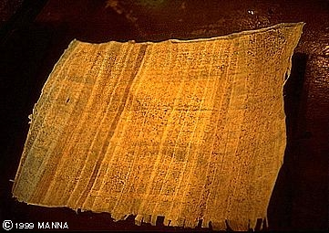
[If not covered on Day 1] Discovery of the Ancient Near East
Objectives
Explain how the Ancient Near East was
discovered.
Explain what a “tell” is.
Identify different kinds of writing material.

Slide 26
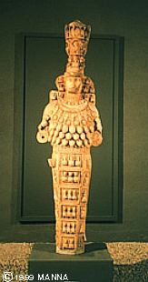
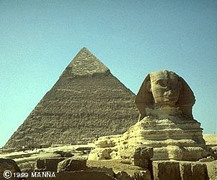
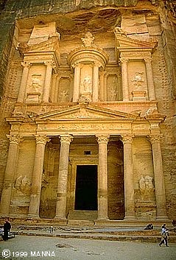
What impact did the discovery of the ANE have on the study of the OT?
Sphinx & Pyramid
Egypt
Goddess Diana statue
Petra Treasure House
Edom
Notes:
Add this material on ANE here?

Slide 27
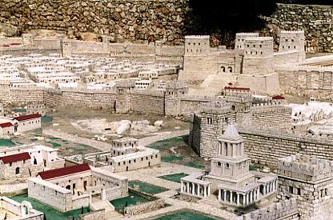
What constitutes “civilization”?

Slide 28
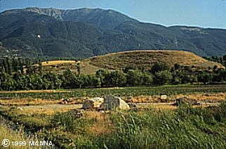
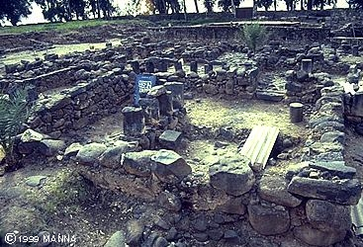
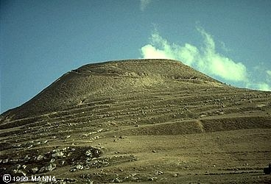
What is a Tell?
Tell of Colossae
Ruins of Capernaum
Tell of Herodium

Slide 29
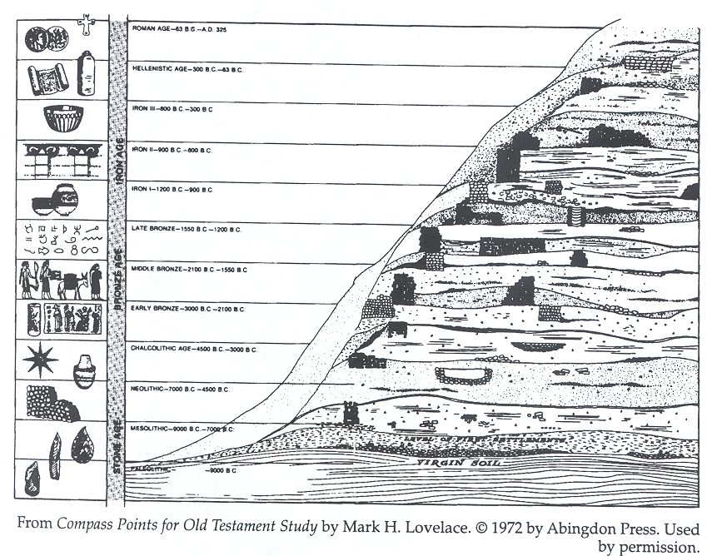
ARCHAEOLOGICAL TELL

Slide 30
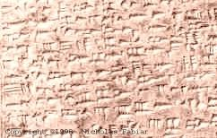
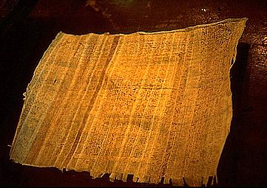
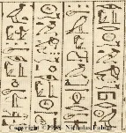
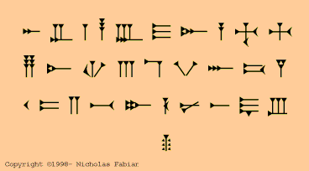
When did writing begin? How long before Abraham?
CUNEIFORM on clay tablet
Ugartic Alphabet
PAPYRUS
EGYPTIAN HIEROGLYPICS

Slide 31
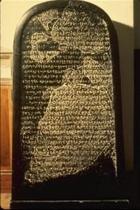
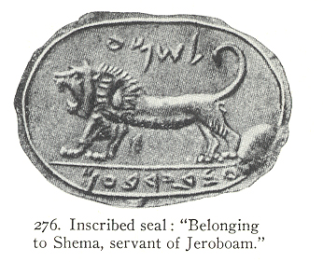
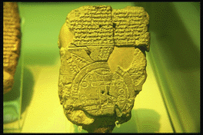
What kinds of literature are found in the ANE?
Govt. | “Science” | Religious | Personal | Other
Treaties | Astrological | Prayers | Inventories | Wisdom teaching
Laws | Maps | Myths & Rituals | Contracts (marriage, divorce, adoption) | Encyclopedic lists
Court records | Medical | Hymns | Letters
Battle accounts | Math | Incantations | Travelogues
Moabite Stone
royal inscription,
c. 840 BCE
Assyrian Map
Zondervan Image Archive

Slide 32
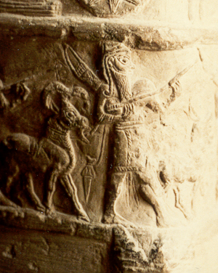
THE MYSTERY OF SHELET
(2 Sam 8:7 // 1 Chronicler 18:7; Song of Sol 4:4; Ezek 27:11 )
Jlv
shield or quiver?
Answer: Bow & arrow case

Slide 33
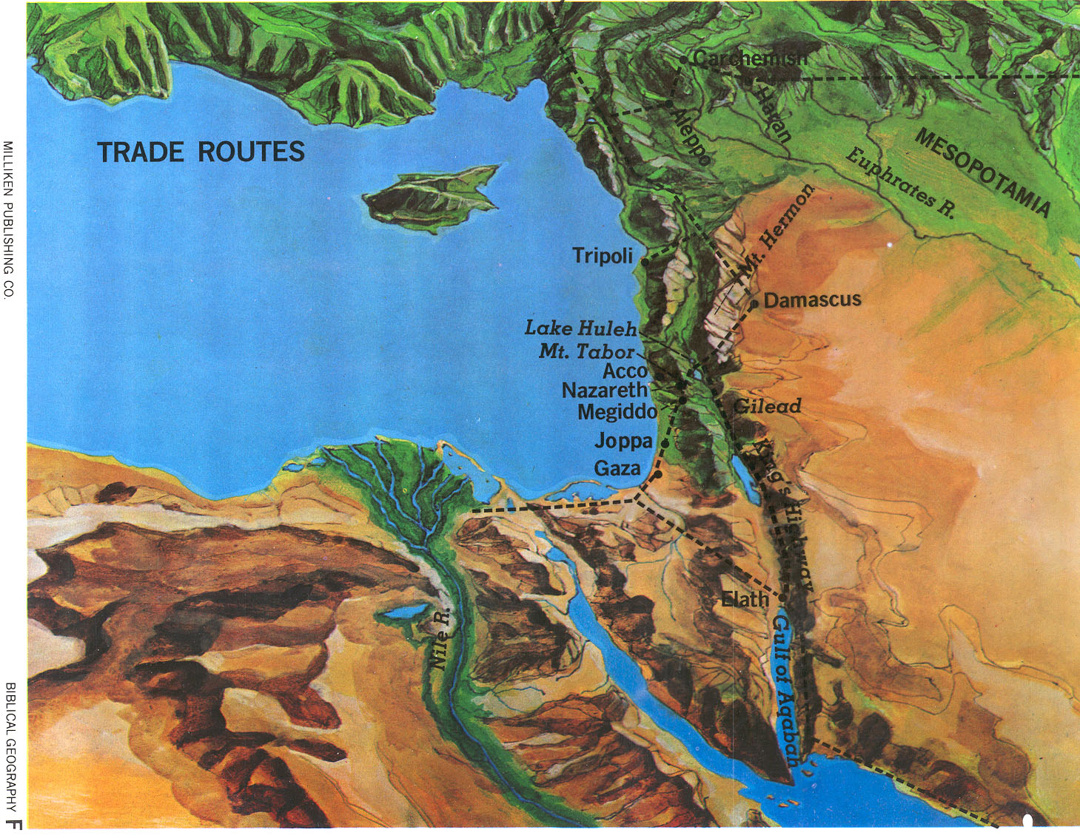
How would you characterize Israel’s impact on the world of the ANE?

Slide 34
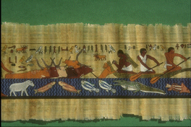
Compare Mesopotamia (Babylonia & Assyria) to Egypt.
What was their natural geographies like? Were they relatively protected or unprotected? How might their geographies have shaped their world views?
How unified were they as a people?
What were their gods like?
What was their attitude toward this world/life?
What was their view of kings?

Slide 35
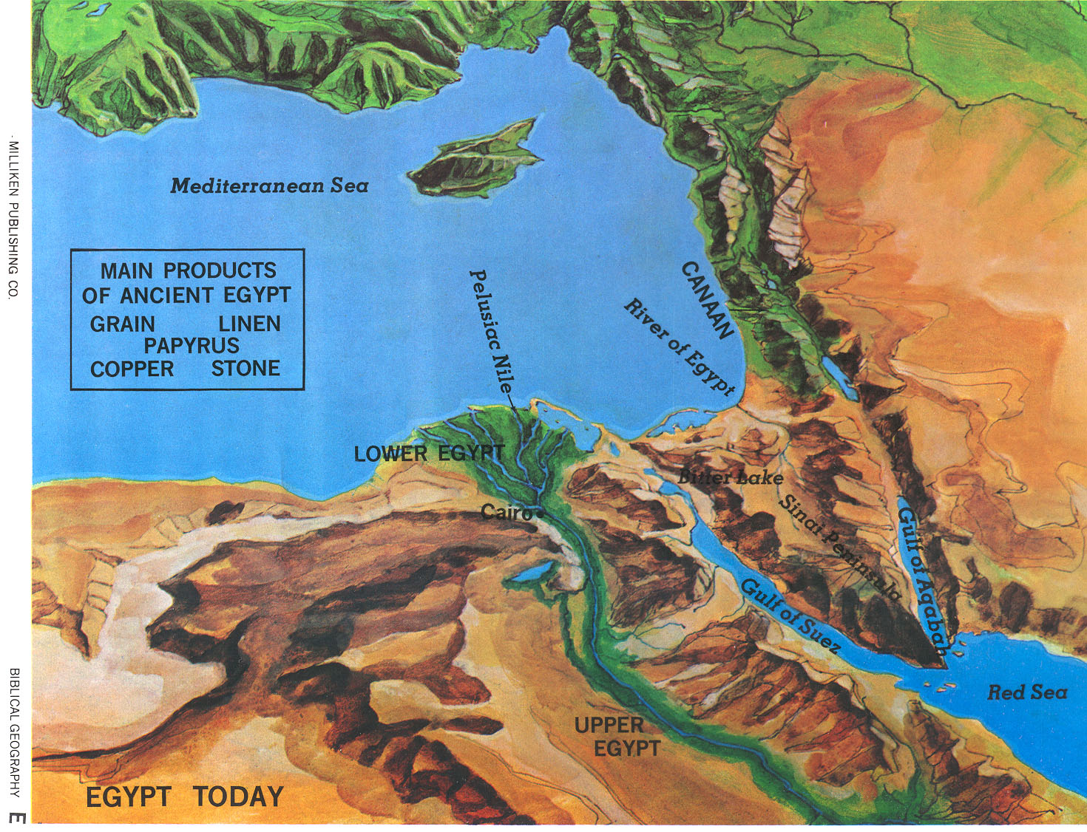

Slide 36
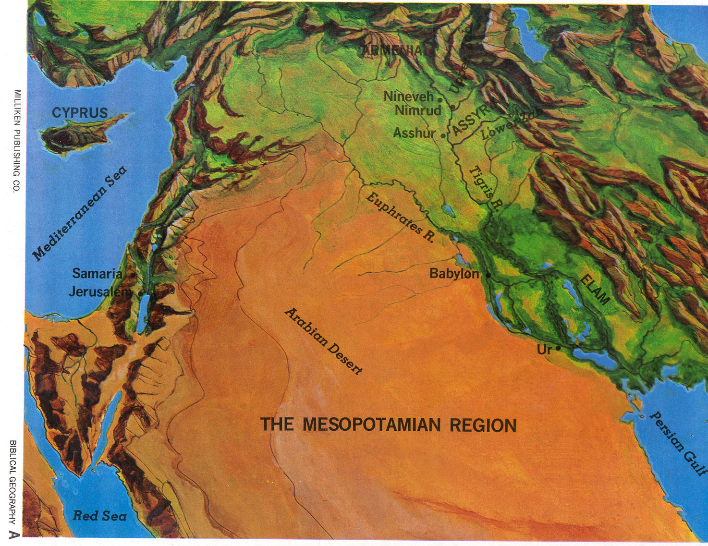

Slide 37
Coming out of Egypt (Ancient Near East), Israelites seem to have moved from:
Polytheism (worship of many gods) to
Henotheism (allegiance to one God among possible others)
Deuteronomy 6:4:
  YHWH our God, YHWH one/only
  The Lord our God, the Lord [is] one; or
  The Lord our God [is] one Lord; or
  The Lord [is] our God, the Lord [is] one; or
  The Lord [is] our God, the Lord alone
Monotheism (allegiance to the only God)

Slide 38
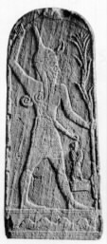
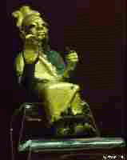
THE CANAANITES
Government: Feudal city-states with own king
Economy: agriculture and trade
Culture had major impact on Israelites
Ba’al from Ugarit
El from Ugarit

Slide 39
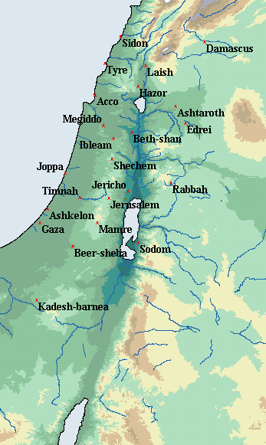
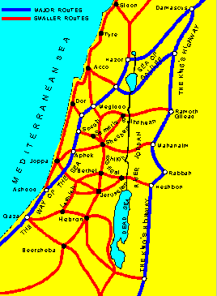
CANAANITE CITIES
Copyright: Logos Bible Atlas

Slide 40
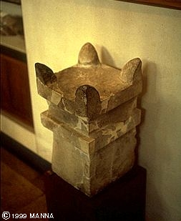
Canaanites (1 of 2)
Texts forbidding Canaanite practices: Hosea 4:10-14; Deut 23:17f.
Gods connected with nature, and therefore fertility (Ba’al). Myths about fertility (agricultural) cycle.
*What made Canaanite religion attractive? Mimetic practices to manipulate the gods: something people could do. [See Lev. 26:1-5]
“horned” altar from Megiddo a Canaanite city taken by Joshua

Slide 41
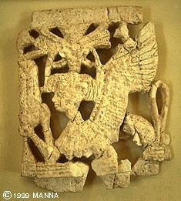
Canaanite (2 of 2)
Texts using literary allusions: Isa 27:1; Ps 74:13f; Ps 29; Ps 48:2.
*Main Point: Israel borrowed poetic, mythical imagery, but adapted it to Yahwistic theology.
Ivory figure from Megiddo, a Canaanite city taken by Joshua

Slide 42
Israelite Functionaries and Institutions
NT assumes knowledge of these roles and institutions
King:
monarchy, national identity, term "messiah," Davidic dynasty
NT: David lineage, Messiah, messianic & political expectation of Jesus’ day [Duke: issue of ‘sovereignty’]
Priest:
cult, sacrificial system, Temple, the Law
NT: sacrificial imagery, Jesus as High Priest and atoning sacrifice,
Sadducees, Christians as a royal priesthood
Prophet:
(unlike ANE: court/temple/shrine) independent "preacher"/ activist /
demonstrator /conscience of the people
NT: John the B, Jesus, apostles, prophets, “pastors,” etc.
Sage:
court advisor, scribe (school?)
NT: wisdom forms of Jesus' teaching, Pharisees, scribes and rabbis.

