Slide 1
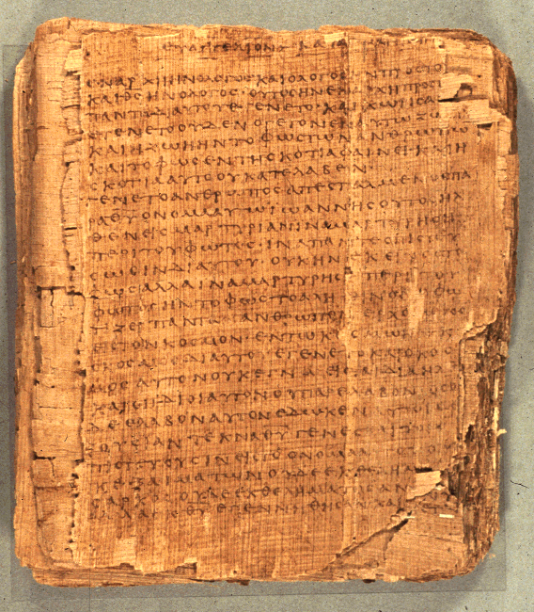
COS 221
Bible II
Dr. Rodney K. Duke

Slide 2
DAY 3
Assign: (see handout)
1) #1 (Journal)
2) #7 Response to “Doing History.”
4) #8 Heart of the covenant
5) #9 Israelite laws
Day Objectives:
1) Explain the process of communication
2) Describe the purpose of “doing history”
3) Formulated a description of biblical narrative
4) Formulate guidelines for reading OT narrative

Slide 3
JOURNAL THOUGHTS & OBSERVATIONS

Slide 4
Israelite Functionaries and Institutions
NT assumes knowledge of these roles and institutions
King:
monarchy, national identity, term "messiah," Davidic dynasty
NT: David lineage, Messiah, messianic & political expectation of Jesus’ day [Duke: issue of ‘sovereignty’]
Priest:
cult, sacrificial system, Temple, the Law
NT: sacrificial imagery, Jesus as High Priest and atoning sacrifice,
Sadducees, Christians as a royal priesthood
Prophet:
(unlike ANE: court/temple/shrine) independent "preacher"/ activist /
demonstrator /conscience of the people
NT: John the B, Jesus, apostles, prophets, “pastors,” etc.
Sage:
court advisor, scribe (school?)
NT: wisdom forms of Jesus' teaching, Pharisees, scribes and rabbis.

Slide 5
HISTORY OF ISRAEL
HISTORIOGRAPHY
AND
HISTORICAL MEMORY

Slide 6

Israelite/Jewish Religion:
A Religion of Historical Heritage
Read Deuteronomy 26:1-11 (read aloud)
  What is happening in this text?
  What is the significance of this text?
Historical Creed (G. von Rad)

Slide 7
Deuteronomy 26:1-11 (New International Version)
Firstfruits and Tithes
¹ When you have entered the land the LORD your God is giving you as an inheritance and have taken possession of it and settled in it, ² take some of the firstfruits of all that you produce from the soil of the land the LORD your God is giving you and put them in a basket. Then go to the place the LORD your God will choose as a dwelling for his Name ³ and say to the priest in office at the time, “I declare today to the LORD your God that I have come to the land the LORD swore to our ancestors to give us.” ⁴ The priest shall take the basket from your hands and set it down in front of the altar of the LORD your God. ⁵ Then you shall declare before the LORD your God: “My father was a wandering Aramean, and he went down into Egypt with a few people and lived there and became a great nation, powerful and numerous. ⁶ But the Egyptians mistreated us and made us suffer, subjecting us to harsh labor.

Slide 8
⁷ Then we cried out to the LORD, the God of our ancestors,
and the LORD heard our voice and saw our misery, toil and oppression. ⁸ So the LORD brought us out of Egypt with a mighty hand and an outstretched arm, with great terror and with signs and wonders. ⁹ He brought us to this place and gave us this land, a land flowing with milk and honey; ¹⁰ and now I bring the firstfruits of the soil that you, LORD, have given
me.” Place the basket before the LORD your God and bow down before him. ¹¹ Then you and the Levites and the foreigners residing among you shall rejoice in all the good things the LORD your God has given to you and your household.

Slide 9
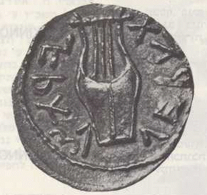
History of Israel
Difficulties for Reconstructing Israelite History (1 of 4)
1. The OT documents are difficult to date ("literary" problem) and often seem to be much later than the event they record.
Why a problem?
"Distance" in time between the date of events and the date of the records, leads to skepticism about the accuracy of the records.
2. External sources (other ANE artifacts) for corroborative evidence are often lacking and sometimes appears contradictory. Problem?
Historians are skeptical about relying on one source.
Scholars divide Israelite history into 2 periods
(Prehistorical and Historical). Why?
Biased in favor of political history

Slide 10
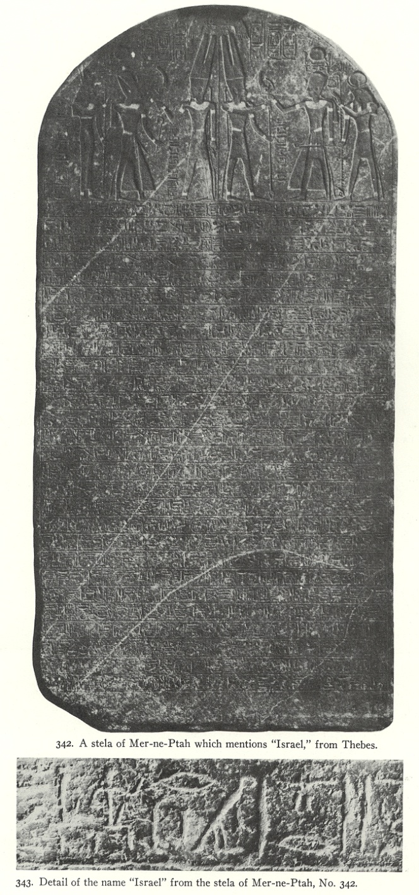
History of Israel
Difficulties for Reconstructing Israelite History (2 of 4)
Prehistorical Period (before Kingdom):
(a) very little external evidence, and
(b) OT sources seem quite late.
Merneptah Stele, first external mention of Israel, c. 1220 BCE

Slide 11
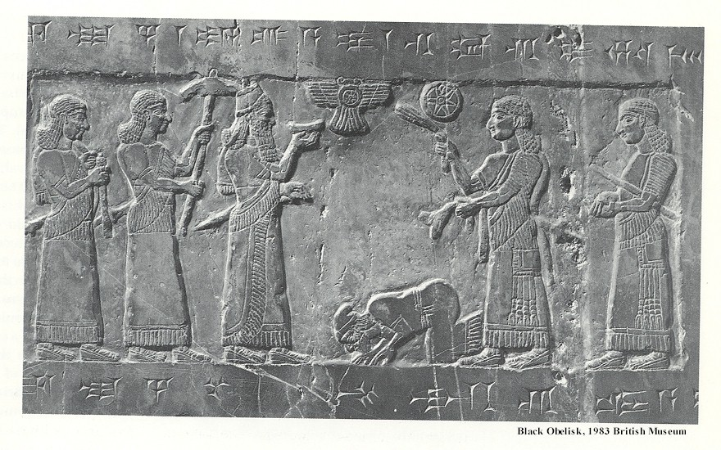
History of Israel
Difficulties for Reconstructing Israelite History 2 of 3
Historical Period (political Israel): (a) more external evidence, and (b) OT sources more contemporary.
(E.g. Jehu, King of Israel paying tribute to Shalmaneser III of Assyria, 825 BCE.)

Slide 12
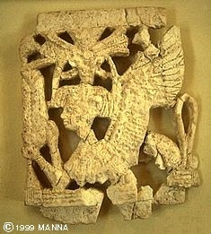
History of Israel
Difficulties for Reconstructing Israelite History (4 of 4)
3. OT history is presented from a theological perspective.
Why a problem?
(a) Seems less objective to modern historians who search for atheistic / “natural” causes to events.
[The Israelite bias should be recognized; however, all history writing is interpreted/biased! (See next slide.)]
(b) Causes the OT history to focus on
different topics than on what the modern
historian would focus,
leaving "gaps" in the record.

Slide 13
All History Telling is Interpretive
Historical Field
History Timeline
A
C
Selective (values)
Relationships
B
Teleology (direction)
When the past is not interpreted, it is meaningless!
Duke thesis: It is impossible to reconstruct “THE” history of Israel and unnecessary; the historical memory/tradition that we have in the OT is sufficient for God’s purposes.
Notes:
On the one hand, I am skeptical about any reconstruction of the history of Israel. On the other hand, I value the biblical construction of the history of Israel, because it communicates the meaning (world view, etc.) that we need to be ‘wise unto salvation.’ We must recognize the communicative intention of why people ‘do history.’

Slide 14
The Story of God’s Glory
Nature of biblical history
The main biblical character is God, even when not mentioned. The biblical story is about God’s creation, plan, and actions, particularly within the life of Israel.
We learn about God, humanity, reality, the way life works, etc. (Purpose: “Wise unto salvation”)
Biblical history ultimately reveals God’s history of redemption (“Salvation History”).
  The “mission” of Israel (now the Church) was/is to so display the HOLINESS of God that people will give glory to God and worship God. [First petition of Lord’s Prayer]

Slide 15
THEREFORE: The Biblical story is a story about the glory of God:
What happens when people recognize God’s glory and glorify Him through holy lives.
What happens when people refuse to recognize the glory of God.
What happens when people are used by God to bring others to recognize His glory and worship Him = MISSIONS.
Notes:
Note motif of what happens when we ‘exchange’ God’s glory and Romans 2.

Slide 16
CROSSROADS OF THE ANCIENT NEAR EASTERN WORLD
Notes:
Israel’s location would/should make an impact on the whole ANE!

Slide 17
HISTORICAL NARRATIVE

Slide 18
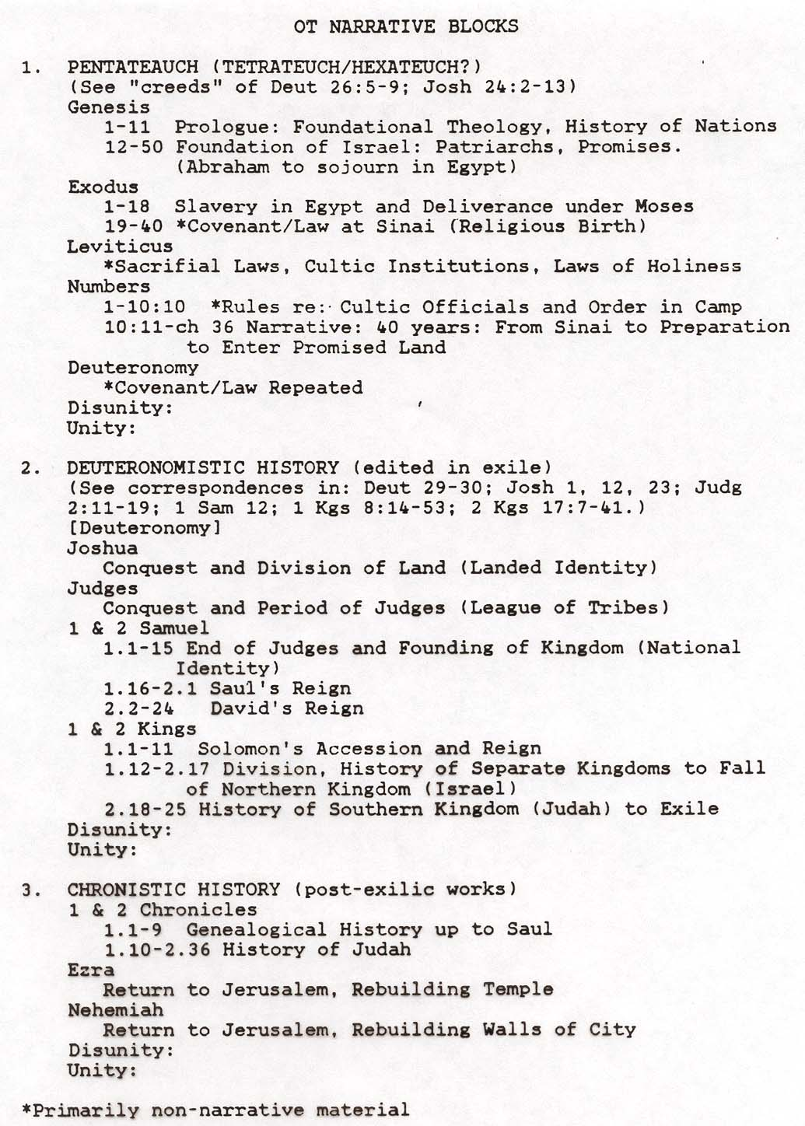
CP, 21

Slide 19
Questions to answer about each narrative block
1) What are the elements of diversity which might be signs of a complex history of composition?
2) What are the elements of unity which bind this block together?
What is the main intention of this block?
What is the main theme/message?
From what historical perspective was it edited (pre-exile, exile, post-exile)?
3) Does this block consist of independent, self-contained “books”?
4) What can be said about the authorship of this material?
Written by one author? Edited?
Author identified internally or externally?

Slide 20
Topics:
Why “do history”?
What should we look for when studying history?
How does narrative communicate meaning/theology?
Goal: Forming a “Reading Strategy” for Biblical Narrative

Slide 21
Doing History
Why do we do history? What is the rhetorical intention?
What, then, is the “truth-value” of history/historical memory?
WHO?
WHAT?
WHERE?
WHEN?
WHY?
WHY?
WHY?
What should we expect from it? How should we evaluate it?

Slide 22
Anamnesis/Historical Memory
Point 1: It is selective and interpretive.
Historical Field
History Timeline
A
C
Selective (values)
Relationships
B
Teleology (direction)
Point 2: Our continuing experience guides the
selectivity.
When the past is not interpreted, it is meaningless!

Slide 23
Anamnesis/Historical Memory
Point 3: Our memory gives us identity, shaping our present and giving us guidance toward the future.

Slide 24
Anamnesis/Historical Memory
Point 4: Our experience/memory causes us to reshape or re- evaluate the more distant past.
Historical Field
A
B
C
*Chronicles vs. Sam-Kings;
*NT writers saw Hebrew Bible through a new perspective.

Slide 25
Anamnesis/Historical Memory
Point 5: Anamnesis is preserved in/by traditions and rituals.

Slide 26
REVIEW: NATURE OF ORAL TRANSISSION OF HISTORICAL NARRATIVES
1. main point retained
2. incidental details dropped
3. tends to shorten
4. follows*stereotypical form
+5. in Mid-east, closing evaluative statements, kept exact
+Wisdom/instructional material, often
memorized word-for-word. Depends on setting.
(Article by Bailey on oral tradition posted on ASULearn)
* ARCHETYPAL PATTERNS
1. Once something has happened in our lives, we tend to find similar happenings to the first. (We interpret the present by the past.)
2. We have cultural patterns: gunfight at high-noon
3. Later OT and NT events compared events to "archetypes" in OT.
(See Literary Description, “Literary Features” CP, p. 26.)

Slide 27
THE 'MYTH' OF HISTORY VS. MYTH
“Myth”
1 a : usually traditional story of ostensibly historical events that serves to unfold part of the world view of a people or explain a practice, belief, or natural phenomenon
“History”
2 a : a chronological record of significant events (as affecting a nation or institution) often including an explanation of their causes
[Merriam-Webster Online Dictionary]
Duke:
If all history telling employs narrative to explain the “why” of the past and, therefore, the nature of reality, then all history telling is “mythic” in a broad sense.

Slide 28
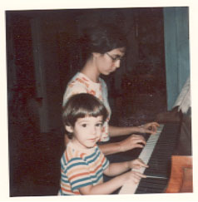
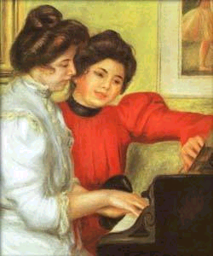
The Nature of Biblical Narrative (Homework #4)
Which is more accurate, a photograph or a portrait?
What are the differences between a photograph and a portrait?
Which are the OT narratives more like?

Slide 29
Overview of OT history as told in OT: 4 Main Events
A) Abraham - "called" by God, promised descendents would
become a nation, land, etc. (ethnic identity)
B) Exodus & Law - key event was deliverance from slavery in
Egypt, led to covenant relationship, giving of law. (religious ID)
C) Enter land and become a nation. (landed and political ID)
D) Exile and restoration (marks division between "Israelite" and
"Judean" history)
Hebrews
Israelites
Jews
Monastery at possible location of Mt. Sinai

Slide 30
CREATION
(Genesis 1-11)
Origins
Global perspective
Basic Israelite world view regarding: divine sphere, human sphere, and natural sphere
E.g. Yahweh is distinct from nature

Slide 31
Creation Theology
Gen 1. Humanity meant to represent the nature of God: created in God’s image and likeness, given sovereignty over the domains of the earth.
  “distinguish” creational activity, priestly duties (good vs. evil)
Gen 2. Humanity [of God’s breath of life] meant to participate in relationship with God : walk and talk with, serve in Garden, AND obey.
  “work” and “guard,” priestly duties

Slide 32
From Creation to Clan
Flood
Abram
Sin
Total corruption
Noah
Creation--
Total corruption
Israel

Slide 33
CLAN
(Genesis 12 - 50; +Job)
Period: Patriarchs (Fathers)
Character: Abraham
Event: “Call” and Promise/Covenant:
Son
Nation
Land
Fate of Nations -blessing or curse
“Birth” of ethnic identity

Slide 34
Gen 12:2-3. Promises to Abraham: A Mission to the World
I will make you into a great nation and I will bless you.
I will make your name great, and you
be a blessing.
I will bless those [plural] who bless you, and whoever [singular] curses you I will curse; and all peoples on earth shall be blessed through you.
  [blue = volitional, NOT future indicative]

Slide 35
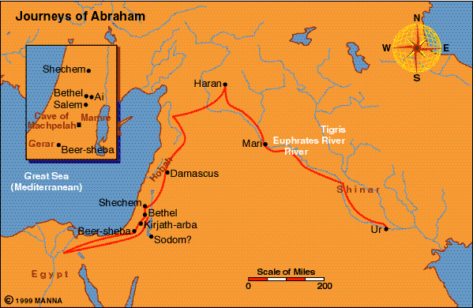

Slide 36
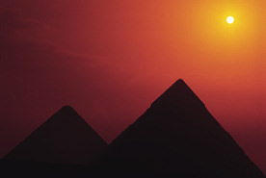
CONFINEMENT
400 years (Exodus 1-19)
Period: Slavery in Egypt
Character: Moses (at end of this period)
Over time the Hebrews went from guests to slave laborers

Slide 37
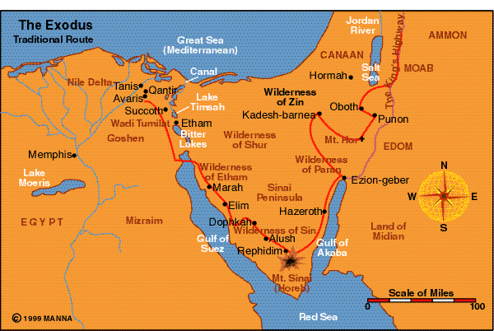

Slide 38
Purposes of the Exodus Event
Exodus 9:13b: Let my people go, so that they may worship me, 14 or this time I will send the full force of my plagues against you and against your officials and your people, so you may know that there is no one like me in all the earth. …16 But I have raised you up for this very purpose, that I might show you my power and that my name might be proclaimed in all the earth. [Spoken to Pharaoh.]

Slide 39
Purposes of the Exodus Event
Exodus 19:5-6 Now if you obey me fully and keep my covenant, then out of all nations you will be my treasured possession. Although the whole earth is mine, 6 you will be for me a kingdom of priests and a holy nation.

Slide 40
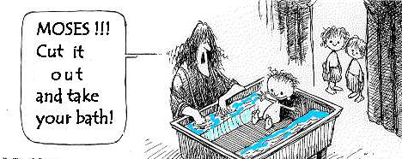

Slide 41
COMMANDMENTS
2 years (Exodus 20 - Leviticus 27)
Period: Giving of the Law at Mt. Sinai
Character: Moses
Event: religious “birth” of Israel
“I’ll be your God and you will be my people, if you will be holy as I am holy.”
wnyhla
hwhy
dha
[mv
larfy
hwhy

Slide 42
Purposes of the Law
Reveal the Holy character of God, that the Israelites might live according to His character and be blessed (Deut. 4:39-40; 6:1-3), AND
Be a holy witness to the nations:
Deuteronomy 4:5-6 See, I have taught you decrees and laws as the LORD my God commanded me, so that you may follow them in the land you are entering to take possession of it. 6 Observe them carefully, for this will show your wisdom and understanding to the nations, who will hear about all these decrees and say, "Surely this great nation is a wise and understanding people."

Slide 43
CAMPING
40 years (Numbers)
Period: Wandering in Wilderness
Character: Moses
Event: rebelled when told to conquer the Promised Land; they will have to wait until the next generation comes of age

Slide 44
COVENANT
1 month (Deuteronomy)
Period/Event: Renew Covenant w/ next generation
Character: Moses
Ready to enter the Land

Slide 45
Covenant Theology
How would you defend the statement: "All of Israelite history may be viewed as a theology of covenant"?
  Specific relationships/covenants: Adam, Noah, Abraham & sons, Moses & Israel, David.
  Books of “Former Prophets” (Deuteronomistic History) interpreted course of Israel's history according to covenant.
  Kings assessed according to covenant faithfulness.
  Prophets held people accountable to standards of covenant.
  Basis for the story line of Pentateuch.

Slide 46
CONQUEST
14 years (Joshua)
Period: take the Land (birth of landed ID)
Character: Joshua
Play BibleMaps “Conquest” here

Slide 47
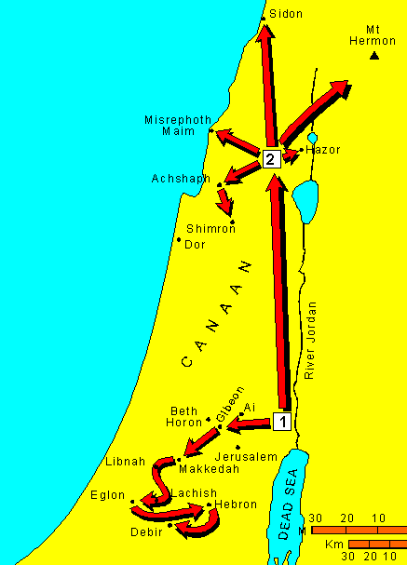
Joshua’s Conquest of Canaan
Logos Bible Atlas, 1994

Slide 48
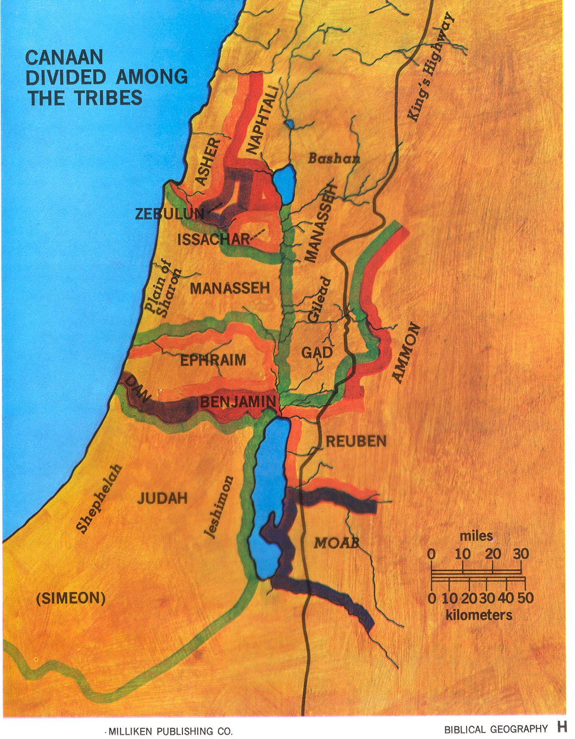

Slide 49
CYCLES
(Judges - 1 Samuel 8)
Period: Judges
(Judges = charismatic, temporary military leader
Cycles:
rebel against God
subjugated by neighbors
repent and cry out
delivered by “judge”

Slide 50
CROWNS
120 years (1 Samuel 9 - 1 Kings 11; + 1 Chronicles 1 - 2 Chronicles 9; Psalms - Song of Solomon)
Period: United Monarchy (“birth” of political ID)
Characters: 1st 3 kings:
Saul (Benjamin)
David (Judah)
Solomon (son of David)

Slide 51
CHASM
200 years (1 Kings 12 - 2 Kings 16; + 2 Chronicles 10 - 28; Isaiah; Hosea - Micah)
Period: Divided Monarchy
N. Kingdom = Israel
S. Kingdom = Judah

Slide 52
CHASM: DIVIDED MONARCHY

Slide 53
CAPTIVITIES
200 years (2 Kings 17 - 25; + 2 Chronicles 29 - 36; Jeremiah - Daniel; Nahum - Zephaniah)
Fall of Kingdoms:
N. Kingdom to Assyria in 721 BCE
S. Kingdom to Babylonia in 586 BCE

Slide 54
CONSTRUCTION*
120 years (Ezra - Esther; +Haggai - Malachi)
Period: Return and Rebuild under Persian control
Characters: Ezra and Nehemiah
*Undeserved restoration / grace should bring humility (Ezek 36:24-32)

Slide 55
BACK TO
PROCESS OF COMMUNICATION

Slide 56
Poles of Communication (Discuss Assign. #2)
Emotive
Addresser
|
Means------------------------|---------------------Referent
|
Addressee
Poetic
Referential
Conative (persuasive)
Application:
Different forms of communication have different functions. The Bible should not be read ‘on the flat’ without recognizing its different forms/functions.

Slide 57
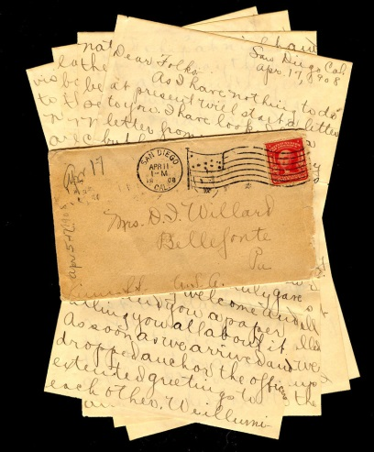


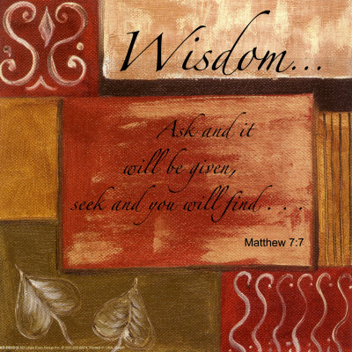
Next Exercise: Functions and Evaluation
Thesis:
Just as different forms have different functions, different communicative functions call for different modes of evaluation and application.

Slide 58
Functions and Evaluation (1 of 2)
1. Water consists of 2 parts hydrogen and 1 part oxygen.
2. Napoleon originated the custom of sewing buttons on the cuffs of dress jackets.
3. I am the best candidate!
4. Use this deodorant and you will become romantic.
5. It is so hot outside, I’m burning up.
6. I love you.
7. Once upon a time a tortoise and a hare had a race….(assume the rest of the story)

Slide 59
Functions and Evaluation (2 of 2)
8.
“Fall Scene”
red
green
orange
twirls
gentle
leaf
home

Slide 60
Summary/Application on "Function and Evaluation” (1 of 2)
What can you apply from this exercise to reading the Bible?
Main Observation:
Before we as readers assess the value/meaning of a literary text, we need to understand the intended communicative function of that text.
[Comment: When it comes to the Bible, people tend to drop their usual reading skills and read the Bible “on the flat” as if it were all referential and to be evaluated as science.]

Slide 61
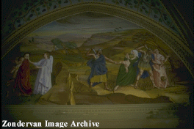
Summary/Application on "Function and Evaluation” (2 of 2)
But:
a. Some genres do not function referentially or conatively in a
“literalistic” sense. [Duke: “literal” vs. “literalistic”]
There may be a “poetic” impact intended.
Illust.: "If your eye causes you to sin, pluck it out....” (Conative and poetic poles work together = “hindrances to the Kingdom of God are so serious …”
b. Some texts do function referentially, but are historically
referential, not scientifically referential
and should be evaluated differently.
(Ref #2 vs #1)

Slide 62
Process of Communication
Speaker
Rhetorical intent
Rhetorical strategy/“rules”
Literary features
Medium
Referent
text
Form
Content
creates =
effective
communication
Reading strategy/ “rules”
= effective communication
Rhetorical impact
Addressee

Slide 63
APPLICATION OF PROCESS OF COMMUNICATION
When reading a specific OT text:
General
1. Identify the literary genre and its function in general.
2. Identify the general literary features of that genre and their
intended impact. (Create a "Reading Strategy")
Specific
3. Identify the literary features of a specific text and their specific
impact. (Apply Reading Strategy)
4. Evaluate in terms of intended function/impact.

Slide 64
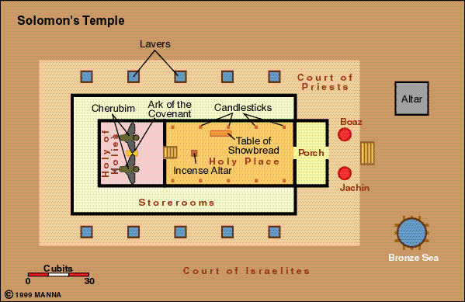

Slide 65

Genre Recognition
Failure to employ a reading strategy that recognizes the types/genres of literature in the Bible and their original functions:
1. Obscures the variety of forms employed in the Bible and makes communication MORE difficult. (People employ different genres to AID communication.)
2. Locates the meaning of the text in the hands of the reader (leading to unintended applications) rather than locating the meaning in the author’s intention.
3. Promotes private and self-centered readings of the Bible (“God speaks to ME”), rather than an informed and communally guided interpretation.
4. Often leads to an “atomizing” of the text.
(Illustration: favorite cake – the impact of
the whole is much different than the
separate parts/ingredients)

