Slide 1
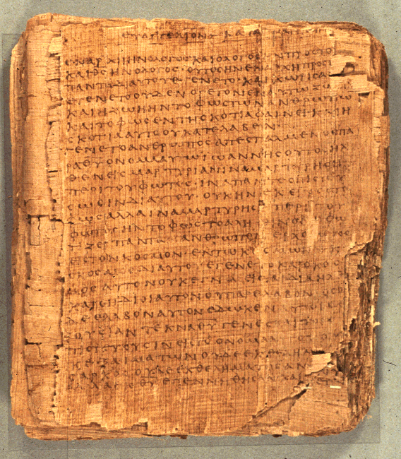
COS 221
Bible II
Dr. Rodney K. Duke

Slide 2
DAY 3
Assign: (see handout)
1) #1 (Journal)
2) #7 Response to “Doing History.”
4) #8 Heart of the covenant
5) #9 Israelite laws
Day Objectives:
1) Explain the process of communication
2) Describe the purpose of “doing history”
3) Formulated a description of biblical narrative
4) Formulate guidelines for reading OT narrative

Slide 3
Questions to answer about each narrative block
1) What are the elements of diversity which might be signs of a complex history of composition?
2) What are the elements of unity which bind this block together?
What is the main intention of this block?
What is the main theme/message?
From what historical perspective was it edited (pre-exile, exile, post-exile)?
3) Does this block consist of independent, self-contained “books”?
4) What can be said about the authorship of this material?
Written by one author? Edited?
Author identified internally or externally?

Slide 4
Topics:
Why “do history”?
What should we look for when studying history?
How does narrative communicate meaning/theology?
Goal: Forming a “Reading Strategy” for Biblical Narrative

Slide 5
Doing History
Why do we do history? What is the rhetorical intention?
What, then, is the “truth-value” of history/historical memory?
WHO?
WHAT?
WHERE?
WHEN?
WHY?
WHY?
WHY?
What should we expect from it? How should we evaluate it?

Slide 6
THE 'MYTH' OF HISTORY VS. MYTH
“Myth”
1 a : usually traditional story of ostensibly historical events that serves to unfold part of the world view of a people or explain a practice, belief, or natural phenomenon
“History”
2 a : a chronological record of significant events (as affecting a nation or institution) often including an explanation of their causes
[Merriam-Webster Online Dictionary]
Duke:
If all history telling employs narrative, ultimately to explain the “why” of the past, and therefore, the nature of reality, then all history telling is “mythic” in a broad sense.

Slide 7
Overview of OT history as told in OT: 4 Main Events
A) Abraham - "called" by God, promised descendents would
become a nation, land, etc. (ethnic identity)
B) Exodus & Law - key event was deliverance from slavery in
Egypt, led to covenant relationship, giving of law. (religious ID)
C) Enter land and become a nation. (landed and political ID)
D) Exile and restoration (marks division between "Israelite" and
"Judean" history)
Hebrews
Israelites
Jews
Monastery at possible location of Mt. Sinai

Slide 8
CREATION
(Genesis 1-11)
Origins
Global perspective
Basic Israelite world view regarding: divine sphere, human sphere, and natural sphere
E.g. Yahweh is distinct from nature

Slide 9
Creation Theology
Gen 1. Humanity meant to “participate” in the nature of God: created in God’s image and likeness, given sovereignty over the domains of the earth.
  “distinguish” creational activity, priestly duties (good vs. evil)
Gen 2. Humanity [of God’s breath of life] meant to participate in relationship with God : walk and talk with, serve in Garden, AND obey.
  “work” and “guard,” priestly duties

Slide 10
CLAN
(Genesis 12 - 50; +Job)
Period: Patriarchs (Fathers)
Character: Abraham
Event: “Call” and Promise/Covenant:
Son
Nation
Land
Fate of Nations -blessing or curse
“Birth” of ethnic identity

Slide 11
Gen 12:2-3. Promises to Abraham: A Mission to the World
I will make you into a great nation and I will bless you.
I will make your name great, and you
be a blessing.
I will bless those [plural] who bless you, and whoever [singular] curses you I will curse; and all peoples on earth shall be blessed through you.
  [blue = volitional, NOT future indicative]

Slide 12
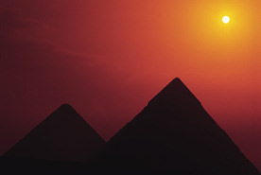
CONFINEMENT
400 years (Exodus 1-19)
Period: Slavery in Egypt
Character: Moses (at end of this period)
Over time the Hebrews went from guests to slave laborers

Slide 13
Purposes of the Exodus Event
Exodus 9:13b: Let my people go, so that they may worship me, 14 or this time I will send the full force of my plagues against you and against your officials and your people, so you may know that there is no one like me in all the earth. …16 But I have raised you up for this very purpose, that I might show you my power and that my name might be proclaimed in all the earth. [Spoken to Pharaoh.]

Slide 14
Purposes of the Exodus Event
Exodus 19:5-6 Now if you obey me fully and keep my covenant, then out of all nations you will be my treasured possession. Although the whole earth is mine, 6 you will be for me a kingdom of priests and a holy nation.

Slide 15
COMMANDMENTS
2 years (Exodus 20 - Leviticus 27)
Period: Giving of the Law at Mt. Sinai
Character: Moses
Event: religious “birth” of Israel
“I’ll be your God and you will be my people, if you will be holy as I am holy.”
wnyhla
hwhy
dha
[mv
larfy
hwhy

Slide 16
Purposes of the Law
Reveal the Holy character of God, that the Israelites might live according to His character and be blessed (Deut. 4:39-40; 6:1-3), AND
Be a holy witness to the nations:
Deuteronomy 4:5-6 See, I have taught you decrees and laws as the LORD my God commanded me, so that you may follow them in the land you are entering to take possession of it. 6 Observe them carefully, for this will show your wisdom and understanding to the nations, who will hear about all these decrees and say, "Surely this great nation is a wise and understanding people."

Slide 17
CAMPING
40 years (Numbers)
Period: Wandering in Wilderness
Character: Moses
Event: rebelled when told to conquer the Promised Land; they will have to wait until the next generation comes of age

Slide 18
COVENANT
1 month (Deuteronomy)
Period/Event: Renew Covenant w/ next generation
Character: Moses
Ready to enter the Land

Slide 19
CONQUEST
14 years (Joshua)
Period: take the Land (birth of landed ID)
Character: Joshua
Play BibleMaps “Conquest” here

Slide 20
CYCLES
(Judges - 1 Samuel 8)
Period: Judges
(Judges = charismatic, temporary military leader
Cycles:
rebel against God
subjugated by neighbors
repent and cry out
delivered by “judge”

Slide 21
CROWNS
120 years (1 Samuel 9 - 1 Kings 11; + 1 Chronicles 1 - 2 Chronicles 9; Psalms - Song of Solomon)
Period: United Monarchy (“birth” of political ID)
Characters: 1st 3 kings:
Saul (Benjamin)
David (Judah)
Solomon (son of David)

Slide 22

CHASM
200 years (1 Kings 12 - 2 Kings 16; + 2 Chronicles 10 - 28; Isaiah; Hosea - Micah)
Period: Divided Monarchy
N. Kingdom = Israel
S. Kingdom = Judah

Slide 23
CAPTIVITIES
200 years (2 Kings 17 - 25; + 2 Chronicles 29 - 36; Jeremiah - Daniel; Nahum - Zephaniah)
Fall of Kingdoms:
N. Kingdom to Assyria in 721 BCE
S. Kingdom to Babylonia in 586 BCE

Slide 24
CONSTRUCTION*
120 years (Ezra - Esther; +Haggai - Malachi)
Period: Return and Rebuild under Persian control
Characters: Ezra and Nehemiah
*Undeserved restoration / grace should bring humility (Ezek 36:24-32)

Slide 25
COMMUNICATION PROCESS

Slide 26
APPLICATION OF PROCESS OF COMMUNICATION
When reading a specific OT text:
General
1. Identify the literary genre and its function in general.
2. Identify the general literary features of that genre and their
intended impact. (Create a "Reading Strategy")
Specific
3. Identify the literary features of a specific text and their specific
impact. (Apply Reading Strategy)
4. Evaluate in terms of intended function/impact.

Slide 27

Genre Recognition
Failure to employ a reading strategy that recognizes the types/genres of literature in the Bible and their original functions:
1. Obscures the variety of forms employed in the Bible and makes communication MORE difficult. (People employ different genres to AID communication.)
2. Locates the meaning of the text in the hands of the reader (leading to unintended applications) rather than locating the meaning in the author’s intention.
3. Promotes private and self-centered readings of the Bible (“God speaks to ME”), rather than an informed and communally guided interpretation.
4. Often leads to an “atomizing” of the text.
(Illustration: favorite cake – the impact of
the whole is much different than the
separate parts/ingredients)

Slide 28
Homework #3: GENESIS 1-2
Objective: Figure out how biblical narratives are to be read.
1. Note that we have two stories (Q#a):
(Where does the first account end?)
Gen 2:4 (chiastic structure suggests verse 4 is not to be subdivided)
“These are the generations:
A. of the heavens and
B. the earth
C. when they were created
C. in the day Yahweh God created
B. the earth and
A. the heavens”

Slide 29
GENESIS 1-2
Parallel literary structure of openings of Gen 1:1-3 and 2:4-7
(Shows that we have two separate accounts)
1. Summary introduction / title: 1:1 and 2:4
2. Circumstantial clauses: 1:2 and 2:5-6
3. Main action begins: 1:3 and 2:7
Title
Setting
Action
Do we have two conflicting accounts of creation?

Slide 30
GENESIS 1-2
Note the differences, the diversity in content and style
(#1. b,c responses)
Problem: How are these accounts to be read?
Are they contradictory and meant to be read separately?
Should we try to solve the "problems" (harmonize) so that they can be read together?
What are their functions? Historical? Fictional/Poetic? Theological? Scientific?
Towards a solution: What questions does each account seek to
answer? (d)
(e) Are the answers to the questions behind these two accounts contradictory or complementary?
Duke: The “key” to get back to the rhetorical intention is to play:
JEOPARDY!

Slide 31
GENRES AND FUNCTIONS OF GENESIS 1-11
COMPARED TO EARLIER TEXTS OF
ANCIENT NEAR EAST
Thesis: Israel appropriated and readapted these texts!
Such texts ‘explained’ in narrative form the nature of this world and how to function in it in order to maintain order; that is: the proper relationships of the divine realm, physical realm, and human realm (kings, priests, politics, etc.)

