Slide 1
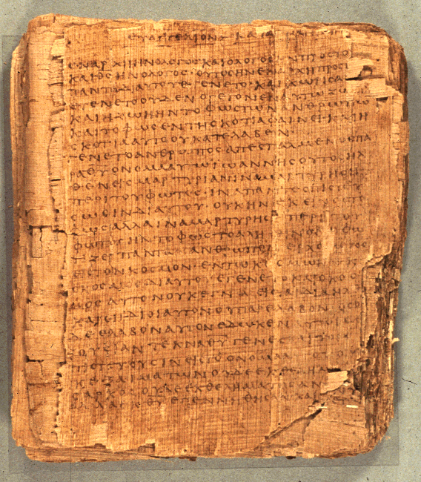
COS 221
Bible II
Dr. Rodney K. Duke

Slide 2
DAY 4
Assign:
1) (Journal)
2) #12 Deuteronomistic History *Change W to N (notes)
3) #14 Priesthood *Change W to N (notes). Posted online.
4) #15 Chronicles *Change W to N (notes)
5) #16 Ruth Just if you want to for fun.
Day Obj.: (Laws, Cult)
1) Describe how narratives communicate meaning.
2) Formulate guidelines for reading biblical narrative.
3) Formulate guidelines for reading and applying OT laws.
4) Describe the Deuteronomistic History.

Slide 3
JOURNAL THOUGHTS & OBSERVATIONS
(in pairs, then group)

Slide 4
Process of Communication
Speaker
Rhetorical intent
Rhetorical strategy/“rules”
Literary features
Medium
Referent
text
Form
Content
creates =
effective
communication
Reading strategy/ “rules”
= effective communication
Rhetorical impact
Addressee

Slide 5

Genre Recognition
Failure to employ a reading strategy that recognizes the types/genres of literature in the Bible and their original functions:
1. Obscures the variety of forms employed in the Bible and makes communication MORE difficult. (People employ different genres to AID communication.)
2. Locates the meaning of the text in the hands of the reader (leading to unintended applications) rather than locating the meaning in the author’s intention.
3. Promotes private and self-centered readings of the Bible (“God speaks to ME”), rather than an informed and communally guided interpretation.
4. Often leads to an “atomizing” of the text.
(Illustration: favorite cake – the impact of
the whole is much different than the
separate parts/ingredients)

Slide 6
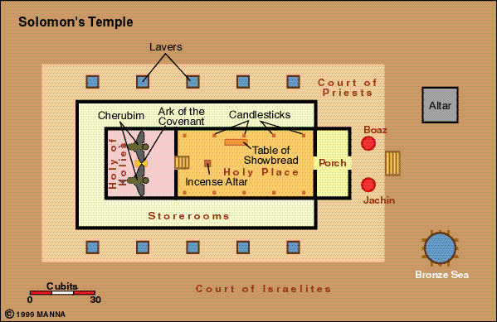

Slide 7
Homework #3: GENESIS 1-2
Objective: Figure out how biblical narratives are to be read.
1. Note that we have two stories (Q#a):
(Where does the first account end?)
Gen 2:4 (chiastic structure suggests verse 4 is not to be subdivided)
“These are the generations:
A. of the heavens and
B. the earth
C. when they were created
C. in the day Yahweh God created
B. the earth and
A. the heavens”

Slide 8
GENESIS 1-2
Parallel literary structure of openings of Gen 1:1-3 and 2:4-7
(Shows that we have two separate accounts)
1. Summary introduction / title: 1:1 and 2:4
2. Circumstantial clauses: 1:2 and 2:5-6
3. Main action begins: 1:3 and 2:7
Title
Setting
Action
Do we have two conflicting accounts of creation?

Slide 9
GENESIS 1-2
Note the differences, the diversity in content and style
(#1. b,c responses)
Problem: How are these accounts to be read?
Are they contradictory and meant to be read separately?
Should we try to solve the "problems" (harmonize) so that they can be read together?
What are their functions? Historical? Fictional/Poetic? Theological? Scientific?
Towards a solution: What questions does each account seek to
answer? (d)
(e) Are the answers to the questions behind these two accounts contradictory or complementary?
Duke: The “key” to get back to the rhetorical intention is to play:
JEOPARDY!

Slide 10
Q & A Behind Gen 1:1-2:3 (Assumes the existence of God)
1) What is the origin of the world? (See Unit 4. pp. 8-9)
The world was made orderly and full of life by God.
2) What is the nature of the God?
God is the ultimate authority; He speaks and it is done.
3) What is the nature of the world?
The world is orderly, receptive of life, good.
4) What is the relationship between God and the world?
God rules over the world and is distinct from it.
5) What is the nature and purpose of humanity?
Humanity is the pinnacle of creation, in the image of God, sovereign over the realms of the earth.
6) What is the relationship between God and humanity?
As creator God is sovereign over humanity.
7) What is the relationship between humanity and the world?
Humanity has been given rule over the domains of the earth like God (preserve order and life).
Fits divine pattern; God gives rest from labor
8) Why a Sabbath rest/7-day week?

Slide 11
Q & A Behind Gen 2:4-25 (Assumes the Fall) (1 of 2)
1) What is the origin and nature of humanity?
Humanity formed by God from dust and divine “breath.”
2) What was the earth/Eden originally like?
Eden was fertile, life-giving.
3) What was humanity’s original relationship with God?
God and humanity were intimate; talked & walked together.
4) What is God like?
God (Yahweh) is personal, caring, authoritative.
5) What was the original purpose of humanity?
To relate to God and to care (“serve” & “watch”--priestly terms) the earth.
6) What was life meant to be like?
Life was to be idyllic: no impediments between humanity and God, humanity and world, men and women.
7) Why men, women and marriage?
Men and women complement (complete) each other in marriage.

Slide 12
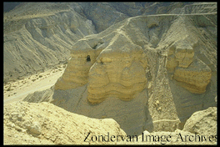
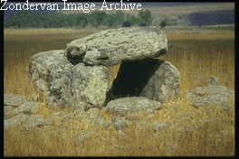
Q & A Behind Gen 2:4-25 (Assumes the Fall) (2 of 2)
[8) What brought about the present pain and struggles that we encounter?]
The Fall brought “death”/chaos to all relationships: between humanity and God, humanity and world, men and women..
Burial sites from time of Abraham

Slide 13
Summary: (Duke’s opinion)
A. Although the accounts have contradictory elements & styles:
1. The accounts need not be seen as contradicting each other.
2. Also, we do not need to harmonize away all the differences.
3. Rather, the answers to the issues they address (based on their
rhetorical intentions) are complementary.
*Such accounts were meant to be held together by focusing on their rhetorical (communicative) intentions.
B. The questions they address are primarily theological, about how things are, or came to be. These are not scientific texts (or historical) in the modern conception of these disciplines, but they do make historical and “scientific”/phenomenological claims about what must have happened from their perspective.
*Biblical narrative blends together historical, theological and aesthetic/poetic.
C. Differences in style (particularly see use of divine name) might indicate different sources and suggest a complex literary history.

Slide 14
Development of Pentateuch
(CP U4, p.10)
United Monarchy ~ 1000 BCE
Divided Monarchy ~ 900 BCE
Fall of Northern Kingdom ~ 722 BCE
Fall of Southern Kingdom ~ 586 BCE
Return from Exile ~ 539 BCE
J 950 BCE
E 850 BCE
(Redaction with E ~ 700 BCE?
D 622 BCE
(JE)
Redaction with D ~ 550 BCE
P ~ 500 BCE?
(JED)
Redaction with P ~ 400 BCE?
JEDP = Pentateuch
Egyptian Saite Dynasty 711-525
Key to Sources:
J = Yahwist
E = Elohist
D = Deuteronomist
P = Priestly

Slide 15
Example:
The ‘Poetics’ of Genesis One

Slide 16
Genesis 1
“Spirit of God”
Darkness
Watery Deep
Formless Earth
Notes:
This slide goes with 1:2 and illustrates how, before any divine action begins (that is, interpreting verse as a title/summary statement of what follows) that state of things consists of 3 “elements” that would be contra life in the ancient Near East: a formless and chaotic earth surrounded by watery deep and engulfed in darkness. The following acts of God deal with these three elements of chaos, establish order within them in order to make an environment that is conducive of life, and then filling the world with life.

Slide 17


Days of Creation
Day 1 -------------------darkness/light separates
Day 4
fills
Day 2 -----------------------waters
separates
Day 5
fills
Day 3 ---------------------- “earth” separates
Day 6
fills
Day 7 ----- rests
Notes:
This slide shows how days 1-3 deal with darkness, the watery deep, and then the chaotic earth in sequence, preparing the world for life. Then on days 4-6, God fills each dimension. For example, having “distinguished” light from darkness on day 1, God creates the bodies of lights for times and season on day 4. Days 5 and 6 follow much the same pattern.

Slide 18
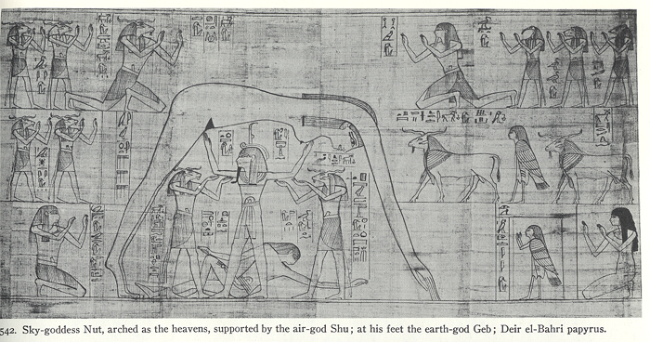
One Egyptian Cosmology
Sky-goddess Nut, arched as the heavens, supported by the air-god Shu; at his feet the earth-god Geb.
Notes:
Egyptian parallels to OT creation, closer than Mesopotamian connections (Currid, Ancient Egypt and the OT)
Both Egypt and Mesopotamia basically start with bringing order out of chaos (maat in Egypt). Mesopotamia starts with 3 gods of water (fresh, salt, and mist?) two of whom copulate to produce the other gods.
E. creation does have stories of all things originating out of one god (sometimes identified as self created): out of one's spit, out of one's semen; and in the case of Ptah (primordial waters) of Memphite theology, out of his breath ex nihilo (56-63) and the idea that objects had no being unless they were named (62).
Gen 1:1 bereshit (from rosh head) is similar to E. sp typ (first time) (typ from head) which refers to creation taking place at the beginning of time (64).
Hermopolitian theology has four male chaos gods and their consorts: formless deep, chaos, darkness and breath -- so, too Gen 1:2. (66)
As God bdl (separates) so does E (67).
God makes fish and birds on same day; so too E. puts these two together (70).
Gen sixth day has animals and mankind, so too E. (70)
As humans are formed and in form/likeness of God, so too, E. (70-71).
As God breathes in the breath of life, so too E. (not found in Mesopot) (71-72).

Slide 19
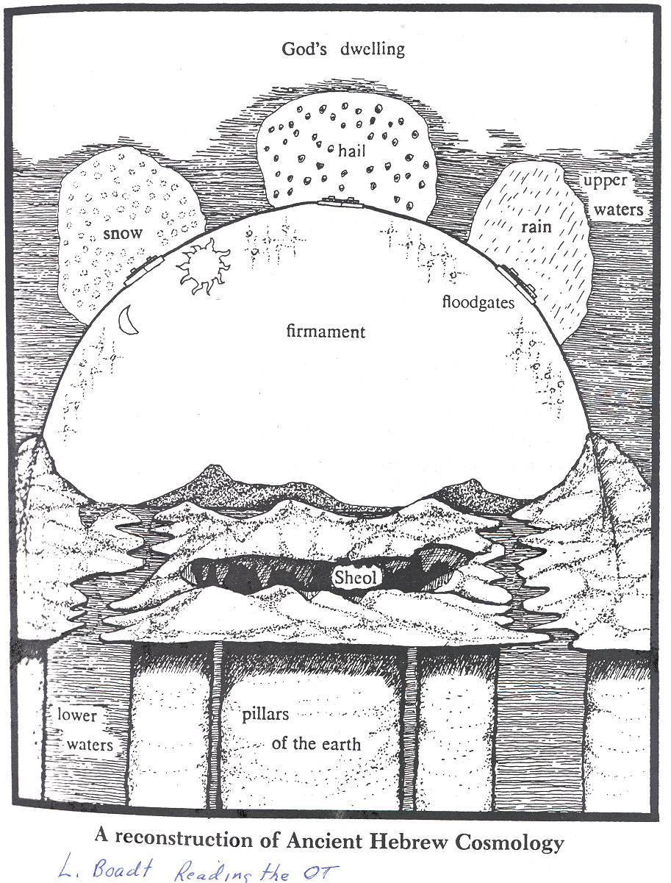
Biblical Cosmology
Notes:
This slide gives and artist’s rendering of the phenomenological view of the cosmos that is described in various places in the Bible. For example: heaven (“firmament”) was believed to be solid because rain, snow, sleet, etc. come down from above and everyone knows that is takes something solid to hold water back. The windows of the heavens must open for the waters above the heavens to be released.

Slide 20
Duke Notes:
Both Gen. accounts start with unexplained “evil”/chaos: surd evil (darkness, etc.) and moral evil (serpent); they are contrary to God, but not presented as eternal dualism.
    [Reflection: Polanyi (?): our world must have balance of order and chaos:
    All order: cosmos would be crystalline and lifeless
    All chaos: cosmos would be unstructured and lifeless]
“Adam” used in different ways in Genesis:
  adam comes from the adamah (ground) = symbolic?
  “adam / the adam” collective term for humanity: 1:26, 27 (the adam); 5:1?, 2; 6:1, 5-7 (the adam); 9:5-6 (the adam)
  “the adam” singular, but generic?: 2:7, 15, 16, etc.
  adam: singular and proper noun: 3:17?; 4:26; 5:3ff, etc.

Slide 21
Example of the blended use adam, personal and generic
All without “definite article.”
Could be read as personal.
Could be read as generic.
“This is the record/book of the generations of adam, in the day God created adam; in the likeness of God he made him. Male and female he created them.
And he blessed them, and he called their name adam, in the day he created them. And adam lived thirty and a hundred years and he gave birth in his likeness like his image, and he called his name Seth.” (Gen. 5:1-3)

Slide 22
1st Genesis Creation account:
Each “day” obliterates the functions of the ANE gods.
bara (create/make) is only used of God, but is often wrongly claimed to be only ex nihilo (out of nothing) (e.g. God “created” Israel)
yom (day) is both literal and nonliteral: used before the bodies of light for time; yet portrays God laboring during the day, and fits pattern of week, temple dedication, etc.
In Gen 1, God is like a king who speaks orders that are carried out.
“Image of God”: Kings (image of god) had images of themselves placed around. Humans (all: male AND female) are in God’s image.
God (Gen. 1) seems to work with the ordered world: “Let the land produce vegetation ... and the land brought forth” (11-12), “Let the waters teem… and God created that which the waters teemed” (20-21), “Let the land produce living creatures… and God made …” (24-25).

Slide 23
2nd Genesis Creation Account:
Gen 2: disobeying God cost humanity immortality.
  ANE Adapa legend: obeying a god cost humanity immortality. (Priest of Enki, Adapa, is told by Enki if he eats heavenly food offered by Anu, he would die, when in actually the food would have given him immortality.
Woman from side of man = not a separate creature/animal.
  Woman as man’s helper & completer = not hierarchical
“The Fall” and “original sin” are Christian (not Jewish) designations that become applied to Paul’s analogies contrasting the reign inaugurated by the one man, Jesus, (righteousness, life, grace) to the reign of sin and death from the time of Adam (Rom 5-6).
[Duke: Important to understand Paul’s main points rather than to use these texts to fill in gaps for our questions.]

Slide 24
GENRES AND FUNCTIONS OF GENESIS 1-11
COMPARED TO EARLIER TEXTS OF
ANCIENT NEAR EAST
Thesis: Israel appropriated and readapted these texts!
Such texts ‘explained’ in narrative form the nature of this world and how to function in it in order to maintain order; that is: the proper relationships of the divine realm, physical realm, and human realm (kings, priests, politics, etc.)

Slide 25
Reading Ancient “Creation” Texts in Context
The texts (e.g. Enuma Elish, Memphite Theology) are not merely abstract cosmogonies (origin of the cosmos) or theogonies (origins of the gods), but political treatises.
  Established state religion, capital city, main temple, ruler
  Egyptian accounts of Heliopolis, Hermopolis, and Thebes, each identifies the primordial land with their cultic center.
  Established social structure/roles/archetypes of tradition
Some of the texts may have been used in religious ritual re-enactments (mimetic magic) of the state religion’s myths in order to encourage the god to carry out their proper functions in maintaining the natural order of the world
  Enuma Elish became used in the New Year Festival.
  Pyramid Texts, king (as image of) ritually stands in for Atum (Kheprer) when he assumed kingship of the world he was creating.
  Egyptian Re-Atum renews world every day.
Notes:
Enuma Elish substitutes Marduk for the leading role of Enlil (going back to Atrahasis) and makes the political statement that Marduk established Babylon at about the time the First Babylonian Dynasty (Semitic people taking over Sumerian culture), when Babylon became the capital. This account consolidated Marduk as the chief god of the state religion. Early Assyrian kings were seen as the “son” of the god and as the “image” of the god, representing the god to the people; so, such stories also consolidated the power of the king. And stories such as the Enuma Elish established the social structure of king > priests and scribes of the court > common people. So, too, the Memphite Theology establishes not just the role of Ptah, but empowered a Pharaoh and the city of Memphis. Each of the Egyptian creation texts of Heliopolis, Hermopolis, and Thebes tell the same story but each identifies the primordial land with their cultic center (Johnston, Genesis 1 and Ancient Egyptian Creation Myths. 189-90).
See Currid, Ancient Egypt and the Old Testament, on Egyptian parallels. Here Pyramid Texts, cited on p. 69.

Slide 26
Those texts which present a cosmogony and/or theogony, even if politically oriented:
Explain the nature of things and how they came to be the way they are.
Are focused not on material origins, but on the origins of the functions and roles of the gods as reflected in the physical world.
Presupposes their ancient phenomenological (commonly observed) understanding of the cosmos. (See following slide on “Issue of Science and the Bible”)

Slide 27
Parallels Between Genesis 1-2 and Enuma Elish
Parallel | Genesis | Enuma Elish
Chaotic Primeval State | “Formless” and “empty” – Gen 1:2a | Chaos from the absence of gods and the absence of “name” – EE I. lines 7-8).
Primordial Waters | “Darkness” over the surface of the watery depths – Gen 1:2b, and separation of two spheres of water (cf. Gen 1:6-7) | Tiamat, personification of primeval ocean, split in two spheres of water – EE IV. lines 100-140.
Creation of Mankind | Man is formed out of “dust” – Gen 2:7 | Mankind is created from the blood of Kingu, Tiamat’s co-conspirator – EE VI. lines 1-10.
Image | Mankind is created in the “image of God” – Gen 1:26-27; cf. Gen 5:3, where the divine image given to Adam is carried on to his progeny (i.e., Seth). | Anu begets Nudimmud in his image – EE I. line 16. *Note: Both Anu and Nudimmud, however, are both gods, not humans.
Temple-Rest | Yahweh takes up divine rest in his cosmic-temple after creation out of chaos (cf. Gen 3:8; Rev 22:1-2) | Marduk and other gods take rest in temple after victory over creation-conflict – EE V. lines 121-130; cf. VI. lines 51-60.
http://atpreston.wordpress.com/2012/11/05/a-comparative-essay-on-the-creation-epic-of-enuma-elish-and-genesis-1-2/

Slide 28
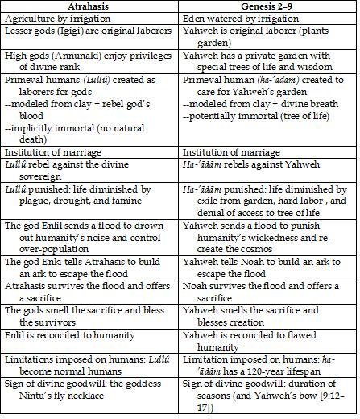
http://biologos.org/blog/the-second-creation-story-and-atrahasis

Slide 29
Egyptian Hermopolis: Pyramid Texts and Coffin Texts Pre-creation conditions: gods of chaos, watery deep, darkness and breath 2. Breath/wind (Amun) moves on the waters 3. Creation of supernatural light (self-generation of Atum) 4. Emergence of primordial hill "in midst of Nun" 5. Procreation of sky (Shu) when Nun was raised over the earth | Genesis 1:1-2:3 1. Pre-creation condition: anti-life chaos, watery deep, and darkness, but breath of God 2. Breath/wind of God moves on the waters 3. Creation of supernatural light (creation by God) 4. Creation of firmament "in midst of the waters" 5. Creation of sky when waters were raised above the firmament
G. H. Johnson, Genesis 1 and Ancient Egyptian Creation Myths, Bibliotheca Sacra 165(Ap-Ju 2008):184. Modified by Duke in light of Currid.
Notes:
Genesis 1 is often compared to Babylonian accounts and dated to the time of the Babylonian Exile; however, Gen. 1 is closer to Egyptian accounts.

Slide 30
Hermopolis: Pyramid Texts and Coffin Texts 6. Formation of heavenly ocean (Nut) by separation 7. Formation of dry ground (Geb) by separation, vegetation prior to humans 8. Humanity accidentally created by tears of Atum; other 9. Sun and moon created to rule the world as the image of Re and Thoth | Genesis 1:1-2:3 6. Formation of heavenly ocean when waters were separated 7. Formation of dry ground when waters were gathered, vegetation prior to humans 8. “Greater and lesser lights” (nameless) created to rule day and night. 9. Creation of humans to rule the world as the image of God
G. H. Johnson, Genesis 1 and Ancient Egyptian Creation Myths, Bibliotheca Sacra 165(Ap-Ju 2008):184. Modified by Duke according to Currid.
Notes:
Note: In Genesis the sun (shemesh) and moon (yareach) remain nameless. They were worshiped in Egypt as Re and Thoth, and in Mesopotamia as Shemesh (sun) and the moon god Sin.
Both Egyptian and Gen 2 have life imparted by the breath of the creator god, something not found in Sumerian or Babylonian texts (Currid, 71).

Slide 31
General Similarities Between Genesis Texts and ANE
Same basic story outlines and emplotment.
Same kinds of literary features.
Neither focused on material origins, but on nature of life now.
  ANE texts explain the functional roles of the gods involved in maintaining the order of the world
  Hebrew explain how God established the proper functioning of the cosmos.
    Difference: God is NOT a part of the material world; God is NOT a functionary in it as other gods; God is sovereign over all.
Both concerned about understanding order and chaos
  ANE gods want to establish equilibrium and rest: after victory, they establish sacred city/temple
  Hebrew: God creates cosmos as Temple of order, equilibrium, unending 7th day of rest. Sabbath (7 day dedication)

Slide 32
General Differences Between Genesis Texts and ANE
Political:
Not establishing a capital city, temple, or a king/pharaoh
All land is the same [Note: no concept of ‘planet earth’]
Not establishing a separate state religion
Worship of Israelite God was apparently both state and popular religion
Not establishing a divided social order with king as ‘son’ (Egypt) or regent (Mesopotamia)
All humans are created in the image of God (image not a statue of a god or king)
Not establishing a labor class from other
All serve with/for God
  In Gen. 2, monogenesis, not polygenesis:
    Adam and Eve as archetypes who ideally walk and talk with Yahweh.

Slide 33
General Differences Cont.
Theological/Religious
No theogony (birth of gods)
Monotheistic: God assumes all functions of the cosmos
No battle among gods (Mesopotamia)
God is sovereign over chaos and all that is contra life
No pantheism or animism (material world as manifestation of gods or spirits)
God is not part of natural world
No mythic enactment and mimetic magic
God, not materially part of world, cannot be coerced
No “common folk”
Humans have lofty calling:
  all in image of God (Gen 1)
  all given priestly role of serving (Gen 2)

Slide 34
Issues of Interpretation
Physical Picture
The “origin” texts of the ancient Near East, including the Bible, have to be read and understood on the basis of their ancient understanding of the physical world (“world picture”), NOT on the perspective of some later era, 18th century, 21st century, or future 22nd century.
  Helpful distinction?
  “World picture” (a scientific and pragmatic explanation of reality) is culturally dependent and ever changing.
  “Worldview” (a religious meaning/value-oriented understanding of reality) might be viewed as lasting.
Function of ANE “Origin” Texts
Such narrative texts presented a basic worldview (divine, human, and natural realms), explaining, in part politically, why things are the way they are.
Notes:
“Science” means knowledge. Our knowledge of this world is constantly changing.

Slide 35
Issue of Science and the Bible
“Usually, even a non-Christian knows something about the earth, the heavens, and the other elements of the world, about the motion and orbit of the stars and even their size and relative positions . . . and so forth . . . Now, it is a disgraceful and dangerous thing for an infidel to hear a Christian, presumably giving the meaning of Holy Scripture, talking nonsense on these topics. . . . If they find a Christian mistaken in a field which they themselves know well . . . how are they going to believe those books in matters concerning the resurrection of the dead, the hope of eternal life, and the kingdom of heaven . . .? Reckless and incompetent expounders of Holy Scripture bring untold trouble and sorrow on their wiser brethren.”
Augustine, The Literal Meaning of Genesis (2 vols.; trans. J. H. Taylor; New York: Newman, 1982), 1:423-43, as cited in M. A. Noll, The Scandal of the Evangelical Mind (Grand Rapids: Eerdmans, 1994), 202-3.

Slide 36
Issue of Science and the Bible
“Here lies the difference; Moses wrote in a popular style things which, without instruction, all ordinary persons, endued with common sense, are able to understand; but astronomers investigate with great labour whatever the sagacity of the human mind can comprehend.”
John. Calvin, Genesis (2 vols.; trans. and ed. J. King; Edinburgh: Banner of Truth, 1965), 1:86-87

Slide 37
Issue of Science and the Bible
“Science is invoked to prove that the narratives of creation in Genesis 1, the story of man’s origin and fall in chapters 2 and 3, the account of patriarchal longevity in chapters 5 and 11, the story of the deluge, and other matters, must all be rejected because in patent contradiction to the facts of modern knowledge…. What is meant by contradiction here? The Bible was never given us in order to anticipate or forestall the discoveries of modern twentieth century science.
The Bible, as every sensible interpreter of Scripture has always held, takes the world as it is, not as it is seen through the eyes of twentieth century specialists, but as it lies spread out before the eyes of original men, and uses the popular every-day language appropriate to this standpoint.”
James Orr, “The Early Narratives of Genesis,” The Fundamentals,
(Ch 11, 1917 collection). http://fundamentalists.whybaptist.com/chaptereleven.aspx

Slide 38
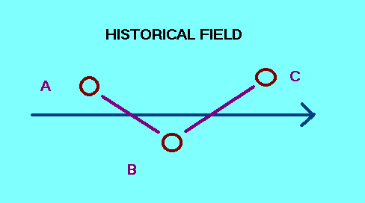
Reflection on History Telling (Review last class)
In pairs discuss:
1. The paragraph you wrote regarding our last class on
“doing” history.
2. Is there a conflict if one claims that the Israelite historical narratives are both ‘subjective’ and ‘inspired’? (Does ‘subjective’ imply inaccurate?)
3. What is the relationship between accuracy and rhetorical intention? (Must details incidental to a text's rhetorical intention be accurate for the text to communicate accurately?)
4. Agree or disagree: Duke, “Without being subjective and interpretive our histories would not communicate meaning.”

Slide 39
BIBLE AS HISTORY
Overview of Issues
1. Nature of the Bible:
The Bible is not a history book but a collection of many genres: wisdom, prophetic, legal, hymnic, apocalyptic, etc., as well as historical narrative.
2. Literary issues:
How do we know a historical narrative when we see it? What distinguishes it from fiction? Are there “blends” (types of literature that blend history and fiction)?
What should we expect from ancient Near Eastern historical narrative? How does it differ from modern Western history telling?

Slide 40
BIBLE AS HISTORY
Functional issue:
What are the communicative purposes of telling history in general? What were the Israelite (OT) and Christian (NT) purposes? [Different genre have different functions.]
Issue of historicity:
How accurate are the biblical historical narratives?
[Note: “accuracy” depends on the function/communicative purposes (#3) and standard necessary to carry out that function.]

Slide 41

BIBLE AS HISTORY
5. Nature of Inspiration:
Does the literature in the Bible carry out God’s communicative purposes?
Not: 21st century expectations of being able to determine the authorship, date of writing, unity of writing, etc.
Question:
Could God work through the community of faith over several generations to preserve, shape,
and edit the biblical text AND it still be
inspired for God’s communicative
purposes?

Slide 42
#2 Literary Issues:
What should we expect from ancient Near Eastern historical narrative versus modern?
Hebrew ‘historical narrative’ combines:
historiography (“Something like this must have
happened…”),
“science” (Rational explanation of cosmology from a
phenomenological perspective. Modern science has this
same “mythic” function of explaining origins materially.
theology (The character and involvement of God), and
aesthetics (Well composed “poetically”).

Slide 43
#3 Functional Issue
What are the communicative purposes of telling history in general?
(See CoursePack, p. 26)
Summary of Purposes of Biblical Historical Narratives
1. a. Preserve the story and traditions of Israel/Jesus,
b. teaching (usually indirectly) the meaning of events, while
c. addressing the questions and needs of the particular
audiences of the greater narrative units.
2. Inculcate (instill) a worldview (i.e. how the world works,
particularly in relationship to the divine).

Slide 44
STRUCTURES OF NARRATIVE

Slide 45
Exploring the Purpose and Attraction of Narrative/Story
(1 of 7)
Questions: Why do stories attract us so? What purpose do they serve?
Thesis: A major component of our lives involves expressing our comprehension of reality in narrative. Therefore, we are naturally attracted to narrative (fictional or historical) for the meaning it conveys.

Slide 46
Exploring the Purpose and Attraction of Narrative/Story
(2 of 7)
A. What are the components of narrative?
“The king was healthy but he became ill.”
1) Select characters and events.
“The king was healthy. The king became ill. The king took medicine. The king died.”
2) story-line/plot (begin, middle, end)
“The king was healthy but he became ill, and although he tried every medicine in the kingdom, he still died.”
3) relationships among events

Slide 47
Exploring the Purpose and Attraction of Narrative/Story
(3 of 7)
Implications:
1) Since the OT narrative blocks are composed of a string of stories in order to create a total impact, we need to understand the intention of the a whole before analyzing the parts.
2) Since the basic components of narrative and historical conception are the same, the process of forming narrative corresponds with the process of doing history.

Slide 48
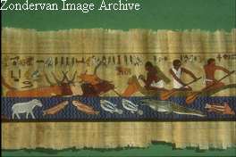
Exploring the Purpose and Attraction of Narrative/Story
(4 of 7)
B. How narratives convey meaning.
They convey a world-view through:
1) Select characters and events: reveal values
2) story-line/plot (begin, middle, end): show purpose/direction
3) relationships: demonstrate laws of reality

Slide 49
Exploring the Purpose and Attraction of Narrative/Story
(5 of 7)
C. We use narrative to express one of the ways we comprehend our world/lives.
Three ways we comprehend reality:
1) Categorization: used in systematic theology, philosophy
2) Hypothetico-deductive, used in science
3) Configurational, used in historical memory, expressed in narrative.
-Important component of our lives; seen in our dreams,
daydreams, plans, evaluation of our lives, etc.
Thesis: A major component of our lives involves expressing our comprehension of reality in narrative. Therefore, we are naturally attracted to narrative (fictional or historical) for the meaning it conveys.

Slide 50
Exploring the Purpose and Attraction of Narrative/Story
(6 of 7)
D. The above observation (historical and fictional stories share the same narrative form) raises other questions:
1. How do fictional narratives differ from historical?
2. How can the reader distinguish them?
1. The difference is whether or not the REFERENT existed in real time and space.
Author
Mean Referent
Audience

Slide 51
Exploring the Purpose and Attraction of Narrative/Story
(7 of 7)
2. Without external corroboration we cannot tell them apart. We must have some clues into the authorial intention (e.g genre clues such as "Once upon a time").
*Caution: We cannot make the distinction on whether or not
the author's world-view differs from ours.

Slide 52
[Duke] Propositional Truth Vs. Mimetic Truth
(Thinking in terms of historical referentiality)
Language
creates Referential Quality
Textual World
How does it
relate? Mimetic
Quality
Real World
Asks if textual world is “accurate” to real world historically (events in time & space)
Asks if textual world is “accurate” to nature of real world in terms of how life “works” (life’s experiences)*
[Note: One might call both qualities “referential,” but pointing to two different considerations: historically unique and/or nature of reality.]
*Can there be interpretation (application), if there is no mimetic quality?

Slide 53
COMMON ASSUMPTIONS OF BOTH
“ATHEISTIC” AND “FUNDAMENTALIST” INTERPRETERS
There is one kind of truth/knowledge: historical & scientific FACTS
There are two kinds of narrative: HISTORY (“true”) & FICTION (“false”)
HOWEVER (Duke):
There are different kinds of truths and ways of knowing.
E.g. Relational knowledge expressed in narrative. Narratives create “narrative worlds” that can be assessed in terms of their mimetic truth (how accurately they portray reality).
There is a whole range, or variety of “blends” between
historical narrative and fiction.
E.g. court records, fictionalized history, historicized fiction, legends, novels, fairytales, etc.
Notes:
Comment: Biblical faith is historically grounded in the redemptive acts of God in time and space. That does not mean that we know how to identify which Israelite stories are more “historical” from those that are more “legendary.” It may not matter if George Washington chopped down a cherry tree – the story presumably captures something of his character accurately – but, it does matter if he was a great general and if he was President. One example is Jonah. I do not know if Jonah is meant to be history or political satire. Have you noticed how it ends on a question, as do some of the parables of Jesus? But, I’m not going to lose sleep over it. God has worked in my life. I have no doubt about God working historically. I don’t doubt that God could create a sea creature to swallow Jonah. Either way, history or satire, there are clear mimetic truths about reality being taught. For this reason, in practice, Jews read Jonah on the Day of Atonement – not for historical recital, but for its convicting message.

Slide 54
POSSIBLE “MODERN” ASSUMPTION?
All biblical narratives/stories must be historically accurate to be “true”!!!
How are they “true”?
How is the historical referentiality of an account meaningful?
How can there be interpretation (application), unless there is mimetic “truth”?
What determines what is “historical”?
  For ancient Greek historians, a good historian was expected to record a person’s speech not verbatim, but accurately in terms of the person’s character and the main point of the speech. (Large numbers in Joshua fits ANE battle accounts.)
Why must all stories be historical?
  Even our culture does not make an absolute separation between history and fiction. We have a range of literature with “blends”: fables, parables, legends, tall tales, dramatic enactments, historical fiction, fictional history, and historical narrative. (Which do we use the most for instruction?)

Slide 55

Literary Issues:
What should we expect from ancient Near Eastern historical narrative versus modern?
Ancient Modern
Theistic perspective vs. Atheistic perspective
Aesthetically crafted vs. Plain “objective” style
Phenomenological view vs. Scientific world view
Functional embellishment vs. Nothing but the “facts”
Creation of speeches for vs. Word-for-word accuracy
character portrayal
Orally transmitted texts vs. Focus on incidental details
drop incidental details
etc.

Slide 56
Paper #16
a. How does Gen 1-11 serve as a prologue?
Flood
Abram
Total corruption
Noah
Creation
Total corruption
Israel
b. What promises to Abraham? What significance?
Signif. (1) Israel’s beginning/ancestry (ethnic ID)
(2) unity of Pentateuch: overarching storyline with main themes related to the promises.

Slide 57
Themes of the Pentateuch:
Gen: 'election'/chosen, covenant/promises (son, become nation, land, blessing/cursing to nations)
Exod: deliverance (to keep promises), covenant-Law
Lev: holiness (to keep covenant) [*middle "book"]
Num: human failure to keep covenant, but God's faithfulness/patience
Deut: renewal of covenant

Slide 58
Moses and the Pentateuch
Moses wrote all
Moses wrote none
Which position do you support and why?

Slide 59
READING STRATEGY
(See CoursePack, pp. 27-28)

Slide 60
Lit. Features of Genesis 18-19 (1 of 3)
(Homework #5)
18:1 Narrator: summary introduction
18:2,10,22,33; 19:1 Narrator: details to guide audience how
revelation of God unfolds
18:2-8 Length & details show significance of scene
Character portrayal through action: emphasis on Abe's haste and humility = righteous
18:10-15 Details (scenic) need to visualize to get impact (Abraham between Sarah and Yahweh)
18:10 Narrator detail: change of number, "He said"
18:10 Echo/repetition of main theme/promise (13-14, 17-19)

Slide 61
Lit. Features of Genesis 18-19 (2 of 3)
18:11 Narrator: highlighting tension to fulfill of promise
18:17-19 Narrator's use of speech of Yahweh: talks to self, emphasizes promises and nature
18:22-33 Length shows significance of scene
Character portrayal through speech/intervention (emphasizes corruption of people as well)
Link/bridge to next episode: Yahweh looking for righteous person.

Slide 62
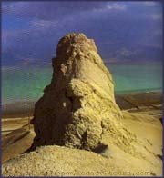
Lit. Features of Genesis 18-19 (3 of 3)
19:1-3 Juxtaposition for comparison, contrast:
Echoing: comparison
Character portrayal through action
19:4-10 Juxtaposition: antithesis of "echo" of Abe: contrast

Slide 63
Homework #6
Genesis: 12:10-20; 20:1-17; and 26:1-11
1) What is the common plot element?
2) (W) How do you account for the similarity?
Judges 2:6-3:30
3) What is the main structuring element in Judges?
4) (W) Support whether or not you think this material was put into written form soon or long after the events mentioned?

