Slide 1
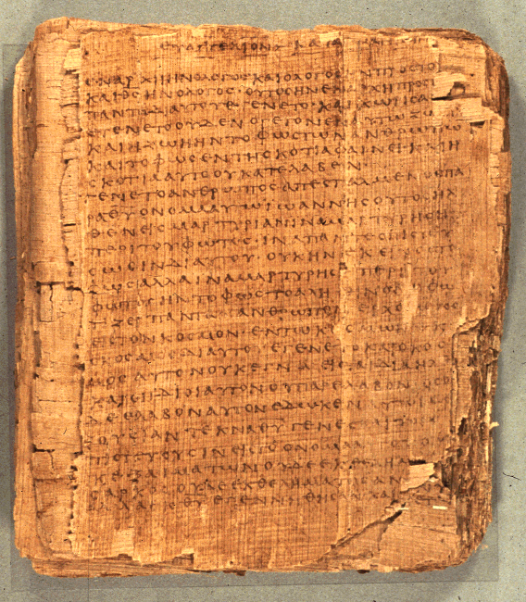
COS 221
Bible II
Dr. Rodney K. Duke

Slide 2
DAY 4
Assign:
1) (Journal)
2) #12 Deuteronomistic History *Change W to N (notes)
3) #14 Priesthood *Change W to N (notes)
4) #15 Chronicles *Change W to N (notes)
5) #16 Ruth Just if you want to for fun.
Day Obj.: (Laws, Cult)
1) Describe how narratives communicate meaning.
2) Formulate guidelines for reading biblical narrative.
3) Formulate guidelines for reading and applying OT laws.
4) Describe the Deuteronomistic History.

Slide 3
Reading Ancient “Creation” Texts in Context
Some of the texts (e.g. Enuma Elish, Memphite Theology) are not merely abstract cosmogonies (origin of the cosmos) or theogonies (origins of the gods), but political treatises.
  Established state religion, capital city, main temple, ruler
  Egyptian accounts of Heliopolis, Hermopolis, and Thebes, each identifies the primordial land with their cultic center.
  Established social structure/roles/archetypes of tradition
Some of the texts may have been used in religious ritual re-enactments (mimetic magic) of the state religion’s myths in order to encourage the god to carry out their proper functions in maintaining the natural order of the world
  Enuma Elish became used in the New Year Festival.
  Pyramid Texts, king (as image of) ritually stands in for Atum (Kheprer) when he assumed kingship of the world he was creating.
  Egyptian Re-Atum renews world every day.
Notes:
Enuma Elish substitutes Marduk for the leading role of Enlil (going back to Atrahasis) and makes the political statement that Marduk established Babylon at about the time the First Babylonian Dynasty (Semitic people taking over Sumerian culture), when Babylon became the capital. This account consolidated Marduk as the chief god of the state religion. Early Assyrian kings were seen as the “son” of the god and as the “image” of the god, representing the god to the people; so, such stories also consolidated the power of the king. And stories such as the Enuma Elish established the social structure of king > priests and scribes of the court > common people. So, too, the Memphite Theology establishes not just the role of Ptah, but empowered a Pharoah and the city of Memphis. Each of the Egyptian creation texts of Heliopolis, Hermopolis, and Thebes tell the same story but each identifies the primordial land with their cultic center (Johnston, Genesis 1 and Ancient Egyptian Creation Myths. 189-90).
See Currid, Ancient Egypt and the Old Testament, on Egyptian parallels. Here Pyramid Texts, cited on p. 69.

Slide 4
Those texts which present a cosmogony and/or theogony, even if politically oriented:
Explain the nature of things and how they came to be the way they are.
Are focused not on material origins, but on the origins of the functions and roles of the gods as reflected in the physical world.
Presupposes their ancient phenomenological (commonly observed) understanding of the cosmos. (See following slide on “Issue of Science and the Bible”)

Slide 5
Parallels Between Genesis 1-2 and Enuma Elish
Parallel | Genesis | Enuma Elish
Chaotic Primeval State | “Formless” and “empty” – Gen 1:2a | Chaos from the absence of gods and the absence of “name” – EE I. lines 7-8).
Primordial Waters | “Darkness” over the surface of the watery depths – Gen 1:2b, and separation of two spheres of water (cf. Gen 1:6-7) | Tiamat, personification of primeval ocean, split in two spheres of water – EE IV. lines 100-140.
Creation of Mankind | Man is formed out of “dust” – Gen 2:7 | Mankind is created from the blood of Kingu, Tiamat’s co-conspirator – EE VI. lines 1-10.
Image | Mankind is created in the “image of God” – Gen 1:26-27; cf. Gen 5:3, where the divine image given to Adam is carried on to his progeny (i.e., Seth). | Anu begets Nudimmud in his image – EE I. line 16. *Note: Both Anu and Nudimmud, however, are both gods, not humans.
Temple-Rest | Yahweh takes up divine rest in his cosmic-temple after creation out of chaos (cf. Gen 3:8; Rev 22:1-2) | Marduk and other gods take rest in temple after victory over creation-conflict – EE V. lines 121-130; cf. VI. lines 51-60.
http://atpreston.wordpress.com/2012/11/05/a-comparative-essay-on-the-creation-epic-of-enuma-elish-and-genesis-1-2/

Slide 6
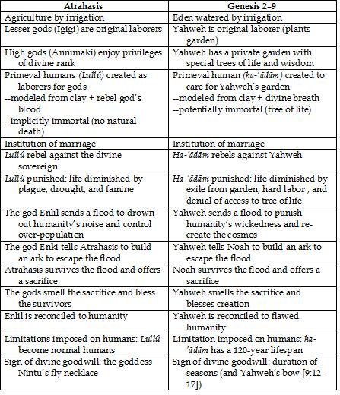
http://biologos.org/blog/the-second-creation-story-and-atrahasis

Slide 7
General Similarities Between Genesis Texts and ANE
Same basic story outlines and emplotment.
Same kinds of literary features.
Neither focused on material origins, but on nature of life now.
  ANE texts explain the functional roles of the gods involved in maintaining the order of the world
  Hebrew explain how God established the proper functioning of the cosmos.
    Difference: God is NOT a part of the material world; God is NOT a functionary in it as other gods; God is sovereign over all.
Both concerned about understanding order and chaos
  ANE gods want to establish equilibrium and rest: after victory, they establish sacred city/temple
  Hebrew: God creates cosmos as Temple of order, equilibrium, unending 7th day of rest. Sabbath (7 day dedication)

Slide 8
General Differences Between Genesis Texts and ANE
Political:
Not establishing a capital city, temple, or a king/pharaoh
All land is the same [Note: no concept of ‘planet earth’]
Not establishing a separate state religion
Worship of Israelite God was apparently both state and popular religion
Not establishing a divided social order with king as ‘son’ (Egypt) or regent (Mesopotamia)
All humans are created in the image of God (image not a statue of a god or king)
Not establishing a labor class from other
All serve with/for God
  In Gen. 2, monogenesis, not polygenesis:
    Adam and Eve as archetypes who ideally walk and talk with Yahweh.

Slide 9
General Differences Cont.
Theological/Religious
No theogony (birth of gods)
Monotheistic: God assumes all functions of the cosmos
No battle among gods (Mesopotamia)
God is sovereign over chaos and all that is contra life
No pantheism or animism (material world as manifestation of gods or spirits)
God is not part of natural world
No mythic enactment and mimetic magic
God, not materially part of world, cannot be coerced
No “common folk”
Humans have lofty calling:
  all in image of God (Gen 1)
  all given priestly role of serving (Gen 2)

Slide 10
Issues of Interpretation
Physical Picture
The “origin” texts of the ancient Near East, including the Bible, have to be read and understood on the basis of their ancient understanding of the physical world (“world picture”), NOT on the perspective of some later era, 18th century, 21st century, or future 22nd century.
  Helpful distinction?
  “World picture” (a scientific and pragmatic explanation of reality) is culturally dependent and ever changing.
  “Worldview” (a religious meaning/value-oriented understanding of reality) might be viewed as lasting.
Function of ANE “Origin” Texts
Such narrative texts presented a basic worldview (divine, human, and natural realms), explaining, in part politically, why things are the way they are.
Notes:
“Science” means knowledge. Our knowledge of this world is constantly changing.

Slide 11
BIBLE AS HISTORY
Overview of Issues
1. Nature of the Bible:
The Bible is not a history book but a collection of many genres: wisdom, prophetic, legal, hymnic, apocalyptic, etc., as well as historical narrative.
2. Literary issues:
How do we know a historical narrative when we see it? What distinguishes it from fiction? Are there “blends” (types of literature that blend history and fiction)?
What should we expect from ancient Near Eastern historical narrative? How does it differ from modern Western history telling?

Slide 12
BIBLE AS HISTORY
Functional issue:
What are the communicative purposes of telling history in general? What were the Israelite (OT) and Christian (NT) purposes? [Different genre have different functions.]
Issue of historicity:
How accurate are the biblical historical narratives?
[Note: “accuracy” depends on the function/communicative purposes (#3) and standard necessary to carry out that function.]

Slide 13

BIBLE AS HISTORY
5. Nature of Inspiration:
Does the literature in the Bible carry out God’s communicative purposes?
Not: 21st century expectations of being able to determine the authorship, date of writing, unity of writing, etc.
Question:
Could God work through the community of faith over several generations to preserve, shape,
and edit the biblical text AND it still be
inspired for God’s communicative
purposes?

Slide 14
Literary Issues:
What should we expect from ancient Near Eastern historical narrative versus modern?
Hebrew ‘historical narrative’ combines:
historiography (“Something like this must have
happened…”),
“science” (Rational explanation of cosmology from a
phenomenological perspective. Modern science has this
same “mythic” function of explaining origins materially.
theology (The character and involvement of God), and
aesthetics (Well composed “poetically”).

Slide 15
[Duke] Propositional Truth Vs. Mimetic Truth
(Thinking in terms of historical referentiality)
Language
creates Referential Quality
Textual World
How does it
relate? Mimetic
Quality
Real World
Asks if textual world is “accurate” to real world historically (events in time & space)
Asks if textual world is “accurate” to nature of real world in terms of how life “works” (life’s experiences)*
[Note: One might call both qualities “referential,” but pointing to two different considerations: historically unique and/or nature of reality.]
*Can there be interpretation (application), if there is no mimetic quality?

Slide 16

Literary Issues:
What should we expect from ancient Near Eastern historical narrative versus modern?
Ancient Modern
Theistic perspective vs. Atheistic perspective
Aesthetically crafted vs. Plain “objective” style
Phenomenological view vs. Scientific world view
Functional embellishment vs. Nothing but the “facts”
Creation of speeches for vs. Word-for-word accuracy
character portrayal
Orally transmitted texts vs. Focus on incidental details
drop incidental details
etc.

