Slide 1
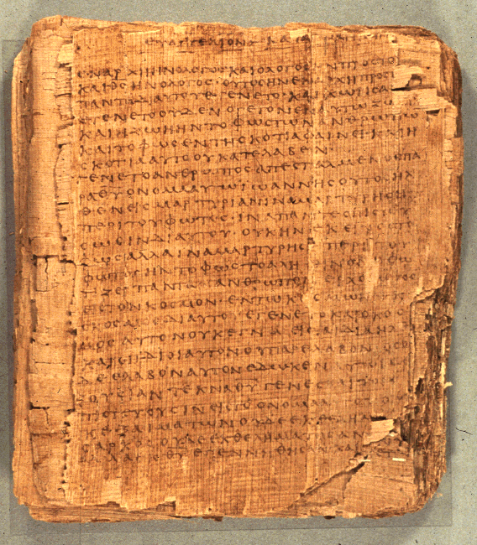
COS 221
Bible II
Dr. Rodney K. Duke

Slide 2
DAY 5
Assign:
1) Love Jesus
2) Love your people
3) Rest
Day Obj.:
1) Formulate guidelines for reading and applying OT laws.
2) Describe the nature of the Israelite priesthood.
3) Describe the Deuteronomistic History.
4) Describe the Chronistic History.

Slide 3
I have sent an email to you with the COS 221 Evaluation Form AND the Ministry Application Assignment.
Both sections MUST BE completed for you to receive your final grade in this course.
Both sections must be “MAILED” by regular mail to the COS Director within 3 days of the last day of the course.
(Fuller instructions are provided in the Ministry Application Form.)

Slide 4
READING STRATEGY
(See CoursePack, pp. 27-28)

Slide 5
Homework #6
Genesis: 12:10-20; 20:1-17; and 26:1-11
1) What is the common plot element?
2) (W) How do you account for the similarity?
Judges 2:6-3:30
3) What is the main structuring element in Judges?
4) (W) Support whether or not you think this material was put into written form soon or long after the events mentioned?

Slide 6
BIBLICAL LAW

Slide 7
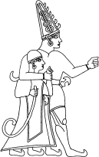
STRUCTURE OF DEUTERONOMY
I. PREAMBLE (1:1-5)
II. HISTORICAL PROLOGUE (1:6 - Ch 4)
III. STIPULATIONS (Ch 5 - 26)
IV. CURSES & BLESSINGS, COVENANT RATIFICATION (Ch 27 - 30)
V. DYNASTIC DISPOSITION (Ch 31 - 34)
Hittite God and King

Slide 8
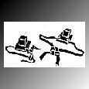
Assign. #8: The Heart of the Covenant
a) If the 10 Commandments are the heart of the Law, what is the heart of the 10 Commandments?
b) What are the reasons for, and benefits of, obeying the Law?
Note: 7:12f
c) Why were the Israelites chosen by God?
Note: 7:6-8 and 9:4-6
d) (W) What is the danger the Israelites face once
settled in the Promised Land?
Note: 6:4-9 the Shema

Slide 9
Review: A 8: Nature of Israelite Law
Why blood not eaten? (Lev 17)
Life in the blood – given to make atonment
2) Why avoid these sexual practices? (Lev 18)
Corrupt practices of others
3) What similarities in content? (Lev 18 & 20)
Same topics
4) What clues to complex history of composition? (Lev 17-20)
(e.g. change of form!)
5) Which laws would you include and which would you exclude? Why? What are your principles for including/excluding? (Lev 19)
What does: “An eye for an eye” mean?
(Monetary equivalent allowed for all but murder.)
6) Is our system of dealing with criminals better or worse?
Notes:
See notes on death penalty on following slide.

Slide 10
Review: Comparing Israelite Criminal Law to USA Criminal Law
Ancient Israel USA
Immediate, bodily punishment
Imprisoned, often lengthy, costly to society
Remain a part of society
Removed from society and family Who provides for the family?
Note: It appears that death as a penalty was only carried out when there had been loss of life. 16 crimes merited the “death penalty” but a ransom is prohibited only for the case of murder. Presumably then a ransom was expected in the other 15 cases.
Publicly carried out (deterrent?)
Privately carried out
Focus on the victim
Focus on the criminal (rehabilitation?)
Individual responsibility
Societal responsibility
(Death-penalty debate)
Notes:
Hard Sayings of the Bible, pp 170f on Numbers 35:31, presents the thesis that, although there are 16 crimes for which the death penalty is prescribed, since only with premeditated murder was a ransom prohibited, the other 15 COULD be adjudicated with a ransom. In those 15 cases the death penalty indicated how serious they were, even though a death was not required.
Considerations:
This is an argument from silence, but would also fit with Paul and Jesus not supporting death for adultery and incest.
God does put Israelites to death for some of these crimes.
MIlgrom, Numbers, p 295, apparently agrees (perhaps was the source), stating, "The talion law implies compensation in all torts except for loss of life (see Exod. 21:23-24; Lev. 24:17-21; Deut. 19:21). Lest taking of life also be regarded as a tort and, hence, subject to monetary compensation, the talion law is not quoted here, and murder is explicitly excluded from monetary compensation.“
NOTE: Rabbinic literature makes the point that it was difficult as well as too harsh to condemn someone to a death penalty: 2 eyewitnesses present were each to give immediate warning to the person committing the act and the person committing the act had to acknowledge that he/she understood! Sayings: a Sanhedrin that put 1 person to death in 7 years was too strict; no, a Sanhedrin that put 1 person to death in 70 years was too strict! (See death penalty in Jewish encyclopedia.) Difficult to know ancient Israelite practice, although note that Hosea does not put wife to death.

Slide 11
Assignment #10 (in class)
A) Lev 18:8
Do not have sexual relations with your father's wife; that would dishonor your father.
B) Lev 20:11
If a man sleeps with his father's wife, he has dishonored his father. Both the man and the woman must be put to death; their blood will be on their own heads.
______________________________________
A) apodictic (absolute), found in covenantal kind of law codes
b) casuistic (case law), lists of parameters for the legal “experts”

Slide 12
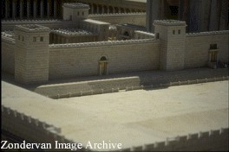
ISRAELITE PRIESTHOOD & HOLINESS SYSTEM
#14. Dictionary article on “Priest, Priesthood”
a) (W) Identify and discuss a new or significant thought on the Israelite understanding of sin and pollution and how it might inform/influence your Christian theology.

Slide 13
“Holiness & Sacrifices” (Unit 3, pp. 4-5)
What are some “unclean” foods in our culture that might be eaten in other cultures? Why are they “unclean” in our culture?
What are some “unclean”/unacceptable behaviors in our culture that might be acceptable in other cultures? Why are they unacceptable?
For the Israelites fish were “clean” but lobsters were “unclean.” What would be a possible explanation?
For Israel blood from a cut was “clean” but menstrual blood was “unclean.” What would be a possible explanation?
Notes:
Probably go over holiness for both HB1 laws and HB2 psalms?

Slide 14

“Holiness & Sacrifices”
a. Purity system and Holiness system
- purity: clean (life, order) vs. unclean
- holiness: holy (set apart for sacred use) vs. common
- both were “contagious”
- “gradations of holiness” examples:
b. Purification:
- permitted impurity (not sin) vs. unpermitted
- unpermitted polluted God’s “dwelling place”

Slide 15
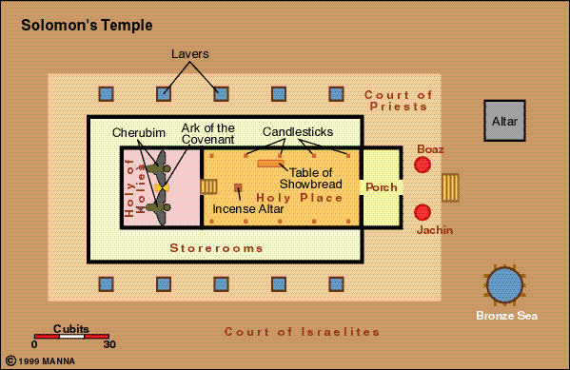

Slide 16
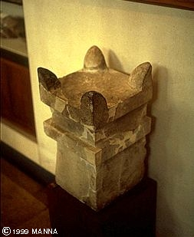
“Holiness & Sacrifices”
c. Sacrificial system:
- gift or gesture of obedience, but not food or magical manipulation
*- blood (Lev. 17:10-14): symbol of life
- types:
“Purgation”: cleansed God’s dwelling
“Well-being”: feast (“Thanks offering”; Todah)
Horned altar from Megiddo

Slide 17
Principles for Assessing Biblical Instructions (Intro)
(See your notes on Assignment #9. e): Which laws would you include and which would you exclude? Why? Lev 19)
Skim through Leviticus 19 and pick out:
a) A couple of laws that are morally neutral, but which symbolically teach the principle of the holiness of God, and
b) A couple of laws that are intrinsically moral.
Any difficulty sorting these out?
What are your principles for including/excluding any instructions?
Come up with some guidelines for the Church to follow.

Slide 18
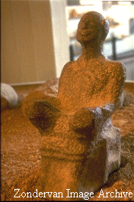
Principles for Assessing Biblical Instructions
(Unit 4, p. 15)
General Principle:
One's response to God is relational, not legislational.
The one standard is God’s character: “I am the LORD who brought you up out of Egypt to be your God; therefore be holy, because I am holy” (Lev. 11:45).] [So, too, Jesus' ethical instructions, "Be perfect as your heavenly Father is perfect" (Matt 5:47), go back to OT.]
Specific Principles:
A. When the situation-in-life of the original audience is the same situation found today, the instruction is applicable.
Canaanite God

Slide 19
Principles for Applying OT Instructions
Care must be taken to determine as fully as possible:
1) The specific issue the instruction is addressing and the impact the instruction is meant to achieve,
Different forms of laws with different intentions and settings.
Casuistic laws give parameters; other types of incest probably
implicitly included.
Restrictions on tattoos, probably aimed at idolatry.
2) Any background context assumed by the author,
Slavery is assumed, not mandated by God
Food laws assume zoological classification
3) If the instruction involves a practice which had a symbolic value in the OT culture.
Mixing types of thread, crops, etc. symbolize chaos
Tattoos, hair and beard styles?

Slide 20
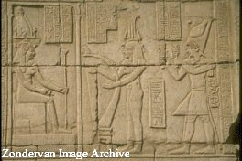
Principles for Applying OT Instructions
B. When Biblical instructions on a given topic are not consistent, then any one instruction probably is not universally applicable.
Do/don’t speak to a fool (Proverbs 26:4 & 5)
1 Cor. 14:34 - women not to speak versus 1 Cor. 11:5 - women to pray and prophesy
C. When the supporting principle of the specific instruction is universal, the principle may be used to generate applications for other similar situations.
Actions that symbolize idolatry
Egyptian court with musician

Slide 21
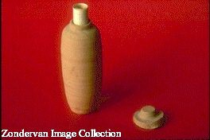
Principles for Applying OT Instructions
When the supporting arguments behind a specific instruction are unclear or not themselves universal, the instruction probably should not be applied universally.
Those that seem to be based on symbols of chaos
E. A text should not be interpreted for general application to say something the author could not have meant.
1 Cor. 13:10 What is wrong about interpreting “the perfect” here as the “New Testament”?
Scroll jar

Slide 22
Principle for Assessing Biblical Instructions
Some factors involved in understanding OT laws:
a. different forms w/different intentions and settings
b. involved different cultural symbols (blood)
c. involve different view of physical world (animal classification system, food laws; note realms of animals in Gen 1.)
d. different principles of justice re: consequences
e. involve different foundation for ethics
f. show complex compositional history (midrashic exegesis)

Slide 23
Exercise in class on Deut 12 (Homework #11). Read and answer:
a. What is the main theme of 12:1-28?
b. What are the "echoes"?
c. What is main point of 4-7? of 8-12? of 13-19? of 20-28?
d. See if you can find a chiastic structure to 13-19.
A 13
B 14
C 15
D 16
C 17
B 18
A 19

Slide 24
Deuteronomy 12: Various structures:
Three-fold pattern:
i. place Yahweh chooses vss. 5 11a 14a 26
ii. make offerings 6 11b 14b 27a
iii. eat and rejoice 7 12 [ ] 27b
Chiasm of vss. 13-19:
A Be careful! (13)
B mayk – ref to place (14)
C what can be eaten (15)
D blood forbidden (16) *focal point
C what cannot be eaten (17)
B mayk – ref. to place (18)
A Be careful! (19)

Slide 25
Deuteronomy 12: Various structures:
Parallels:
vs. 15 expanded in vss. 20-22
vs. 16 expanded in vss. 23-25 (3-fold repetition)
vs. 17 what not to do and what to do with consecrated vs. 26
vs. 18 edible vs. “burnt” vs. 27
Chiasm in vss. 19-28:
A Be careful! (19)
B eat what you desire (20)
C place Yahweh chooses (21)
D what is common (22)
E blood forbidden (23-25) 3-fold *focal point
D what is holy (26a)
C place Yahweh chooses (26b)
B eat the flesh of offerings (27)
A Be careful (28)

Slide 26
DEUTERONOMISTIC HISTORY
“FORMER PROPHETS”

Slide 27
Deuteronomistic History (1 of 4)
(Assign. #12)
(Walking in the footsteps of Martin Noth)
What evidence of complex history of composition (based on diversity)?
Elements of diversity: many genres, styles, and perspectives (land records, oral traditions, political accounts, court records, etc.)
What then makes this material “hang together” in unity as a block?
In groups:
a) Go over results of #12. a) & b)
b) Discuss: “For what reason would someone have compiled this body of literature? Note the historical situation at the end of 2 Kings.

Slide 28
Deuteronomistic History (2 of 4)
Responses to #12:
Observations:
More narrator comment than description of action.
Mainly speeches in the mouths of main characters
Indirectly address the audience
Reflective recitals on past history or reflection on upcoming events
Uphold the covenant (Deut.) as the standard

Slide 29
Deuteronomistic History (3 of 4)
2. Elements of unity:
Edited with blocks of speeches/narrator comments from same covenantal, “Deuteronomistic perspective” which address the audience with interpretive reflections
Main intention:
To explain the exile & preserve their identity
Main theme/message:
Exile was the result of Israel's violation of the covenant. Yahweh did not abandon them.
Historical perspective:
Probably edited during exile.

Slide 30
Deuteronomistic History (4 of 4)
3. Independent, self-contained 'books'?
No (some self-contained units)
4. Authorship:
diverse, anonymous; much editing
5 Periods:
Conquest: (Joshua) obedience and victory
Judges: (Judges) disobedience (cycles)
King David: (1-2 Sam) time of greatest blessing
Kings: (1-2 Kings) downhill slide, intervention of prophets
Fall & Exile (2 Kings) the end (ambiguous, King Jehoiachin released from prison)

Slide 31
Add images
David as King (c. 1000-961 BCE)
Intro.: Time of David and Solomon:
Period of the United Monarchy - "Glory Years" of Israel
David - Israel's 'greatest' king. "Heart for Yahweh”
A. Prior to Death of King Saul
1. Background conditions:
a) tribal identity: land composed of several small units
b) loosely organized/related; no standing army
c) each had own “Patriarchal system of justice
2. Kingship under Saul produced a standing army, but began
the socio-economic change of a centralized government
(mainly developed under David)
3. David fights for Saul, becomes too popular, pursued by Saul becomes outlaw and a “protection agent.”
4. Death of Saul in battle against Philistines (suicide vs. killed by
the Amalekite messenger)

Slide 32
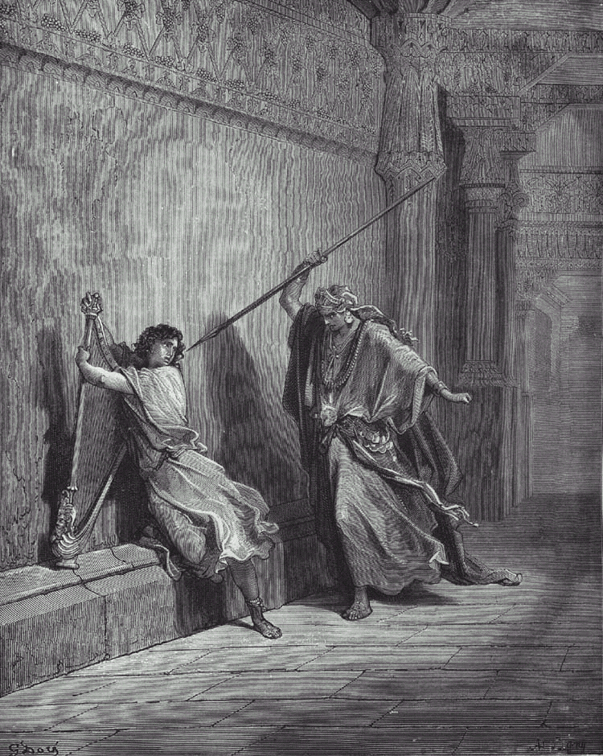
Saul and David
Saul and David (engraving). Copyright Blue Letter Bible Images (http://www.khouse.org/blueletter/images_menu.html

Slide 33
David as King (c. 1000-961 BCE)
B. David's rise to power as King over Judah at Hebron (2 years?)
1. Approx. 30 yrs old
2. Supported by Judean landholders
3. Rest of tribes of Israel under Saul's son, Ishbaal/Ish-Bosheth
4. Period of civil war, Ishbaal's general defects
King over all Israel at Hebron (recognized as king by all tribes)
1. Established peace and extended territory by victories over Philistines and other nations.
2. Centralized political identity: captured Jerusalem, made capital, built palace (neutral area between N & S)

Slide 34
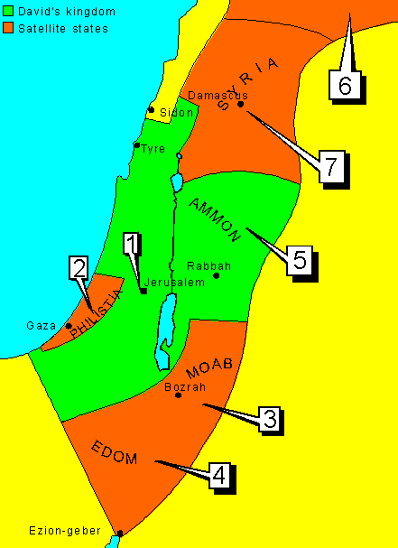
David Subdues his Enemies
      1 Captures Jerusalem (2 Samuel 5:6-10).
      2 Philistine power decisively crushed (2 Samuel 5:17-25; 8:1).
      3 Moabites are made David's subjects, paying taxes (2 Samuel 8:2).
      4 Edom defeated, controlled by troops and taxed (2 Samuel 8:13-14).
      5 Ammon's power destroyed. Ammonite people used for forced labour (2 Samuel 12:26-31).
      6 Defeat of King Hadadezer the Aramean. His vassal states (as far as the Euphrates) became David's (2 Samuel 10:15-19).
      7 Damascus conquered, controlled by troops and taxed (2 Samuel 8:5-8).

Slide 35
David as King (c. 1000-961 BCE)
C. King over all Israel (cont.)
3. Centralized religious worship: installed Ark of Covenant
in Jerusalem, brought in priests. ('Apostasy' when N.
tribes separate and create new sites) *Makes plans for temple, which is built and dedicated by son King Solomon
4. Legitimizes David dynasty: (Follows Abraham and Moses as recipient of covenant promises: 2 Sam 7:12-17; 23:1-7; Matt 1:1)
5. Centralized administrative powers:
a) King as main 'judge,' appointed others (restructures
tribal system)
b) Appointed Chief of Staff (Joab)
c) Selected commander of foreign mercenaries: Benaiah
d) Selected 2 chief priests (Zadok, Abiathar)
e) Selected public relations secretary (Jehoshaphat)
f) Established forced labor (administrator: Adoram)
g) Took census for military enlistment (used for taxation)

Slide 36
Homework #13 (in class): 2 Samuel 11
Listen to 2 Sam 11:1 when it is read with and without the narrator’s comments. What is the difference in the impact between these two readings?
What is the pace of the scenes in 2 Samuel 11? What impact does this create?
Quick (2-5):
Slow: (6-15):
Quick (16-17):
Slow (18-25):
Quick (26-27):
adultery w/Bathsheba
Uriah’s honorable behavior & David’s deceit
death of Uriah
report of death of Uriah (David - callous)
David takes Bathsheba as wife
If you were to make a movie about this chapter, what would you name it?

Slide 37
Consequences of David's Action
1) Death of child (should have been David)
2) Amnon rapes Tamar (Amnon was next in line for throne)
3) Absalom kills half-brother Amnon
4) Absalom tries to usurp David
5) Absalom sleeps with David's concubines
----------------------
6) Absalom is killed (ch 18)
7) Division in kingdom, Benjaminites withdraw support (ch 20)
8) Adonijah makes bid for throne, killed by Solomon (1Kgs 1-2)
Would you have recognized the above events as consequences, if the assignment had not directed your attention to them? What does the lack of interpretive comments from the narrator tell us about how to read biblical narrative?
Point:
Once God has spoken, directly or through a prophet or dream, the audience is expected to look for God’s word to be fulfilled.

Slide 38
David as King (c. 1000-961 BCE)
[Source: “Succession Document/Narrative” (2 Sam 9-20,
1 Kgs 1-2) appears to be based on contemporary records by a member of David’s court.]
D. “Fall of David” Cause
1. David and Bethsheba / murder of Uriah (ch 11-12)
2. Judgment/curse pronounced by prophet Nathan, who tricked David into condemning himself
3. David's repentance (See Psalm 51)
E. “Fall of David” “Curse”
1. Death of child (should have been David)
2. Amnon rapes Tamar (Amnon was next in line for throne)
3. Absalom kills half-brother Amnon (making Absalom next in
line for throne, assuming that Kileab was dead)
4. Absalom tries to usurp David
5. Absalom sleeps with David's concubines
6. Absalom is killed (ch 18)
7. Division in kingdom, Benjaminites withdraw support (ch 20)

Slide 39
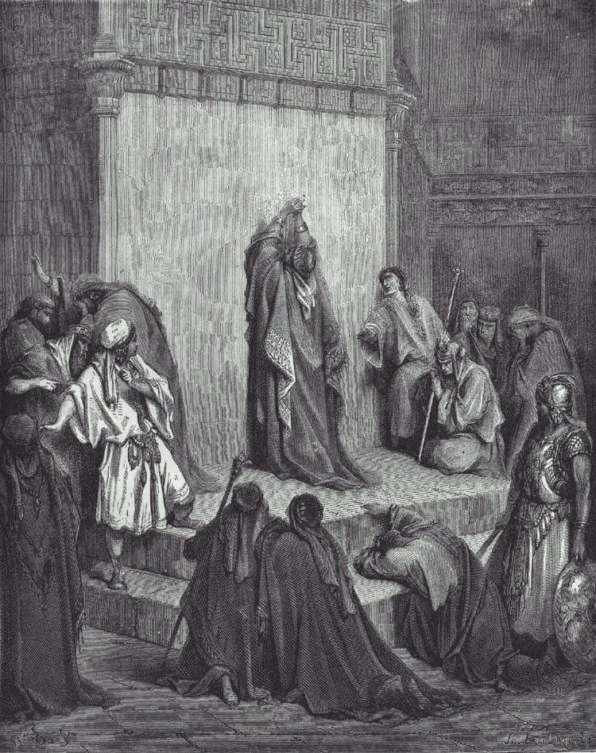
David Mourning for Absalom
David Mourning for Absalom (engraving). Copyright Blue Letter Bible Images (http://www.khouse.org/blueletter/images_menu.html

Slide 40
II Samuel 13
Jonadab - Amnon (3-5) A. counsel
Amnon - David (6) B. request made
David - Tamar (7) and carried out
Tamar - Amnon (8-16) C. rape
B. request made Amnon - Servant (17)
and carried out Servant - Tamar (18)
A. counsel Tamar - Absalom (19-20)
What impact does this literary structure have?

Slide 41
CHRONISTIC HISTORY: Assign #15
Objective: Identify how the author of the Books of Chronicles has shaped his retelling of the history of Israel.
The author/editor of the Books of Chronicles retells the history of Israel that is also found in the Deuteronomistic History (Joshua – 2 Kings) but from a different time period and perspective, and with different purposes. Both histories were seen as authoritative and both become canonical.
a) Discuss whether or not you think it can be historically accurate and/or valuable to have two accounts of the same historical period. (Is one necessarily right and the other wrong?)

Slide 42
CHRONISTIC HISTORY
In-class Exercise: Why retell history?
If you were the person writing Chronicles, in a setting of starting over after a “near death” experience, and you were going to look back over the history of Israel and retell it:
a) What would be your purpose?
b) On what subject matter on what kinds of events would you focus?
c) As someone retelling known traditions from a different perspective, what problems would you have to overcome to persuade your audience?
d) How would you overcome those problems?

Slide 43
CHRONISTIC HISTORY: Assign #15
1) (N) Read and compare the following pairs of passages between the DtrH and Chronicles. List for each pair the major differences between them that you note:
(a) 1 Samuel 31 and 1 Chronicles 10,
(b) 1 Kings 14:21, 25-28 and 2 Chronicles 12:1-14, and
(c) 2 Kings 21:1-18 and 2 Chronicles 33:1-20.

Slide 44
CHRONISTIC HISTORY: Assign #15
2) (W) Think about the different historical/theological perspective the Chronicler seems to have that might account for these differences. What seems to be the theological message (or perspective) of the writer of Chronicles?

Slide 45
CHRONISTIC HISTORY: Assign #15
2) (P) How does Chronicles differ from Samuel-Kings in the subject of its history?
Why do you think this would be the case?

Slide 46
Rhetorical Structure of Chronicles
1 Chron 1-10: Genealogies and lists, narrative on Saul
Introduces major subjects: Judah and Davidic tribes, Levi and priestly tribes/families
Narrator comments present the “seeking” argument in traditional terms: seek God and receive blessing, forsaking leads to cursing.
1 Chron 11- 2 Chron 9: Stories of David and Solomon
Presents them as a model (paradigm) of correct cultic behavior.
Narrator stays in background, but inductively by examples he modifies the concept of “seeking God” to show that when they establish the Temple cultus, God establishes them.
2 Chron 10-36: Accounts of each generation of Davidic kings
Narrator again comes to the foreground with comments evaluating each king according to “seeking” argument.

Slide 47
Assign. #15:CHRONISTIC HISTORY (1 of 3)
A. Historical perspective of Chronicler:
After return from exile
B. Content (What particular focus of Chronicles vs. Sam-Kgs?)
Chron.: retells history of nation (emphasis on Judah) from creation to exile and the promise of return.
Ez-Neh: tells of return and rebuilding, re-establishing the community.
C. Impact of exile:
greater access to the Law,
stricter supervision of cult.
major impact on shape of Hebrew Bible (Pent, DtrH, ChrH.)

Slide 48
CHRONISTIC HISTORY (2 of 3)
D. Compositional nature:
disunity:
different types of material, sources edited, then
re-edited with additions. (note ending and
question of unity w/Ezra-Neh)
unity of Chron:
Chr.'s theology of history (related to intention),
expressed through Davidic paradigm as organizing
structure
E. Intention (Chron.):
To present a message of hope, that all goes well when
one seeks God.
F. Major theme:
seeking (cultic) God brings blessing; forsaking
God brings cursing (disaster)

Slide 49
CHRONISTIC HISTORY (3 of 3)
G. Structure of Chron.:
First, David (and Solomon) are stereotypically portrayed as a model of ones who sought Yahweh. As they established the
proper worship of God, God established them and Israel.
Then the following Davidic kings are each presented explicitly or implicitly in comparison to the model of David.
New emphasis: Each generation has its chance to change.
H. Independent, self-contained books?
No, show signs of growing and merging
I. Authorship:
Chronicles: one primary editor/authors (w/revisions)
Ezra-Neh: different authors/editors

Slide 50
Review on Structures of Narrative
Structures of Narrative:
  Selection of subject matter: reveals what is
  significant
  Perception of relationships: reveals how “laws” of
  how the world operates
  Configuration in a plotline with beginning, middle,
  and end reveals a teleology and purposefulness (or
  lack)
If one knows what values/subjects are significant, and if one knows the laws of reality operative in the world and the direction things are moving, then implicitly an ideology is presented to guide human action within that world.

Slide 51
Application to Chronicles
Subject matter:
Yahweh, Davidic monarch, Temple cult and Levitical priesthood, prophetic figures, and “all Israel.”
Laws of reality:
Yahweh is the primary agent of history, but does not dictate the course the chosen people will take. They (kings and people) are responsible for maintaining a right relationship with God. Their choice to seek or forsake Yahweh, defined by the Chronicler in cultic terms, sets into motion the laws of blessing and cursing. These “laws” unlike in the DtrH are operative within a single reign or generation, not multigenerational.

Slide 52
Application to Chronicles
Teleology:
There is an original story line of the birth of Israel, the establishment of the line of David, and the institution to the Temple cult, which is then broken by the vignettes of Davidic kings, before the story line picks up again with the life of Israel threatened by extinction and the hint of promised restoration. Vignettes of Davidic Kings: each generation accountable.
Calls audience (each generation) of the new Jerusalem community into this world view and to accountability to seek God, if they want the hope of blessing.

Slide 53
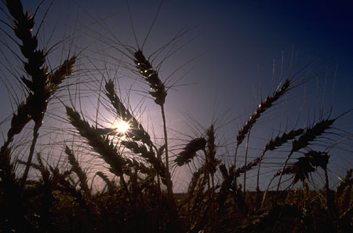
Homework #16: Structure of Book of Ruth
People who died
before main action
Ruth vs. Orpah
Women of Bethlehem (negative)
Naomi-Ruth
Boaz-servant
Boaz-Ruth
Boaz-servants
Naomi-Ruth
Boaz-Ruth
Naomi-Ruth
Boaz vs. “redeemer”
Women of Bethlehem (positive)
People who were born
after main action
Ruth = companion
Orpah = disloyal
Boaz = strength
Naomi = pleasant

