Slide 1
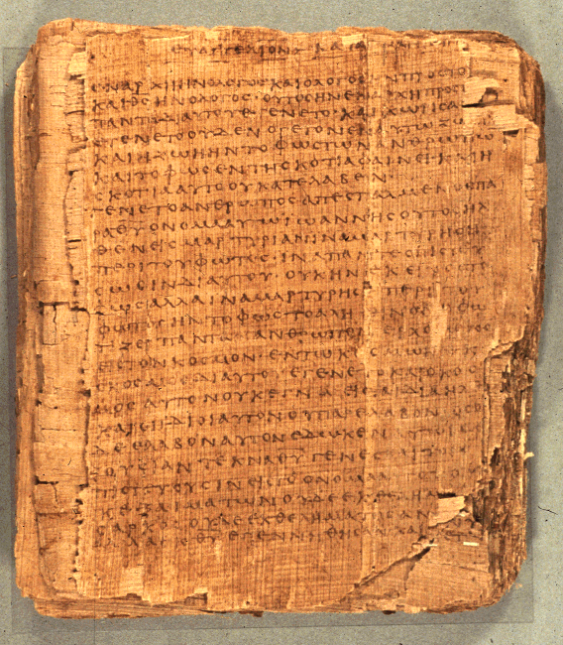
COS 221
Bible II
Dr. Rodney K. Duke

Slide 2
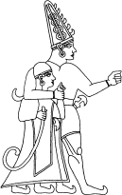
STRUCTURE OF DEUTERONOMY
I. PREAMBLE (1:1-5)
II. HISTORICAL PROLOGUE (1:6 - Ch 4)
III. STIPULATIONS (Ch 5 - 26)
IV. CURSES & BLESSINGS, COVENANT RATIFICATION (Ch 27 - 30)
V. DYNASTIC DISPOSITION (Ch 31 - 34)
Hittite God and King

Slide 3
Comparing Israelite Criminal Law to USA Criminal Law
Ancient Israel USA
Immediate, bodily punishment
Imprisoned, often lengthy, costly to society
Remain a part of society
Removed from society and family Who provides for the family?
Publicly carried out (deterrent?)
Privately carried out
Focus on the victim
Focus on the criminal (rehabilitation?)
Individual responsibility
Societal responsibility
(Death-penalty debate)
Notes:
It appears that death as a penalty was only carried out when there had been loss of life (cf. Milgrom, Numbers, 295, and Hard Sayings, 170f). 16 crimes merited the “death penalty” but a ransom is prohibited only the case of murder.

Slide 4
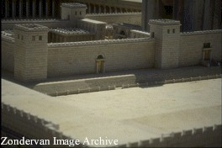
ISRAELITE PRIESTHOOD & HOLINESS SYSTEM
#14. Dictionary article on “Priest, Priesthood”
a) (W) Identify and discuss a new or significant thought on the Israelite understanding of sin and pollution and how it might inform/influence your Christian theology.

Slide 5
Principle for Assessing Biblical Instructions
Some factors involved in understanding OT laws:
a. different forms w/different intentions and settings
b. involved different cultural symbols (blood)
c. involve different view of physical world (animal classification system, food laws; note realms of animals in Gen 1.)
d. different principles of justice re: consequences
e. involve different foundation for ethics
f. show complex compositional history (midrashic exegesis)

Slide 6
Exercise in class on Deut 12 (Homework #11). Read and answer:
a. What is the main theme of 12:1-28?
b. What are the "echoes"?
c. What is main point of 4-7? of 8-12? of 13-19? of 20-28?
d. See if you can find a chiastic structure to 13-19.
A 13
B 14
C 15
D 16
C 17
B 18
A 19

Slide 7
Deuteronomy 12: Various structures:
Three-fold pattern:
i. place Yahweh chooses vss. 5 11a 14a 26
ii. make offerings 6 11b 14b 27a
iii. eat and rejoice 7 12 [ ] 27b
Chiasm of vss. 13-19:
A Be careful! (13)
B mayk – ref to place (14)
C what can be eaten (15)
D blood forbidden (16) *focal point
C what cannot be eaten (17)
B mayk – ref. to place (18)
A Be careful! (19)

Slide 8
Deuteronomy 12: Various structures:
Parallels:
vs. 15 expanded in vss. 20-22
vs. 16 expanded in vss. 23-25 (3-fold repetition)
vs. 17 what not to do and what to do with consecrated vs. 26
vs. 18 edible vs. “burnt” vs. 27
Chiasm in vss. 19-28:
A Be careful! (19)
B eat what you desire (20)
C place Yahweh chooses (21)
D what is common (22)
E blood forbidden (23-25) 3-fold *focal point
D what is holy (26a)
C place Yahweh chooses (26b)
B eat the flesh of offerings (27)
A Be careful (28)

Slide 9
DEUTERONOMISTIC HISTORY
“FORMER PROPHETS”

Slide 10
Deuteronomistic History (3 of 4)
2. Elements of unity:
Edited with blocks of speeches/narrator comments from same covenantal, “Deuteronomistic perspective” which address the audience with interpretive reflections
Main intention:
To explain the exile & preserve their identity
Main theme/message:
Exile was the result of Israel's violation of the covenant. Yahweh did not abandon them.
Historical perspective:
Probably edited during exile.

Slide 11
Deuteronomistic History (4 of 4)
3. Independent, self-contained 'books'?
No (some self-contained units)
4. Authorship:
diverse, anonymous; much editing
5 Periods:
Conquest: (Joshua) obedience and victory
Judges: (Judges) disobedience (cycles)
King David: (1-2 Sam) time of greatest blessing
Kings: (1-2 Kings) downhill slide, intervention of prophets
Fall & Exile (2 Kings) the end (ambiguous, King Jehoiachin released from prison)

Slide 12
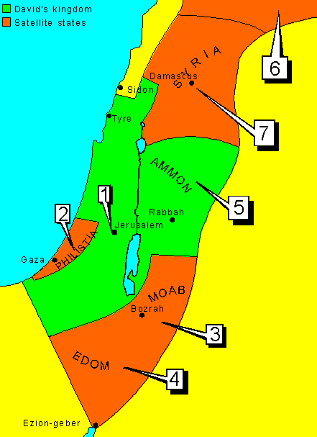
David Subdues his Enemies
      1 Captures Jerusalem (2 Samuel 5:6-10).
      2 Philistine power decisively crushed (2 Samuel 5:17-25; 8:1).
      3 Moabites are made David's subjects, paying taxes (2 Samuel 8:2).
      4 Edom defeated, controlled by troops and taxed (2 Samuel 8:13-14).
      5 Ammon's power destroyed. Ammonite people used for forced labour (2 Samuel 12:26-31).
      6 Defeat of King Hadadezer the Aramean. His vassal states (as far as the Euphrates) became David's (2 Samuel 10:15-19).
      7 Damascus conquered, controlled by troops and taxed (2 Samuel 8:5-8).

Slide 13
Rhetorical Structure of Chronicles
1 Chron 1-10: Genealogies and lists, narrative on Saul
Introduces major subjects: Judah and Davidic tribes, Levi and priestly tribes/families
Narrator comments present the “seeking” argument in traditional terms: seek God and receive blessing, forsaking leads to cursing.
1 Chron 11- 2 Chron 9: Stories of David and Solomon
Presents them as a model (paradigm) of correct cultic behavior.
Narrator stays in background, but inductively by examples he modifies the concept of “seeking God” to show that when they establish the Temple cultus, God establishes them.
2 Chron 10-36: Accounts of each generation of Davidic kings
Narrator again comes to the foreground with comments evaluating each king according to “seeking” argument.

Slide 14
Assign. #15:CHRONISTIC HISTORY (1 of 3)
A. Historical perspective of Chronicler:
After return from exile
B. Content (What particular focus of Chronicles vs. Sam-Kgs?)
Chron.: retells history of nation (emphasis on Judah) from creation to exile and the promise of return.
Ez-Neh: tells of return and rebuilding, re-establishing the community.
C. Impact of exile:
greater access to the Law,
stricter supervision of cult.
major impact on shape of Hebrew Bible (Pent, DtrH, ChrH.)

Slide 15
CHRONISTIC HISTORY (2 of 3)
D. Compositional nature:
disunity:
different types of material, sources edited, then
re-edited with additions. (note ending and
question of unity w/Ezra-Neh)
unity of Chron:
Chr.'s theology of history (related to intention),
expressed through Davidic paradigm as organizing
structure
E. Intention (Chron.):
To present a message of hope, that all goes well when
one seeks God.
F. Major theme:
seeking (cultic) God brings blessing; forsaking
God brings cursing (disaster)

Slide 16
CHRONISTIC HISTORY (3 of 3)
G. Structure of Chron.:
First, David (and Solomon) are stereotypically portrayed as a model of ones who sought Yahweh. As they established the
proper worship of God, God established them and Israel.
Then the following Davidic kings are each presented explicitly or implicitly in comparison to the model of David.
New emphasis: Each generation has its chance to change.
H. Independent, self-contained books?
No, show signs of growing and merging
I. Authorship:
Chronicles: one primary editor/authors (w/revisions)
Ezra-Neh: different authors/editors

Slide 17
Review on Structures of Narrative
Structures of Narrative:
  Selection of subject matter: reveals what is
  significant
  Perception of relationships: reveals how “laws” of
  how the world operates
  Configuration in a plotline with beginning, middle,
  and end reveals a teleology and purposefulness (or
  lack)
If one knows what values/subjects are significant, and if one knows the laws of reality operative in the world and the direction things are moving, then implicitly an ideology is presented to guide human action within that world.

Slide 18
Application to Chronicles
Subject matter:
Yahweh, Davidic monarch, Temple cult and Levitical priesthood, prophetic figures, and “all Israel.”
Laws of reality:
Yahweh is the primary agent of history, but does not dictate the course the chosen people will take. They (kings and people) are responsible for maintaining a right relationship with God. Their choice to seek or forsake Yahweh, defined by the Chronicler in cultic terms, sets into motion the laws of blessing and cursing. These “laws” unlike in the DtrH are operative within a single reign or generation, not multigenerational.

Slide 19
Application to Chronicles
Teleology:
There is an original story line of the birth of Israel, the establishment of the line of David, and the institution to the Temple cult, which is then broken by the vignettes of Davidic kings, before the story line picks up again with the life of Israel threatened by extinction and the hint of promised restoration. Vignettes of Davidic Kings: each generation accountable.
Calls audience (each generation) of the new Jerusalem community into this world view and to accountability to seek God, if they want the hope of blessing.

Slide 20
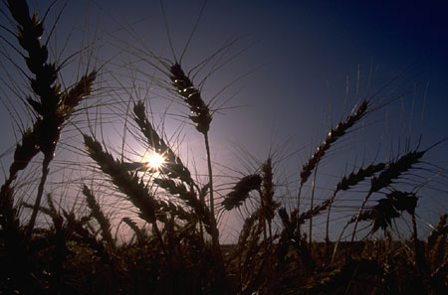
Homework #16: Structure of Book of Ruth
People who died
before main action
Ruth vs. Orpah
Women of Bethlehem (negative)
Naomi-Ruth
Boaz-servant
Boaz-Ruth
Boaz-servants
Naomi-Ruth
Boaz-Ruth
Naomi-Ruth
Boaz vs. “redeemer”
Women of Bethlehem (positive)
People who were born
after main action
Ruth = companion
Orpah = disloyal
Boaz = strength
Naomi = pleasant

