Slide 1
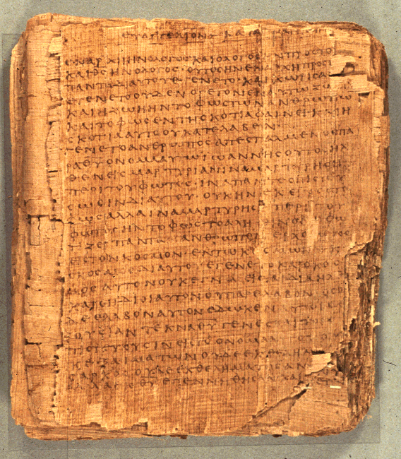
COS 421
Bible IV
Dr. Rodney K. Duke

Slide 2
DAY 1
Assign: (see handout, “Weekday Assignments”)
1) Daily: Write in a journal entry (1-2 paragraphs)
2) #1 Wisdom subtypes in Proverbs
3) #2 Analyze the two-line relationships in Pro 20:1-15
4) #3 Apply “Reading Strategy” to Pro 26:17; 13:14; 25:27
5) #4 Reflect on the form and intention of Gen 1:1-2:3
6) Review course assign, Section A. #’s 5-9, Section B. #3 for
discussion.
Day Objectives:
1) Explain the course goals and objectives.
2) Identify the structure and content of the Hebrew Bible.
3) Explain the process of successful communication and
identify how you should approach interpreting the Bible.
4) Explain how to read the two-line proverb.

Slide 3
QUICK NITTY GRITTY OVERVIEW
Class pace: fairly fast and intense
Work load: moderately heavy; budget 2 hours for reading and writing preparation required for next class
Literary approach: communication model. This is not “anything goes,” opinion vs. opinion. We will seek to uncover what the texts meant to their original audiences.
#1 Rule: be willing to be wrong and make mistakes, then we can all loosen up, learn from each other, and have fun learning

Slide 4
COS 421 Bible IV:
Prophets, Psalms, and Wisdom Literature
Overview
Students will be able to:
Understand the origin, history, and use of these forms of biblical literature among God’s people.
2. Exegete these forms of biblical literature.
3. Apply exegesis to preaching, other pastoral responsibilities, and issues of the present day.

Slide 6
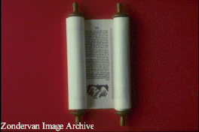
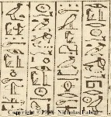
STRUCTURE OF HEBREW CANON (1of 3)
Law/Torah/Pentateuch
1. Traditional Domain: priests (preserved ritual laws, in late
period taught Torah)
2. Literary Forms: historical narratives and laws
3. Functions: to provides Israelite foundations for:
a. world-view (nature of God, world, humanity)
b. origin and purpose of Israel (covenant with God)
c. conduct (ritual, moral, social, criminal laws, etc.)

Slide 7
STRUCTURE OF HEBREW CANON (2 of 3)
Prophets
1. Traditional Domain: prophets
"Former Prophets": key characters in course of Israelite
history, believed to have kept records
"Latter Prophets": main characters and their messages
2. Literary Forms:
"Former Prophets": broad-sweeping historical narratives
"Latter Prophets": narratives focused on individuals;
oral, poetic messages
3. Functions:
"Former Prophets":
a. preserve the traditions of Israel,
b. answer questions about the course their history
took, evaluating their kings and nation
c. teach about the nature of reality
"Latter Prophets": hold people accountable to faith priorities
(different emphases with each prophet)

Slide 8
STRUCTURE OF HEBREW CANON (3 of 3)
Writings
1. Traditional Domain: varied, but wisdom literature associated
with the sage (collected knowledge, wisdom)
2. Literary Forms: (varied) wisdom literature, hymnic lit.,
historical narrative, story
3. Functions: (varied)
a. wisdom: teach about the nature of life and how to live
skillfully
b. hymnic: guidance and encouragement in
expressions of prayer, worship and celebration
c. narrative: (same as under "Former Prophets")

Slide 9
Israelite Functionaries and Institutions
King:
monarchy, national identity, term "messiah," Davidic dynasty
NT: David lineage, Messiah, messianic & political expectation of Jesus’ day
Priest:
cult, holiness symbol system, sacrificial system, Temple, the Law
NT: sacrificial imagery, Jesus as High Priest and atoning sacrifice,
Sadducees, Christians as a royal priesthood
Prophet:
(unlike Ancient Near East: court/temple/shrine) independent "preacher"/ activist / demonstrator /conscience of the people
(NT: John the B, Jesus, apostles, prophets, “pastors,” etc.)
Sage:
court (school?) scribe (palace & temple); Joseph, Daniel
NT: wisdom forms of Jesus' teaching, Pharisees, scribes and rabbis.
NT assumes knowledge of these roles and institutions.

Slide 10
COMPONENTS OF THE BIBLICAL TEXTS
Oral Stage: Documents: Author/
Community Authors Editor Text Audience
……..……...……………..
Source Criticism
Text Criticism
Literary Criticism (narrow)
Historical Reconstruction
Reader-response Criticism
Form Criticism
Redaction Criticism
History of the Text
Literary Criticism (Broad)

Slide 11
Sample questions that can be asked about the Bible
1) How can this text be used to reconstruct the history of the …?
(historical criticism)
2) What does the audience bring to the reading of a text that
influences their conclusions about what it means?
(reader-response criticism)
3) What was the psychological makeup of the author?
(psychological criticism)
4) What impact did the original author wish to have on the original
audience? (literary/rhetorical criticism)
5) Did the author/editor use documentary source to help compose
the final text? (source criticism)
6) How did the author/editor use the sources to shape the final text?
[redaction (=to edit) criticism]
7) Was the text, or sections of it, given form by use in an oral
setting? (form criticism)

Slide 12

Genre Recognition
Failure to employ a reading strategy that recognizes the types/genres of literature in the Bible and their original functions:
1. Obscures the variety of forms employed in the Bible and makes communication MORE difficult. (People employ different genres to AID communication.)
2. Locates the meaning of the text in the hands of the reader (leading to unintended applications) rather than locating the meaning in the author’s intention.
3. Promotes private and self-centered readings of the Bible (“God speaks to ME”), rather than an informed and communally guided interpretation.
4. Often leads to an “atomizing” of the text.
(Illustration: favorite cake)
The form and function of the biblical text should
influence the form and function of the sermon.

