Slide 1
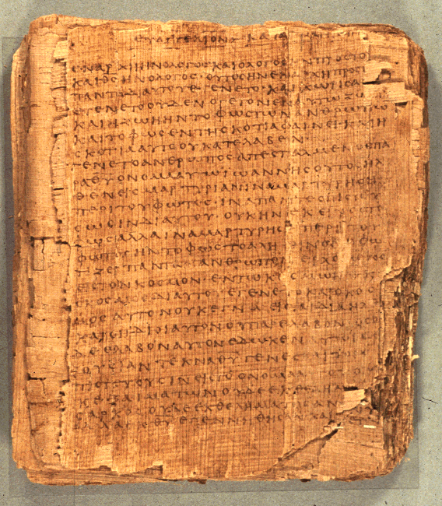
COS 421
Bible IV
Dr. Rodney K. Duke
Notes:
Ran a little short. Can extrapolate. Might use Ppt on Hermeneutics

Slide 2
DAY 2
Assign: (see handout)
1) (Daily) Write in a journal entry
2) #5 Analyze Pro 26:22 and 17:22
3) #6 Form psalm pairs
4) #7 Learn about the Israelite priesthood and *cultic symbol
system (sent as Duke_Priests.pdf)
5) Review for discussion: Section B. #5
[*“cult” = tangible expression/practice of religious beliefs]
Day Objectives: (Finish Wisdom Lit and Intro Hymnic Lit.)
1) Describe the nature of wisdom lit. and how proverbs apply.
2) Describe the Israelite world-view and how it relates to
wisdom.
3) Describe how psalms functioned in the Temple setting.
4) Define “cult” and identify Israelite cultic elements.

Slide 3
Process of Communication:
Three Images
Addresser
Rhetorical intent
“Window” (world behind) Embeds some authorial intention
Rhetorical strategy/“rules”
Literary features
“Picture”
(world of) focus on text itself
Referent
Medium
Form
Content
Reading strategy/ “rules”
“Mirror” (world in front)
Reflects what reader brings
Rhetorical impact
Addressee

Slide 4

Excursus: BIBLICAL INSPIRATION*
Nature of Inspiration:
Does the literature in the Bible carry out God’s communicative purposes?
NOTE: Maybe not our 21st century expectations of being able to determine the authorship, date of writing, unity of writing, etc.) (For modern people “author” = “authority”.)
Question:
Could God work through the community of faith over several generations to preserve, shape,
and edit the biblical text AND it still be
inspired for God’s communicative
purposes?
*See slides below, “Addressing Background Assumptions”

Slide 5
Differences between Oral and Writing Cultures
Oral Culture Writing Culture
Authority based on spoken (memorized) words of teacher/tradent
Based on communal knowledge
Words are dynamic, visual and dramatic
Performance oriented
Fluidity to respond to audience and situation
Communal interpretations
Text as authority/orthodox
Text as unchanging artifact
Teaching is static
Rule oriented
Individual interpretations

Slide 6
Duke: World Picture vs. World View
World Pictures:
Phenomenological perspectives based on current “scientia” (knowledge)
Changes with cultures
Changes through time as knowledge grows
World Views:
Address the basic philosophical questions of life (origins, dimensions of reality, purpose, values, etc.)
May be expressed through different world pictures
May abide through time and cultural changes

Slide 7
ISRAELITE WISDOM LITERATURE (1 of 2)
Definition of Hebrew term hochmah (wisdom): skillful living
I. Premise: Yahweh has created an orderly world. (Gen 1)
A. Ultimate source of wisdom: Yahweh; therefore, "fear the
LORD" (awe and obedience, a relational expression)
B. Avenues to wisdom:
1. Reflection on experience, the observations of order (See
Proverbs 24:30-34)
2. Reflection on the nature of God (revelation)

Slide 8
ISRAELITE WISDOM LITERATURE (2 of 2)
II. The fruit of wisdom is life. (Prov 3:18; 8:35; 14:27)
A. 'Life' and 'death' are not used in an absolute sense.
[Proverbs often appear to be simplistic, due to use of
opposites, but are not. ]
B. 'Life' and 'death' are dynamic processes. A person is on the
path of 'life' or the path of 'death'.
C. 'Life' generally emphasizes "abundant life" rather than
"eternal life;" however,
D. Wisdom presses the bounds of Israelite theology towards a
concept of an afterlife. (Pro 12:28; Psalm 73)

Slide 9
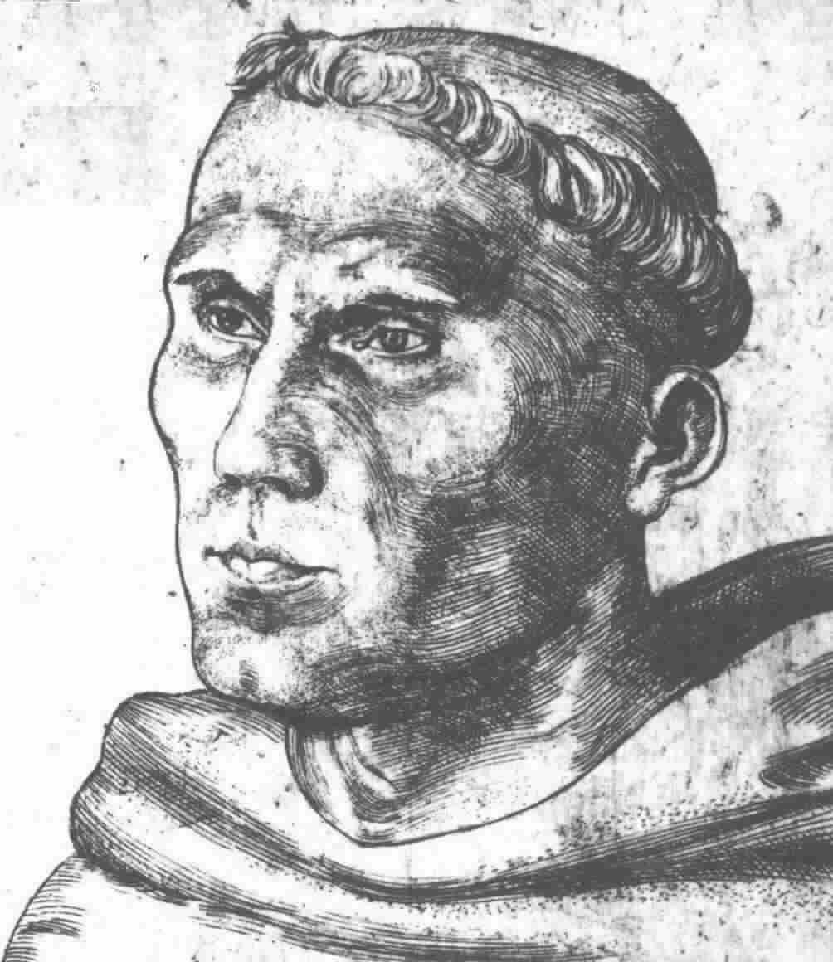
Introduction
Martin Luther on the Book of Psalms:
Where does one find finer words of joy than in the psalms of praise and thanksgiving? There you look into the hearts of all saints, as into fair and pleasant gardens, yes, as into heaven itself. There you see what fine and pleasant flowers of the heart spring up from all sorts of fair and happy thoughts toward God, because of his blessings.

Slide 10

Luther cont.
On the other hand, where do you find deeper, more sorrowful, more pitiful words of sadness than in the psalms of lamentation? There again you look into the hearts of all the saints, as into death, yes, as into hell itself. How gloomy and dark it is there, with all kinds of troubled forebodings about the wrath of God! So, too, when they speak of fear and hope, they use such words that no painter could so depict for you fear or hope, and no Cicero or other orator so portray them.

Slide 11
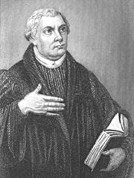
Luther cont.
And that they speak these words to God and with God, this, I repeat, is the best thing of all. This gives the words double earnestness and life…. Hence it is that the Psalter is the book of all saints; and everyone, in whatever situation he may be, finds in that situation psalms and words that fit his case, that suit him as if they were put there just for his sake, so that he could not put it better himself, or find or wish for anything better.
Luther’s Works, vol. 35: Word and Sacrament I (Fortress, 1960), pp. 255f. Taken from P. Miller, Interpreting the Psalms (Fortress, 1986), pp. 19f.

Slide 12
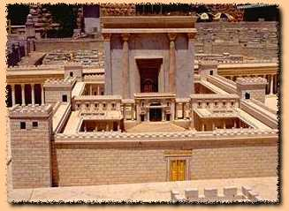
How to Read the Book of Psalms?
Psalms are NOT simply poems or songs.
They were functional songs: “cultic” expressions of faith – part of various religious rituals in specific settings for specific purposes.
How do cultic elements in your church setting aid people to worship God?

Slide 13
Overview
Setting of transmission and employment
1. Whatever the origin of the Psalms, they seem to have been used
in the Temple worship.
2. The Psalms as we have them have been made very generic:
enemies, illnesses, threats, occasions of joy, etc. are stated in
general terms.
3. As a result the Psalms have become applicable to all people.

