Slide 1
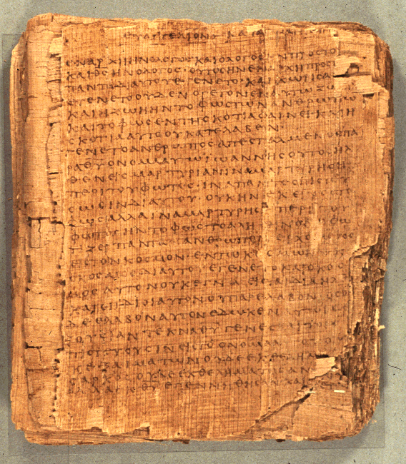
COS 421
Bible IV
Dr. Rodney K. Duke

Slide 2
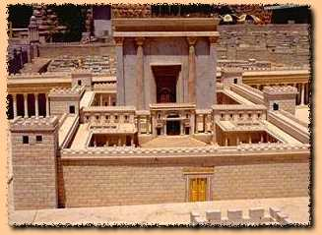
Reading Psalms Overview
Setting of transmission and employment
1. Whatever the origin of the Psalms, they seem to have been used
in the Temple worship.
2. The Psalms as we have them have been made very generic:
enemies, illnesses, threats, occasions of joy, etc. are stated in
general terms.
3. As a result the Psalms have become applicable to all people.

Slide 3
Reading Psalms Overview
1. Because of the generic nature of the Psalms, we can read them
“form critically,” that is, according to their use within a social
setting. (Versus reading according to superscriptions.)
A. The social setting of the temple can shed light on the
function of the psalms, and
B. The forms of the psalms can shed light on the social setting
(the faith and practices) of the Israelites.
2. 3 major forms found in the 150 psalms [two naming systems]
Psalms of Petition / Psalms of Lament
Psalms of Declarative Praise / Psalms of Thanksgiving
Psalms of Descriptive Praise / Hymns

Slide 4
Observations about Rhetorical Intentions
2/3 of all psalms have one of 3 Rhet. Intent’s:
1) get God to do something,
2) thank God for something already done,
3) praise God in general for God’s nature.
Doing #6 (pairing) Looked for formal features such as:
rhetorical intention
mood, mood shift
temporal orientation of the speaker
addressee, addressee shift

Slide 5
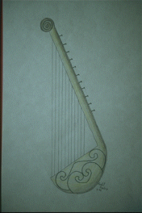
Psalms of Lament/Petition (1 of 3)
General characteristics: personal, speaker primarily addresses God, mood shifts from to despair to some hope/trust, oriented in the present setting of need or crisis
(What difference does music make?)
I. Motifs Found in Lament Psalms
A. [Introductory petition/lament]
B. Lament [1) claim innocence
2) plea for forgiveness]
1) You (God)
2) I
3) They (foes)
Drawing of a Lyre. Copyright Zondervan Image Archives

Slide 6
Psalms of Lament/Petition (2 of 3)
C. Petition
1) To take favorable notice
2) To intervene
3) Motivation
4) “Double wish”
a) against enemies (imprecation)
b) for oneself
[honest how they feel and bold]

Slide 7
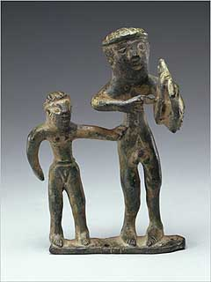
Psalms of Lament/Petition (3 of 3)
D. Confession of Trust
(WAW adversative) Look for words such as “then” “now” “but” and a shift to a positive mood.
1. Specific trust elements:
a) vow of praise
b) declarative praise
Statuette of Lyre Player. Copyright: http://www.getty.edu/museum/objects/Antiquities/90_AB_6_A.htm

Slide 8
Psalms of Declarative Praise (Thanksgiving)
(1 of 2)
General
Personal, use of 1st person
Mood: consistent, joyful
Audience: usually switches between God and community
Time: in the present, the psalmist looks back to the past
Setting: celebration of todah offering with extended family and the poor
I. Motifs and Structure
A. Proclamation
1. States intention to praise God (“You”)
and/or 2. (Introductory Summary)

Slide 9
Psalms of Declarative Praise (Thanksgiving)
(2 of 2)
B. Report of Deliverance
1. Trial or problem
2. Psalmists cry to God - “I cried,” “He heard”
3. The deliverance - “He delivered”
C. Conclusion
1. Renewed vow of praise
(2. Descriptive praise )
(3. Instruction )
May be woven into the “Report”

Slide 10
Psalms of Descriptive Praise (Hymns)
General:
Tone: impersonal (often in 3rd person)
Audience: community and God
Mood: consistently joyful
Time: atemporal
Setting: often festivals and pilgrimages
I. Motifs and Structures
(Prologue: Hallelujah)
A. Call to Praise
imperative: often repeated throughout psalm
B. Cause for Praise
1. Summary Statement (often 2-fold)
a. God’s majesty: Lord of Creation
b. God’s grace: Lord of history
2. Descriptive Illustrations
Drawing of a Lyre. Copyright Zondervan Image Archives

Slide 11
Psalms of Descriptive Praise (Hymns)
C. Conclusion: many options
1. Renewed call to praise
2. Exhortations
3. Petition, etc.
4. Vow of praise
(Epilogue: Hallelujah)
any

Slide 12
UNIT 3...BACKGROUND ON PSALMS
Theological Basis and/or Implications
Each psalm has own distinct message; but some generalizations:
A. Petitions:
1. God is to be approached boldly, with complete openness
2. Even in despair, the psalmist expressed trust
B. Thanksgivings:
1. God is to be thanked by testimony before community in celebration
2. God is experientially knowable
3. Faith in God who acts on their behalf
C. Hymns:
1. God is worthy of praise
2. God, who is majestic and sovereign, graciously condescends to care for those who trust God

Slide 13
DAY 3
Assign:
1) Daily Journal
2) #8 Identify type and outline: Psalms 32, 33, 54.
3) #9 Outline & diagram balanced thought structure of Ps 24
4) Review for discussion: Section B. #6, Section C. #’s 1-3
Day Objectives:
Explain the cultic symbol system behind the sacrificial system.
Learn to identify and outline the 3 basic psalm types.
Learn how to diagram “balanced thought structures.”

Slide 14
“Holiness & Sacrifices”
(relates to Handouts, pp. 10-11)
What are some “unclean” foods in our culture that might be eaten in other cultures? Why are they “unclean” in our culture?
What are some “unclean”/unacceptable behaviors in our culture that might be acceptable in other cultures? Why are they unacceptable?
For the Israelites fish were “clean” but lobsters were “unclean.” What would be a possible explanation?
For Israel blood from a cut was “clean” but menstrual blood was “unclean.” What would be a possible explanation?

Slide 15

“Holiness & Sacrifices”
a. Purity system and Holiness system
- purity: clean (life, order) vs. unclean
- holiness: holy (set apart for sacred use) vs. common
- both were “contagious”
- “gradations of holiness” examples:
b. Purification:
- permitted impurity (not sin) vs. unpermitted
- unpermitted polluted God’s “dwelling place”

Slide 16
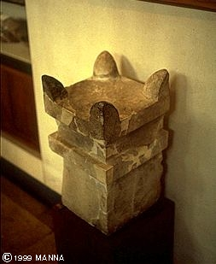
“Holiness & Sacrifices”
c. Sacrificial system:
- gift or gesture of obedience, but not food or magical manipulation
*- blood (Lev. 17:10-14): symbol of life
- types:
“Purgation”: cleansed God’s dwelling
“Well-being”: feast (“Thanks offering”; Todah)
Horned altar from Megiddo

Slide 17
Functions of the Priesthood
In the OT the people of Israel were called to be holy:
NIV Leviticus 20:7-8, "Consecrate yourselves and be holy, because I am the LORD your God. Keep my decrees and follow them. I am the LORD, who makes you holy.” (also 11:44,45; 9:2; 20:7)
Idea of consecration of priests, people
Priestly role of “distinguishing”: Leviticus 10:10, “You must distinguish between the holy and the common, between the unclean and the clean.”
Called to “make a distinction” and share in the divine creational activity. (Gen 1:4,7)
Point of confrontation: God calls us, as the Church, to reveal His holiness to the world as a royal priesthood and holy people (I Pet 2:9). We bear God’s name; and we are called to reveal His holy character to the world! [First petition of “Lord’s Prayer.”]
Notes:
Quote from Bonhoffer?: The Church is the new humanity of Jesus. [I.e. we are to reveal God’s holiness.]

