Slide 1
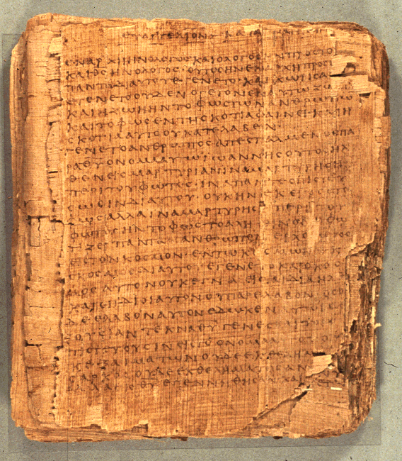
COS 421
Bible IV
Dr. Rodney K. Duke

Slide 2
DAY 4
Assign:
Daily Journal
#10 Nahum
#11 Ezekiel
#12 Jonah
#13 NT use of OT
Review for discussion: C. #’s 4-16
Day Objectives:
Develop skill identifying and outlining psalms.
Develop skill diagramming balanced thought structures.
Explain the background to the Book of Psalms.
Identify the nature of biblical prophecy and prophetic literature.

Slide 3
How did the New Testament Writers “Read” the Prophets?
[Intro. to Assignment #13, NT use of OT]
Main issue: Were the prophetic messages univalent (one meaning or application only) or polyvalent (more than one meaning or application)?
Case illustration: Read Matthew 1:18-23 and Isaiah 7:13-16 in its context of the Syro-Ephraimitic War of 734 BCE.
Does the prophetic word apply only to Isaiah’s day?
Does the prophetic word apply only to Matthew’s day?
Does it apply somehow to both times?
Notes:
Moved this slide first to make sure that I introduced the assignment.

Slide 4
PSALM 54 (1 of 2)
O God, by Your name save me,
And by Your power vindicate me!
O God, hear my prayer,
Give ear to the words of my mouth!
For strangers have arisen against me,
And terrifying ones seek my life;
Men who do not set God before them.

Slide 5
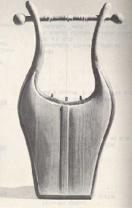
PSALM 54 (2 of 2)
Behold, God [is] the One who helps me,
My Lord [is] the One who upholds my life.
May He return evil to those lurking for me,
In Your faithfulness bring them to an end.
With a free-will offering I will sacrifice to You,
I will thank Your name, Yahweh, because [it is] good.
Because from every trouble You have delivered me,
And against my enemies my eye has gloated.

Slide 6
Literary Features (1 of 2)
(Handouts, p. 22)
I. General
A. poetic:
1. Densely packed
2. parallelism (balanced thought structures)
3. figurative language (e.g. hyperbole, metaphor,
simile, personification, merism)
4. graphic, picturesque language
B. "lofty" (theological)
C. intensely personal language (testimonial; bold, honest,
emotional, emphatic)
D. direct address
E. questions and answers
(etc.)

Slide 7
READING STRATEGY (1 of 3)
(Handouts, p. 23)
Analyze (Many of the "steps" are not sequential, but simultaneous.)
1. Identify type of psalm.
2. Seek to recover historical and cultic setting.
3. Outline the general structure.
a. What are the main sections and their motifs?
b. What is the connection/flow of thought among sections?
4. Identify the flow of thought and topics within each section.
5. Identify/diagram the structural patterns among the verses.
What impact are these structures meant to have?
6. Identify/diagram the parallelism (balanced structures) within
verses. What are the relationships between the balanced
elements?
7. Identify the figures of speech and explore how each one "works."
8. Focus on the graphic language and ask what it is meant to evoke. (Discover the emotive, conative and persuasive elements.)

Slide 8
READING STRATEGY (2 of 3)
9. Look for allusions to other OT events and texts.
What would this relationship indicate?
10. If the title/superscription gives a setting (eg. in the life of
David), look up that event and explore what this perspective would add to the themes and mood of the psalm.*
*This step moves away from a form-critical reading to a “historical” reading.
Synthesize
1. What is/are the psalmist's intention/s?
2. What is the psalmist's situation (personally, cultically)?
3. What is the psalmist feeling and experiencing?
4. What is/are the psalmist's thesis/theses?

Slide 9
READING STRATEGY (3 of 3)
Application
1. Can I identify or empathize with the psalmist's situation and/or
feelings?
2. What is the psalmist teaching about the God-humanity
relationship and/or about how life works?
3. Can/should this psalm provide a model for me when speaking to
God or others about God?

Slide 10
UNIT 3. BACKGROUND ON PSALMS (1 of 8)
(Handouts, pp. 24-27)
I. Historical Context
A. Relationship to ancient Near East hymnic literature
1. Similar: cultic function; style; content of petitioning, lamenting, praising; (types?)
2. Difference: theology and world-view; no mythic enactment
B. Authorship/Origin
1. Cannot be certain of specific author from title
2. Debate about personal vs. cultic origin
C. Setting of transmission and employment
1. Transmission and preservation: temple functionaries
2. Employment: cultic rituals connected w/Temple
D. Role of Priests and Levites:
1. Preserved and taught the Law (late stage?)
2. Guided & guarded the cultic rituals: sacrifice,
worship, music (pastoral role?)

Slide 11
UNIT 3. BACKGROUND ON PSALMS (2 of 8)
II. Psalms Outside the Psalter (particularly in prophets)
1. Ex. 15:1-18, 20-21, (Song of the Sea).
2. Dt. 32:1-43, (Song of Moses).
3. Jdg. 5:1-31, (Song of Deborah).
4. 1 Sam. 2:1-10, (Song of Hannah).
5. 2 Sam. 22:2-51, (Psalm of David, also Ps. 18).
6. Isa. 12:4-6, (Thanksgiving).
7. Isa. 39:9-20, (Song of Hezekiah).
8. Isa. 42:10-12; 52:1-10.
9. Hab. 3:2-19, (Hymn of Praise).
10. Jonah 2:1-9 (Jonah's Prayer from the Belly of the Fish).
11. Job 5:8-16; 9:10-14; 12:7-10, 13-25 (Hymns); 3:3-12, 13-19, 20-26; 7:1-10, 12-21; 9:2-31; 10:1-22 (Laments.)
12. Jer. 15:15-18; 17:14-18; 18:9-23, (Laments) also Lam. Ch. 3,5.
Read Jonah 2:2-9
What type of Psalm is this?

Slide 12
UNIT 3...BACKGROUND ON PSALMS (3 of 8)
III. Growth of Psalter
A. 1st stage: individual psalms
B. 2nd stage: superscriptions/titles
C. 3rd stage: collected according to titles (cf. Ps 72:20) by
Levitical priests who were responsible for music (?)
Collections of Psalms Within the Psalter
1. Davidic Collection, 3-41.
2. Korah Musical Guild, 42-49.
3. Davidic Collection, 51-72.
4. Asaph Musical Guild, 73-78, Ps. 50.
5. Various Musical Guilds, 84-89.
6. Various Other Collections, 90-150, including
(a) Psalms of Yahweh's Kingship, 93-99.
(b) Psalms of Pilgrimage, 120-134.
(c) Hallelujah 104-106, 111-113, 135, 146, 150.

Slide 13
UNIT 3. BACKGROUND ON PSALMS (4 of 8)
D. 4th stage: collection into “books” Structure of the Psalter
Book 1: Psalms 1-41
Concluding Doxology, 41:13
Book 2: Psalms 42-72
Concluding Doxology 72:18-19
Book 3: Psalms 73-89
Concluding Doxology 89:52
Book 4: Psalms 90-106
Concluding Doxology 106:48
Book 5: 107-150
Concluding Doxology for entire Psalter, Psalm 150
God/Elohim Lord/Yahweh
15 272
Elohistic Psalter
164 30
14 370
Read Psalms 14 and 53. What do you observe?
Notes:
Anderson, and others, have suggested that the 5-book arrangement parallels the Torah, p. 517. [Duke: If so, it seems that it happened in the gradual historical process of the compilation of the Psalter as individual “books” were added and not a single act imposed on a complete psalter.] Evidence from Qumran and LXX support conclusion that Bks 1-3 were stabilized before Bks 4-5.

Slide 14
UNIT 3. BACKGROUND ON PSALMS (5 of 8)
D. 4th stage: collection into “books” (cont.)
Note parallel psalms/sections:
Ps 14 = Ps 53
Ps 40:13-17 = Ps 50
Ps 57:7-11 +Ps 60:5-12 = Ps 108
E. 5th Stage: Five Book Arrangement
Pss 1-2 - Introduction
Pss 145-50 - Finale
(3-year lectionary cycle, 4 per Sabbath?)
Notes:
Anderson, and others, have suggested that the 5-book arrangement parallels the Torah, p. 517.

Slide 15
UNIT 3...BACKGROUND ON PSALMS (6 of 8)
IV. Superscriptions/Titles (126 psalms) [any postscripts?]
A. Types of information:
1. linked to person with lamed (to, for, by)
2. technical name for psalm types
3. musical terms
4. melody indicators
5. liturgical indicators
6. historical connection to life of David
B. Evaluation:
1. SEEM to be secondary
2. Cannot safely assume lamed (A 1)
means author
3. May be useful to read in light of
historical notices (See Psalm 51)

Slide 16
UNIT 3...BACKGROUND ON PSALMS (7 of 8)
V. Theological Basis and/or Implications
Each psalm has own distinct message; but some generalizations:
A. Petitions:
1. God is to be approached boldly, with complete openness
2. Even in despair, the psalmist expressed trust
B. Thanksgivings:
1. God is to be thanked by testimony before community in celebration
2. God is experientially knowable
3. Faith in God who acts on their behalf
C. Hymns:
1. God is worthy of praise
2. God, who is majestic and sovereign, graciously condescends to care for those who trust God

Slide 17
UNIT 3...BACKGROUND ON PSALMS (8 of 8)
VI. Principles for Application
A. Can I identify or empathize with the psalmist's situation and/or feelings? (subjective)
B. Can/should this psalm provide a model for me when speaking to God or others about God? (subjective)
Caution: elements of imprecation
C. What is the psalmist teaching about the God-humanity relationship and/or about how life works? (objective)
Caution: not the same as explicitly taught doctrine

Slide 18
Personal Summary
B. 6. Obj.: Reflect on the value of the hymnic literature for Christian faith and practice.
(W) Based on the above assignments regarding the Psalms and Temple worship, explain, as if speaking to a member of your congregation, why it is valuable for Christians to read and study the Psalms.

Slide 19
PROPHETIC LITERATURE

Slide 20
C. 1. Obj.: Explore why and how prophetic words might have been recorded. (Case study)
Speculate:
a) (T) For what reasons, by whom, and in what form might this message have been preserved initially? How much would you expect the initial preservation to agree in form and content with what was literally spoken?
b) (T) For what reasons, by whom, and in what form would this account have been preserved for later generations? How much would you expect this later account to agree in form and content with the first account?
c) (W) What would you as a modern audience need to do or find out in order to understand the message as fully as possible? What comparisons and contrast to this process would you expect to apply to the message of the biblical prophets?
Point: Following generations must have believed that what happened had continuing meaning/application. They preserved the account.
Notes:
Also raises questions about who recorded this: when, where, why, how?

Slide 21
C. 2. Obj.: Form an overview of OT Prophets and Prophecy.
Prequestion (W): Define "prophet," and "prophecy" based on your own understanding.
Read a Bible dictionary article on “prophets, prophecy.”
(W) Explain how your definitions would change. If they would not change, what is something new that you learned?

Slide 22
Prophetic Books: Difficulties (1 of 3)
Factors which make them difficult to read:
a)
b)
c)

Slide 23
Prophetic Books: Difficulties (3 of 3)
d) They have often been shaped by two processes:
1)
2)
It is now often difficult to reconstruct the process of
development of a prophetic book into the final written
form and get back to the original historical setting and
original purpose.
The community of faith was not interested in historical
reconstruction as much as application!

