Slide 1
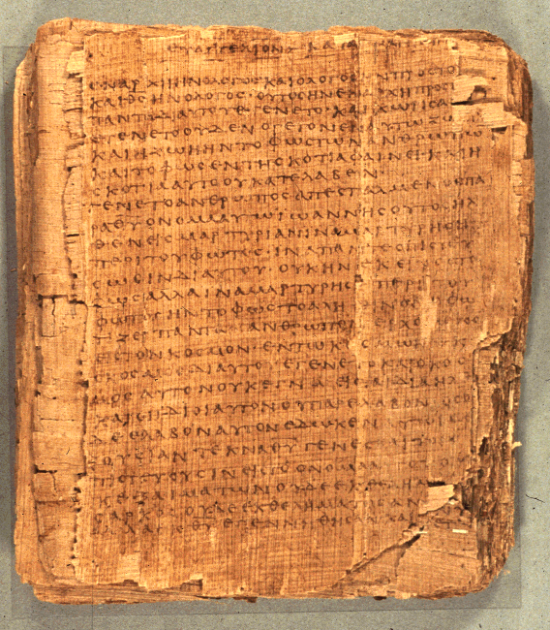
COS 421
Bible IV
Dr. Rodney K. Duke

Slide 2
DAY 5
Assign:
Homework assignment:
Love Jesus and love your people.
Day Objectives:
Identify the nature of biblical prophecy and prophetic literature.
Identify reasons for reading the prophets and look at some key prophetic texts
Evaluate the NT writers’ use of the OT prophetic literature.
Explain the nature of apocalyptic literature.

Slide 3
C. 1. Obj.: Explore why and how prophetic words might have been recorded. (Case study)
Speculate:
a) (T) For what reasons, by whom, and in what form might this message have been preserved initially? How much would you expect the initial preservation to agree in form and content with what was literally spoken?
b) (T) For what reasons, by whom, and in what form would this account have been preserved for later generations? How much would you expect this later account to agree in form and content with the first account?
c) (W) What would you as a modern audience need to do or find out in order to understand the message as fully as possible? What comparisons and contrast to this process would you expect to apply to the message of the biblical prophets?
Point: Following generations must have believed that what happened had continuing meaning/application. They preserved the account.
Notes:
Also raises questions about who recorded this: when, where, why, how?

Slide 4
C. 2. Obj.: Form an overview of OT Prophets and Prophecy.
Prequestion (W): Define "prophet," and "prophecy" based on your own understanding.
Read a Bible dictionary article on “prophets, prophecy.”
(W) Explain how your definitions would change. If they would not change, what is something new that you learned?

Slide 5
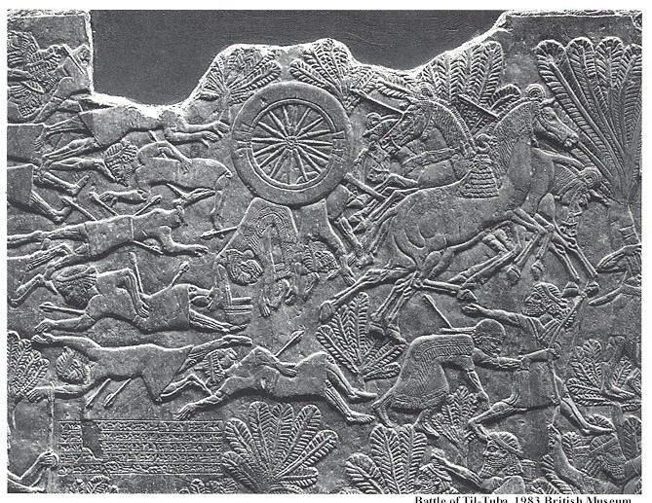
Why Read the Prophets?
(C. 3. Summarize what you learned about the prophets.)
Poetic value: Nahum 3:1-5
NIV Nahum 3:1-5a: Woe to the city of blood, full of lies, full of plunder, never without victims! 2 The crack of whips, the clatter of wheels, galloping horses and jolting chariots! 3 Charging cavalry, flashing swords and glittering spears! Many casualties, piles of dead, bodies
without number, people stumbling
over the corpses-- 4 all because of
the wanton lust of a harlot, alluring,
the mistress of sorceries, who
enslaved nations by her prostitution
and peoples by her witchcraft. 5
"I am against you," declares the
LORD Almighty.
Assyrian battle of Til-Tubal.
Notes:
Add holiness of God in Isaiah

Slide 6
Why Read the Prophets?
(C. 3. set “a”)
Insight into others' personal struggles with God:
Isa 6, Jer 1, Ezek 1-2: “call” of these prophets, each felt unworthy, each faced with difficult task.
Jeremiahs’ struggles with his calling (“Laments”)

Slide 7
2) Insight into others' personal struggles with God
NIV Jeremiah 20:7-18
O LORD, you deceived me, and I was deceived; you overpowered me and prevailed. I am ridiculed all day long; everyone mocks me. 8 Whenever I speak, I cry out proclaiming violence and destruction. So the word of the LORD has brought me insult and reproach all day long.
9 But if I say, "I will not mention him or speak any more in his name," his word is in my heart like a fire, a fire shut up in my bones. I am weary of holding it in; indeed, I cannot.
10 I hear many whispering, "Terror on every side! Report him! Let's report him!" All my friends are waiting for me to slip, saying, "Perhaps he will be deceived; then we will prevail over him and take our revenge on him."

Slide 8
NIV Jeremiah 20:7-18 cont.
11 But the LORD is with me like a mighty warrior; so my persecutors will stumble and not prevail. They will fail and be thoroughly disgraced; their dishonor will never be forgotten. 12 O LORD Almighty, you who examine the righteous and probe the heart and mind, let me see your vengeance upon them, for to you I have committed my cause. 13 Sing to the LORD! Give praise to the LORD! He rescues the life of the needy from the hands of the wicked.
14 Cursed be the day I was born! May the day my mother bore me not be blessed! 15 Cursed be the man who brought my father the news, who made him very glad, saying, "A child is born to you-- a son!" 16 May that man be like the towns the LORD overthrew without pity. May he hear wailing in the morning, a battle cry at noon. 17 For he did not kill me in the womb, with my mother as my grave, her womb enlarged forever. 18 Why did I ever come out of the womb to see trouble and sorrow and to end my days in shame?

Slide 9
Why Read the Prophets?
(C. 3. set “b”)
3) Call to morality and values (popular in 3rd world countries):
Isa 1:10-20, Jer 2:1-13: called people to repentance, etc.
NIV Hosea 6:6
For I desire mercy, not sacrifice, and acknowledgment of God
rather than burnt offerings.

Slide 10
3) Call to morality and values
NIV Micah 6:1-8
Listen to what the LORD says: "Stand up, plead your case before the mountains; let the hills hear what you have to say. 2 Hear, O mountains, the LORD's accusation; listen, you everlasting foundations of the earth. For the LORD has a case against his people; he is lodging a charge against Israel.
3 "My people, what have I done to you? How have I burdened you? Answer me. 4 I brought you up out of Egypt and redeemed you from the land of slavery. I sent Moses to lead you, also Aaron and Miriam. 5 My people, remember what Balak king of Moab counseled and what Balaam son of Beor answered. Remember your journey from Shittim to Gilgal, that you may know the righteous acts of the LORD."

Slide 11
NIV Micah 6:1-8 cont.
6 With what shall I come before the LORD and bow down before the exalted God? Shall I come before him with burnt offerings, with calves a year old? 7 Will the LORD be pleased with thousands of rams, with ten thousand rivers of oil? Shall I offer my firstborn for my transgression, the fruit of my body for the sin of my soul?
8 He has showed you, O man, what is good. And what does the LORD require of you? To act justly and to love mercy and to walk humbly [carefully?] with your God.
כִּי אִם־עֲשֹׂות מִשְׁפָּט וְאַהֲבַת חֶסֶד וְהַצְנֵעַ לֶכֶת עִם־אֱלֹהֶֽיךָ׃
Notes:
“humbly” [ hiph of ts n ( ]: only here. HALOT: Meaning of root in doubt. The versions differ: Sept. to be ready; Theodotion to be careful; Quinta to be prudent; Vulg. to go around anxiously; thus the exact translation equivalent of it is difficult; traditionally humble (Luther; Gesenius-B.; ZürBib.; NRSV and REB: walk humbly with your God); recent proposals:
a. to be clear, pure
b. —i. cautious, careful; —ii. wisely; —iii. reasonable, careful; —iv. attentive; the second alternative (b), with the various possible suggestions given there, is in general preferable to the first (a)
Clines: brings in 4Q424 1:6 and the idea of being discreet and modest.

Slide 12
Why read prophets? (2 of 2)
(C. 3. set “c”)
4) Hope for future:
The prophets looked forward to a perfect time when God's rule would be established and all people would "know" God.

Slide 13
4) Hope for future
NIV Isaiah 11:1-9
A shoot will come up from the stump of Jesse; from his roots a Branch will bear fruit. 2 The Spirit of the LORD will rest on him-- the Spirit of wisdom and of understanding, the Spirit of counsel and of power, the Spirit of knowledge and of the fear of the LORD-- 3 and he will delight in the fear of the LORD. He will not judge by what he sees with his eyes, or decide by what he hears with his ears; 4 but with righteousness he will judge the needy, with justice he will give decisions for the poor of the earth. He will strike the earth with the rod of his mouth; with the breath of his lips he will slay the wicked. 5 Righteousness will be his belt and faithfulness the sash around his waist.

Slide 14
NIV Isaiah 11:1-9
6 The wolf will live with the lamb, the leopard will lie down with the goat, the calf and the lion and the yearling together; and a little child will lead them. 7 The cow will feed with the bear, their young will lie down together, and the lion will eat straw like the ox. 8 The infant will play near the hole of the cobra, and the young child put his hand into the viper's nest. 9 They will neither harm nor destroy on all my holy mountain, for the earth will be full of the knowledge of the LORD as the waters cover the sea.

Slide 15
4) Hope for future
NIV Jeremiah 31:31-34
"The time is coming," declares the LORD, "when I will make a new covenant with the house of Israel and with the house of Judah. 32 It will not be like the covenant I made with their forefathers when I took them by the hand to lead them out of Egypt, because they broke my covenant, though I was a husband to them," declares the LORD. 33 "This is the covenant I will make with the house of Israel after that time," declares the LORD. "I will put my law in their minds and write it on their hearts. I will be their God, and they will be my people. 34 No longer will a man teach his neighbor, or a man his brother, saying, 'Know the LORD,' because they will all know me, from the least of them to the greatest," declares the LORD. "For I will forgive their wickedness and will remember their sins no more."

Slide 16
MESSAGES OF THE PROPHETS (1 of 2)
Pre-Exilic
God is active in and sovereign over history.
God's ultimate rule would be established in the distant future.
Called people to faithfulness, away from idolatry.
Called people to righteous behavior (vs. meaningless ritual).
"Day of the LORD" will bring judgment on Israel, not just the nations.
Called leaders (kings, priest, judges) into accountability.
Called nation to depend on strength of God, not themselves or other nations.
Judgment was coming unless there was repentance; finally, judgment was inevitable.
Zion and the Temple were not invulnerable, God would abandon them in judgment.

Slide 17
MESSAGES OF THE PROPHETS (2 of 2)
Exilic
God was still with the nation, even in exile.
Called people to avoid idolatry and practice righteousness.
Promise of restoration, new covenant, nations would recognize God.
Post-Exilic
Called people and leaders to make God their priority, establish the cultic forms of worship and tithe.
Assured people that God was working through their current leaders despite their lack of independence.
Promise of restoration and ultimate rule of God.

Slide 18
Daniel (1 of 5)
Genre: apocalyptic, with narratives
Nature of Apocalyptic:
Setting: "underground" literature of oppressed people (primarily Jewish) for whom symbolic language is a "code" not to be understood by oppressors.
Form: narrated accounts of visions and dreams, often with angelic interpretation; heavy use of symbolism: numbers and strange animals, many in fantasy forms rather than realistic forms.
Function: set present struggle in light of cosmic, spiritual perspective and in light of ultimate victorious outcome, in order to guide and encourage audience to be faithful. (Daniel 3:16-18)
Main theses: God is in control of history; conditions will not improve in this age; one is to live faithfully until God ushers in Age to Come / Kingdom of God.

Slide 19
Daniel (2 of 5)
Interpretive Approaches to Book of Daniel [Revelation]:
Preterist: focuses on original historical setting, what the text meant. Weakness: ignores what text "means" to community of faith.
Historicist: interprets as forecast of course of history (up to time of interpreter). Weakness: very subjective, little agreement, tends to ignore what text meant.
Futurist: reads as a guide book for events yet to come. Weakness: ignores what text meant and what it means to contemporary community.
Idealist: interprets as a timeless expression of basic principles regarding the activities of God and the community of faith. Weakness: sees no ultimate consummation of Kingdom of God in history.

Slide 20
Daniel (3 of 5)
Duke: Suggested "Blended" Approach: Typologico-historical:
1) Start with preterist perspective to ground symbolic language in its original setting, while
2) recognizing historicist perspective that text speaks of a real historical consummation of Kingdom of God, the pattern of which,
3) applies typologically (idealist) to the ongoing experiences of the community of faith.

Slide 21
Daniel (4 of 5)
Suggested Reading Tips/Strategies:
1) Read for overall story-line and message of the whole work.
2) Read each vision looking for the impact of the whole. Do not focus on and allegorize all of the details.
3) Explore allusions to other OT texts to get some control over the symbols and theological perspective.
4) Look for internal interpretation of images.
5) Recognize distinction between "oppression," which is the experience of the community of faith and "wrath," which is judgment on the opponents of God.
6) Identify how events fit typologically with the current setting of the community of faith and look for the book's message for such situations today, but exercise great caution about reading as blueprint for specific historical events.

Slide 22
Daniel (5 of 5)
Irenaeus, Bishop of Lyons ca. 139-200, said:
[In regard to using the number 666 in the Book of Revelation to
predict the person of the Antichrist]
“It is therefore more certain, and less hazardous, to await the fulfillment of the prophecy, than to be making surmises, and casting about for any names that may present themselves, inasmuch as many names can be found possessing the number mentioned; and the same question will, after all, remain unsolved.”
Against Heresies, Book V. in The Ante-Nicene Fathers (Grand
Rapids: Eerdmans, reprinted 1973), vol. 1, xxx. 3, p.559.

