Slide 1
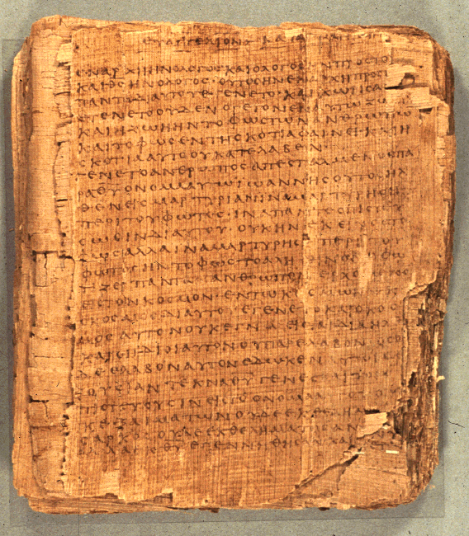
Biblical Interpretation: Paul and Women
Dr. Rodney K. Duke

Slide 2
Duke’s opinion: Paul and Women (1 of 4)
1. Paul’s main principle is that in Christ there is no male or female. (Gal 3:28)
2. The “Household Codes” functioned rhetorically to communicate the point that Christianity was not a social revolution designed to overthrow the status quo. Rather, Paul argues that the individual Christian is to exhibit the character of Christ within whatever role he/she is in. (Eph 5:22-6:9; Col. 3:18-25)
3. Point #2 characterizes Paul’s life: although he is free in Christ (to eat food offered to idols, etc.), he subordinates his freedom to the principle of being a Christian witness, who gives no cause for others to “stumble.” (See 1 Cor. 8-9, especially 9:19-23) He is asking no more from others than he does of himself.
4. Paul actually “presses the bounds” for his day, using women in ministry as much as possible.

Slide 3
Duke’s opinion: Paul and Women (2 of 4)
5. Paul’s instructions regarding women’s roles in worship and in church leadership need to be placed in the background context in which some men and women were for the first time coming together in “worship” which did not involve fertility religions. Other religions often separated men and women.
6. Paul actually does a great deal of subtle “equalizing” of men and women. Eph. 5: 21-33:
Note: Although on the surface, rhetorically, Paul appears to be upholding the status quo between these traditional pairings (husbands and wives, masters and slaves, etc.), Paul does not use the typical hierarchical language of his day when he gives instructions to husbands and wives.

Slide 4
Duke’s opinion: Paul and Women (3 of 4)
6. Paul actually does a great deal of subtle “equalizing” of men and women. Eph. 5: 21-33: (Cont.)
A) Regarding women: Eph. 5:22 uses ellipsis (deliberate omission): “Wives [ ] to your husbands as to the Lord,” picks up its verbal idea of “submit” from the previous verse:
submit
“submit to one another” (vs. 21)*
*Paul asks women to do what he asks ALL Christians to do, submit to one another!
B) Regarding husbands: Eph 5
(1) Eph 5:23 Husband as “head.” Figurative use of “head” in Greek culture: can be used as “boss,” but can also be used as “source,” as in the “head” of a river. Need to ask which is being assumed here.

Slide 5
Duke’s opinion: Paul and Women (4 of 4)
B) Regarding husbands: Eph 5 (cont.)
(2) Husbands are to “love” their wives. Again, Paul has applied not a verb of hierarchy, but a verb that he has applied to all Christians to employ in their relationships, love one another.
Conclusion: While on the surface Paul has maintained the status quo of his culture in regard to the roles of husbands and wives, in actuality he has applied the roles (submitting and loving) that he demands of all Christians. By implication he has done much “leveling” between wives and husbands in the culture of his day. The later church, however, did not continue to follow the trajectory that Paul, and Jesus, began.

