Slide 1
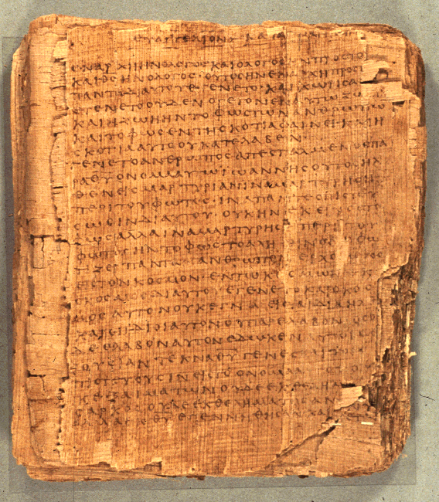
COS 421
The Reliability of the Bible and Modern Assumptions
Dr. Rodney K. Duke
Appalachian State Univ.

Slide 2

ADDRESSING BACKGROUNDED ASSUMPTIONS
What do we mean by “reliable”?
What is the personal response to that which is reliable?
Notes:
I want to address some of what might be some background assumptions we hold, assumptions that have been influenced by modernity, rationalism, our Western Enlightenment world.
Analogy: Different modes of transportation may be reliable for different situations. We should not impose our modern situation on the text, but look at its situation.

Slide 3
IF SCRIPTURE IS “RELIABLE,” WHAT IS IT RELIABLE FOR?

Slide 4

2 TIMOTHY 3:14-17
Red = purpose statements
¹⁴ But as for you, continue in what you have learned and have become convinced of, because you know those from whom you learned it, ¹⁵ and how from infancy you have known the holy Scriptures, which are able [Duke: “empowering”] to make you wise for salvation through faith in Christ Jesus. ¹⁶ All Scripture is God-breathed [Duke: or “God breathing”] and is useful for teaching, rebuking, correcting and training in righteousness, ¹⁷ so that the person of God may be thoroughly equipped for every good work.
Notes:
First purpose statement: Wisdom belongs to the conceptual realm that there is a divine order. Being aligned with that order leads to “salvation” -- not “going to heaven,” but the concept of preserving, healing, delivering in the present time, NOW.
Scripture is God breathed. Form could be translated, “God breathing.” Either way, the original audience did not think of God’s word as a static product. God’s word is dynamic. Like radio waves, it is always “out there.’
Second purpose statement: “complete” for serving, for works of righteousness. We are not “called” to “be saved,” we are called to serve.
Conclusion: Scripture (here): puts us in alignment with God’s order, which connects us to Life, and it equips us to serve.

Slide 5

POSSIBLE “MODERN” ASSUMPTION
To be reliable, it (e.g. Book of Isaiah) must be written by one person from the first word to the last!
Why? The evidence is that much of the Bible is communal literature that was passed down in both oral and written forms and was shaped by the community of faith for generations.
Notes:
In the modern world, we have been influenced to attach compositional expectations about accurately identifying time, place, and authorship of a writing to the concept of biblical inspiration. Note how our word “authority” is based on “author”. In the modern world, we tend to believe that there must be one author, whom we know, we a text to be authoritative. The ancient audience saw the locus of authority in the words themselves regardless of who passed them on or wrote them down. Can God not work through the community of faith even over several generations to preserve, shape, and edit the biblical text AND it still be inspired for God’s communicative purposes?

Slide 6

POSSIBLE “MODERN” ASSUMPTION
We will find systematic, propositional truths about God! (E.g. God is omnipotent, omnibenevolent, omnipresent, omniscient, etc.)
Why? Psalmists, prophets, and others move from relational experiences with God to general conclusions about the nature of God (top down), not from placing human abstract definitions onto God (bottom up).

Slide 7
Poles of Communication
Emotive
Addresser
|
Means------------------------|---------------------Referent
|
Addressee
Poetic
Referential
Conative (persuasive)
“Modern” readers tend to want to limit truth and meaning to scientific referential statements. What about: “If your eye causes you to sin, pluck it out?” Is that referential? Does it have meaning? What poles are emphasized? What is its function?
Notes:
We (modern people) tend to reduce communication/’meaning’ to the referential pole. More particularly, we want to reduce things to “scientific” statements and facts. But, there are a variety of emphases in any process of communication. When Jesus says, “If your eye causes you to sin, pluck it out,” that is not a scientific statement. It is a blend of conative and poetic poles; and, understanding that blend is important for accurate communication. Part of the meaning of Jesus’ communication is to shock and promote thought – not just convey a referential fact. Even among referential statements, there are different classes: Water is H2O, Napoleon said …, God is … Those are different classes of statements and have to be evaluated differently.

Slide 8

POSSIBLE “MODERN” ASSUMPTION
Biblical teaching will be logically consistent!
Yes, but, consistent to the purposes of the Scripture!
Proverbs 26:4,5:
  4) Do not answer a fool according to his folly, or you will be like him yourself.
  5) Answer a fool according to his folly, or he will be wise in his own eyes.
Notes:
Something is inerrant and/or infallible only in terms of its intended purpose, not abstractly.
Example of time: bus and space capsule. If you arrive at a bus stop without a watch and someone tells you that your are four minutes early, but their watch is 60 seconds off, their time is fine for your purposes. If you are in a space capsule and have to fire your retro rockets more precisely on time in order both not to burn up and to land somewhere in the ocean near the rescue ships, a watch that is 60 seconds off is errant for your purposes.

Slide 9
POSSIBLE “MODERN” ASSUMPTION
All biblical narratives/stories must be historically accurate in all aspects to be true!
Why? Even our culture does not make an absolute separation between history and fiction. We have a range of literature with “blends”: fables, parables, legends, tall tales, dramatic enactments, historical fiction, fictional history.
Notes:
We “do history” in narrative form. All narratives about the past are selective constructions that attempt to preserve and teach aspects about the course of life. No historical narrative can include every detail from every perspective. Narratives communicate in ways that propositional statements do not. Narratives demonstrate character; they show movement through time; they reveal relationships between actions and consequences, etc. Therefore, one measure of accuracy is how well a narrative captures the truth, the reality, about the nature of people, God, and their interactive relationships.

