Slide 1
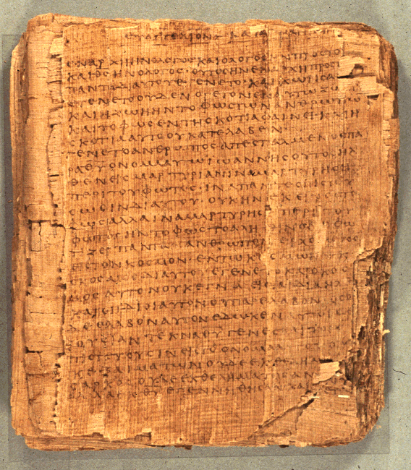
Reading the Old Testament in its Contexts
“Sins of the Fathers”
Dr. Rodney K. Duke

Slide 2
Objectives:
Encourage serious Bible study
Address some the difficulties of studying the Old Testament / the Hebrew Bible
Explore the image of God in the Old Testament

Slide 3
A Case Study
IS THE GOD OF THE OLD TESTAMENT IMMORAL?
I, the LORD your God, am a jealous God, punishing the children for the sin of the fathers to the third and fourth [generation] of those who hate me (Exodus 20:5 NIV).

Slide 4
“Visiting the sins of the fathers on the sons”
Four times in the Pentateuch in two different formulations
Form One: In 2 statements of the Ten Commandments
"You shall not bow down to them or worship them [idols]; for I, the LORD your God, am a jealous God, punishing the children for the sin of the fathers to the third and fourth generation of those who hate me, but showing love to a thousand generations of those who love me and keep my commandments" (Exod 20:5-6 NIV, similar to Deut 5:9-10), and

Slide 5
Form Two: Statements in narrative contexts about God’s character
"And he passed in front of Moses, proclaiming, "The LORD, the LORD, the compassionate and gracious God, slow to anger, abounding in love and faithfulness, 7 maintaining love to thousands, and forgiving wickedness, rebellion and sin. Yet he does not leave the guilty unpunished; he punishes the children and their children for the sin of the fathers to the third and fourth generation" (Exod 34:6-7 NIV, similar to Numbers 14:18-19)

Slide 6
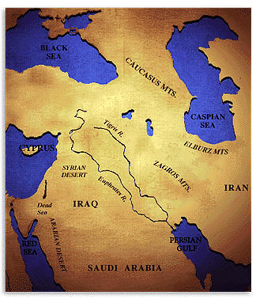
Examining the Text in its Contexts
Grammatical
Literary
Historical –Cultural
Theological

Slide 7
Point 1: Grammatical Context
"You shall not bow down to them or serve them [idols]; for I, Yahweh your God, am a jealous God, visiting the guilt of the fathers on the sons to the third and fourth generation to the ones hating me. [Exod. 20:5, literal translation]
לֹֽא־תִשְׁתַּחְוֶ֥֣ה לָהֶ֖ם֘ וְלֹ֣א תָעָבְדֵ֑ם֒
כִּ֣י אָֽנֹכִ֞י יְהוָ֤ה אֱלֹהֶ֙יךָ֙ אֵ֣ל קַנָּ֔א
פֹּ֠קֵד עֲוֹ֙ן אָבֹ֧ת עַל־בָּנִ֛ים עַל־שִׁלֵּשִׁ֥ים וְעַל־רִבֵּעִ֖ים לְשֹׂנְאָֽ֑י׃
Hebrew word order tends to become more specific.
The last word (to the ones hating me) probably qualifies BOTH the sons and the fathers.

Slide 8
Deuteronomy 7:9-10 (following the 10 Commandments) shows how the phrase, “to the ones hating me,” was interpreted:
  "Know therefore that the LORD your God is God; he is the faithful God, keeping his covenant of love to a thousand generations of those who love him and keep his commands. But those who hate him he will repay to their face by destruction; he will not be slow to repay to their face those who hate him." (Deut 7:9-10 NIV).
“Sons” committing the same sins as the “fathers.”
So, too, the early Church Fathers: Origen, Chrysostom, Augustine.

Slide 9
Point 2: Literary Context: Form
Whole statement is formulaic and figurative language of extreme contrast – hyperbole.
  Punishing to the 3rd and 4th [generation] “of those who are hating me,” BUT showing steadfast love to the thousands [of generations] of those loving me and keeping my commandments.
Emphasis: God’s faithfulness and mercy!
This formulaic language is used as an appeal to God’s mercy: our text in Numbers 14, as well as: Nehemiah 9:17-18; Jonah 4:2; Joel 2:13; Psalm 86:15.
So, too, Jewish rabbis understood the formula.

Slide 10
Point 3: Literary Context: Genre
Form One is found in the 10 Commandments (Law Code), in the 2nd commandment that forbids idolatry.
The goals of the Law/Torah were:
to create a holy covenant community of faith,
  to be a blessing to them, and
  to make them to be a blessing to all nations.
    (See next point: Covenant Context)
Idolatry, worshipping other “gods,” would destroy God’s redemptive plans for them and for the world.

Slide 11
Form Two: Literary Context, Genre
Both are speeches in narrative texts, making a point about God’s merciful character!
  Exodus 34:7
  God is revealing His character to Moses on Mt. Sinai.
  Numbers 14:18
  Moses is interceding, after the Israelites have rebelled, and asking God not to destroy the people, by reminding God of His merciful character.
  (Moses expects there to be consequences on those who led the rebellion, but is trying to save the people as a whole.)
So, too, Nehemiah 9:17-18; Jonah 4:2; Joel 2:13; Psalm 86:15, use this language to appeal to God’s mercy.

Slide 12
Point 4: Covenant Context (relates to 10 Commandments)
The people of Israel freely entered into a legally binding contract / covenant relationship with Yahweh.
They interpreted their lives and history in terms of keeping or breaking this covenant with God.
Second commandment: against idolatry.
  Idolatry would totally thwart the purposes of the covenant community. [Genesis 12, promises to Abraham to bless all people through his descendants.]
Note: To claim Jesus as “Lord” also defines a self-binding relationship!

Slide 13
Point 5: Cultural Context, Family
A “family” was perceived as multi-generational unit.
Common to ancient world to apply consequences to a whole family.
“To the 3rd and 4th generation” may have been a statement of LIMITATION to the extended living family of the father (children, grand children and great grand children).
Illustration: Numbers 14. The extended family wander in wilderness until the first generation dies off.
  (A case of mercy. God spared the community and continued the covenant with the next generation.)

Slide 14
Point 6: Cultural Context, Community
Common concept of corporate identity
  (foreign to Western individualism).
Corruption of the father/leader, who is in charge of instructing in righteousness, corrupts all who follow. (A father who “hates” God, raises children who “hate” God.)
Contemporary Illustrations:
  War reparations (the people of Germany just paid off reparations for WWI on Oct. 3, 2010)
  Holocaust survivors
  Japanese Americans interned
  Ongoing debate about American Indians

Slide 15
Point 7: Context of Internal Application in the OT
Example of Numbers 16: Leadership Rebellion
250 leaders apparently sway the whole community toward rebellion.
Moses and Aaron intercede and ask the God not destroy the whole community.
God warns the people to separate themselves from the tents of the rebellious leaders.
Whereas all others move away, the families stay put.
    [Presumably innocent family members could have separated themselves, but it would not be likely in that culture.]
The leaders, their families, and all of their belongings are destroyed. Symbolic of purging the community.

Slide 16
Point 8: Context of the Justice System
No record of this statement applying to criminal justice system within Israel.
  [David is pressured into putting Saul’s sons to death, because Saul broke a covenant with the Gibeonites (2 Samuel 21), but we are not told that this action was just.]
Justice system specifically prohibited punishing the sons for the fathers:
  "Fathers shall not be put to death for their children, nor children put to death for their fathers; each is to die for his own sin" (Deut 24:16 NIV; repeated in 2 Kings 14:6 and 2 Chron 25:4).

Slide 17
Point 9: Theological Context of Divine Justice
Principle of individual responsibility
Contrary to the people’s expectation, “Why does the son not share the guilt of the father?" (see Ezek 18:19-20), God tells Ezekiel to say:
  "What do you people mean by quoting this proverb about the land of Israel: " 'The fathers eat sour grapes, and the children's teeth are set on edge'? 3 "As surely as I live, declares the Sovereign LORD, you will no longer quote this proverb in Israel. 4 For every living soul belongs to me, the father as well as the son--both alike belong to me. The soul who sins is the one who will die" (Ezek 18:2-4 NIV; see too, Jer 31:30).
[Example of “Progressive Revelation”?]

Slide 18
Issue:
Divine justice for the individual AND corporate punishment (the Babylonian destruction) are affirmed in the same book!
So, too, Jeremiah holds together corporate guilt AND individual justice:
  You show love to thousands but bring the punishment for the fathers' sins into the laps of their children after them. O great and powerful God, whose name is the LORD Almighty, great are your purposes and mighty are your deeds. Your eyes are open to all the ways of men; you reward everyone according to his conduct and as his deeds deserve (Jer 32:18 NIV).

Slide 19
Toward a Resolution: Corporate Guilt and Individual Justice Held Together
In Ezek 18 the principle of individual responsibility is being used as a call to repentance; God does not want people to die, but to repent and live (cf. 18:2 and 32).
Still, the prophets see the individuals as all participating in the breaking of covenant, so that corporate guilt is justified.
    Ezek 18:30 addresses the "house of Israel" and "each one" at the same time; so too, Jeremiah sees all of Israel as being guilty for generations (Jer 32:30-32).

Slide 20
Both principles can work together.
  In Numbers 14:
  The rebellious fathers were not permitted to enter the Promised Land (individual justice)
  But, their children had to suffer the consequence of wandering in the wilderness until their "fathers" died and the children became of age (a corporate consequence).
  Main emphasis: God showed mercy and maintained the covenant commitment with the children and brought them into the Land.

Slide 21
Point 10: Context of Progressive (Christian) Revelation
God’s acts of purging the covenant community, are acts of immediate, but temporary consequences in terms of eternal life.
  “Book of Life” a concept in both OT and NT bases final judgment on back to individual accountability: Exod 32:32,33; Psalm 69:28; Daniel 12:1; Luke 10:20; Philip. 4:3; Rev. 3:5; 13:8; 17:8; 20:12,15; 21:27; 22:19).
The final status of the individual, in terms of eternal life or ultimate destruction, still lies in the hands of a merciful God.

Slide 22
IS THE GOD OF THE OLD TESTAMENT IMMORAL?
Conclusion
These phrases are partly formulaic and figurative.
These phrases are grounded in a culture of covenant and corporate identity.
These phrases DO NOT express God’s principles for criminal justice or for ultimate judgment of the individual.
These phrases emphasize BOTH the seriousness of God’s covenant people breaking covenant AND the long lasting mercy of God toward those who keep covenant.

Slide 23
Principles of Bible Study
First: Prayer, prayer, prayer!
Second: Context, context, context!
Contexts I looked at:
  Grammatical [close reading, commentaries]
  Literary form [close reading, commentaries]
  Immediate literary setting [close reading]
  Literary type (genre) [close reading, commentaries]
  (Historical) [Bible introductions, commentaries]
  Cultural and social [Bible dictionaries, comment.]
  Theological and Canonical [reflection and comment.]

Slide 24
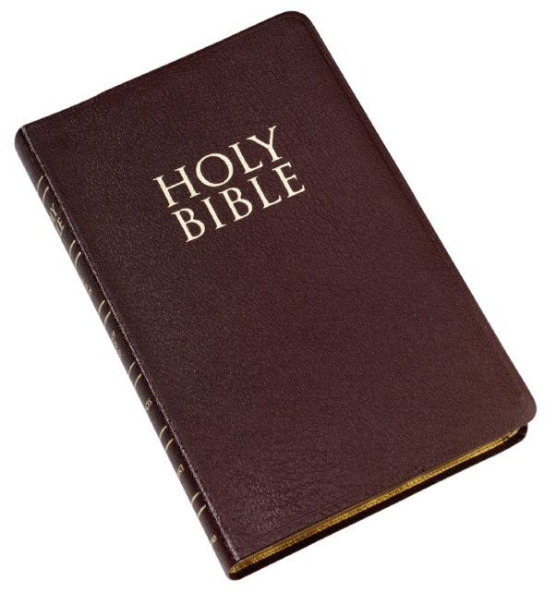
Do your best to present yourself to God as one approved, a worker who does not need to be ashamed and who correctly handles the word of truth.
(2 Timothy 2:15)

