Slide 1
Signal Detection Theory Separation of Strategy & Sensitivity

Slide 2
Method
Only 1 Stimulus is Used.
The issue is: Is it there or not? A yes/no decision must be made.
Notice how this task can be generalized.
Cancer?: Yes vs. No. Bomb?: Yes vs. No?
Can be applied to nonhumans like computer-based recognition systems
Manipulate Percentage of Cases that Stimulus Is Present.
How influenced are you by Likelihood of Stimulus being present?

Slide 3
Signal Detection Theory
 |  | Response
 |  | Yes | No
Stimulus | Present | Hit | Miss
 | Absent | False Alarm | Correct Rejection

Slide 4
Focus on Hit and False Alarm Rates
 |  | Response
 |  | Yes | No
Stimulus | Present | Hit
 | Absent | False Alarm

Slide 5
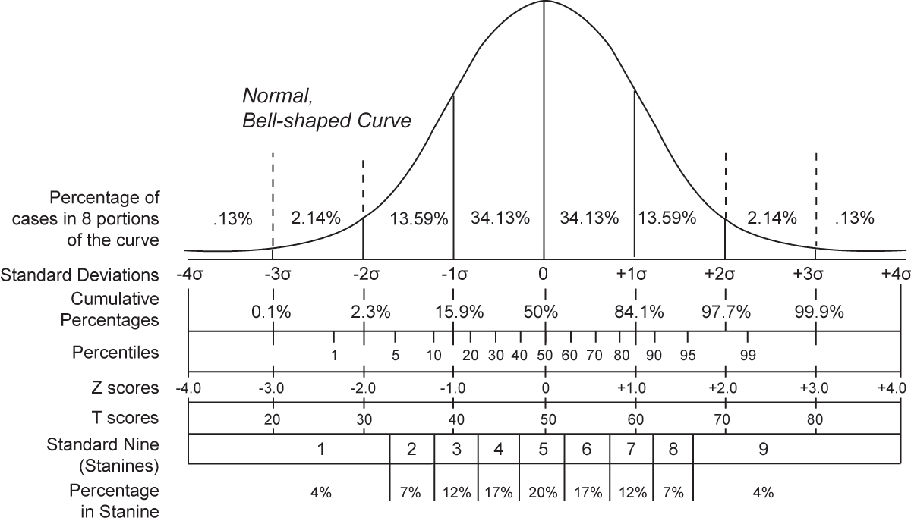

Slide 6
Sensitivity Measure
d’ Measure: Look at Size of Difference of Hit vs FA
d’ = Z(Hit) – Z(FA)
Z transformation -> Units into Standard Deviation (SD) steps
0 (zero) = zero sensitivity to presence of stimulus
Increased d’ scores indicate increased sensitivity to stimulus
A practical maximum = 4 SD steps

Slide 7
Strategy Measures
All Decisions involve Uncertain Outcomes
“Liberal” = tendency to say “Yes” that stimulus is present
“Conservative” = tendency to say “No” that stimulus is present
Cost/Benefit Ratio is the question
What are the consequences of saying “Yes” if wrong?
What are the consequence of saying “No” if wrong?

Slide 8
Strategy Measures
Many measures: Bias and Criterion
All measure tendency to say “Yes” or “No” when uncertain
One Example Measure
C indicates Criterion rule for saying “Yes”
C = [Z(Hit) + Z(FA)] / 2 (note: usual value is -2, which flips direction)
C = 0 indicates neutral criterion
C > 0, bias towards “Yes” (“liberal” criterion)
C < 0, bias towards “No” (“conservative” criterion)

