Slide 1
Richard Gregory (1963) Inappropriate Scaling Theory Explanation of the Mueller-Lyer Illusion

Slide 2
Inappropriate Scaling Theory
The M-L Effect is a By-product of Issues Related to Depth Perception
The Size of the Retinal Image is controlled by
Size of the Object
Smaller Object = Smaller Retinal Image
Distance from Observer to Object
Greater Distance = Smaller Retinal Image

Slide 3
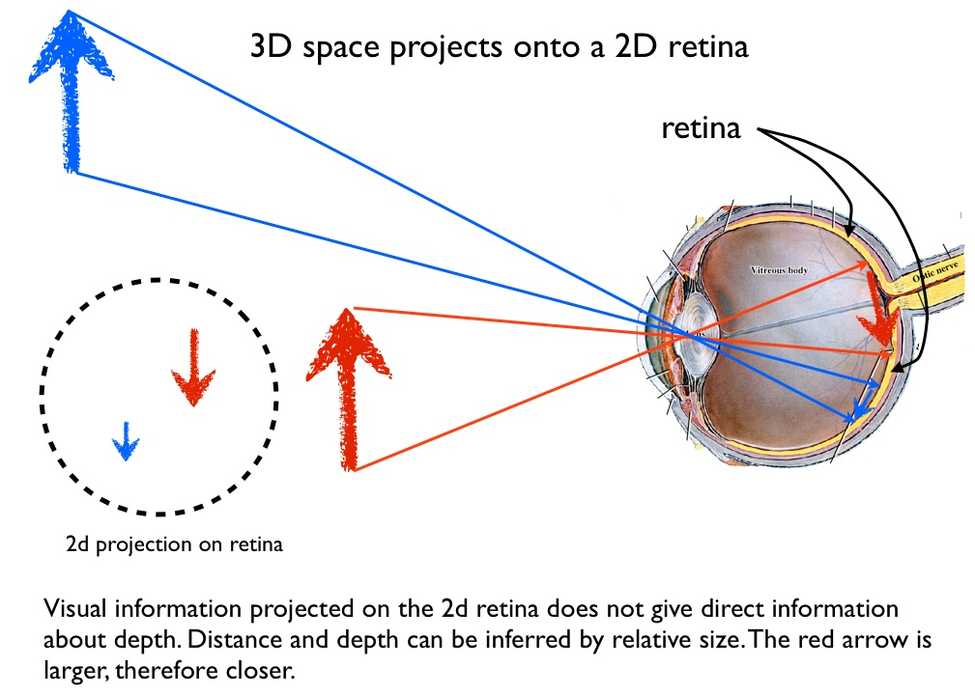

Slide 4
Inappropriate Scaling Theory
The Visual System Must Decide Whether
Object is Small and Close
Object is Big and Distant
The Visual System uses 2 Sources of Info
Binocular Cues
Amount & Type of Disparity (Crossed vs. Uncrossed)
Monocular Cues
Pictorial Cues (ex: Closeness to Horizon Line)

Slide 5
Inappropriate Scaling Theory
Line Drawings/Photographs are Odd Mix of 2D and 3D Information
They are Located on Flat Surface (2D)
They may contain 3D Cues indicating Depth

Slide 6
Inappropriate Scaling Theory
Gregory’s theory is some illusions are due to our responding to 3D info in the image and using that information Inappropriately to rescale the sizes of portions of the display
His analysis of the Mueller-Lyer Illusion

Slide 7
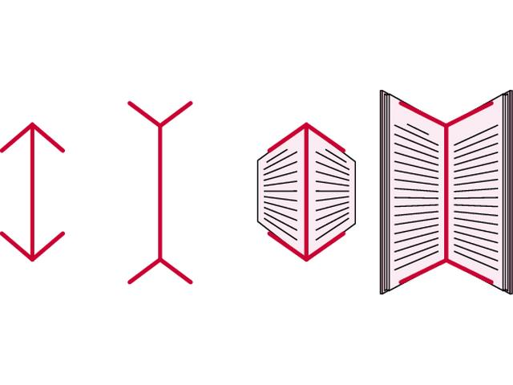

Slide 8
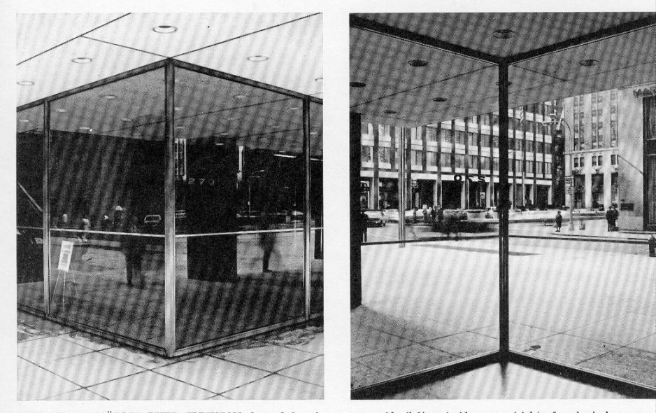
Closer
Farther Away

Slide 9
Analysis of Mueller-Lyer Illusion
The 2 Red Shafts are the Same Size and the Same Distance from You
Therefore Retinal Images are Same Size
But the Angles of the Wings contain 3D info about Distance
In-facing Wings indicate Shaft is Close
Out-facing Wings indicate Shaft is more Distant
Same Retinal Size but Farther Away means Out-facing Wings have longer Shaft.

Slide 10
Question for Lab Experiment
Gregory argues that Wings contain 3D info to which we Respond
Wing angle to Shaft is influenced by Distance in 3D world
In-facing Wings: Closer to Shaft means Shaft is Closer to Viewer
Out-facing Wings: Farther from Shaft means Shaft is Farther from Viewer

Slide 11
Question for Lab Experiment
Experiment will Manipulate Wing Angle
Question is Whether Manipulation of Wing Angle will produce Changes in Shaft Length as Predicted by Gregory

Slide 12
Question for Lab Experiment
Gregory’s Predictions
In-facing Wings:
In-facing Wings means that Shaft is closer
Closer Shaft means that retinal image is larger
Apparent larger size of Shaft should be discounted because it is closer
Adjustable line length should be made shorter than standard

Slide 13
Question for Lab Experiment
Gregory’s Predictions
Out-facing Wings:
Out-facing Wings means that Shaft is farther away
Far-away Shaft means that retinal image is Smaller
Apparent smaller size of Shaft should be discounted because it is farther-away
Adjustable line length should be made longer than standard

Slide 14
Question for Lab Experiment
Gregory’s Predictions
Most extreme angles produce strongest distance Cues
Should see gradual change in Size and Sign (+/-) of illusion as you go from one extreme to other.

