Slide 1
Magnitude Estimation Procedure
The assumption of direct scaling.
The observer is presented with a standard stimulus.
The stimulus is assigned a value.
This value is the modulus.

Slide 2
Magnitude Estimation Procedure
The observer is presented with a series of stimuli that vary along 1 physical dimension. (In our case it will be dot density.)
Stimuli are presented in random order.
The observer must assign a number to indicate magnitude of the stimulus relative to the modulus.

Slide 3
Magnitude Estimation Results
The basic question: If you double the physical magnitude then what is the effect on psychological magnitude?
Double?
More than Double?
Less than Double?

Slide 4
Stevens’ Power Law
The basic question: If you double the physical magnitude then what is the effect on psychological magnitude?
S = aI^{n}
I = Physical Intensity or Magnitude
S = Psychological Intensity or Magnitude
n = Exponent that specifies size of conversion
Goal is to discover the size of n.

Slide 5
Magnitude Estimation Results
The basic question: If you double the physical magnitude then what is the effect on psychological magnitude?
Double? Then n = 1
More than Double? Then n > 1
Less than Double? Then n < 1

Slide 6
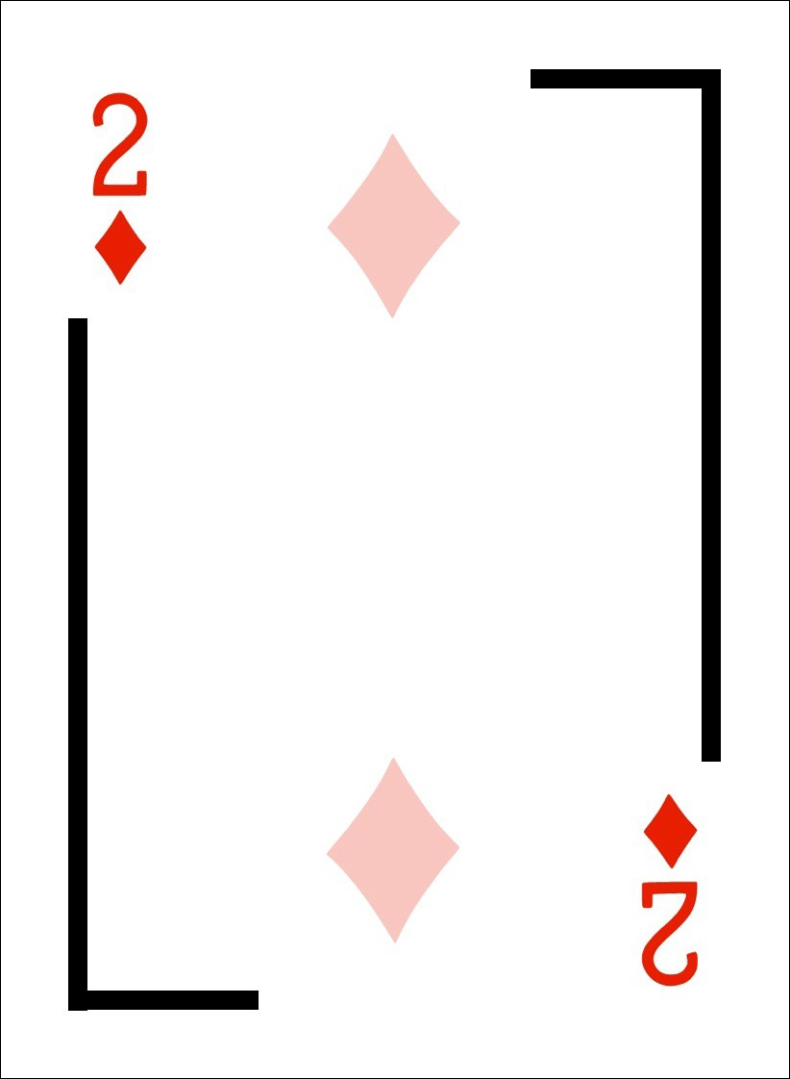
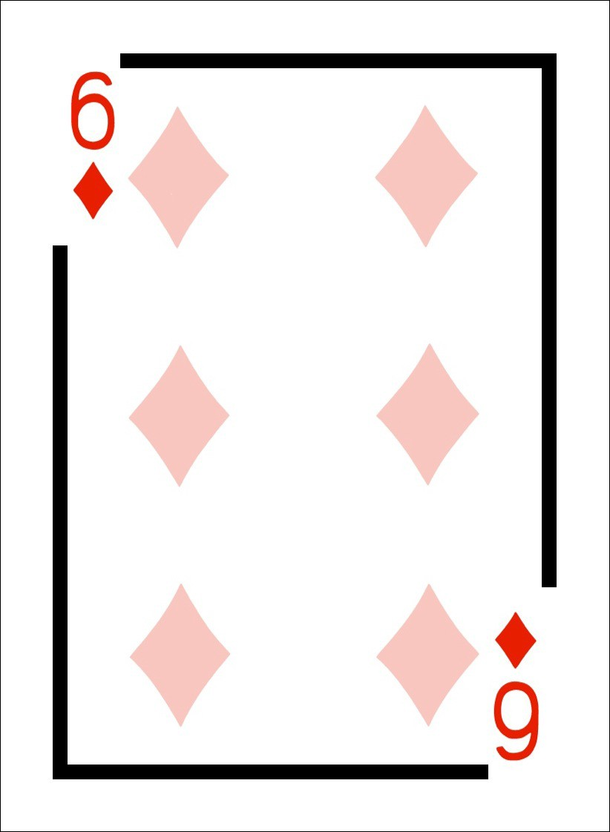
Magnitude Estimation Task
Ace
“15”
“70” “5” “50” “25”
5. Record this number, and place the card in a “discard” pile to the side.
1. Extract the diamonds and the ace of spades. Shuffle the diamonds.
2. Turn the diamonds pile face down and place the ace face down on the table.
6. Repeat steps 4-5 for all the cards in the diamonds pile.
3. Assume the ace is the standard and its pattern has a density of 50 (half class) or 100 (other half of class)
7. Turn the discard pile over and enter the density estimates under the corresponding card numbers in the spreadsheet.
4. Compare the pattern on the top card in the diamonds pile to the pattern on the ace standard and assign it a number that represents it density relative to the standard.
8. Shuffle the diamonds pile and repeat steps 4-7. Record the results of the 3rd round.
9. Email your modulus, n, and R² results to me. Email the spreadsheet to yourself.

Slide 7
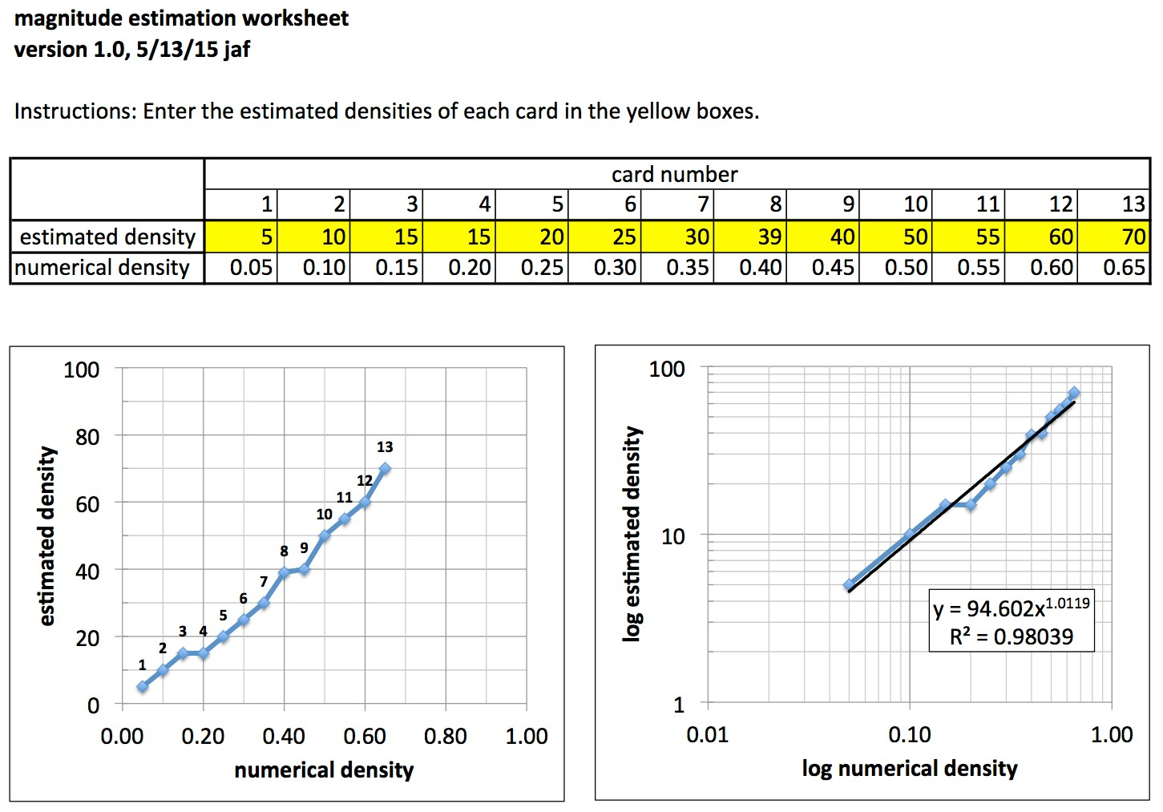
Magnitude Estimation Analysis

Slide 8
Lab Report
You have determined the exponent for your psychological magnitude of change when there standard changes in dot density.
The first question is the value of n. Is it close to 1, less than 1, greater than 1? What does that mean?
The second question is how much agreement is there in the class? What does that mean?
The third question involves the size of the modulus (50 vs 100). Did changing the modulus produce a systematic change in the size of n? What does that mean?

