Slide 1
Method of Constant Stimuli
A “standard” stimulus is selected.
A range of comparison stimuli are selected from below the difference threshold to above the difference threshold.
The comparison stimuli are arranged and presented in a random sequence. All stimuli will be compared against the standard stimulus.
Forced Choice: The observer is to judge only whether the difference was detected (Yes) or not detected (No).
The trial is ended when all comparison stimuli have been presented.

Slide 2


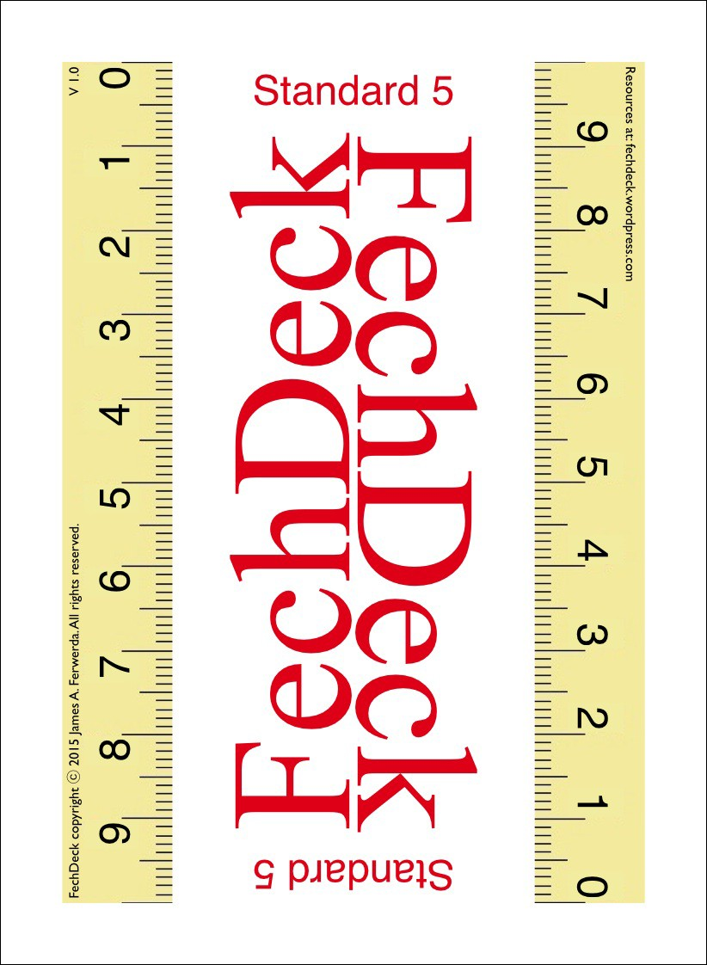




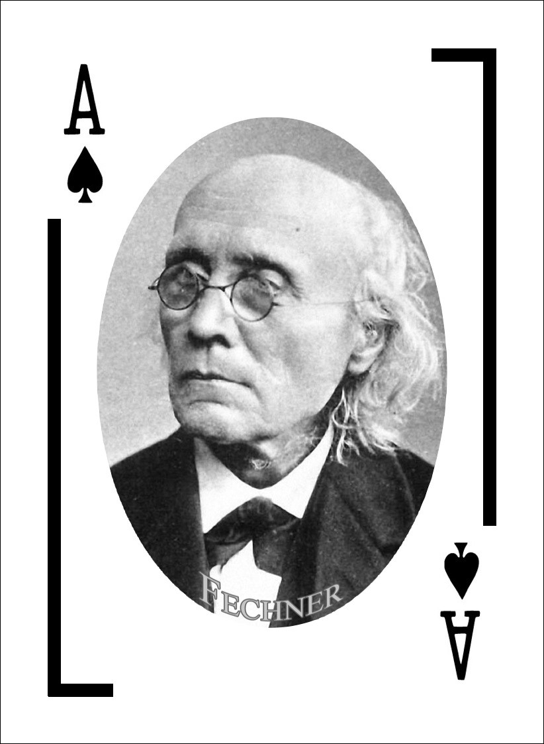




















Method of Constant Stimuli
standard standard
less dense
more dense
less dense
more dense
?
Place the standard 5 Joker face down on the table.
Extract the spades from the deck.
Shuffle the spades into a randomly ordered pile. Turn this pile face down.
Starting from the top of the pile, compare each card to the standard.
If the pattern on the card is less dense than the standard place it to the left of the standard, if it is more dense place it to the right.
Turn the “less dense” and “more dense” piles face up. Record the results for each pile in the appropriate columns in the spreadsheet.
Repeat steps 3-6 until 10 trials have been completed.
Analyze the data using the spreadsheet.

Slide 3
Difference Threshold
Point of Subjective Equality (PSE)
  P(change) = 50% = Most Similar to Standard
Upper Difference Limen (UDL)
  P(change) = 75% = PSE + JND
Lower Difference Limen (LDL)
  P(change) = 25% = PSE – JND
Interval of Uncertainty (IU)
  UDL – LDL
Just Noticeable Difference (JND)
  IU/2
  0.67*SD

Slide 4
Lab Report
You have determined the difference threshold using the Method of Limits and the Method of Constant Stimuli.
You will describe both Methods and report the Results for each method.
The question is whether there is a systematic difference in results between the methods.
    PSE – Shift to smaller/larger value across methods for class
    JND – Shift to smaller value indicates greater sensitivity
I will email/post a spreadsheet containing the class results for the two methods for you to use in your report.

