Slide 1
Method of Limits
A “standard” stimulus is selected.
A range of comparison stimuli are selected from below the difference threshold to above the difference threshold.
The stimuli are ordered and presented in a sequence that corresponds to either an ascending or descending series of the “amount” of the physical dimension under investigation.
Forced Choice: The observer is to judge only whether the difference was detected (Yes) or not detected (No).
The trial is ended when there is a transition.

Slide 2

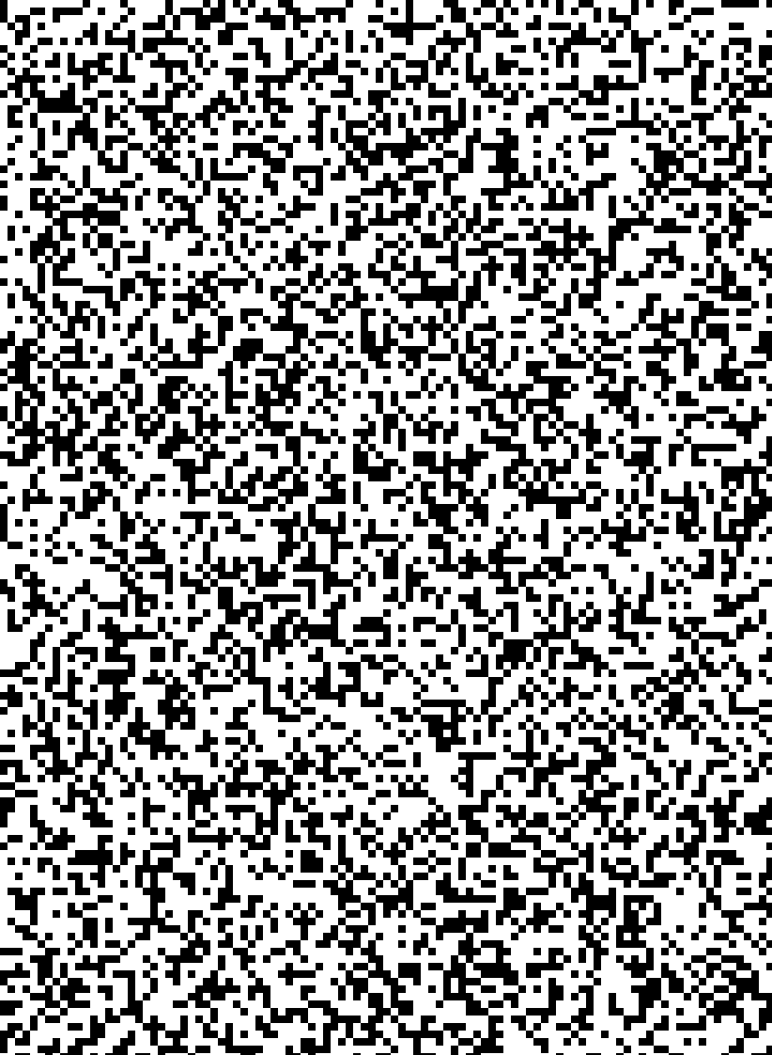
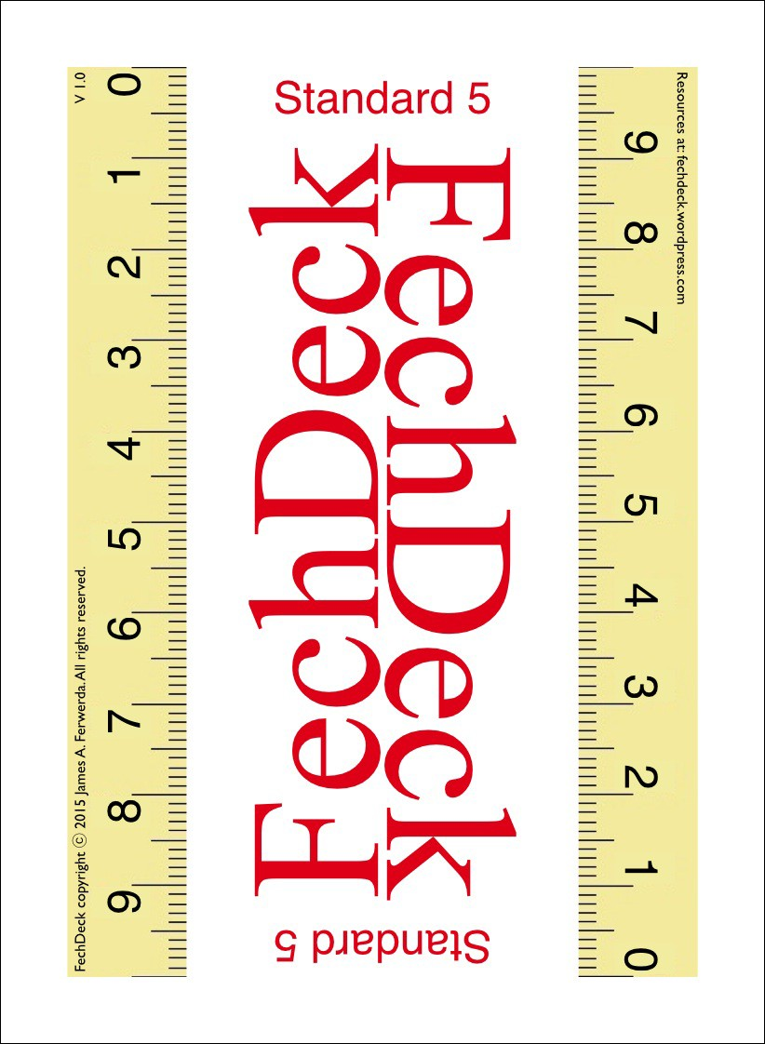
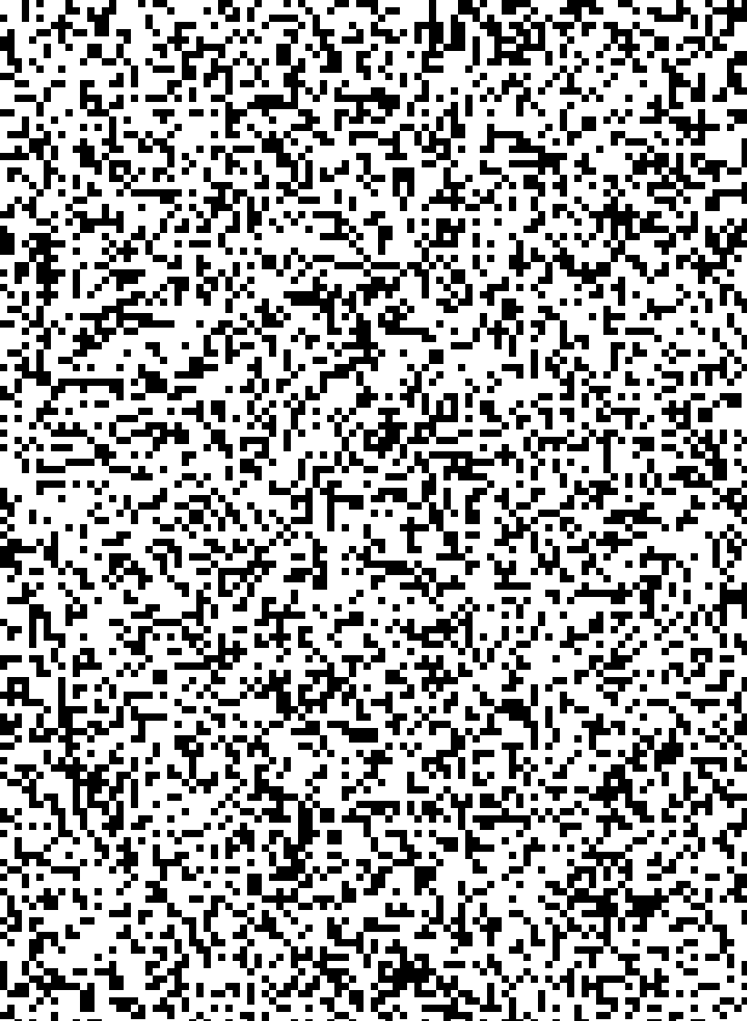
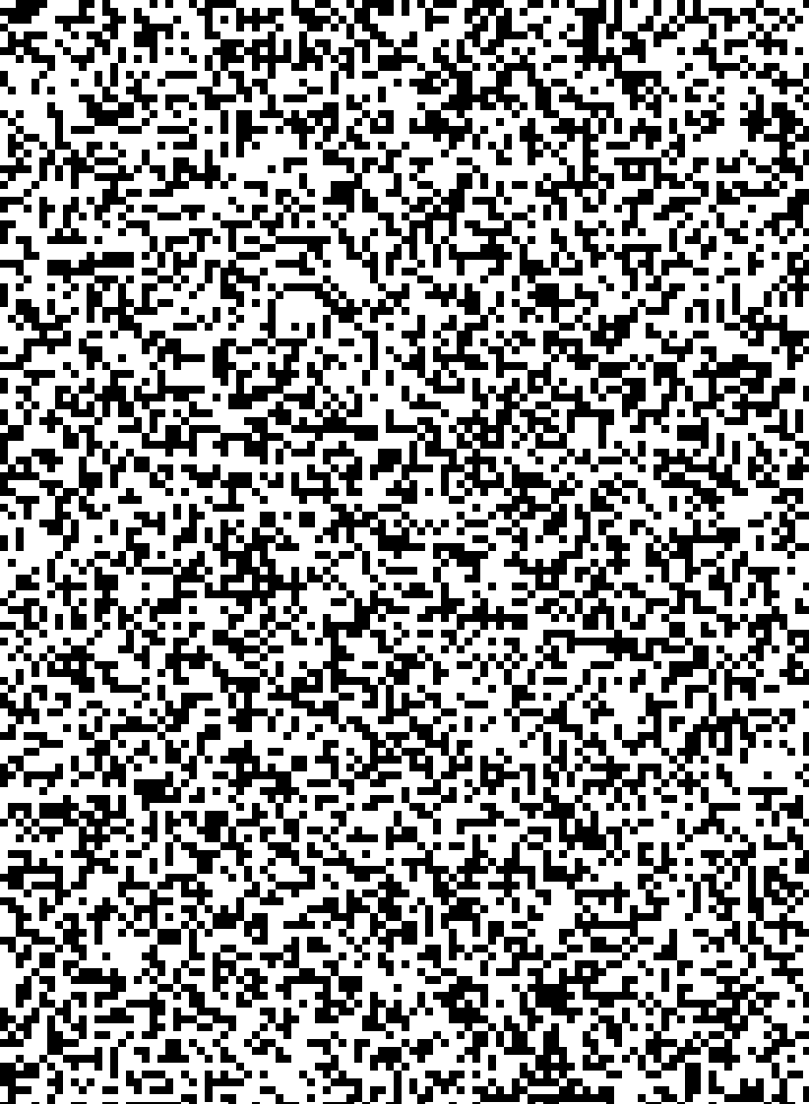
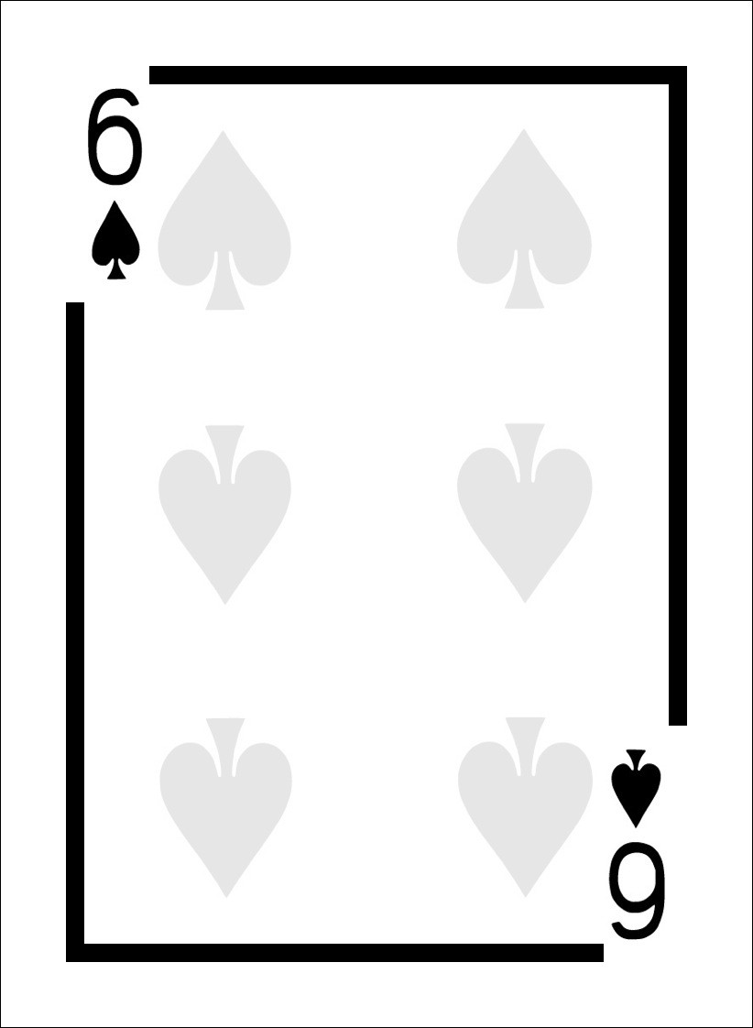
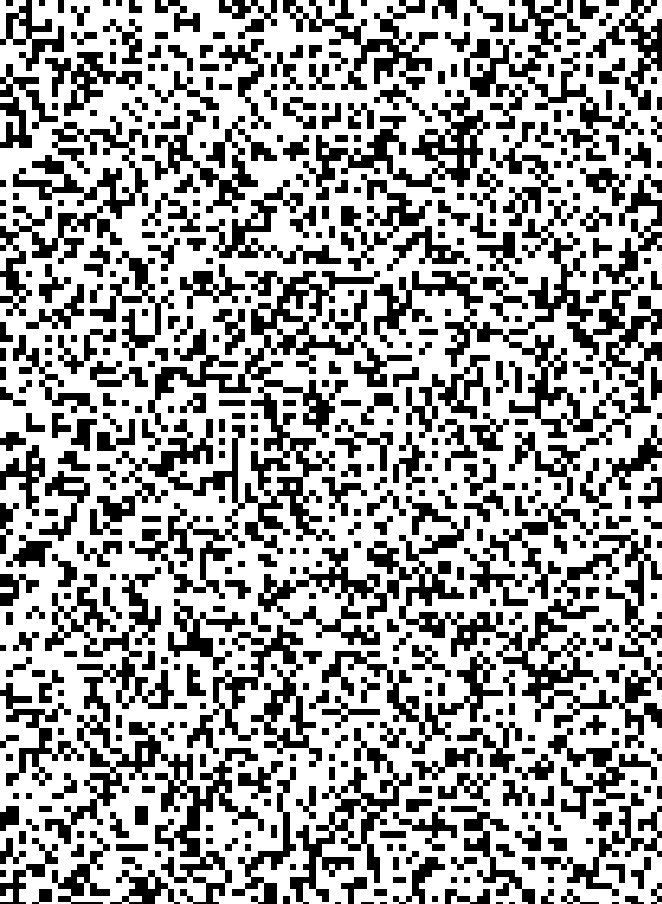
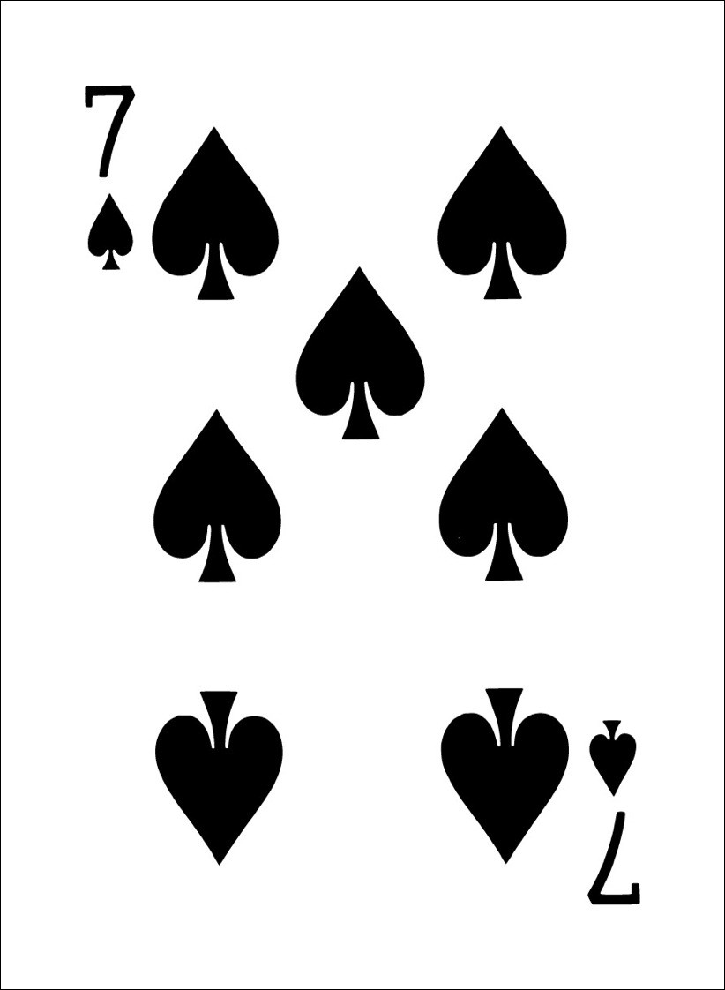
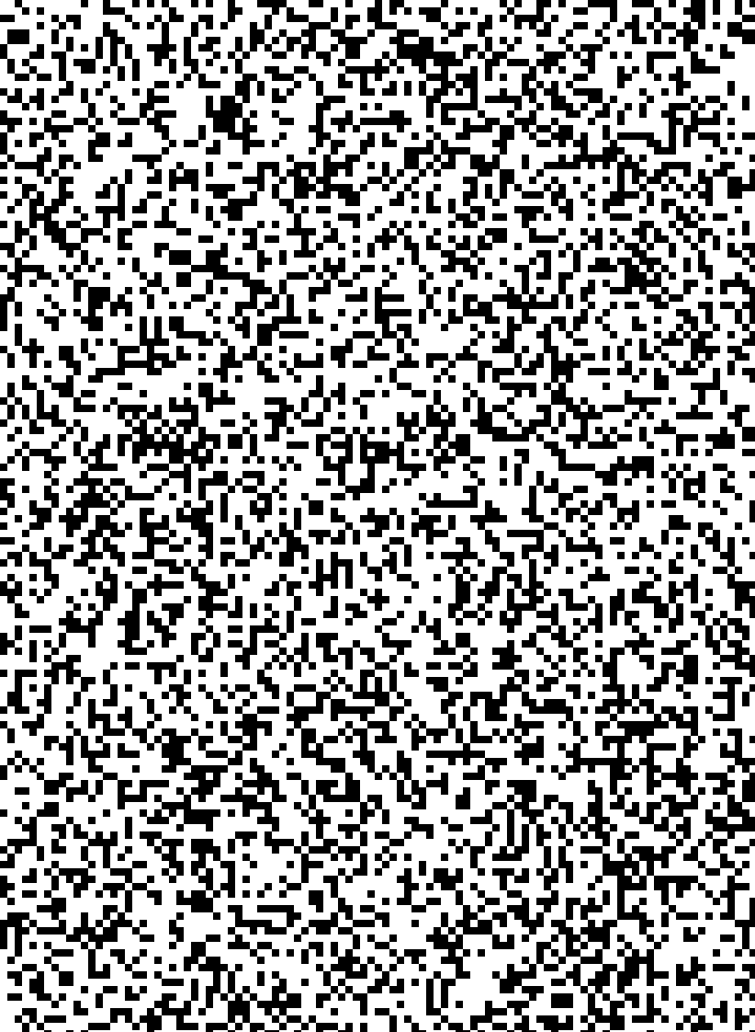
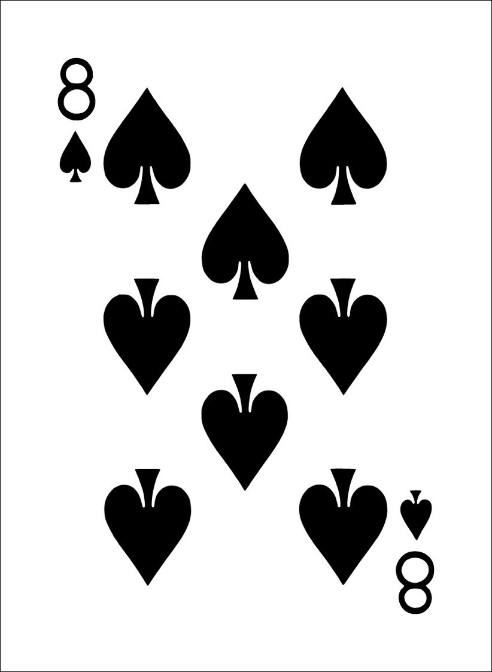
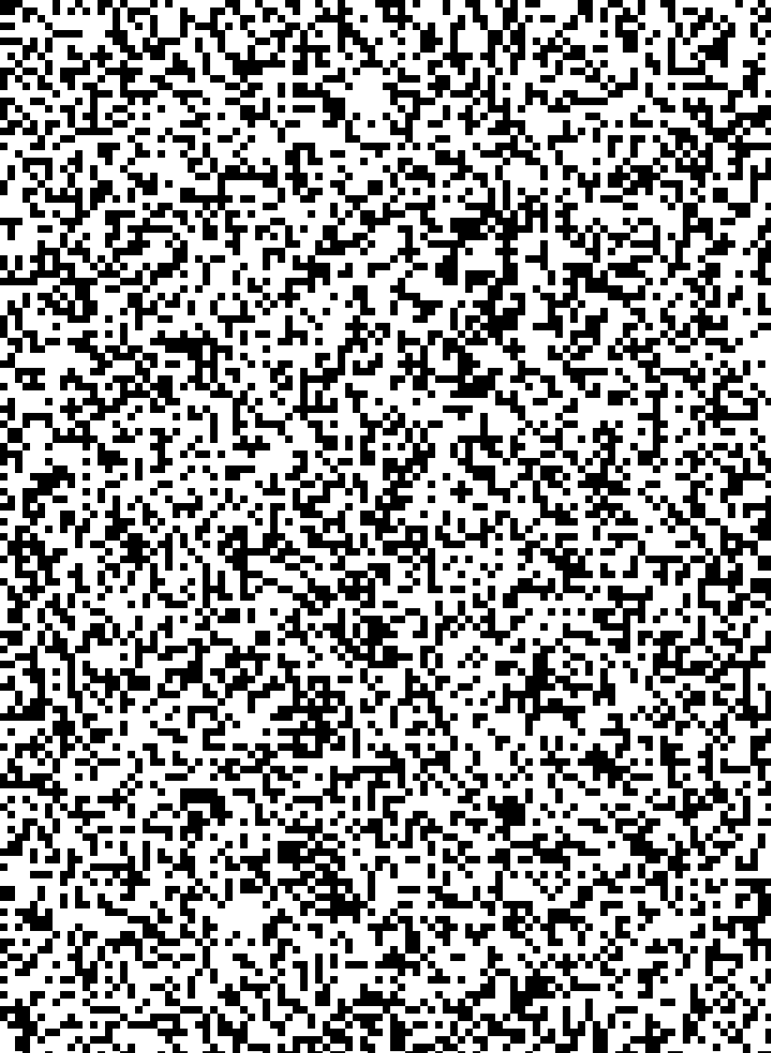
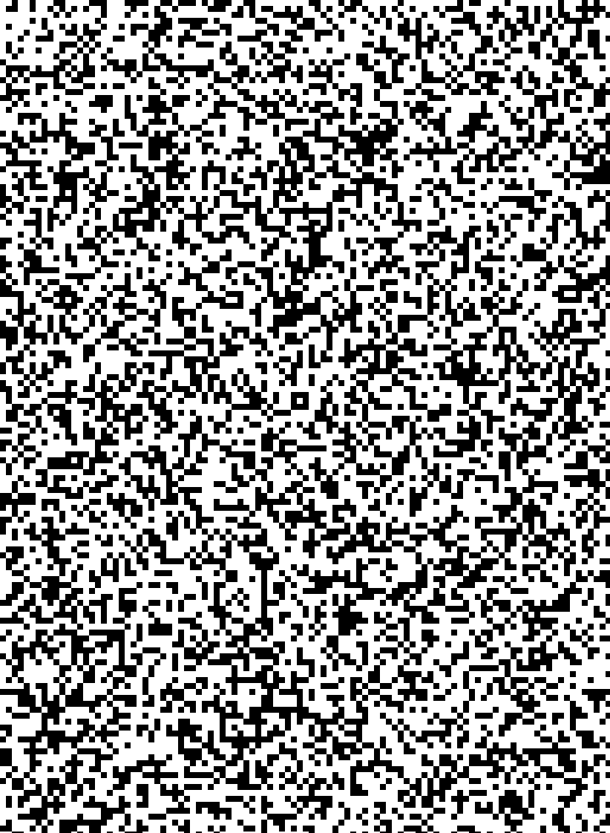
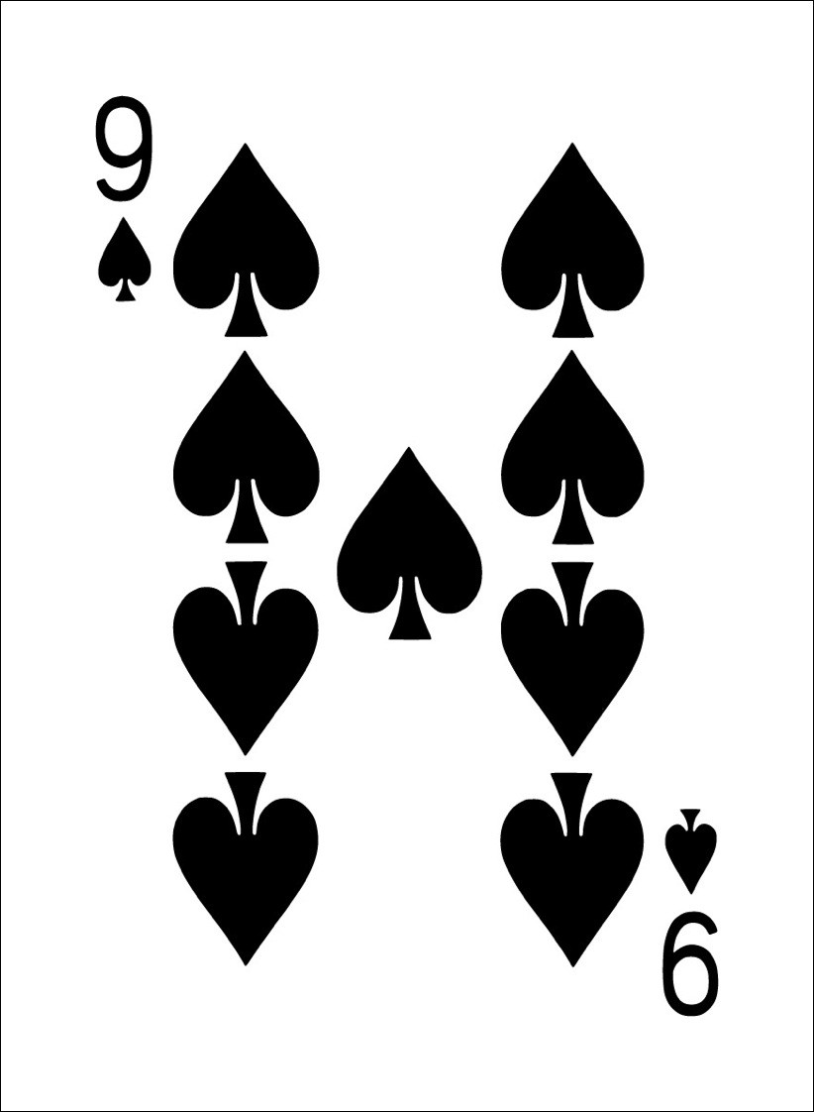

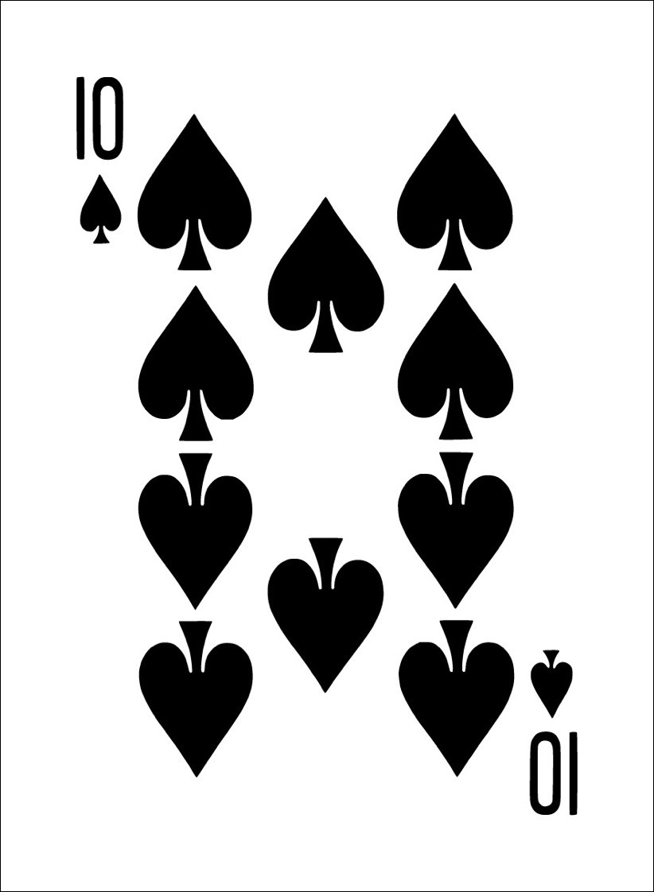

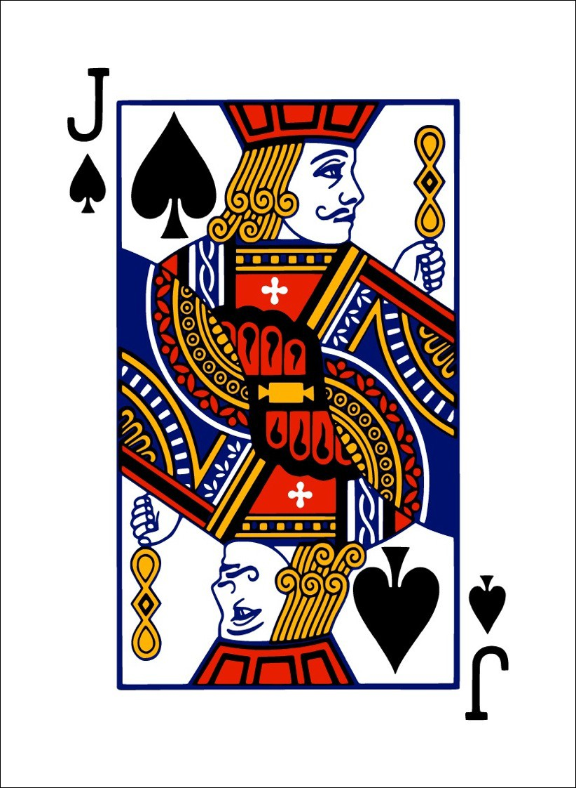
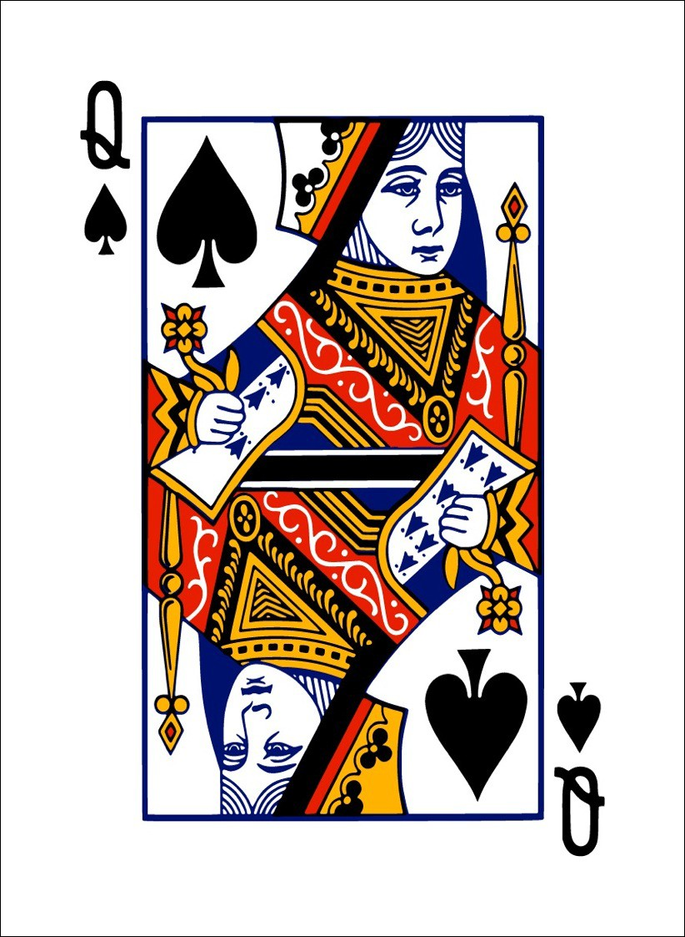
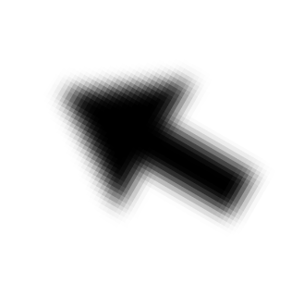


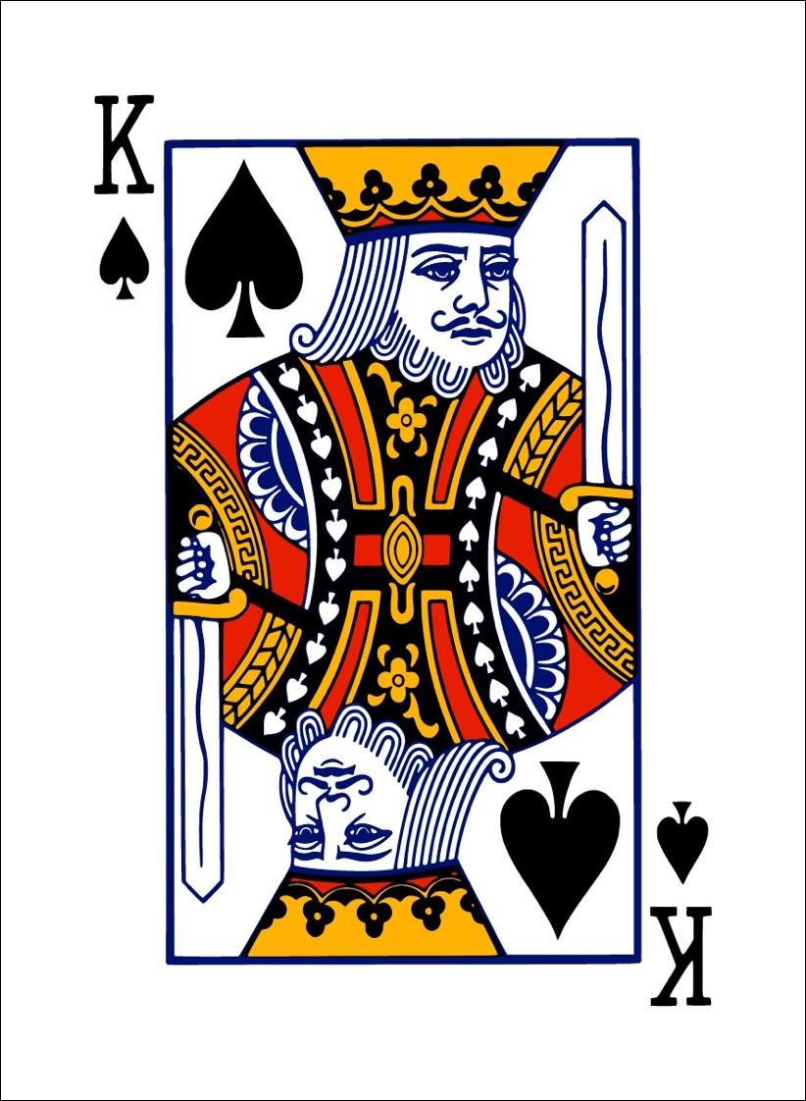

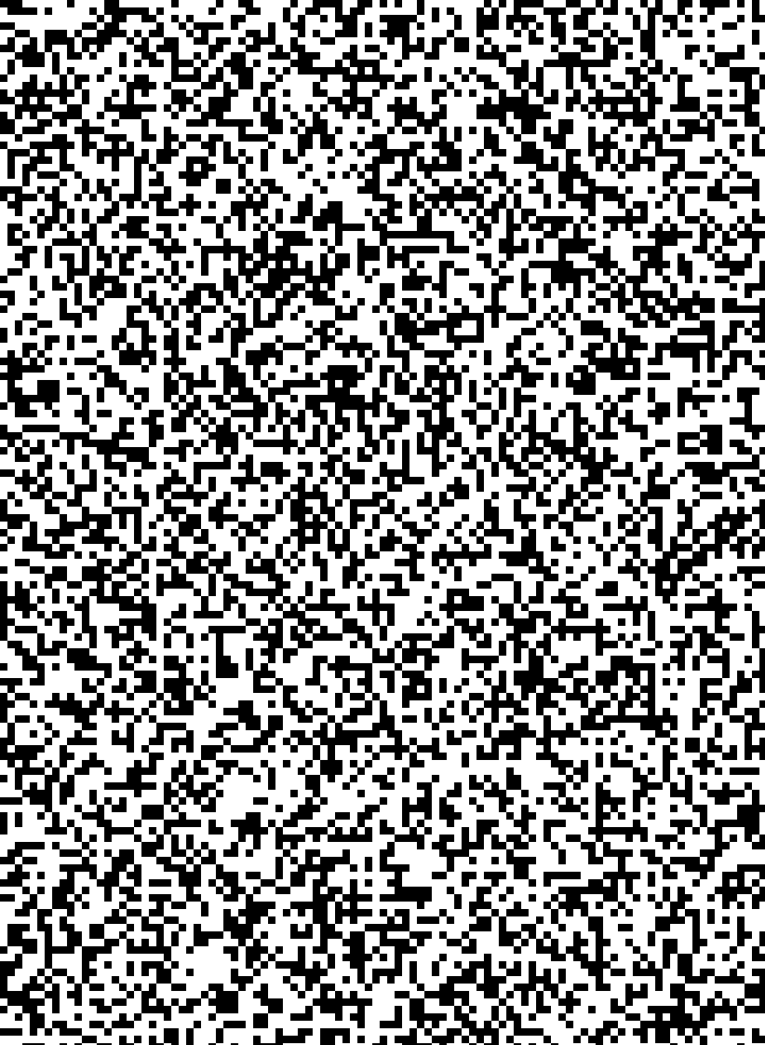
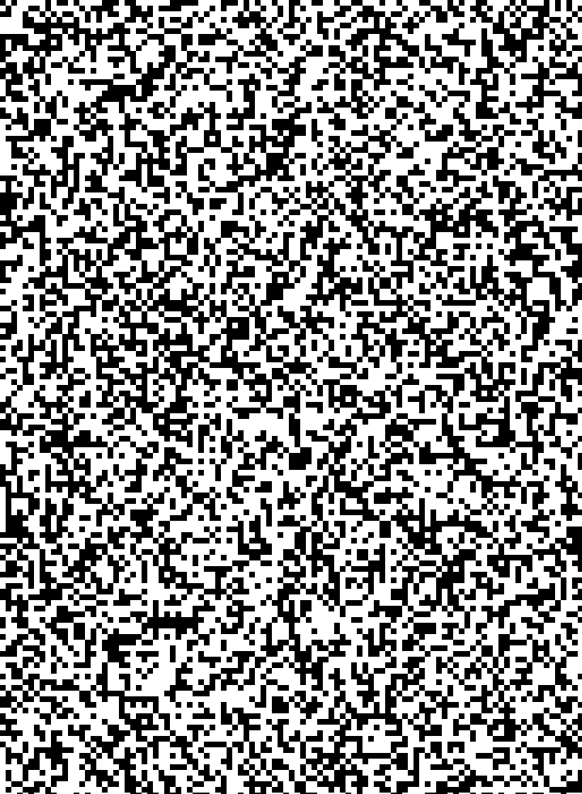
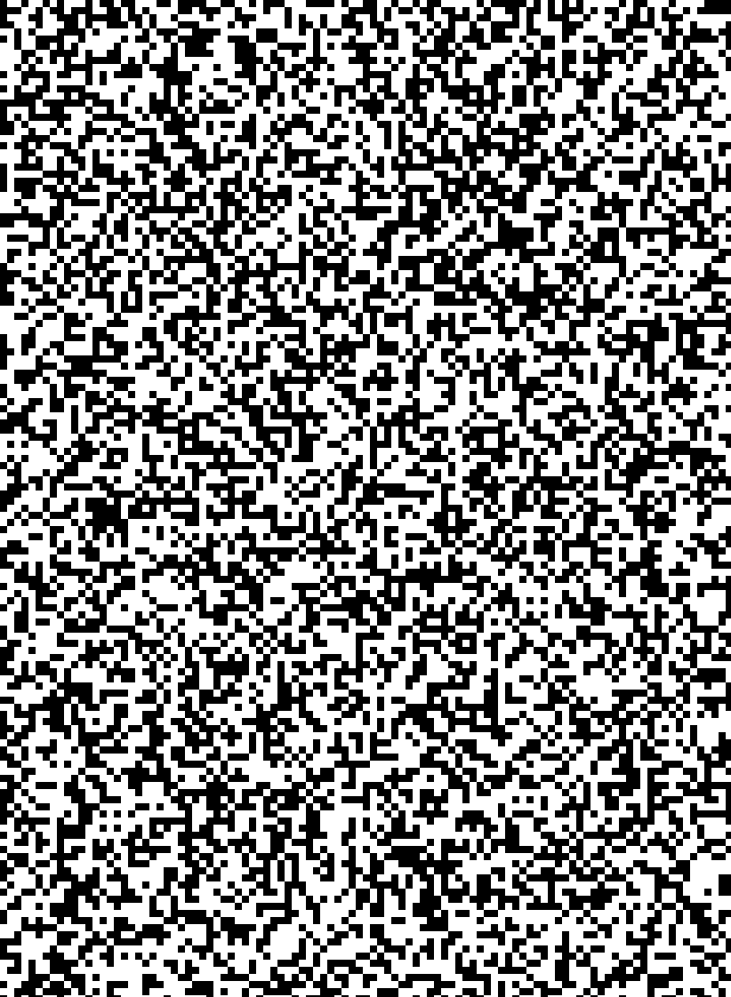

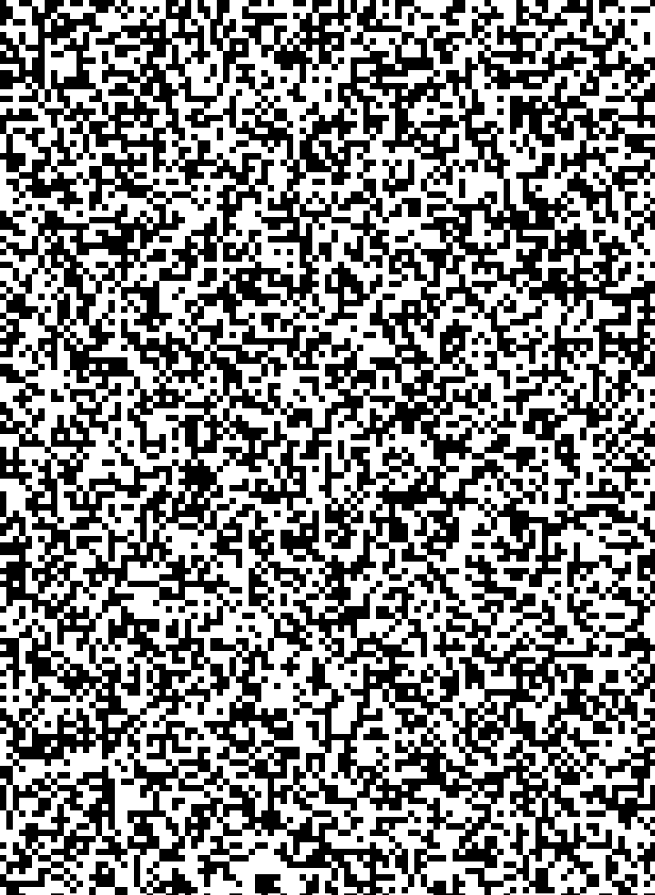
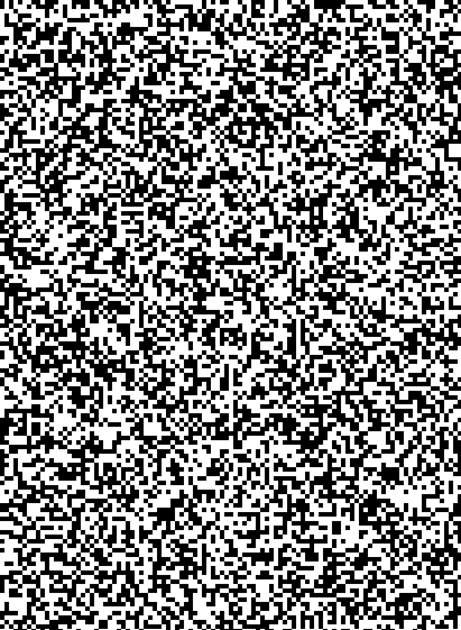
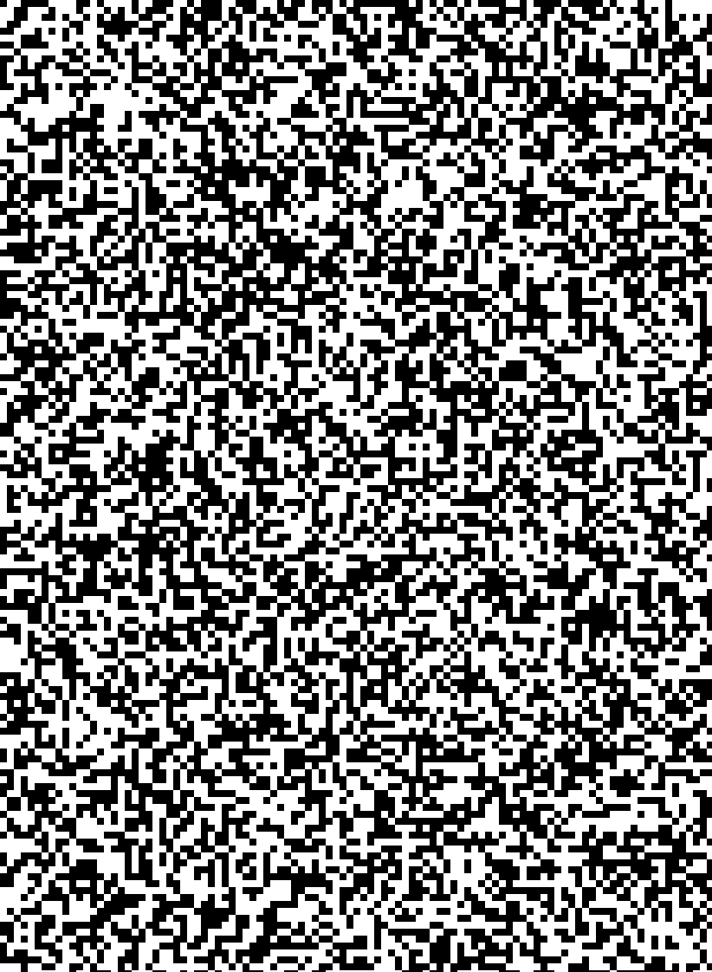
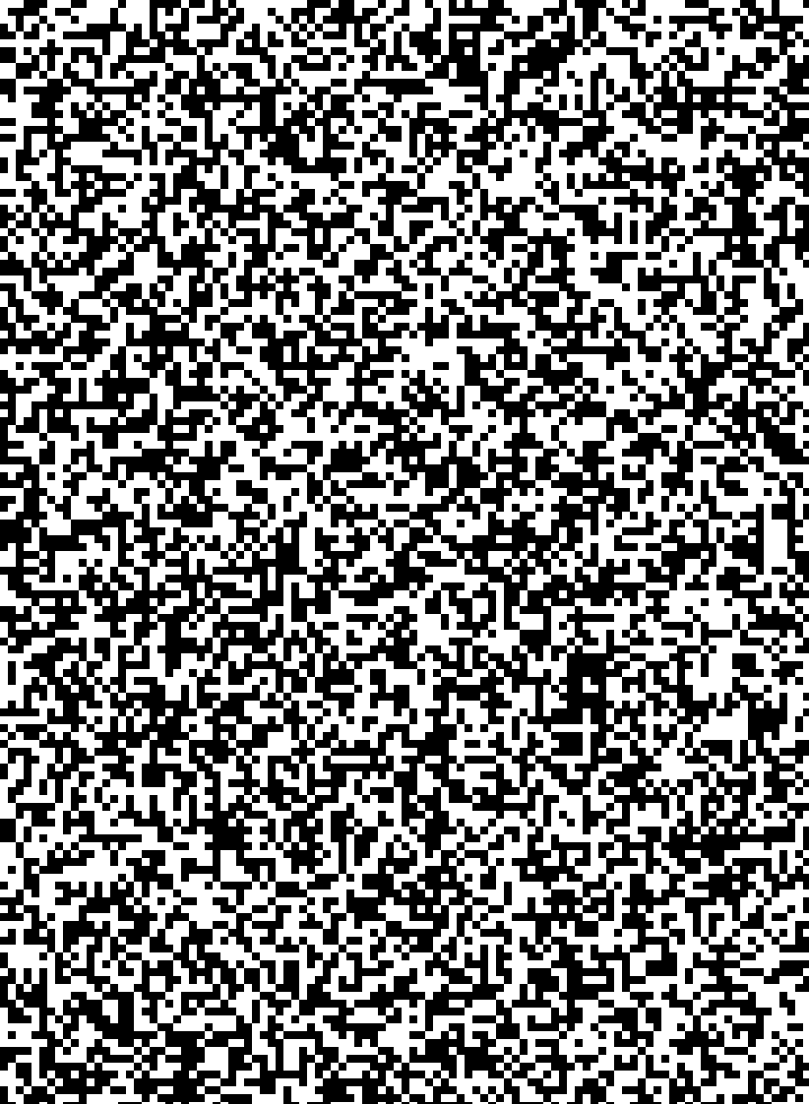
Method of limits
standard
standard
less dense
more dense
less dense
more dense
?
Place the standard 5 Joker face down on the table.
Sort the deck into suits, then sort the suits into A-K order. Select the spades pile and turn it face down.
Starting from the top of the pile, compare each card to the standard.
If the pattern on the card is less dense than the standard place it to the left of the standard, if it is more dense place it to the right.
Continue this process until the first card is placed on the opposite side of the standard, then deal (do not place) the remaining cards on top of this card.
Turn this pile face up and record the number of the top card in the appropriate box in the spreadsheet.
Turn the other pile face up, and place it on top of the first pile. Pick up the merged pile and turn it face down.
Repeat steps 3-7 until the desired number of trials have been completed.
Repeat steps 2-7 for the other suits.
Analyze the data using the spreadsheet.
.

Slide 3
Difference Threshold
Point of Subjective Equality (PSE)
  P(change) = 50% = Most Similar to Standard
Upper Difference Limen (UDL)
  P(change) = 75% = PSE + JND
Lower Difference Limen (LDL)
  P(change) = 25% = PSE – JND
Interval of Uncertainty (IU)
  UDL – LDL
Just Noticeable Difference (JND)
  IU/2
  0.67*SD

